Slide 1
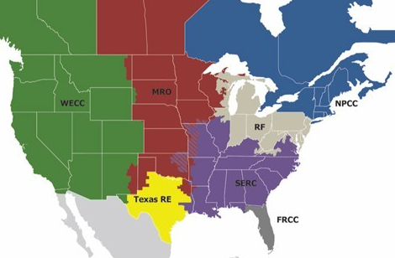



RMN
YZV
YQT
YUY
NWC
NWI
DLH
NPCC
FAR
YQB
NVW
YOW
YUL
YFC
MRO
MSP
PWM
YHZ
WECC
YYZ
PBG
BTW
RMN
MSN
MKE
RST
UCA
ALB
MHT
DTW
BUF
SYR
ORH
BOS
OMA
ORD
CLE
BDL
BDR
PVD
RF
PIT
NYC
HID
PHL
NCV
HID
ICT
MCI
STL
BWI
SPP
SDF
CRW
NCC
SCI
BNA
AMA
OKC
CLT
SCC
SCV
SCV
DSW
SERC
ATL
SCC
TXN
CHS
ERCOT
GAI
TXE
TFW
TXW
TNC
JAX
TSC
MSY
TXC
TXS
MIA

Slide 2



RMN
YZV
YUY
NPCC
YQT
E7I
NWC
NWI
DLH
FAR
YQB
E7C
YUL
YFC
NVW
YOW
E6I
E6C
MSP
PWM
YHZ
YYZ
PBG
BTW
E5I
RMN
MSN
RST
UCA
MHT
MKE
ALB
DTW
BUF
SYR
ORH
E5B
ORD
BOS
OMA
BDL
BDR
PVD
E5C
CLE
NYC
PIT
E4C
HID
PHL
HID
ICT
MCI
STL
BWI
NCV
SPP
SDF
CRW
NCC
BNA
SCI
AMA
OKC
CLT
SCC
SCV
SCV
ATL
DSW
SCC
TXN
CHS
GAI
TXE
TFW
TXW
TNC
JAX
TSC
MSY
TXC
TXS
MIA

Slide 3


RMN
YZV
YUY
YQT
NWC
NWI
DLH
FAR
YQB
YUL
YFC
NVW
YOW
MSP
PWM
YHZ
YYZ
PBG
BTW
RMN
MSN
UCA
MHT
MKE
RST
DTW
BUF
SYR
ALB
ORH
BOS
ORD
BDL
OMA
BDR
PVD
CLE
NYC
RF
PIT
HID
PHL
HID
MCI
STL
BWI
ICT
NCV
SPP
SDF
CRW
NCC
BNA
SCI
AMA
OKC
CLT
SCC
SCV
SCV
ATL
DSW
SCC
TXN
CHS
GAI
TXE
TXW
TNC
TFW
JAX
TSC
MSY
TXC
TXS
MIA

Slide 4

RMN
YZV
YUY
YQT
NWC
NWI
DLH
FAR
YQB
YUL
YFC
NVW
YOW
MSP
PWM
YHZ
PBG
BTW
RMN
MSN
MKE
RST
UCA
MHT
DTW
BUF
ITH
ALB
ORH
BOS
ORD
BDL
OMA
CLE
BDR
PVD
NYC
PIT
HID
PHL
HID
ICT
MCI
STL
BWI
NCV
SPP
SDF
CRW
NCC
BNA
SCI
AMA
OKC
CLT
SCC
SCV
SCV
ATL
DSW
SERC
SCC
TXN
SPS
CHS
ERCOT
GAI
TXE
TYR
TFW
MAF
TXW
ABI
TNC
DFW
JAX
TSC
AUS
MSY
TXC
IAH
TXS
CRP
MIA

Slide 5




RMN
YZV
YQT
YUY
NPCC
NWC
NWI
DLH
FAR
YQB
NVW
YUL
YFC
YOW
MRO
MSP
BTW
PWM
YHZ
YYZ
PBG
WECC
MHT
RMN
MSN
MKE
RST
UCA
DTW
BUF
SYR
ALB
ORH
ORD
BOS
OMA
CLE
BDL
BDR
PVD
NYC
RF
PIT
HID
PHL
HID
ICT
MCI
STL
BWI
NCV
SPP
SDF
CRW
NCC
BNA
SCI
AMA
OKC
CLT
SCC
SCV
SCV
DSW
ATL
SERC
SCC
TXN
CHS
ERCOT
GAI
TXE
TFW
TXW
TNC
JAX
TSC
MSY
TXC
TXS
MIA

