Slide 1



dashboard
View in Power BI
Last data refresh:
07/10/2026 19:00:27 UTC
Downloaded at:
07/10/2026 19:17:19 UTC

Slide 2
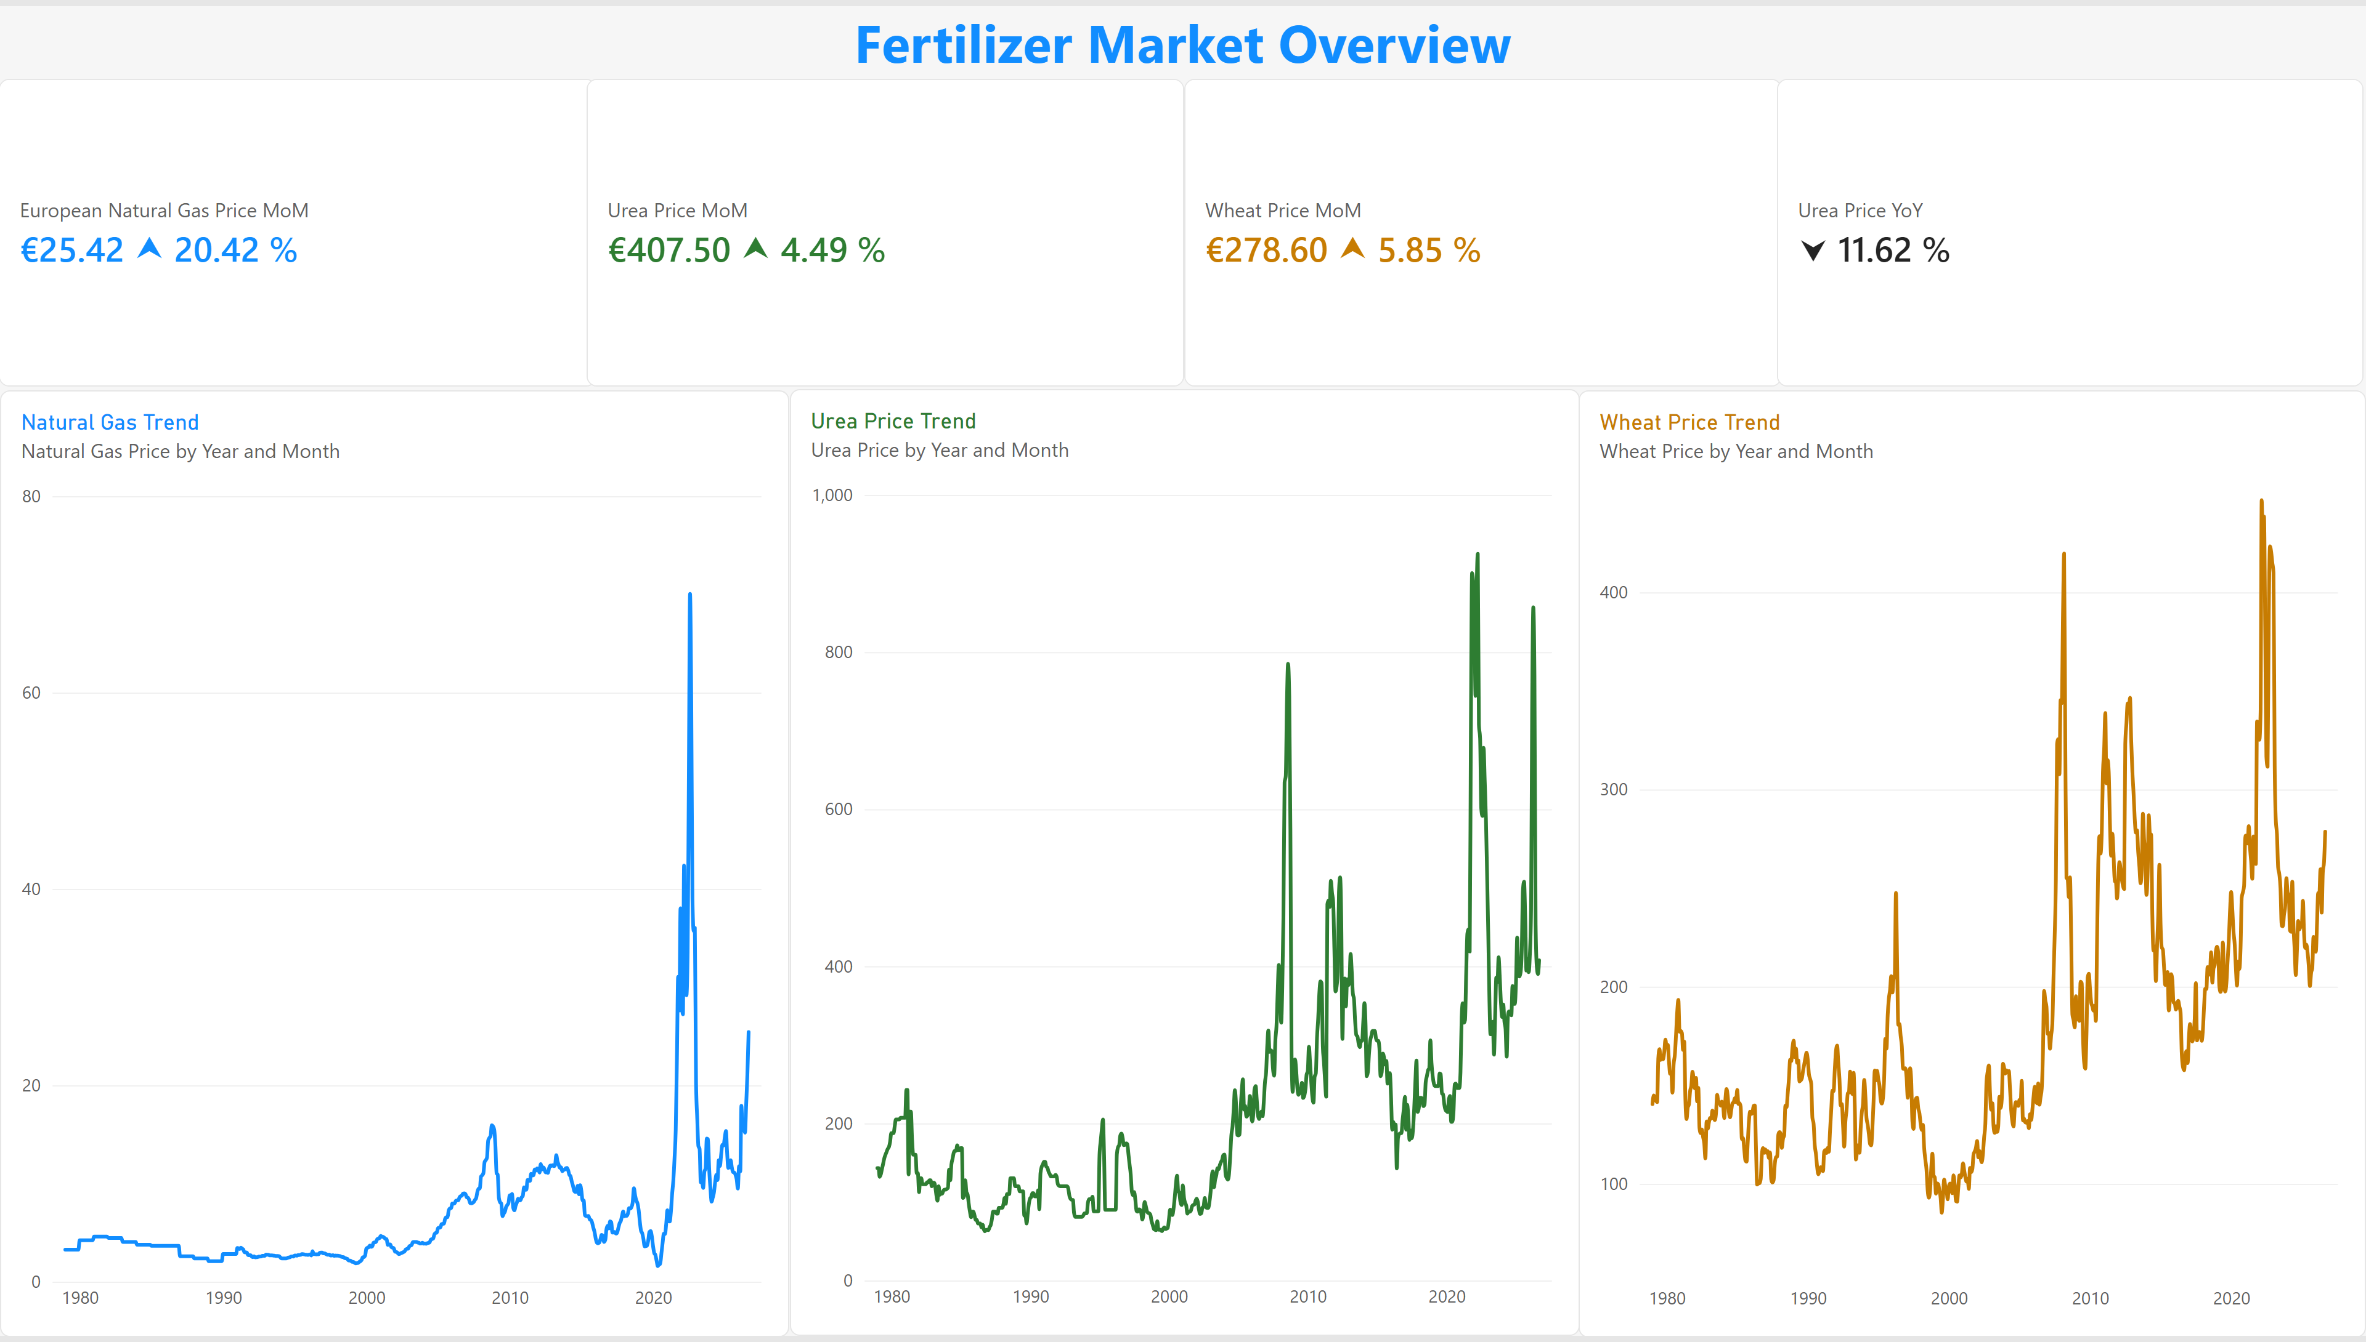
Page 1
Notes:
cardVisual
No alt text provided
cardVisual
No alt text provided
cardVisual
No alt text provided
Urea Price
No alt text provided
Urea Price Trend
No alt text provided
Natural Gas Trend
No alt text provided
Wheat Price Trend
No alt text provided
textbox
No alt text provided

Slide 3
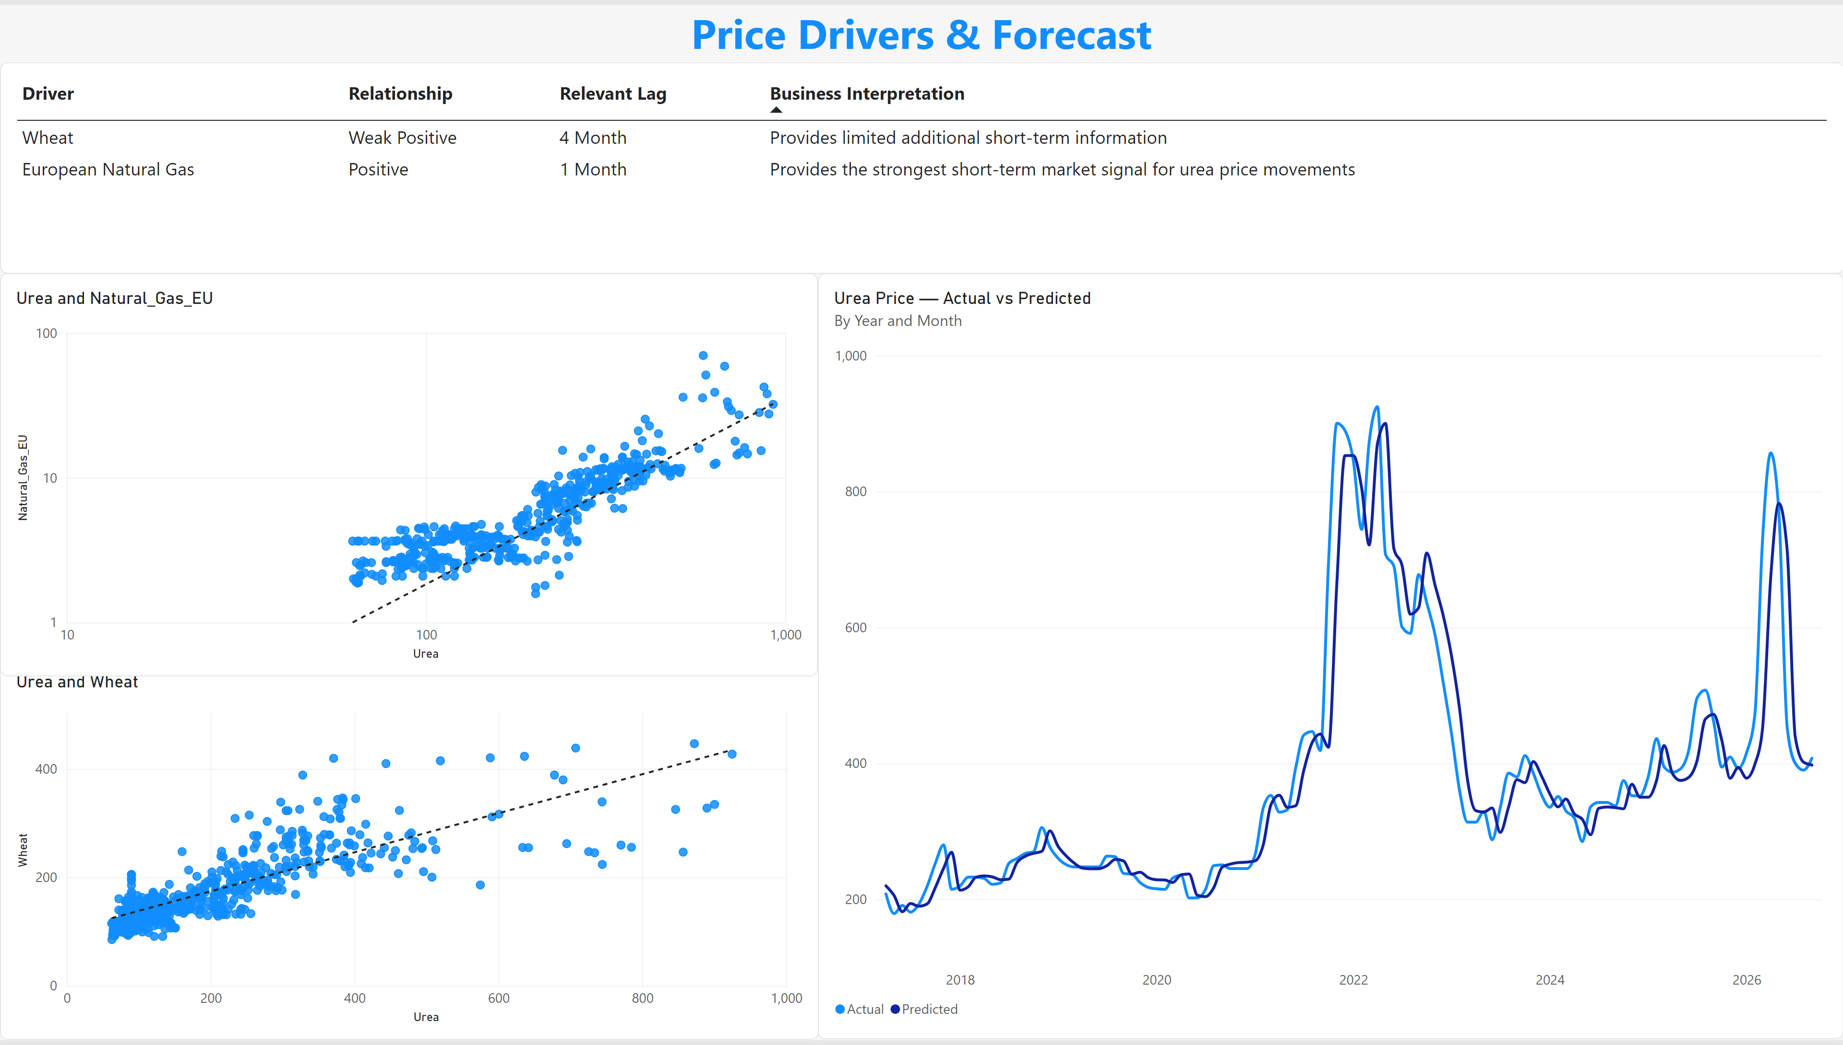
Page 2
Notes:
textbox
No alt text provided
Urea Price — Actual vs Predicted
No alt text provided
scatterChart
No alt text provided
scatterChart
No alt text provided
tableEx
No alt text provided

