Slide 1


Author(s): Name1, Name2 Advisor(s): Name1, Helvetica 80
Title Helvetica, size 100-144, bold: blah, blah, blah
Poster Creation: Use Powerpoint to create poster.
Save as pdf for submission and printing.
Poster Size: 42 inches wide (max) by 36 inches high.
Suggested Font Choices and Sizes:
Title: Helvetica, 100-144 points
Section Headings: Helvetica, 72-84 points
Main Content: Times, 18-24 points, 1.2 –1.5 spaced
Acknowledgements and References: Times, 10-16 points, single spaced
More at
http://skovira.ece.cornell.edu/meng-poster-links/

Slide 2


Author(s): Name1, Name2 Advisor(s): Name1, Helvetica 80
Title Helvetica, size 100-144, bold: blah, blah, blah
Poster Creation: Use Powerpoint to create poster.
Save as pdf for submission and printing.
Poster Size: 42 inches wide (max) by 36 inches high.
Suggested Font Choices and Sizes:
Title: Helvetica, 100-144 points
Section Headings: Helvetica, 72-84 points
Main Content: Times, 18-24 points, 1.2 –1.5 spaced
Acknowledgements and References: Times, 10-16 points, single spaced
More at
http://skovira.ece.cornell.edu/meng-poster-links/

Slide 3
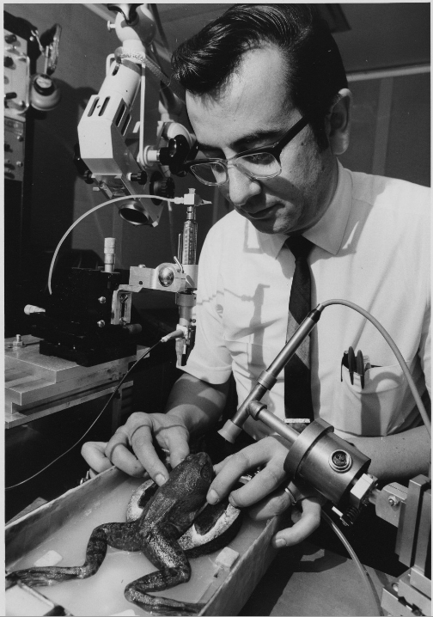
Title Helvetica, size 100-144, bold: blah, blah, blah
Replace left image and this box with image or text.
Author(s): Name1, Name2 Advisor(s): Name1, Helvetica 80
Optional picture/image areas, do not use these!
Poster Creation: Use Powerpoint to create poster.
Save as pdf for submission and printing.
Poster Size: 42 inches wide (max) by 36 inches high.
Suggested Font Choices and Sizes:
Title: Helvetica, 100-144 points
Section Headings: Helvetica, 72-84 points
Main Content: Times, 18-24 points, 1.2 –1.5 spaced
Acknowledgements and References: Times, 10-16 points, single spaced
More at
http://skovira.ece.cornell.edu/meng-poster-links/

Slide 4
Title Helvetica, size 100-144, bold: blah, blah, blah
Replace left image and this box with image or text.
Author(s): Name1, Name2 Advisor(s): Name1, Helvetica 80
Optional picture/image areas, do not use these!
Poster Creation: Use Powerpoint to create poster.
Save as pdf for submission and printing.
Poster Size: 42 inches wide (max) by 36 inches high.
Suggested Font Choices and Sizes:
Title: Helvetica, 100-144 points
Section Headings: Helvetica, 72-84 points
Main Content: Times, 18-24 points, 1.2 –1.5 spaced
Acknowledgements and References: Times, 10-16 points, single spaced
More at
http://skovira.ece.cornell.edu/meng-poster-links/

