Slide 1
NTM (Copy Task)

Slide 2
What is a copy task in turing machine?
Initial Configuration of the tape in turing machine ( B represents Blank)
|
Run copy algorithm
|
V
Final Configuration of the tape in turing machine ( B represents Blank)​

Slide 3
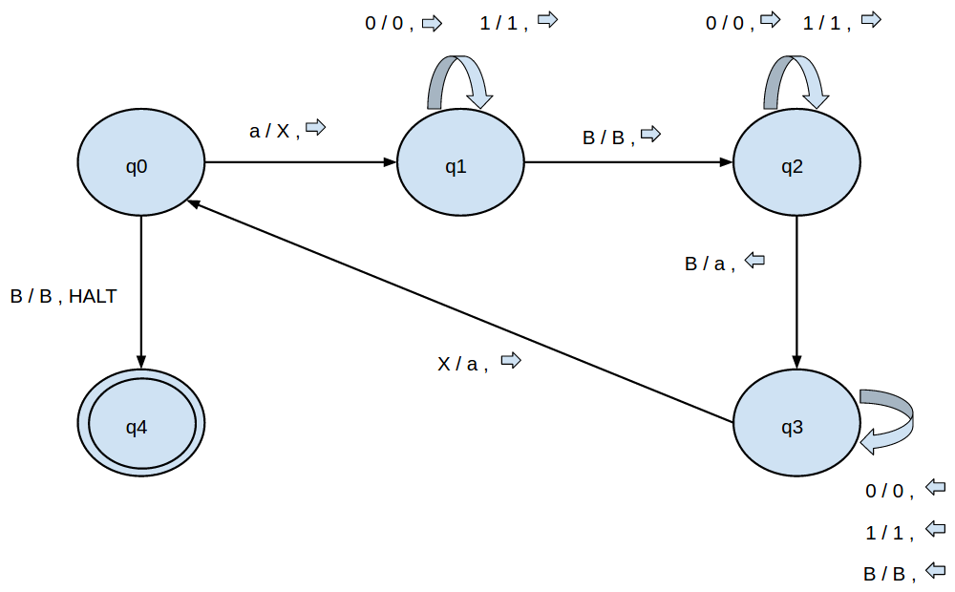
Copy task Transition function (as graph)
q0 = Initial State
a can be 0 or 1
x/y, -> means on reading x write y in current cell and move head to right.

Slide 4
What does NTM do?
Learns algorithm mapping input to output.

Slide 5
Copy Task in NTM
External Input: A sequence of binary strings X where
X=[X1, X2, … Xt, … Xn, B, B, B, B, .... ] where
X1 and Xn=Different delimiter binary strings marking start and end of sequence.
B = Blank string (string of 0s)
Expected External Output (not exactly same as that in Turing Machine): Again, a sequence of binary strings Y where
Y=[B, B, … n times, X2, X3, … Xn-1]

Slide 6
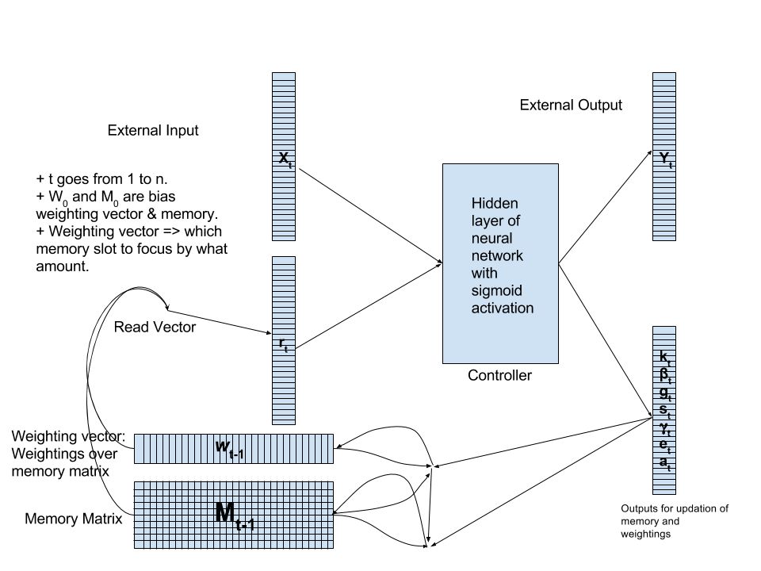
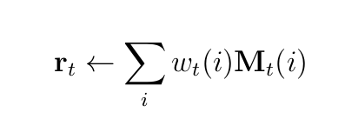
NTM Working
Memory Matrix: A matrix of type double.
Weighting vector: A vector of type double with each element in [0, 1] and with sum of elements equal to 1. It is used to strongly focus on a single or weakly focus on multiple memory slots.
Read vector: formed by weighted linear combination of Memory slots in Memory Matrix (weighted by weighting vector).
External Input: A binary string/vector.
External output: A binary string/vector (after thresholding output by Controller)

Slide 7
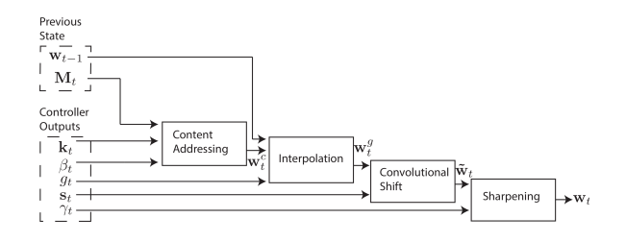
Weight Updation
Updation outputs, kt, βt, gt, st and gamma_t are used.
kt = Key vector
bt = Key strength scalar
gt = Gate scalar for interpolation
st = Shift weighting vector
gammat = sharpening scalar

Slide 8
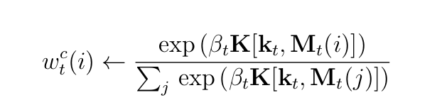
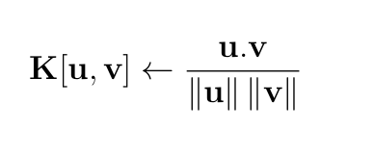
Weight Updation (Content Addressing)
Updation outputs, kt and βt are used.
kt = Key vector
bt = Key strength scalar
Softmax
Cosine Similarity

Slide 9
Weight Updation (Content Addressing)
Updation outputs, kt and βt are used.
kt = Key vector
bt = Key strength scalar
The weightings produced by the content addressing module will focus on those memory slots which are similar to the key vector (wrt to cosine similarity) and hence the content of the read vector (if formed by this weighting alone) will be similar to the content of the focussed memory slot content.
As an example (just for illustration):
Suppose Memory is: [ A B C D … Z ] i.e. 26 memory slots with one unique alphabetic character each.
Suppose Key Vector is D and key strength is very large(Note: Infinite Key strength changes softmax to max function).
Then weighting produced by content addressing module will be: [ 0 0 0 1 0 … 0 ] and corresponding read vector will be D.

Slide 10

Weight Updation (Interpolation)
Updation output, gt is used.
gt = Gate scalar for interpolation
The aim of having this module is to give the addressing mechanism capability to completely neglect the weighting produced by content based module and use the previous final weighting as a reference point.
This gives NTM the power to iterate over memory slots (this module just sets the reference point i.e. the weighting to start from while the next module takes care of the iteration part).
As an example (just for illustration):
Suppose Memory is: [ A B C D … Z ] i.e. 26 memory slots with one unique alphabetic character each.
Suppose that the weighting produced by content addressing module is:
[ 0 0 0 1 0 … 0 ] (focussing on memory slot containing D).
Suppose that the previous final weighting is: [ 0 1 0 0 … 0 ] (focussing on memory slot containing B) and also suppose that value of gate scalar is 0.
Then the weighting produced by interpolation module will be [ 0 1 0 … 0 ].

Slide 11
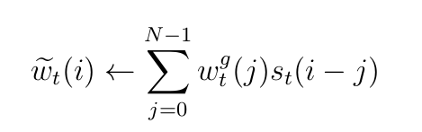
Weight Updation(Convolutional Shift)
Updation output st is used.
st = Shift weighting vector
Note: modulo N subtraction.
This gives NTM the power to iterate over memory slots.
As an example (just for illustration):
Suppose Memory is: [ A B C D … Z ] i.e. 26 memory slots with one unique alphabetic character each.
Suppose that the weighting produced by interpolation module is:
[ 0 1 0 0 0 … 0 ] (focussing on memory slot containing B).
Now, suppose that shift weighting vector produced only allows shifts of 1 and the corresponding shift weight value be 1. That means st(1)=1 and st(i)=0 for all i not equal to 1.
Then, using the formula new weighting produced will be: [ 0 0 1 0 … 0].
Also, note that if the shift weighting vector produced only allows shifts of -1, 0 and 1 and the corresponding shift weight value be 0.1, 0.8 and 0.1 respectively. That means st(1)=0.1, st(-1)=0.1, st(0)=0.8 and st(i)=0 for all i not equal to {-1,0,1}.
Then, it can be seen that new weighting will be: [ 0.1 0.8 0.1 0 … 0].

Slide 12
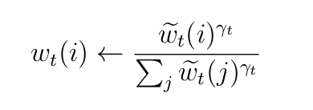
Weight Updation (Sharpening)
Updation output gamma_t is used.
gammat = sharpening scalar
This gives NTM the power to iterate over memory slots.
As an example (just for illustration):
Suppose Memory is: [ A B C D … Z ] i.e. 26 memory slots with one unique alphabetic character each.
Suppose that weighting produced by convolutional shift module is:
[ 0.1 0.8 0.1 0 … 0].
So, here, the original weighting [ 0 1 0 0 … 0 ] has been blurred and has to be sharpened up.
Now, suppose that the sharpening scalar produced by the controller has a large value. Then, the new weighting produced will be [ ~0 ~1 ~0 0 … 0 ].
~x = close to x.

Slide 13


Memory Updation
Updation outputs, et and at are used.
et = Erase vector
at = Add vector

