Slide 1

Blockchain-Based E-Voting System
Presented By Sanjoy Khoirom
MCA 4th Sem, Roll No. 2450036
Under The Guidance of
Dr. Nazrul Hoque,
Department Of Computer Science
Manipur University

Slide 2
Introduction
The Blockchain-Based E-Voting System is being developed to provide a secure, transparent, and decentralized voting platform using blockchain technology. The implementation focuses on replacing traditional centralized voting mechanisms with smart contract-based automation to ensure vote integrity, prevent tampering, and improve public trust in elections.
The current development stage includes smart contract creation, blockchain deployment, frontend integration, wallet authentication, vote handling, and system testing.

Slide 3
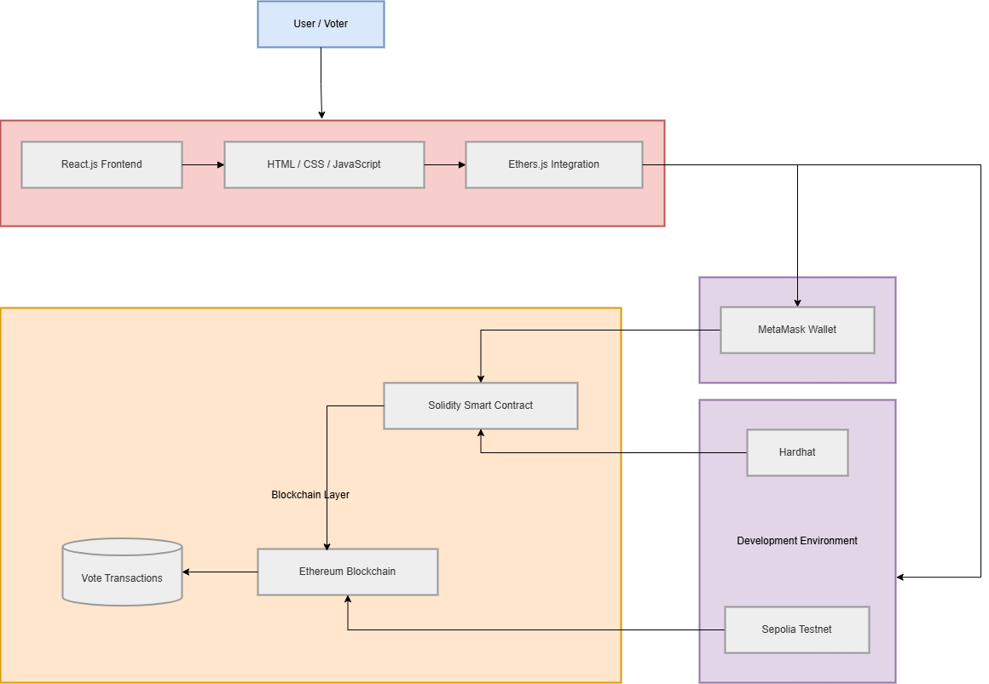
System Architecture

Slide 4
Architectural Layers
Presentation Layer : React frontend for user interaction.
Application Layer : Voting logic.
Smart Contract Layer : Solidity logic on Ethereum Sepolia.
Blockchain Layer : Ethereum network.

Slide 5
Development and Implementation Tools Used
VS Code - Used as the primary code editor for developing frontend, smart contracts, and blockchain integration modules.
Node.js - Used to run JavaScript-based development tools and manage the blockchain application environment.
Npm - Used for installing and managing project dependencies, libraries, and blockchain development packages.
Github - Used for storing, managing, and maintaining the project repository online.
Git – Used for version control and tracking project source code changes during development.
Chrome - Used for testing the frontend application, MetaMask integration, and blockchain transactions.

Slide 6
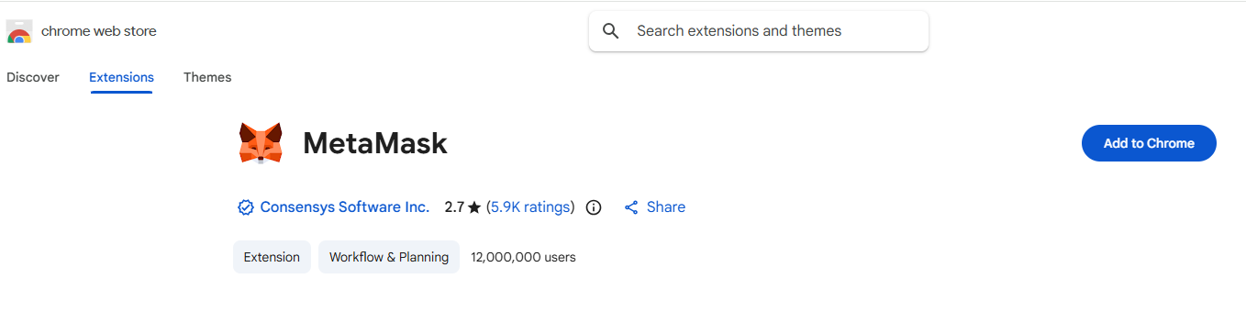
MetaMask Setup

Slide 7
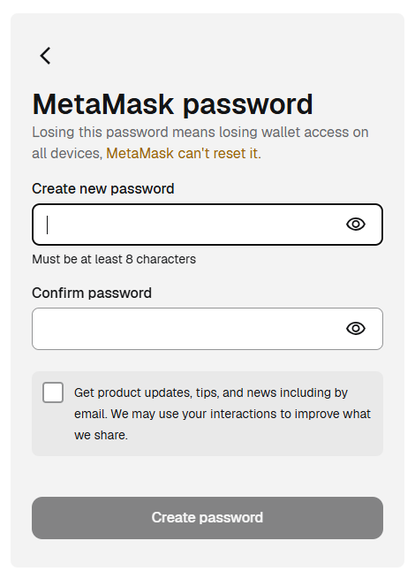
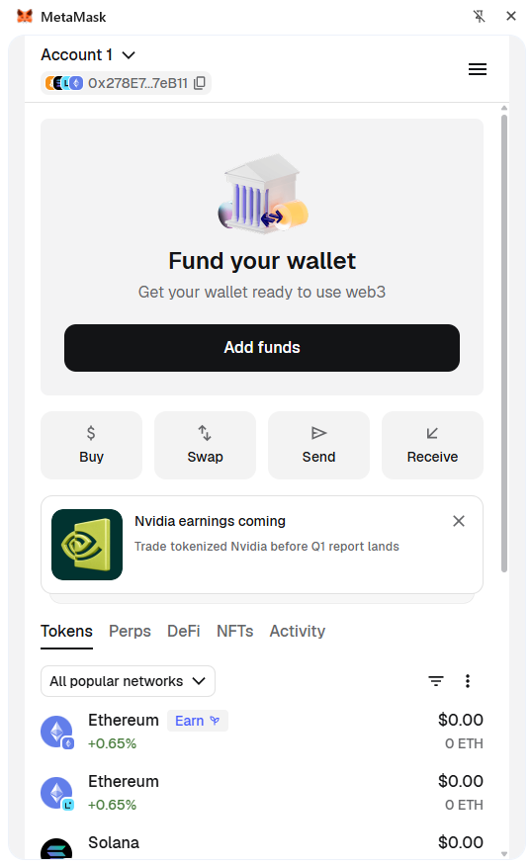
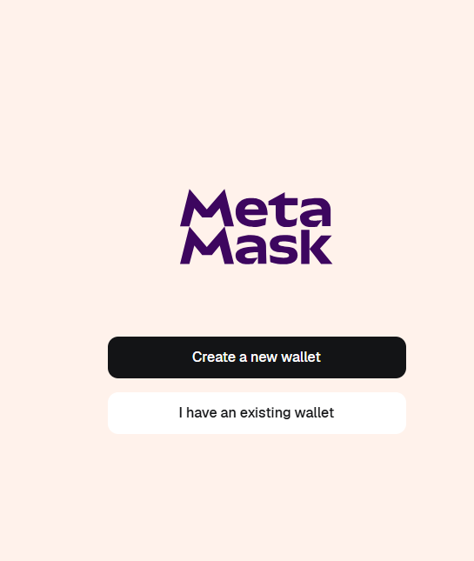

Slide 8
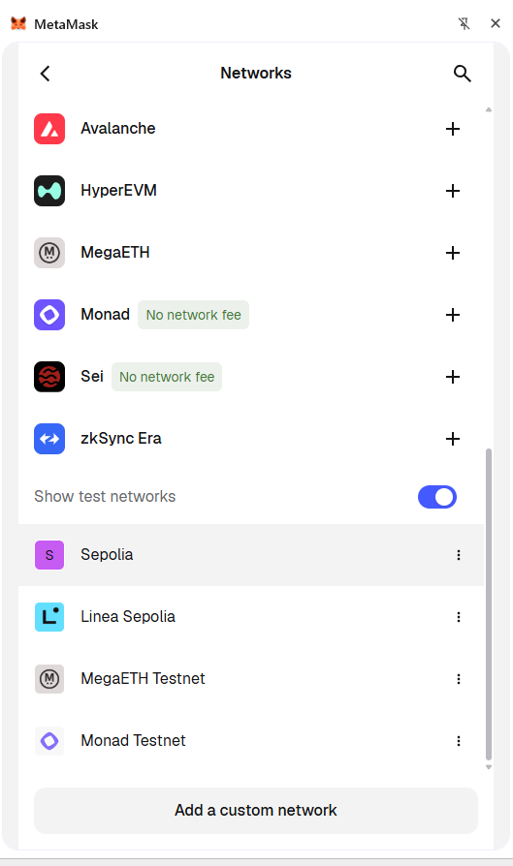
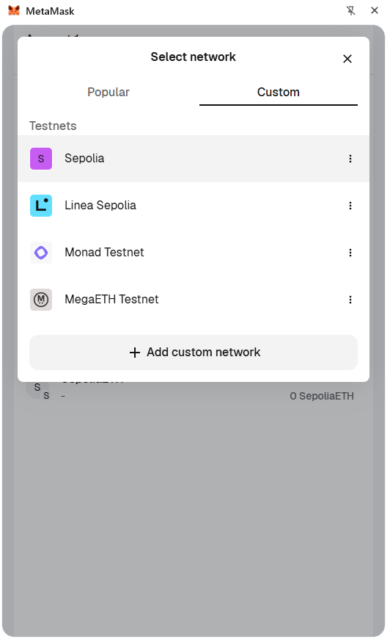
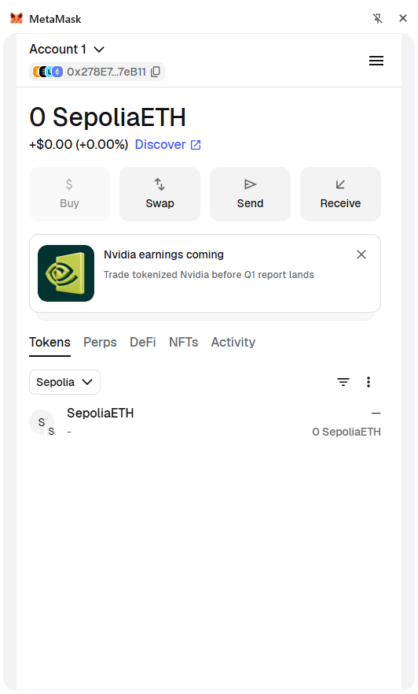

Slide 9
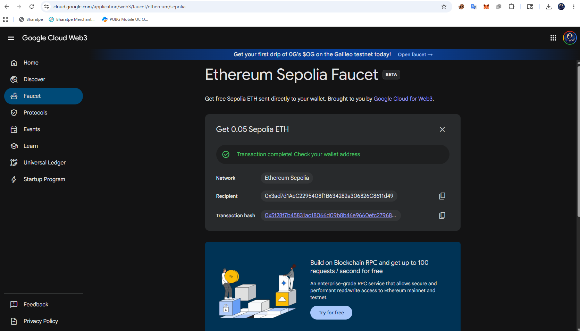

Slide 10
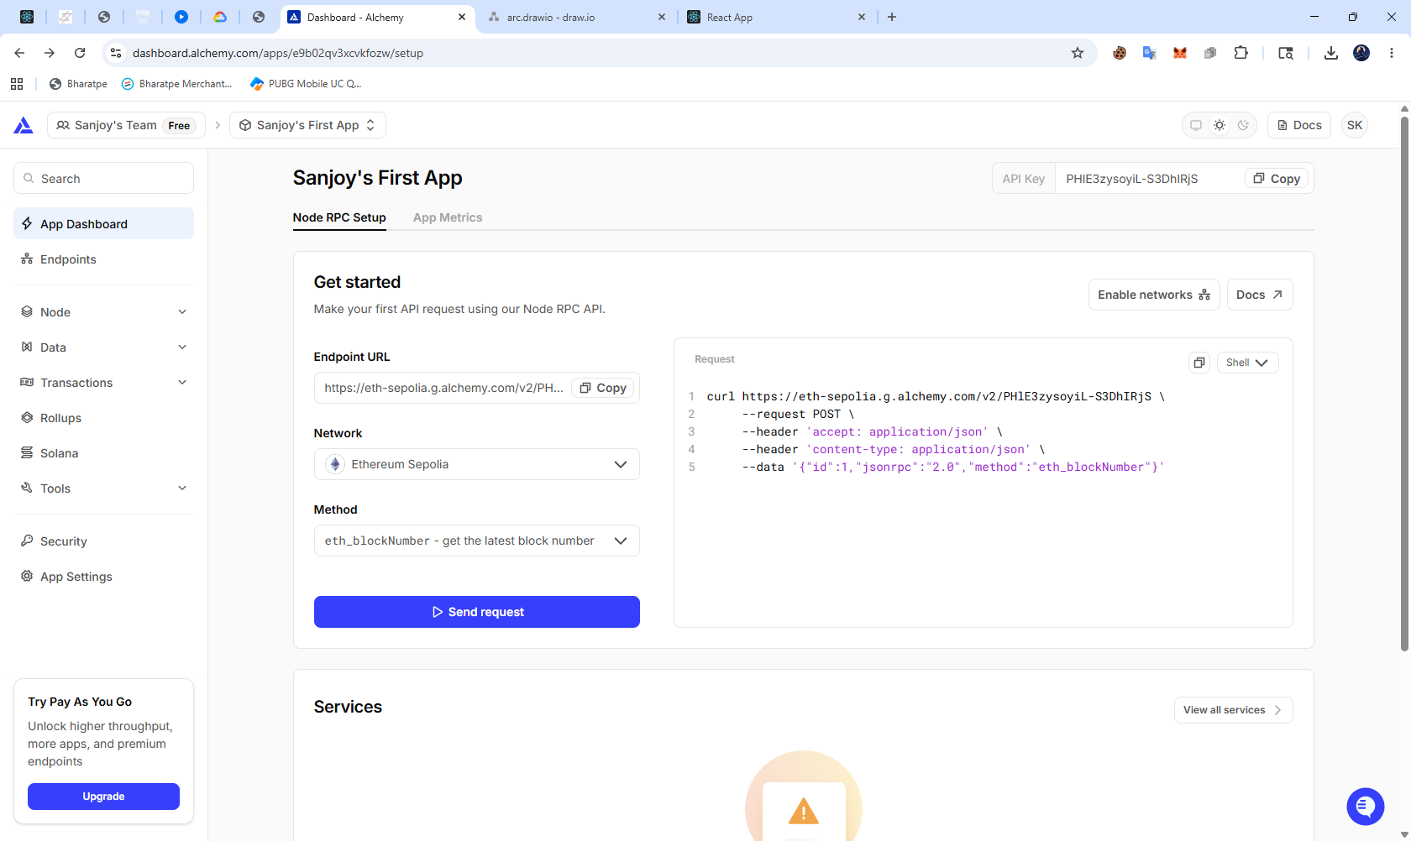

Slide 11
Blockchain Stack
Ethereum - Decentralized blockchain network
Solidity - Smart contract development
Smart Contracts - Automated voting logic and election management
MetaMask - Wallet authentication and transaction signing
Ethers.js - Frontend and blockchain interaction

Slide 12
Blockchain Development Environment
Hardhat - Smart contract compilation and deployment
Ethereum Sepolia - Public blockchain testnet deployment
Node.js - Running blockchain development tools
Npm - Dependency and package management

Slide 13
Smart Contract Development
Candidate Structure - Implemented candidate data structure containing candidate ID, name, and vote count.
Voting Function - Developed smart contract voting function for secure vote casting and recording.
Duplicate Vote Prevention - Implemented one-person-one-vote validation using voter address tracking.
Election Control - Added election start and end control functions managed by the administrator.

Slide 14
Smart Contract Deployment
Contract Compilation - Compiled Solidity smart contracts using Hardhat framework.
Deployment Process - Deployed smart contracts to Ethereum Sepolia test network.
Contract Address Generation - Generated unique blockchain contract address after deployment.
Blockchain Verification - Verified successful deployment and smart contract interaction on blockchain.

Slide 15
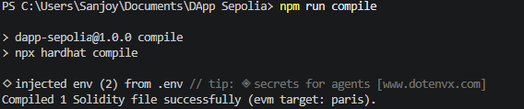
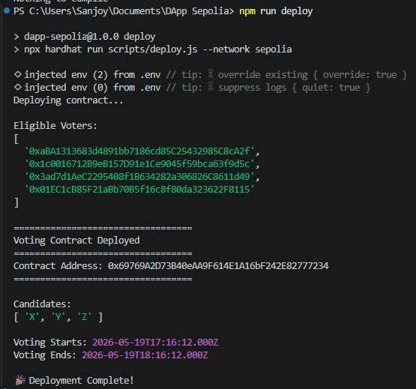
Compilation
Deploy

Slide 16
Frontend Stack
React - Frontend UI development
JavaScript - Application logic and functionality
HTML5 - Webpage structure
CSS3 - UI styling and responsive design
Ethers.js - Blockchain and smart contract interaction
MetaMask - Wallet connection and transaction signing

Slide 17
Frontend Development
Completed frontend features:
Homepage UI - Developed the main landing page for the e-voting system.
Candidate cards - Implemented candidate display cards with voting options.
Wallet connection - Integrated MetaMask wallet connection for user authentication.
Voting Page - Created voting interface for secure vote casting.

Slide 18
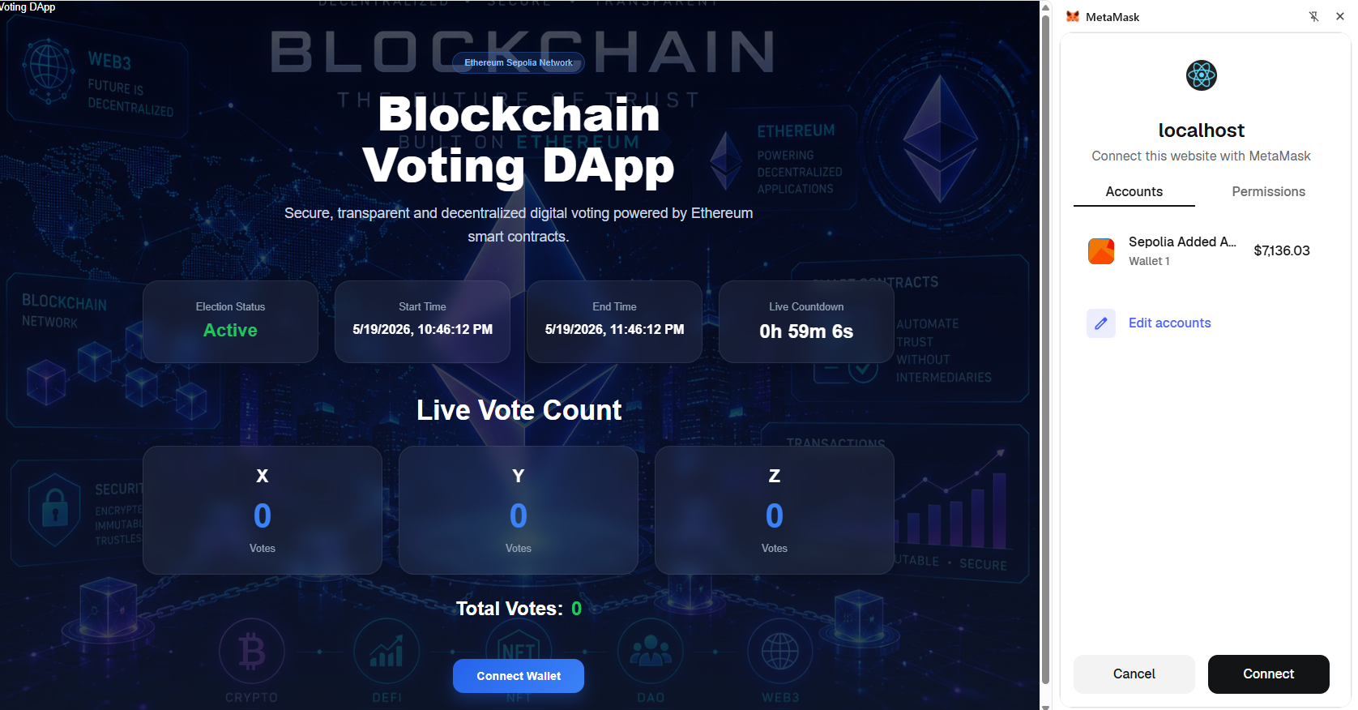

Slide 19
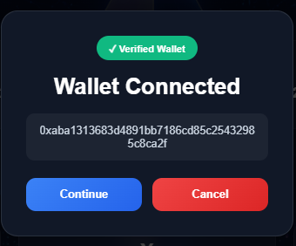

Slide 20
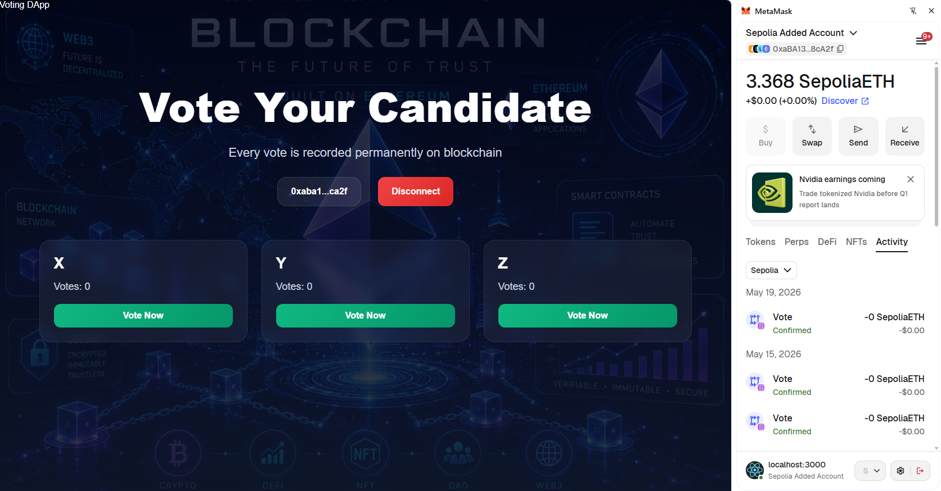

Slide 21
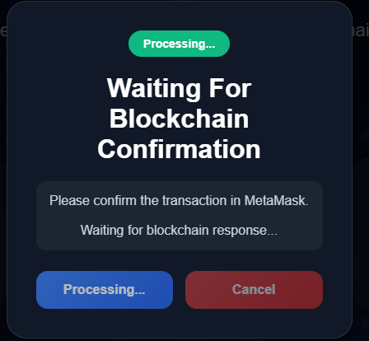
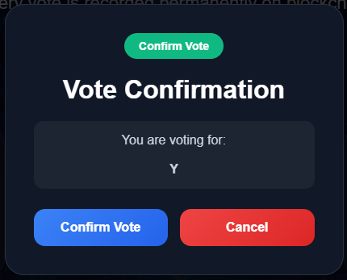

Slide 22
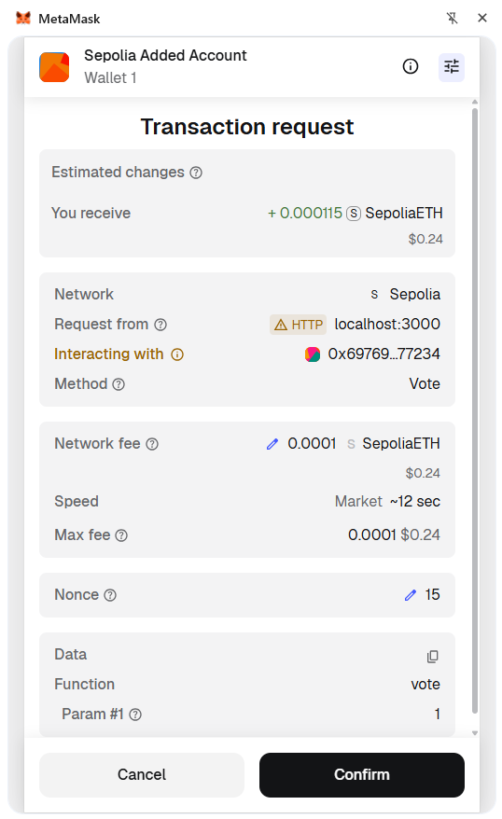


Slide 23
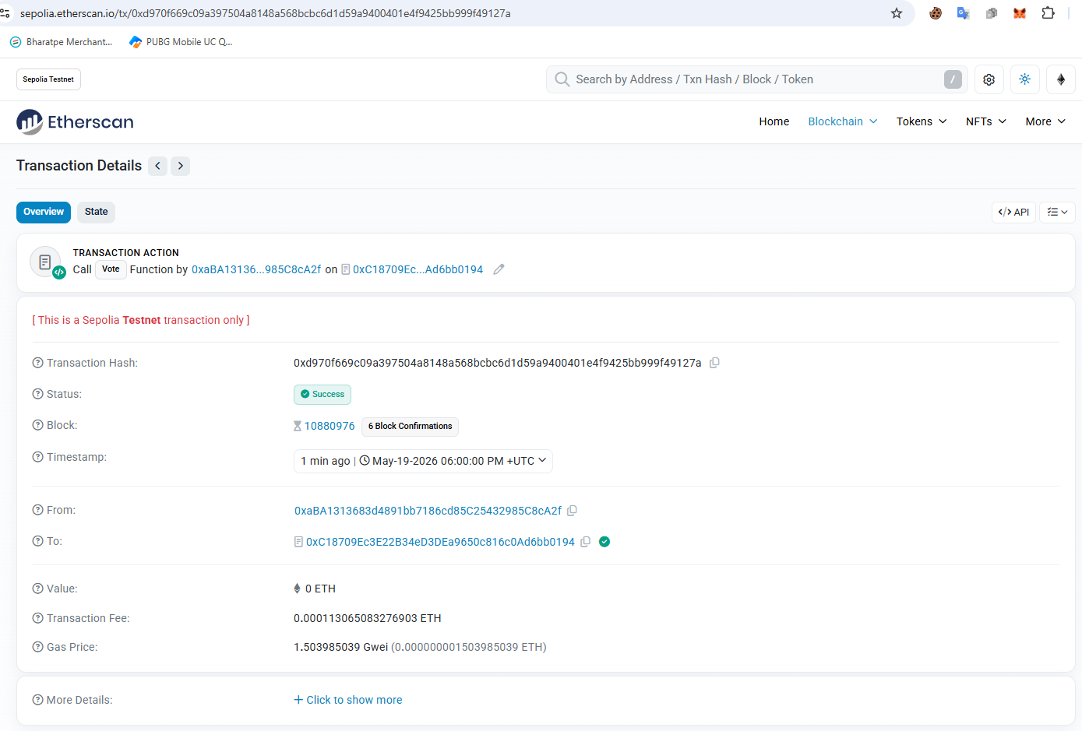
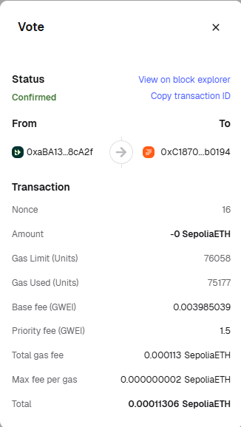
Transaction Details

Slide 24
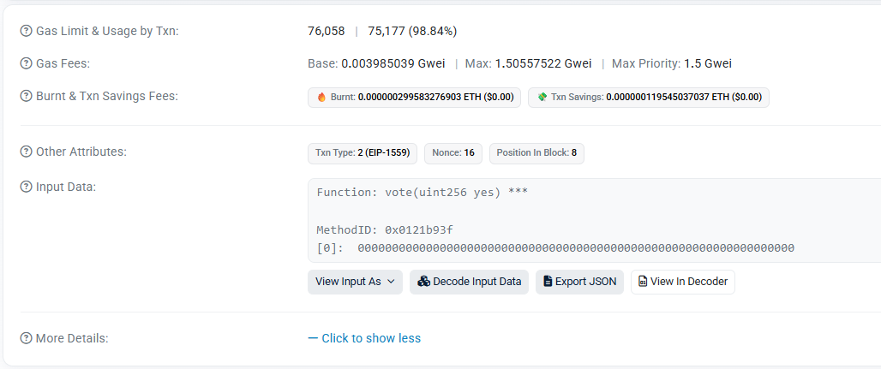

Slide 25
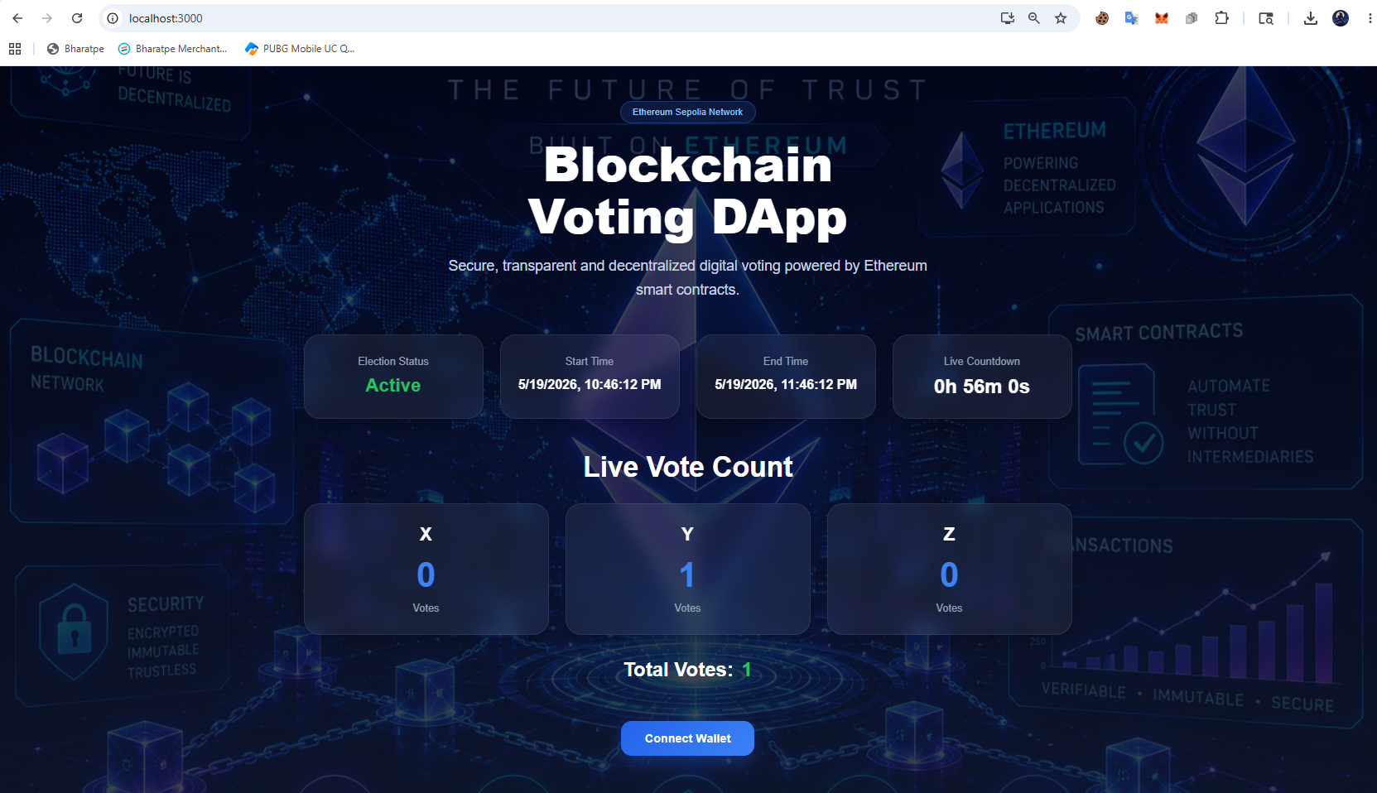

Slide 26
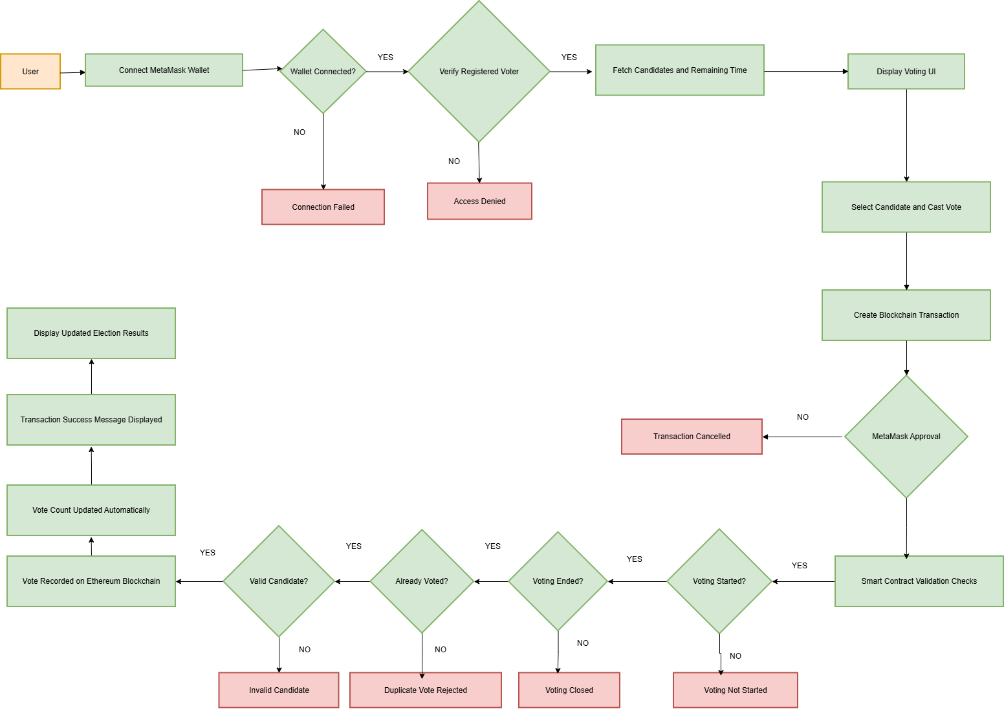
END-TO-END WORKFLOW

Slide 27
Testing Progress
Functional Testing - Tested voting, candidate loading, and result generation features.
Duplicate Vote Testing - Verified prevention of multiple voting attempts by same user.
Security Testing - Tested unauthorized access and invalid transaction handling.
Blockchain Transaction Testing - Verified successful transaction recording and confirmation on blockchain.

Slide 28
Current Implementation Status
Module | Status
Smart Contract Development | Completed
Frontend Development | Completed
Wallet Integration | Completed
Blockchain Integration | Completed
Smart Contract Deployment | Completed
Vote Casting System | Completed
Duplicate Vote Prevention | Completed
Countdown Timer | Completed
Testing and Validation | Completed till current logic

Slide 29
Challenges Faced During Implementation
MetaMask Connection Issues - Improved wallet connection handling and account detection.
Smart Contract Deployment Errors - Fixed Hardhat configuration and deployment scripts.
Transaction Confirmation Delay - Added loading indicators and transaction status handling.
Network Delays on Blockchain - Implemented transaction waiting and confirmation handling for stable processing.
Frontend State Synchronization - Improved React state management for real-time updates.
Blockchain Interaction Errors - Implemented proper Ethers.js error handling and validation.

Slide 30
Future Enhancements
Biometric Authentication - Add fingerprint or facial authentication for secure voter verification.
Mobile Voting Support - Develop mobile-friendly voting platform for remote voting access.
Admin Dashboard - Implement advanced election management and monitoring features.
Scalability Improvements - Optimize blockchain performance for large-scale elections.
Enhanced Privacy - Integrate advanced cryptographic privacy-preserving techniques.

Slide 31
Conclusion
The Blockchain-Based E-Voting System implementation has been successfully completed for the core modules, including smart contract development, frontend integration, blockchain deployment, wallet authentication, and secure vote casting. The system demonstrates decentralized and transparent electronic voting using Ethereum blockchain technology.
Testing results confirmed secure transaction handling, duplicate vote prevention, and successful smart contract execution. The project establishes a strong foundation for secure and trustworthy blockchain-based electronic voting systems.

Slide 32
THANK YOU

