Slide 1
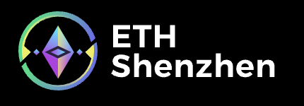
ChainWhiz
The first AI-driven aggregation gateway that empowers effortless natural language exploration of everything on-chain.

Slide 2
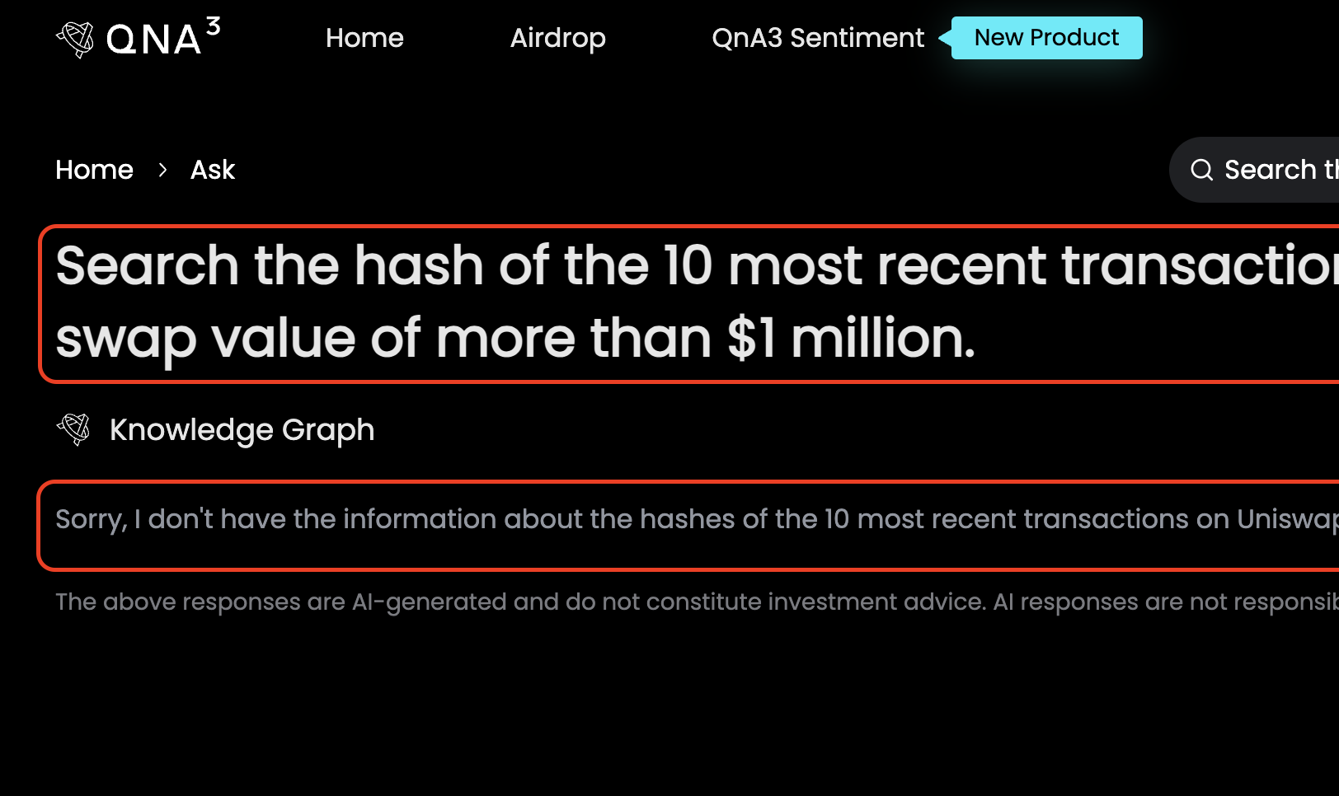
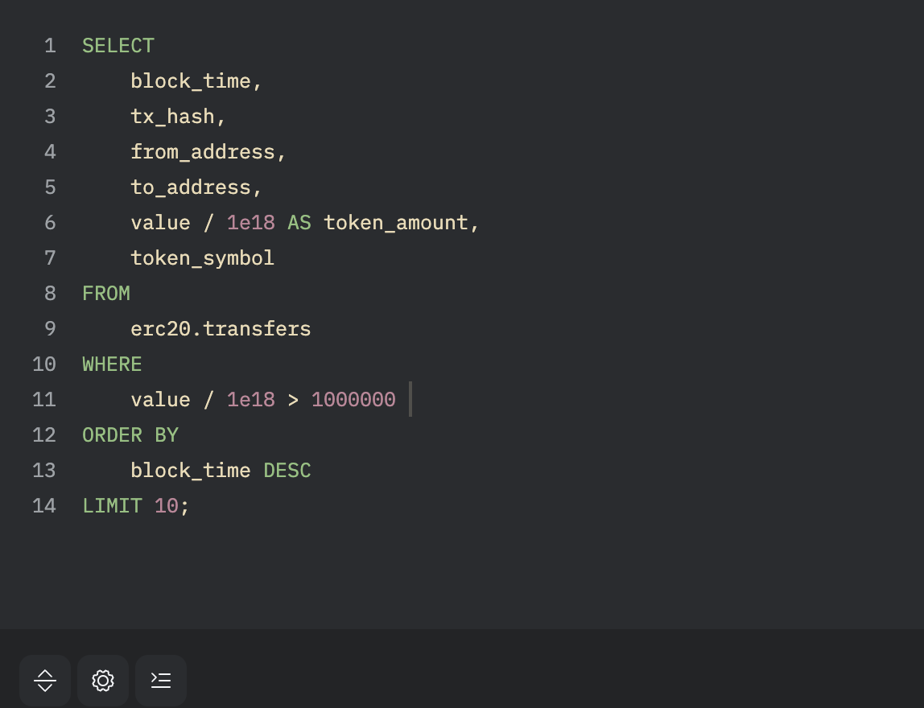
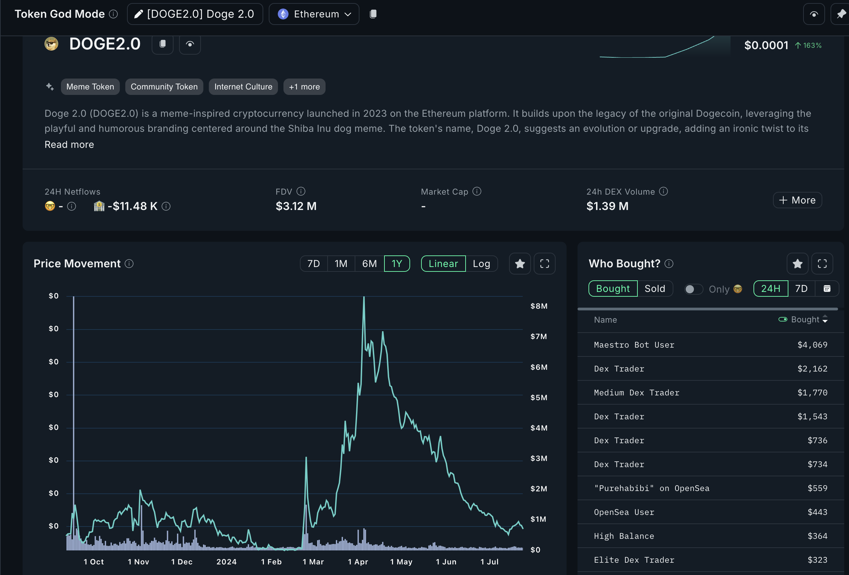
Current Problems
🚫 Outdated
Current AI bots can't provide real-time on-chain data, leading to outdated insights.
🤖 Inaccessible
Querying blockchain data requires specialized knowledge, not user-friendly for non-technical users; e.g. SQL query on Dune.
🤯 Imprecise
Existing solutions often misinterpret user intent, resulting in broad or irrelevant responses.

Slide 3



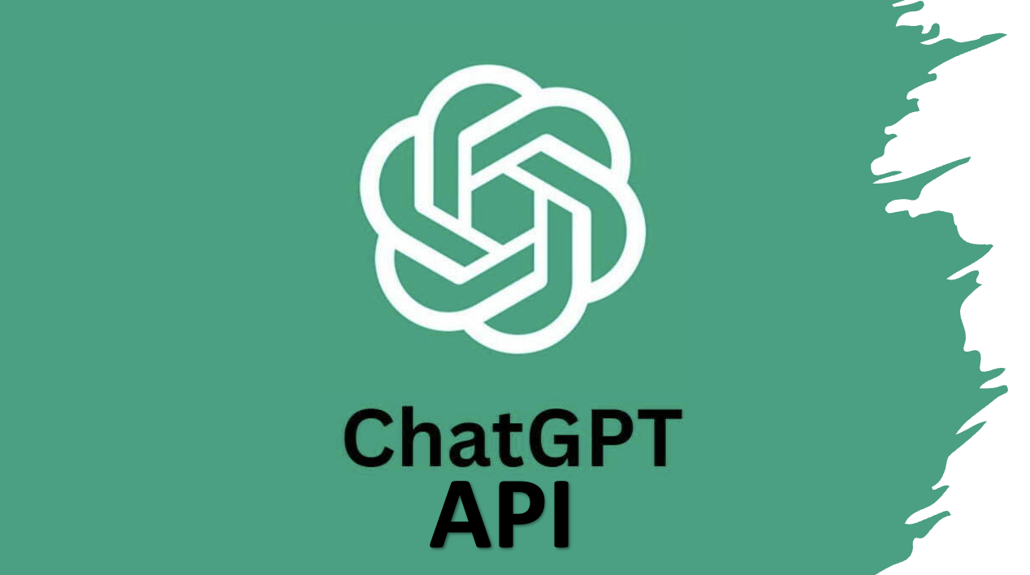


Introducing ChainWhiz …
+
+
Advanced Natural Language Processing (NLP) Integration
Data Source Abstraction
User Intent-Centric Design
Notes:
Real-Time Processing
Description: Immediate access to up-to-date blockchain data. Interfaces with multiple blockchain data platforms.
Highlight: Ensures users get the latest insights without delays. Broad data access and integration capabilities.
Advanced NLP Integration
Description: Utilizes GPT-4o for precise natural language understanding.
Highlight: High accuracy in interpreting user intent and generating relevant queries.
Intent-Centric Design
Description: Easy-to-use interface for seamless user interaction.
Highlight: Reduces the complexity of blockchain data queries for end-users.
Data Source Abstraction
Unified Data Access: ChainWhiz abstracts data sources, providing a unified access point for querying across multiple blockchain platforms.
Highlight: Simplifies data integration and interaction, making diverse data sources seamlessly accessible.

Slide 4
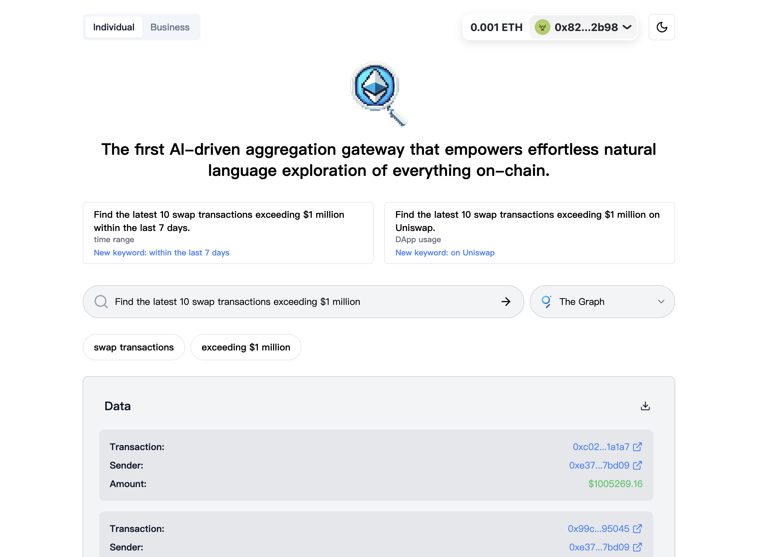
Front-end Demo
Users’ View

Slide 5
Architecture Overview
Features
User Interface (UI)
Real-Time Processing
Cross-Platform Compatibility
Scalable Architecture
Advanced NLP Integration
User-Centric Design
Input natural language queries
Natural Language Processing (NLP) Layer
Query Compiler
Data Aggregation & Response
Data Query Engines
Notes:
1. User Interface (UI)
Description: The user-friendly interface where users input natural language queries.
Highlight: Intuitive design for easy query submission and interaction.
2. Natural Language Processing (NLP) Layer
Description: Utilizes GPT-4o API to process and "compile" natural language queries into SQL-like queries.
Highlight: Advanced NLP for accurate translation of user queries into actionable data requests.
3. Query Compiler
Description: Converts processed queries into format-specific queries compatible with various blockchain data platforms (e.g., Dune, The Graph).
Highlight: Flexibility to interact with multiple data sources.
4. Data Query Engines
Description: Interfaces with blockchain data platforms to execute queries and retrieve data.
Highlight: Real-time data retrieval from diverse sources.
5. Data Aggregation & Analysis
Description: Aggregates and processes data from different platforms to provide comprehensive results.
Highlight: Seamless integration and synthesis of data for accurate insights.
6. Response Generator
Description: Formats and presents the results back to the user in an understandable manner.
Highlight: Clear and actionable data presentation.

Slide 6
Thanks!
ChainWhiz - Where Your Intent Meets Blockchain Insights
ChainWhiz is dedicated to transforming how you interact with blockchain data—making it intuitive, precise, and intent-driven. Our aim is to empower you with seamless insights that align perfectly with your needs.

