Slide 1
Middle School Grades Data Analysis (ALY 6070 WEEK03-Tableau PROJECT)
By-
CHIRAG SHAH
PRERAK SHAH

Slide 2
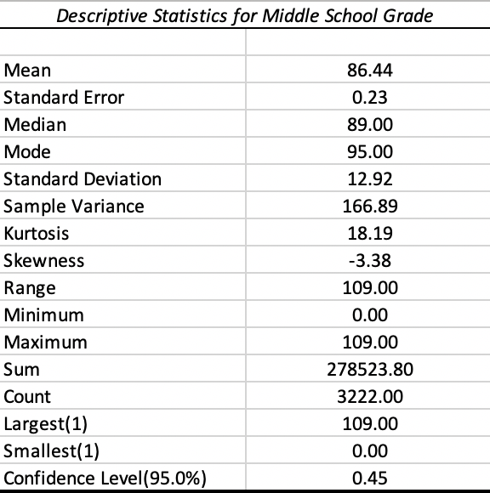

Descriptive Statistics of Performance percentage grade of all Grade Level
Conclusion: Average percentage of the middle school grade is 86.44% having most of the students at 95% grading.

Slide 3
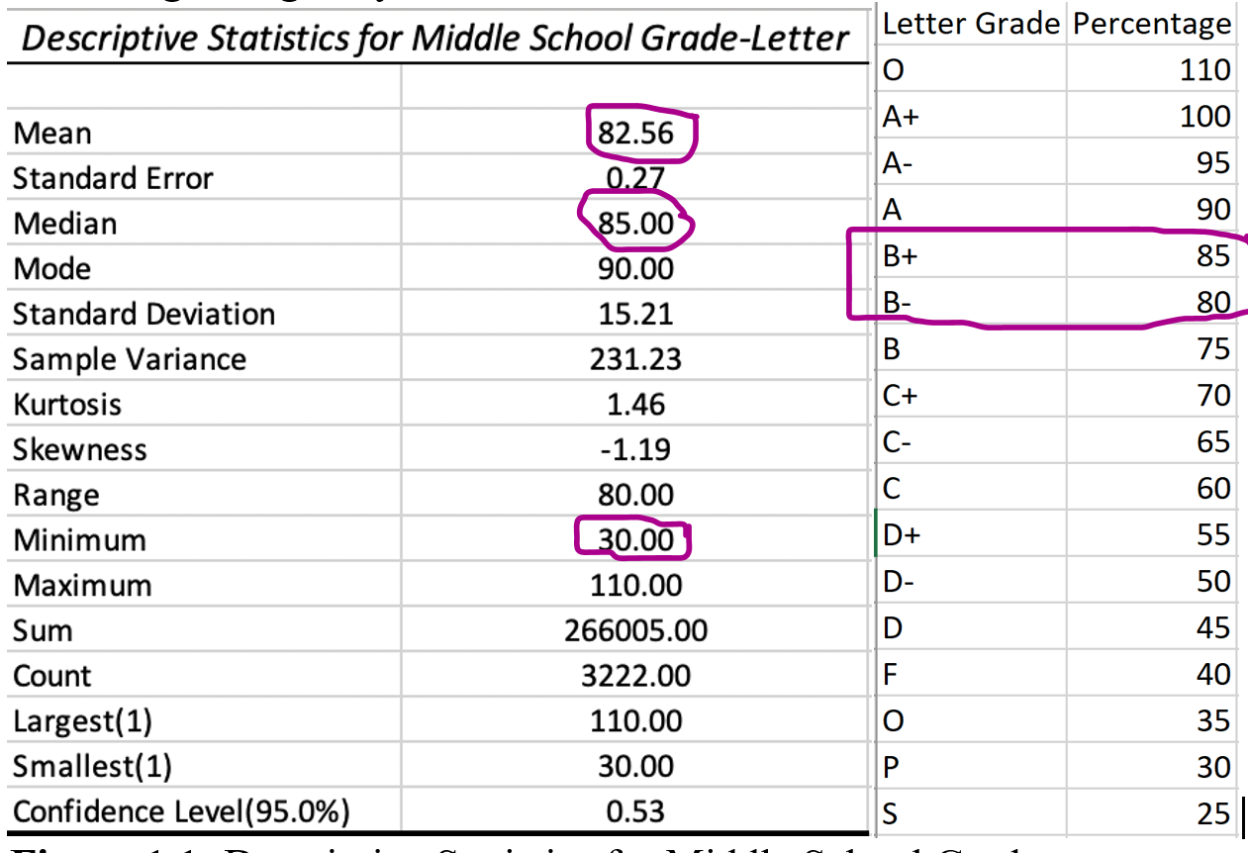
Descriptive Statistics of Performance Letter grade of all Grade Level
Conclusion: Average percentage letter grade of the middle school is above B- having most of the students at B+ letter grade.

Slide 4
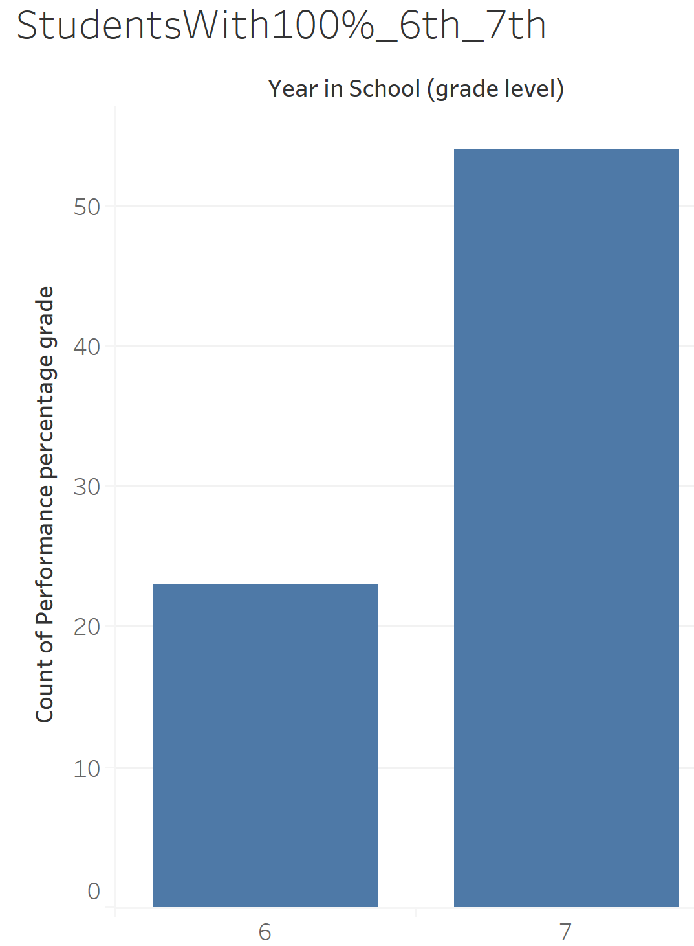

Bar Chart of Students with 100% in 6th grade vs 7th grade
Conclusion: Performance percentage grade of 7th grade is much higher than 6th grade

Slide 5
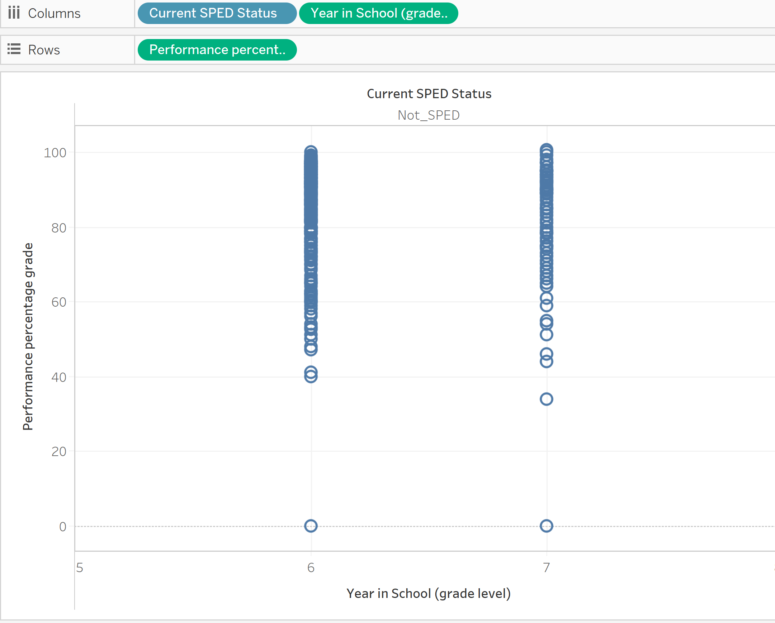
Scatter Chart showing Not_SPED students with percentage grade in 6th grade vs 7th grade
Conclusion: There are more number of Not_SPED students in 7th grade from the dataset who has the performance percentage grade.

Slide 6
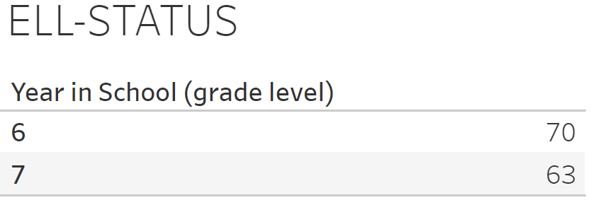
Count of students who has ELL status in 6th and 7th grades
The number of students with ELL status are more in 7th grade than in 6th grade.

Slide 7
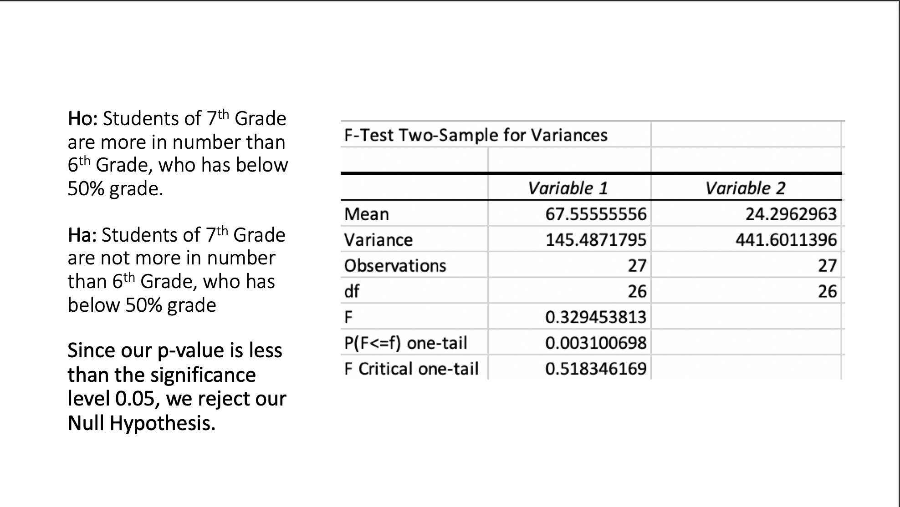
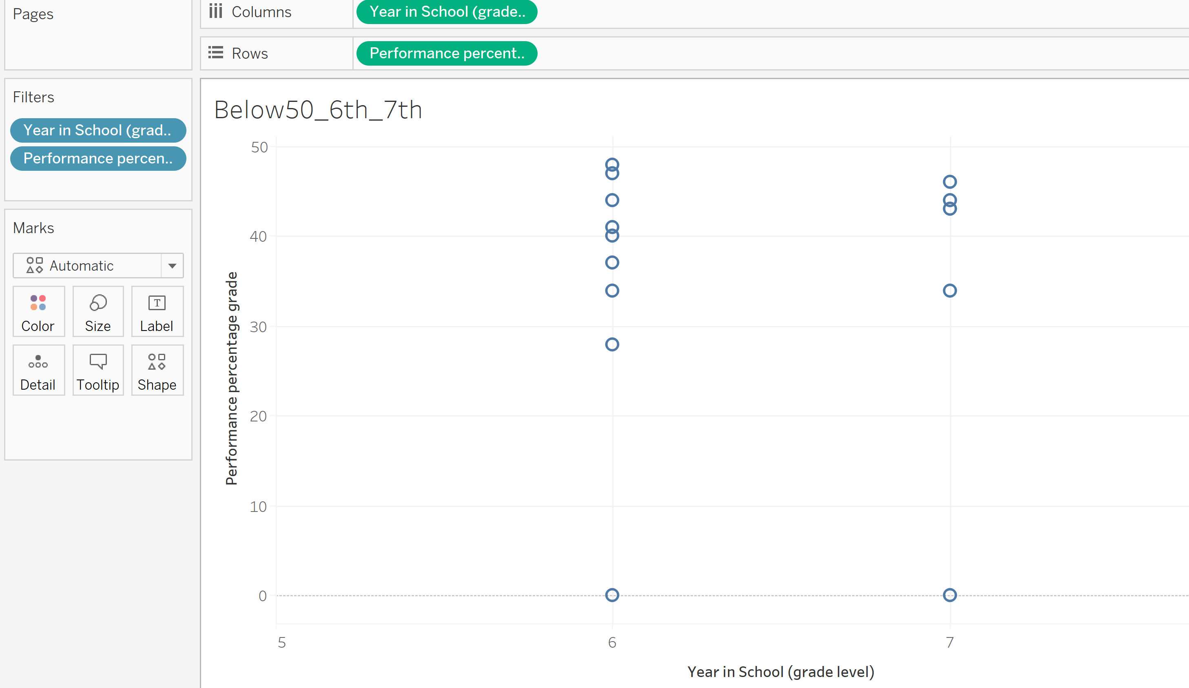


Hypothesis-1
Statistical Analysis in Excel
Visual Presentation(Tableau) of students who got below 50% grades in 6th vs 7th grade.
Conclusion: The overall students of 7th grade are more intelligent than 6th grade students.

Slide 8
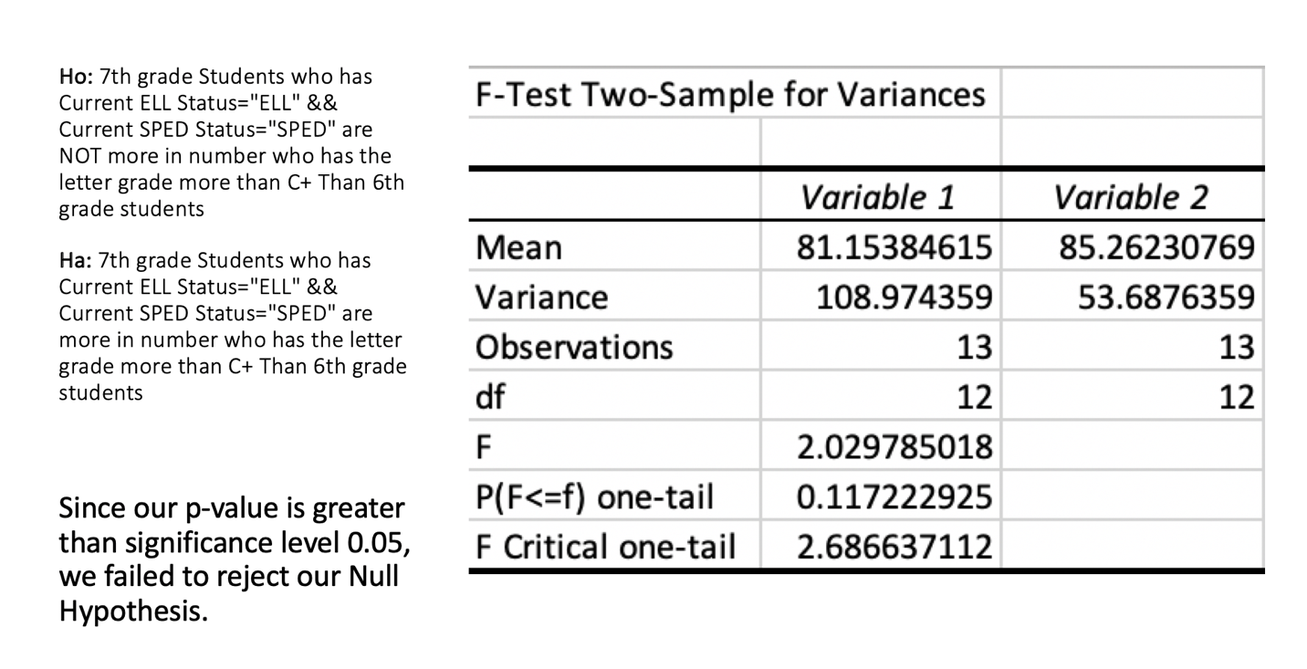
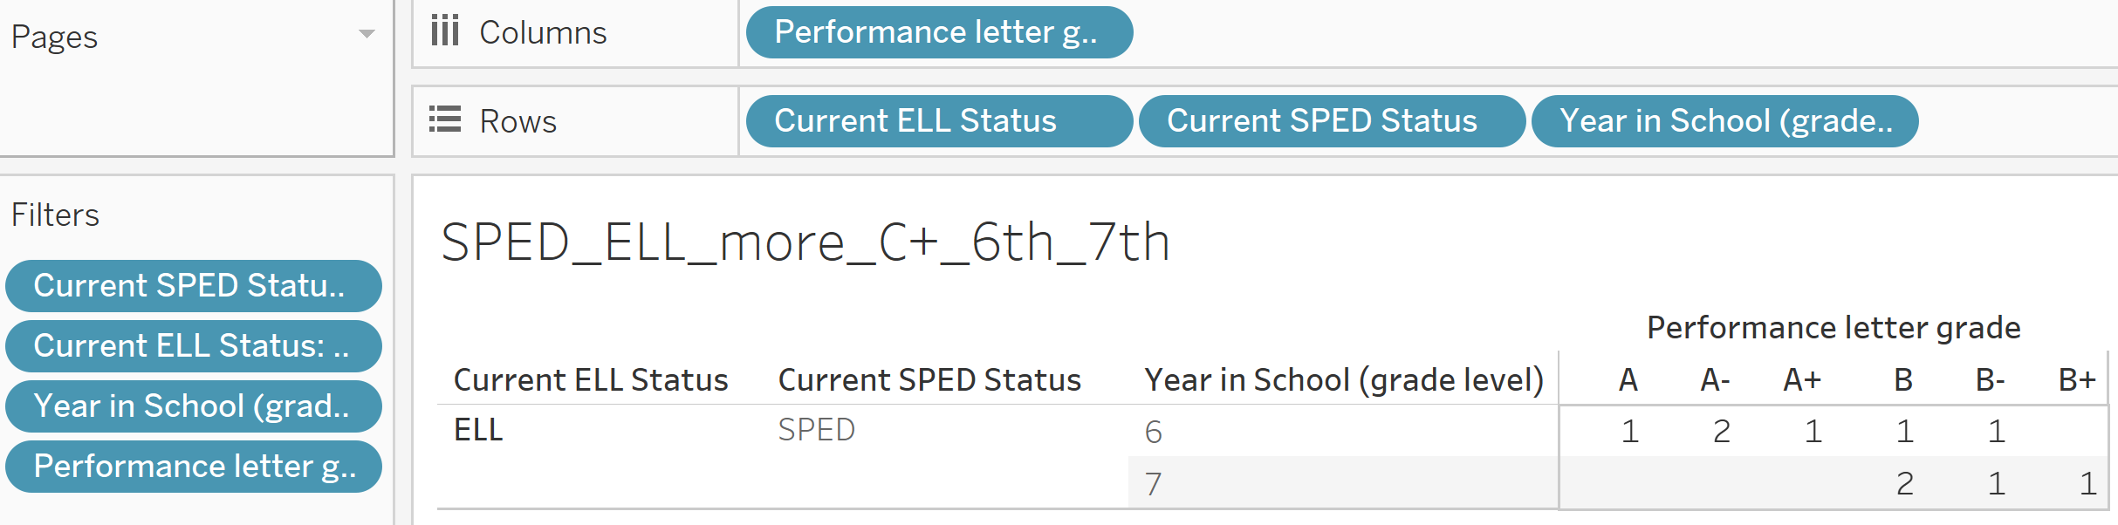

Hypothesis-2
Statistical Analysis in Excel
Visual Presentation(Tableau) of students who get more than C+ in 6th vs 7th grade.
Conclusion: The students of 6th grade are more in number than 7th grade who got the grades more than C+.

Slide 9




THANK YOU

