Slide 1
Confusion Matrix
PR Curve
Model Evaluation Tools
Chih-Cheng Wu

Slide 2
Agenda
1.Confusion Matrix
  Two Key Indicators: Precision and Recall
2.Decision Threshold Affect
3.PR Curve (Precision-Recall Curve)
4.AUC & Usage
Sub-Discussion
5.Confusion Matrix Other Indicators
6.ROC Curve
7.Classification or Prediction
In Multiple Classes

Slide 3
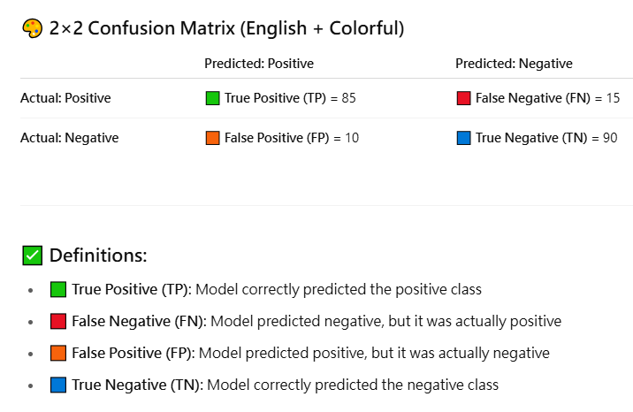
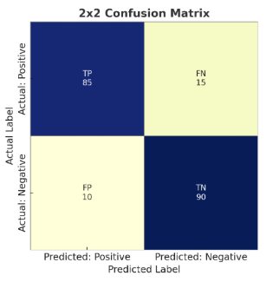
1.Standard 2×2 Confusion Matrix
Only For Classification a single Class
  OR Prediction Positive and Negative

Slide 4
Two Key Indicators
Precision = TP / (TP + FP)
    Model Prediction N times Positive, its accuracy percentage.
    85/(85+10)=0.895
Recall = TP / (TP + FN)
    In All true positive cases, model correct hit percentage.
    Also naming:
      TPR(True Positive Rate) and Sensitivity
    85/(85+15)=0.85

Slide 5
2.Decision Threshold Affect Precision and Recall
Must understand Confidence
A higher threshold increases precision but decreases recall, while a lower threshold increases recall but decreases precision.
Choosing the suitable classification threshold depends on the specific use case and the costs of different types of classification errors.

Slide 6
3.PR Curve
(Precision-Recall Curve)

Slide 7
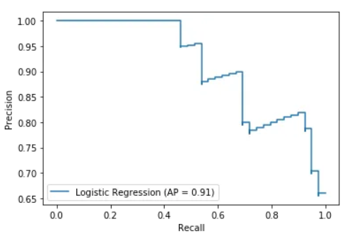
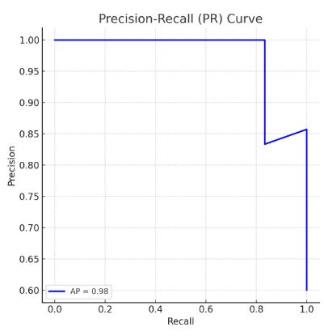
3.PR Curve(Precision-Recall Curve)
Threshold =100
Threshold=0

Slide 8
3.How Precision-Recall Curve Works.
The PR curve is created by changing the decision threshold of your model and checking how the precision and recall change at each step.
The threshold is the cutoff point which you decide:
  If the probability is above the threshold Model predict positive, Else predict Negative

Slide 9
3. PR Curve Tips
Key Points:
  Each point on the curve represents a different threshold for classifying a sample as positive.
  A perfect classifier would reach the top-right corner (Precision = 1, Recall = 1).
  Curves closer to the top-right indicate better performance.
  The Average Precision (AP) score is shown in the legend (≈ 0.98)
  A Precision-Recall (PR) Curve is a performance visualization tool used in binary classification tasks.

Slide 10
4. PR Curves VS ROC Curves
PR Curves are usually used for
  Classes are unbalanced
  When using need Adopt Full-Name: PR-AUC
ROC Curves usually used for
  Classes are balanced or false positives matter less
  AUC(Area under curve) can be used as an indicator to judge the overall modeling capability.

Slide 11
Sub-Discussion - I
AUC (Area Under Curve)
  Can be used as an indicator to judge the overall modeling capability.
AP (Average Precision)
  The average of under PR Curve area
mAP (mean Average Precision)
IoU (Intersection over Union)
  Discussion at object detection
mAP@0.5

Slide 12
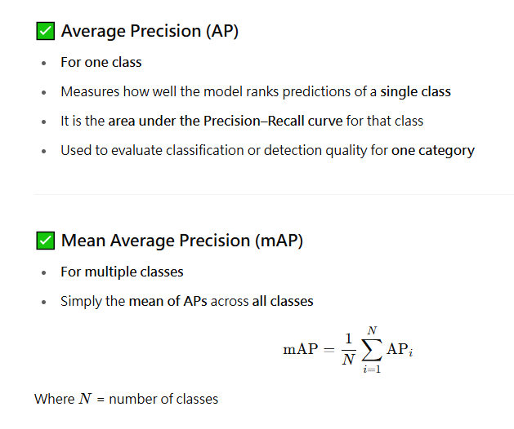
Sub-Discussion - II

Slide 13
5.Confusion Matrix
Other Indicators

Slide 14
5-1. Accuracy
Accuracy = (TP+TN)/(TP+FP+FN+TN)
    In All Prediction Times， Model Correct hit Percentage.
    Tip: Similar of Precision

Slide 15
5-2. Sepecificity & FPR
      Sepecificity
= TN/(TN+FP)
    In All true Negative cases, model correct hit Negative percentage.
FPR(False Positive Rate) = FP/(TN+FP)
    In All true Negative cases, model prediction Incorrect percentage.
Tip: Both Similar to Recall

Slide 16
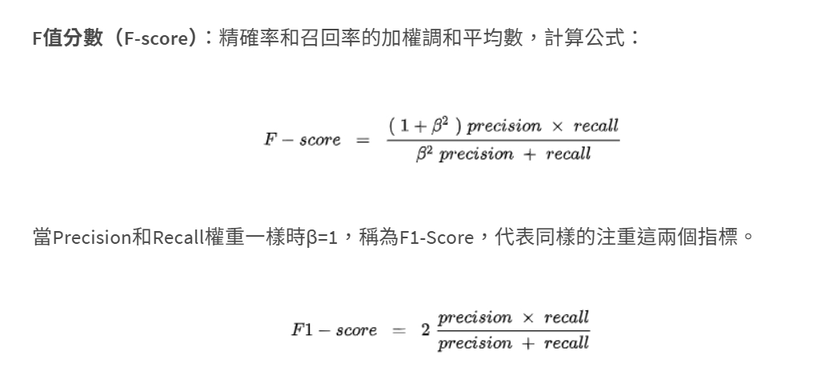
5-3. F1-Score
https://tako-analytics.com/2024-03-21-data-science-what-is-confusion-matrix-model-evaluation-metric/

Slide 17
6.ROC Curve
(Receiver Operating Characteristic Curve)

Slide 18
7.Classification or Prediction
In Multiple Classes

Slide 19
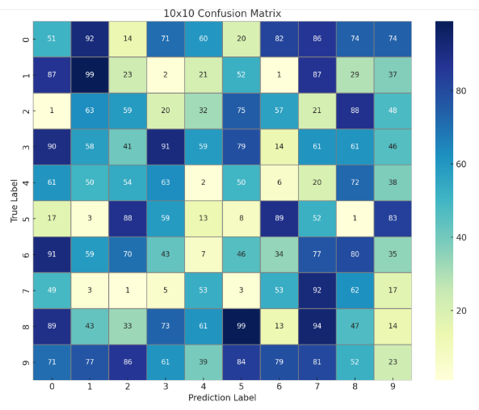
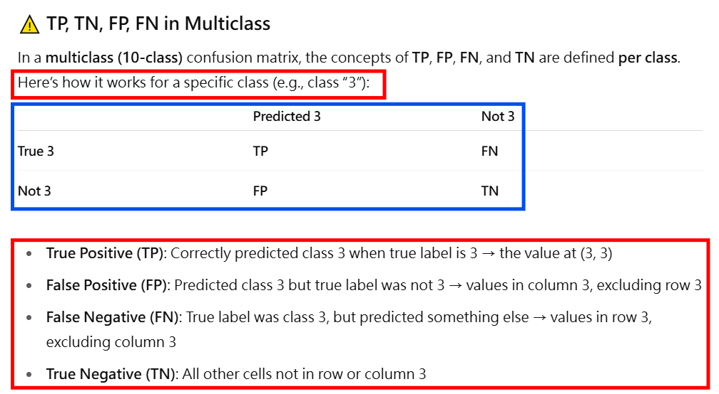
8.10×10 Confusion Matrix

