Slide 1
Confidence and
Decision-Threshold
Chih – Cheng, Wu

Slide 2
Before Start, …
The decision-threshold and confidence are closely related concepts in classification models, especially binary classification.
Here's how they are connected:

Slide 3
Agenda
1. Confidence (Prediction Probability)
2. Decision-Threshold
3. Relation Between Them
4. Why Change the Decision-Threshold?

Slide 4
1.Confidence
(Prediction Probability)
In most classification models (like logistic regression, neural networks, etc.), the model outputs a probability (between 0 and 1) that a new object belongs to a particular class.
This is often referred to as the confidence score.
Example:
A model predicts:
  Class 1 with probability = 0.85 → Confidence = 85%
  Class 0 with probability = 0.15

Slide 5
2. Decision-Threshold
The decision threshold is the cutoff value you set to decide which class to assign based on the confidence.
By default, it is usually set to 0.5, meaning:
  If P(class 1) > 0.5, predict class 1
  Else, predict class 0
But you can change the threshold depending on the use case.

Slide 6
3. Relation Between Them
Confidence is the model's output.
Threshold is your rule for converting that confidence into a final decision.
So the relation is:
  Prediction = (Confidence > Threshold ? Class 1 : Class 0)

Slide 7
4. Why Change the Threshold?
Changing the threshold affects:
  Precision and Recall
    Get the trade-off between precision and recall
    according to real-world requirements.
  False Positives and False Negatives
  F1 Score
  It’s often visualized in:
    PR Curve (Precision-Recall)
    ROC Curve

Slide 8
Example
Confidence | Threshold | Prediction
0.85 | 0.5 | Class 1
0.45 | 0.5 | Class 0
0.45 | 0.3 | Class 1

Slide 9
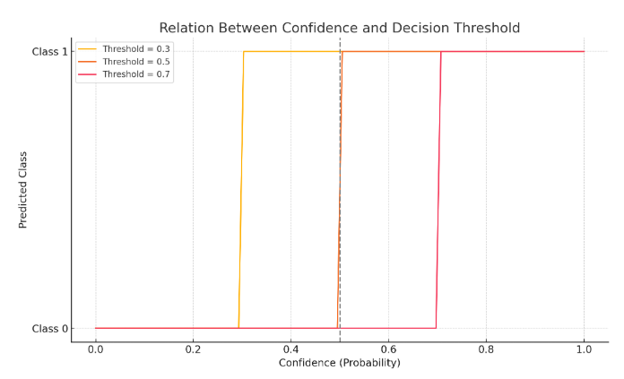
Graph to Visualize

Slide 10
Explain
The graph shows how different decision thresholds affect the predicted class based on the confidence score:
  The x-axis is the confidence (model's predicted probability).
  The y-axis is the predicted class (0 or 1).
  Each colored line represents a different threshold:
    At threshold = 0.3, the model predicts class 1 more easily (even if confidence is just above 0.3).
    At threshold = 0.7, the model requires higher confidence to predict class 1.
    Threshold = 0.5 is the default and is shown with a dotted vertical line.

