Slide 1
Agenda
  1.Quartile 、Box Plot and Outlier
  2.Data Proprocessing
1

Slide 2
I.Quartile、 Box Plot and Outlier

Slide 3
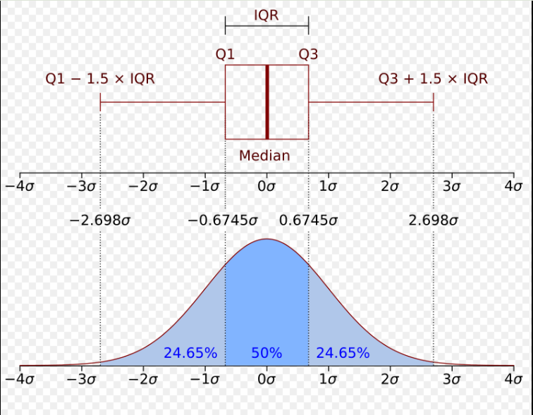
  Quartile (Box plot) and outlier

Slide 4
What Quartile Use For ?
Quartiles are used in statistics to divide a data set into four equal parts, providing insights into the distribution and spread of the data. Their main uses include:
Measuring Spread – Quartiles help describe the variability of a data set by showing the range within which the middle 50% of the data falls.
Detecting Outliers – The interquartile range (IQR), which is the difference between the third quartile (Q3) and the first quartile (Q1), helps identify outliers when values fall significantly beyond the IQR.
Summarizing Data – Quartiles provide a simple yet effective way to summarize a data set without relying solely on the mean or median.
Comparing Distributions – They allow comparison of different data sets by assessing their spread and central tendency.
Box Plot Representation – Quartiles are essential in constructing box plots, a visual tool for understanding the distribution, skewness, and potential outliers in a dataset.

Slide 5
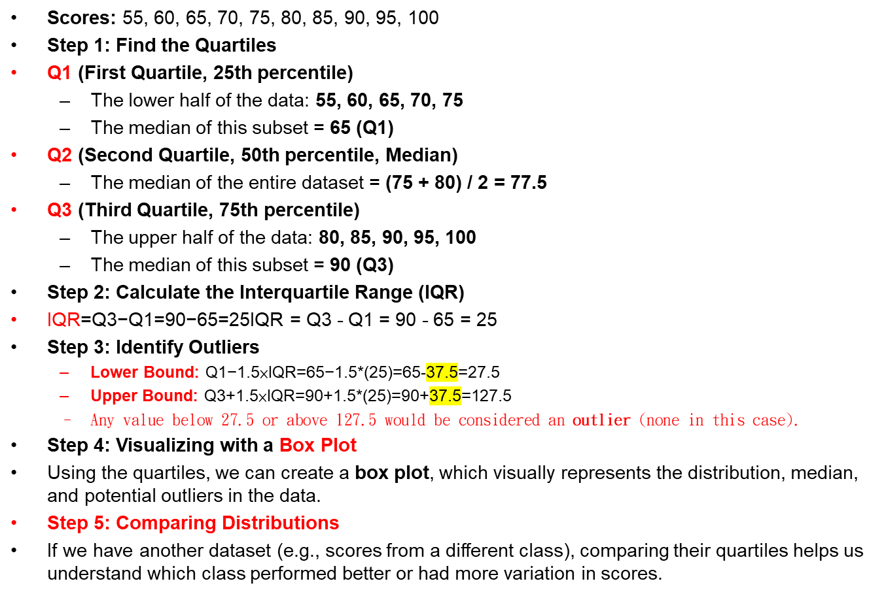
Example dataset of students' test scores

Slide 6
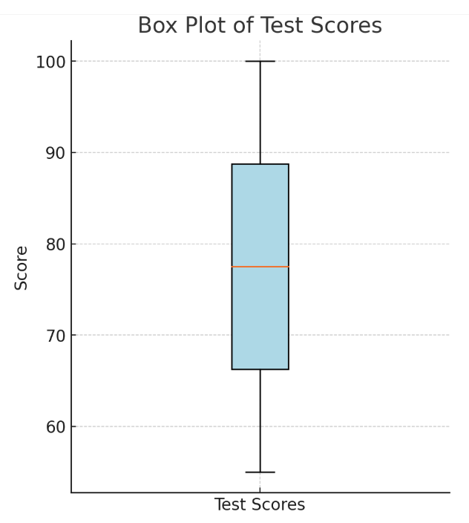
Box Plot
Qmax
Q3
Q2
Q1
Qmin

Slide 7
Quartile and Box plot
  Quartile (Box plot) and outlier
    Q₁、Q₂、Q₃、IQR、Qmin、Qmax
      Q₂:Median
      Q₁:25% 、Q3:75%
      IRQ:InterQuartile Range = Q₃-Q₁
      Qmin=Q₁-IRQ、Qmax=Q₃+IRQ
      Outlier: <Qmin _{or} >Qmax
    Quartile:
      https://en.wikipedia.org/wiki/Quartile
    Box plot :
      Understand data distribution and Outlier
      https://en.wikipedia.org/wiki/Box_plot

Slide 8
II.Data Proprocessing

Slide 9
II.Data Proprocessing
    1.Data Cleaning
      Missing data, Duplicate, Redundant
      Fill, insert, delete, merge
    2.Data standardization
      Z-score、Min-Max [0, 1] 、MaxAbs [-1, 1]
    3.Data Augmentation

Slide 10
2.Data Augmentation
Data augmentation is a technique used in machine learning and deep learning to artificially expand a dataset by applying transformations to existing data. This helps improve model performance, especially when the amount of available training data is limited.
Why is Data Augmentation Important?
Increases the size of the dataset without collecting new data.
Helps prevent overfitting by making the model more generalizable.
Improves the robustness of machine learning models.
Useful in fields like computer vision, natural language processing (NLP), and speech recognition.

Slide 11

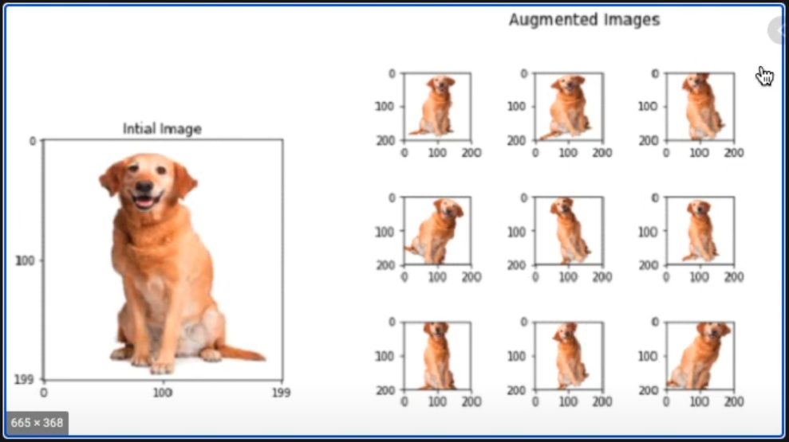
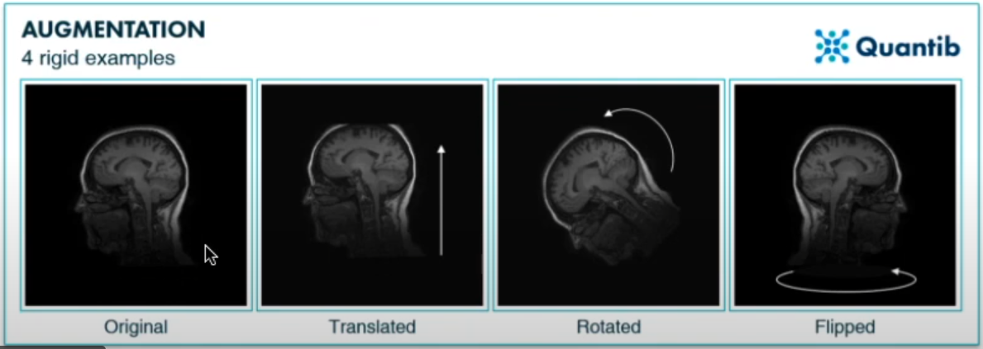
https://www.youtube.com/watch?v=nBKpTqu18E0&t=721s

Slide 12
Types of Data Augmentation
1. Image Data Augmentation
  Geometric Transformations: Rotation, flipping, cropping, scaling, and shearing.
  Color Modifications: Brightness, contrast, saturation, and hue adjustments.
  Noise Injection: Adding Gaussian noise or blurring.
2. Text Data Augmentation (for NLP)
  Synonym Replacement: Replacing words with synonyms.
  Random Insertion & Deletion: Adding or removing words.
  Back Translation: Translating text into another language and back.
  Shuffling Sentences: Changing the order of sentences while keeping meaning intact.
3. Audio Data Augmentation
  Time Stretching: Slowing down or speeding up the audio.
  Pitch Shifting: Changing the pitch while keeping duration constant.
  Adding Background Noise: Simulating real-world noise conditions.

