Slide 1
Common Use SQL Syntax
Using Standard MSSQL
Reporter:Wu-Chih-Cheng
Assistant Professor, Department of Information Technology and Management, Tzu Chi University

Slide 2
Example 1.
Purpose: Display some day purchase receiving total amount money
select * from InputHeadTbl
where chInpDateTime like '1140612%' order by chInpDateTime desc
select chInpDateTime, chFactNo, rlInpTotAmt
from InputHeadTbl
where chInpDateTime like '1140612%' order by chInpDateTime desc
SELECT [chInpDateTime], [chFactNo], [rlInpTotAmt]
FROM [DB_TEST].[dbo].[InputHeadTbl]
WHERE [chInpDateTime] like '1140612%' order by [chInpDateTime] desc

Slide 3
Illustrate 1.
SQL Syntax
Select Column list (use comma separate)
From Table-name
where Conditions
-
Order by
Desc
Reminder
* Wild Card -1
% Wild Card -2
-- ellipsis

Slide 4
Thinking & Practice 1.
Practice
1. Use InputDetailTbl Substititue InputHeadTbl
2. Try ProductTbl
3.Try FactoryTbl

Slide 5
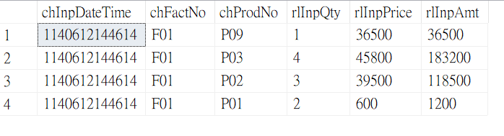
Example 2.
Purpose: Display some today purchase receiving More Detail Item
SQL Statement
select * from InputDetailTbl
where chInpDateTime like '1140612%' order by chInpDateTime desc
Results

Slide 6
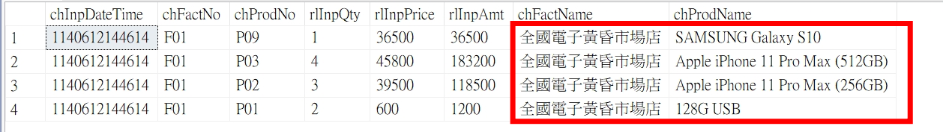
Add Join
SQL Statement
select a.*, b.chFactName, c.chProdName from InputDetailTbl a
left join FactoryTbl b on a.chFactNo=b.chFactNo
left join ProductTbl c on a.chProdNo=c.chProdNo
where a.chInpDateTime like '1140612%' order by a.chInpDateTime desc
Results
Reminder
1. left join
2. alias

Slide 7
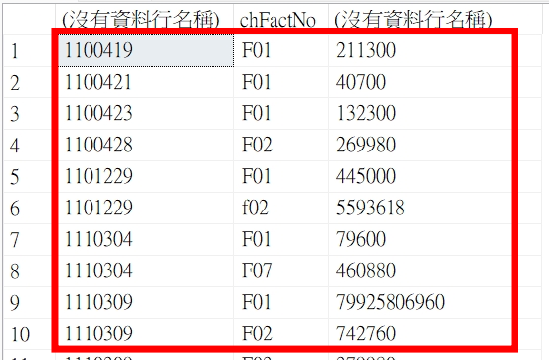
Example 3.
SQL Statement
select left(chInpDateTime,7), chFactNo, sum(rlInpAmt)
from InputDetailTbl
group by left(chInpDateTime,7), chFactNo
order by left(chInpDateTime,7), chFactNo
Purpose
Display Some day purchase receiving total amount money
Reminder
1.group by
2.order by
3.sum
4.having count(*)

Slide 8
Example 3.
/*3-1 SELECT a.OrderID, a.CustomerID, b.ProductID, c.Price, b.Quantity FROM Orders a
left join OrderDetails b on a.OrderID=b.OrderID
left join Products c on b.ProductID = c.ProductID
where a.orderDate >='1996-07-01' and a.orderDate <='1996-07-31' */
SELECT a.CustomerID, a.OrderID, d.CustomerName, d.ContactName, sum(c.Price * b.Quantity) as 訂單金額 FROM Orders a
left join OrderDetails b on a.OrderID=b.OrderID
left join Products c on b.ProductID = c.ProductID
left join Customers d on a.CustomerID = d.CustomerID
where a.orderDate >='1996-07-01' and a.orderDate <='1996-07-31'
group by a.OrderID, a.CustomerID, d.CustomerName, d.ContactName
order by a.CustomerID, a.OrderID
1.Multiple join
2. sum
3.group by + order by

Slide 9
Example 4.
--select * from OrderDetails where OrderID='10248' and OrderDetailID=1
--update OrderDetails set ProductID='99999' where OrderID='10248' and OrderDetailID=1
SELECT a.*, b.ProductName, b.Price from [OrderDetails] a
left join Products b on a.ProductID=b.ProductID
where a.OrderID like '1024%'
Select OrderDetails table, the product with OrderID=‘10248’ and OrderDetailID=1
Update its product ID to 99999.
Select OrderDetails left join Products

Slide 10
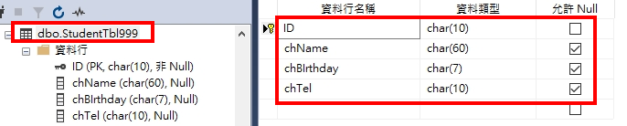
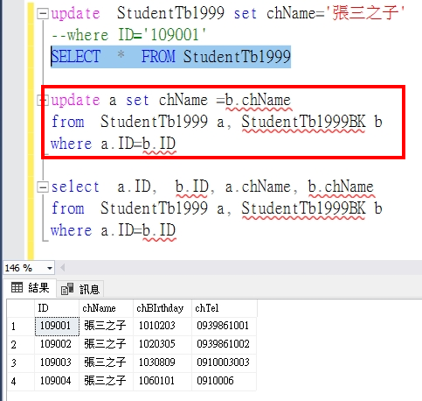
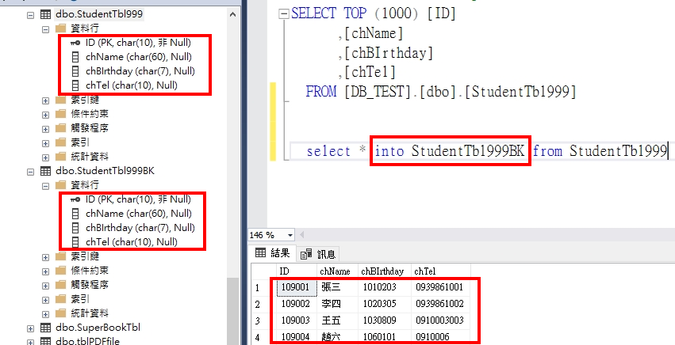
Example 5.
Note: MSSQL server IP:203.68.62.33 ID:Exc/Password/Excpwd
1.According above Chart. Create StudentTbl999 first, and setting PK, Then append 4 records
2.Select * from StudentTbl999, insert to StudentTbl999BK By SQL
3. Wrong update, and Recover Correct Data

Slide 11
Example 6.
Store Procedure
  We can save our SQL statement into Database in advance，Then We can quickly execute them more quickly and convenient
Job
  In MS SQL Enterprise version, We can save SQL statement into (Job), and setting regular time to execute them.

Slide 12
Use SQL (to calculate the total amount of the day's purchase)
declare @YYY char(3) –Today’s Chinese year
declare @MM char(2) –Today’s month
declare @DD char(2) –Today’s day
declare @YYYMMDD char(7)—Today’s year-month-day
select @YYY=convert(char(3),year(getdate())-1911)
--month
select @MM= replicate('0',2-len(rtrim(convert(char(2),month(getdate()))))) + rtrim(convert(char(2),month(getdate())))
--day
select @DD=replicate('0',2-len(rtrim(convert(char(2),day(getdate()))))) + rtrim(convert(char(2),day(getdate())))
select @YYYMMDD=@YYY + @MM + @DD --month day
print @YYYMMDD
SELECT [chInpDateTime] ,[chFactNo] ,[rlInpTotAmt]
FROM [DB_TEST].[dbo].[InputHeadTbl]
where left(chInpDateTime,7) = @YYYMMDD
SELECT left(chInpDateTime,7) as ToDate, sum(rlInpTotAmt)
FROM [DB_TEST].[dbo].[InputHeadTbl]
where left(chInpDateTime,7) = @YYYMMDD
group by left(chInpDateTime,7)

Slide 13
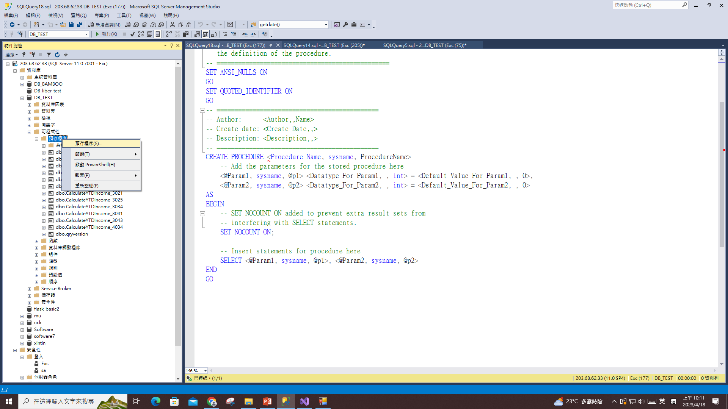
Store Procedure’s Method

Slide 14
Complete - SP.
ALTER PROCEDURE [dbo].[CalculateYTDIncome_0000]
-- Add the parameters for the stored procedure here
AS
BEGIN
-- SET NOCOUNT ON added to prevent extra result sets from
-- interfering with SELECT statements.
SET NOCOUNT ON;
declare @YYY char(3) --Today’s Chinese year
declare @MM char(2) --Today’s Chinese month
declare @DD char(2) --Today’s Chinese day
declare @YYYMMDD char(7)--Today’s Chinese year-mon
declare @YesterdayWestDate datetime--Yesterday’s Chinese year-month-day
select @YesterdayWestDate = getdate()-1
print @YesterdayWestDate
select @YYY=convert(char(3),year(@YesterdayWestDate)-1911)
--month
select @MM= replicate('0',2-len(rtrim(convert(char(2),month(@YesterdayWestDate))))) + rtrim(convert(char(2),month(@YesterdayWestDate))) --day
select @DD=replicate('0',2-len(rtrim(convert(char(2),day(@YesterdayWestDate))))) + rtrim(convert(char(2),day(@YesterdayWestDate)))
select @YYYMMDD=@YYY + @MM + @DD --month day
print @YYYMMDD
SELECT left(chInpDateTime,7) as ToDate, sum(rlInpTotAmt)
FROM [DB_TEST].[dbo].[InputHeadTbl]
where left(chInpDateTime,7) = @YYYMMDD
group by left(chInpDateTime,7)
END

Slide 15
Change yesterday's date.
declare @YYY char(3) --Today’s Chinese year
declare @MM char(2) --Today’s Chinese month
declare @DD char(2) --Today’s Chinese day
declare @YYYMMDD char(7) --yesterday’s Today’s Chinese year-month-day
declare @YesterdayWestDate datetime-- yesterday’s Today’s Chinese year-month-day(western)
select @YesterdayWestDate = getdate()-1
print @YesterdayWestDate
select @YYY=convert(char(3),year(@YesterdayWestDate)-1911)
--month
select @MM= replicate('0',2-len(rtrim(convert(char(2),month(@YesterdayWestDate))))) + rtrim(convert(char(2),month(@YesterdayWestDate)))
--day
select @DD=replicate('0',2-len(rtrim(convert(char(2),day(@YesterdayWestDate))))) + rtrim(convert(char(2),day(@YesterdayWestDate)))
select @YYYMMDD=@YYY + @MM + @DD --month day
print @YYYMMDD

Slide 16
Use SQL (to calculate the total amount of yesterday's purchase)
declare @YYY char(3) --Today’s Chinese year
declare @MM char(2) --Today’s Chinese month
declare @DD char(2) --Today’s Chinese day
declare @YYYMMDD char(7)-- yesterday’s Today’s Chinese year-month-day declare @YesterdayWestDate datetime-- yesterday’s Today’s Chinese year-month-day(western)
select @YesterdayWestDate = getdate()-1
print @YesterdayWestDate
select @YYY=convert(char(3),year(@YesterdayWestDate)-1911)
--month
select @MM= replicate('0',2-len(rtrim(convert(char(2),month(@YesterdayWestDate))))) + rtrim(convert(char(2),month(@YesterdayWestDate)))
--day
select @DD=replicate('0',2-len(rtrim(convert(char(2),day(@YesterdayWestDate))))) + rtrim(convert(char(2),day(@YesterdayWestDate)))
select @YYYMMDD=@YYY + @MM + @DD --month day
print @YYYMMDD
SELECT left(chInpDateTime,7) as ToDate, sum(rlInpTotAmt)
FROM [DB_TEST].[dbo].[InputHeadTbl]
where left(chInpDateTime,7) = @YYYMMDD
group by left(chInpDateTime,7)

Slide 17
Previous SP. Divide two stage to Execute
ALTER PROCEDURE [dbo].[Main_0000]
-- Add the parameters for the stored procedure here
AS
BEGIN
declare @YYY char(3) -- Today’s Chinese year
declare @MM char(2) -- Today’s Chinese month
declare @DD char(2) -- Today’s Chinese day
declare @YYYMMDD char(7)-- yesterday’s Today’s Chinese year-month-day
declare @YesterdayWestDate datetime-- yesterday’s Today’s Chinese year-month-day(western)
select @YesterdayWestDate = getdate()-1
print @YesterdayWestDate
select @YYY=convert(char(3),year(@YesterdayWestDate)-1911)
--month
select @MM= replicate('0',2-len(rtrim(convert(char(2),month(@YesterdayWestDate))))) + rtrim(convert(char(2),month(@YesterdayWestDate)))
--day
select @DD=replicate('0',2-len(rtrim(convert(char(2),day(@YesterdayWestDate))))) + rtrim(convert(char(2),day(@YesterdayWestDate)))
select @YYYMMDD=@YYY + @MM + @DD --month day
print @YYYMMDD
exec GetDayInpSum_0000 @YYYMMDD
END

Slide 18
Called SP. (accept previous stage parameter)
ALTER PROCEDURE [dbo].[GetDayInpSum_0000]
-- Add the parameters for the stored procedure here
@Date as char(7)
AS
BEGIN
-- SET NOCOUNT ON added to prevent extra result sets from
-- interfering with SELECT statements.
SET NOCOUNT ON;
SELECT left(chInpDateTime,7) as ToDate, sum(rlInpTotAmt)
FROM [DB_TEST].[dbo].[InputHeadTbl]
where left(chInpDateTime,7) = @Date
group by left(chInpDateTime,7)
END

Slide 19
Example 7.
Two stage CURSOR，Using Loop

Slide 20
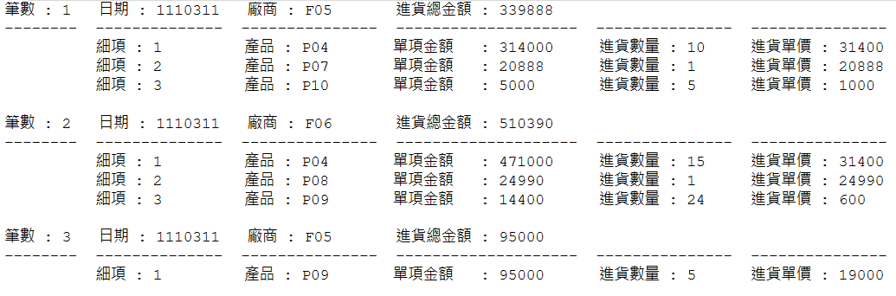
/* 以 SQL讀出某一天的HEAD, 及當天的細項 */
--First stage using variable - HEAD
Declare @chInpDateTime as char(13)
Declare @chFactNo as char(10)
Declare @rlInpTotAmt as numeric
Declare @mCounter as int
select @mCounter = 1
--Second stage using variable - DETAIL
Declare @chProdNo as char(13)
Declare @rlInpQty as real
Declare @rlInpPrice as numeric
Declare @rlInpAmt as numeric
Declare @mCounter_2 as int
--1.Declare and Define First stage CURSOR : HEAD
DECLARE Print_Order CURSOR FOR select chInpDateTime, chFactNo, rlInpTotAmt FROM [DB_TEST].[dbo].[InputHeadTbl] where chInpDateTime like '1110311%'
OPEN Print_Order--2.打開 CURSOR : HEAD
fetch next from Print_Order into @chInpDateTime , @chFactNo ,@rlInpTotAmt --3. . From CURSOR , Read data to variable
while (@@FETCH_STATUS<>-1)--4.Loop judge: success status 0, Cannot read or reach Bottom -1
begin
  print '筆數 : ' + rtrim(convert(char(5), @mCounter)) + ' 日期 : ' + convert(char(7), left(@chInpDateTime,7)) + ' 廠商 : ' + @chFactNo
  + '進貨總金額 : ' + convert(char(10), @rlInpTotAmt)--5.顯示: HEAD 資料
  print replicate('-',8) + space(2) + replicate('-',14) + space(2) + replicate('-',15) + space(2) + replicate('-',20) + space(2) + replicate('-',15)
  + space(2) + replicate('-',15)
  DECLARE Print_Detail CURSOR FOR-- 一.Decalre and Define two stage’sCURSOR : DETAIL
  SELECT chProdNo,rlInpQty,rlInpPrice,rlInpAmt FROM DB_TEST.dbo.InputDetailTbl where chInpDateTime = @chInpDateTime and chFactNo= @chFactNo
  select @mCounter_2 = 1
  OPEN Print_Detail-- 二.打開 CURSOR : DETAIL
  fetch next from Print_Detail into @chProdNo , @rlInpQty ,@rlInpPrice, @rlInpAmt -- 三.從現在的 CURSOR , 讀資料到變數
  while (@@FETCH_STATUS<>-1)-- 4.Loop judge: success status 0, Cannot read or reach Bottom -1
  begin
    print space(10) + '細項 : ' + rtrim(convert(char(3), @mCounter_2)) + space(9) + '產品 : ' + left(@chProdNo, 10)
    + '單項金額 : ' + convert(char(10), @rlInpAmt) + ' 進貨數量 : ' + convert(char(5), @rlInpQty) + space(2)
    + '進貨單價 : ' + convert(char(10), @rlInpPrice)-- 五.顯示: DETAIL 資料
    select @mCounter_2 = @mCounter_2 + 1
    fetch next from Print_Detail into @chProdNo , @rlInpQty ,@rlInpPrice, @rlInpAmt-- 六.重覆動作(三)
  end
  print ''
  CLOSE Print_Detail-- 七. 關閉 CURSOR : DETAIL
  DEALLOCATE Print_Detail-- 八. 清除 CURSOR : DETAIL
  select @mCounter = @mCounter + 1
  fetch next from Print_Order into @chInpDateTime , @chFactNo ,@rlInpTotAmt-- 6.重覆動作 (3)
end
CLOSE Print_Order-- 7. Close CURSOR : HEAD
DEALLOCATE Print_Order-- 8. Clear CURSOR : HEAD
2 stage CURSOR
Full SQL statement
Execute Result

Slide 21
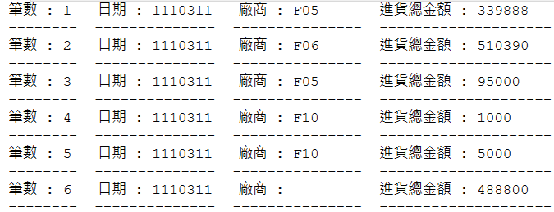
/* 以 SQL讀出某一天的HEAD, 及當天的細項 */
--第一層用到的變數 HEAD
Declare @chInpDateTime as char(13)
Declare @chFactNo as char(10)
Declare @rlInpTotAmt as numeric
Declare @mCounter as int
select @mCounter = 1
--第二層用到的變數 DETAIL
Declare @chProdNo as char(13)
Declare @rlInpQty as real
Declare @rlInpPrice as numeric
Declare @rlInpAmt as numeric
Declare @mCounter_2 as int
--1.Declare and Define First stage’s CURSOR : HEAD
DECLARE Print_Order CURSOR FOR select chInpDateTime, chFactNo, rlInpTotAmt FROM [DB_TEST].[dbo].[InputHeadTbl] where chInpDateTime like '1110311%'
OPEN Print_Order--2.打開 CURSOR : HEAD
fetch next from Print_Order into @chInpDateTime , @chFactNo ,@rlInpTotAmt --3. From CURSOR , Read data to variable
while (@@FETCH_STATUS<>-1)--4. 4.Loop judge: success status 0, Cannot read or reach Bottom -1
begin
  print '筆數 : ' + rtrim(convert(char(5), @mCounter)) + ' 日期 : ' + convert(char(7), left(@chInpDateTime,7)) + ' 廠商 : ' + @chFactNo
  + '進貨總金額 : ' + convert(char(10), @rlInpTotAmt)--5.顯示: HEAD 資料
  print replicate('-',8) + space(2) + replicate('-',14) + space(2) + replicate('-',15) + space(2) + replicate('-',20) + space(2) + replicate('-',15)
  + space(2) + replicate('-',15)
  select @mCounter = @mCounter + 1
  fetch next from Print_Order into @chInpDateTime , @chFactNo ,@rlInpTotAmt-- 6.redo action (3)
end
CLOSE Print_Order-- 7. Close CURSOR : HEAD
DEALLOCATE Print_Order-- 8. Clear CURSOR : HEAD
One stage CURSOR’s
SQL statement
Execute Result

Slide 22
Example 8.
Create 2 new Table
  FactoryTbl_999
  ProductTbl_999
    再加上PK, index
    Insert into FactoryTbl_999 select * from FactoryTbl
    Insert into ProductTbl_999 select * from ProductTbl
Using SQL statement to Create 2 new Table
  InputHeadTbl_999
  InputDetailTbl_999
    Select * into InputHeadTbl_999 from InputHeadTbl
    Select * into InputDetailTbl_999 from InputDetailTbl
      再加上PK, index

Slide 23
Final SQL Requirement
1. select ( left join, inner join) where {Condition}
2.count , sum amount
3.delete、update、insert(Instruction)
4.Using cursor
5.CreateStore Procedure

