Slide 1
Big data for intelligence medical
Department of information technology and management
Chih-cheng Wu

Slide 2
Foucs on
Data analysis /Big /intelligence medical

Slide 3
Concept of Big data Analysis
1.What is data analysis ?
2.Why need data analysis ?
3.How ?
4.What is Big data analysis ?

Slide 4
1.What is data analysis ? 1/2
What Is Data Analysis? (With Examples)
  https://www.coursera.org/articles/what-is-data-analysis-with-examples
  4 Types :
    1. Descriptive: Over presenting statistics report what happened ?
    2. Diagnostic: Determines why did it happen?
    3. Predictive: What might happen in the future?
    4. Prescriptive: What should we do about it?

Slide 5
1.What is data analysis ? 2/2
The Power of Data Analysis in Research (Overview/ Outline)
  https://www.newhorizons.com/resources/blog/data-analysis-for-research
  Usually use Tools
    PC : SPSS 、SAS、 Rapidminer 、Excel
    Language: Python、R
    Data visualization: Power BI 、 Tableau
      often used in business intelligence to help understand trends and insights.
    SQL : Used to extract, manipulate, and aggregate data from relational database
    Hadoop Spark and Azure: Cloud DB and Distributed data processing
  Applications

Slide 6
2.Why need data analysis ?
What Is Data Analysis: Examples, Types, & Applications
  https://www.simplilearn.com/data-analysis-methods-process-types-article
  Why Data Analysis Important?
    1. Decision Making :Improved decision, Predictive insights
    2. Optimization and Efficiency: Resource allocation, Cost reduction
    3. Competitive Advantage: Market trends and opportunities, Customer insights
    4. Risk Management: Identifying and mitigating risks, Forecasting risks

Slide 7
3.How ?
How To Analyze Data in 7 Simple Steps:A Definitive Guide
  https://www.indeed.com/career-advice/career-development/analyzing-data
The data analysis process typically involves the following steps:
    1. Define the problem or research question.
    2. Collect the relevant data from various sources.
    3. Clean and organize the data. (Data Preprocessing)
    4. Analyze the data.
    5.Data visualization
    6. Interpret the results of your analysis
    7. Communicate the findings.
    8. Take action.

Slide 8
3.How ?
How To Analyze Data in 7 Simple Steps:A Definitive Guide
  https://www.indeed.com/career-advice/career-development/analyzing-data
  Have 7 Simple Steps Need add step :
    8.Analyzing the data.
    9. Interpret the results of your analysis
The data analysis process typically involves the following steps:
    1. Define the problem or research question.
    2. Collect the relevant data from various sources.
    3. Clean and organize the data.
    4. Analyze the data.
    5. Interpret the results.
    6. Communicate the findings.
    7. Take action.

Slide 9
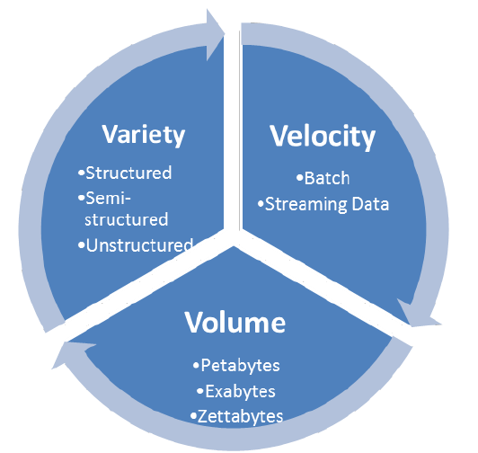
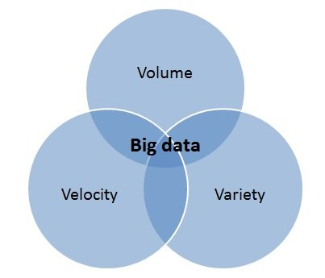
4.What is Big data analysis ? 1/3
Storage Capacity Unit ：Bit, Byte, KB, MB, GB, TB , PB, EB, ZB, YB

Slide 10
4.What is Big data analysis ? 2/3
In the context of big data analysis, "big" refers to the massive volume of data that is generated from a variety of sources at high speed and in diverse formats. This data is typically too large, complex, and fast-moving for traditional data processing tools to handle efficiently. The characteristics of big data are often summarized by the 3 Vs:
  Volume: Refers to the sheer amount of data. Big data can be measured in terabytes, petabytes, or even exabytes. The volume comes from sources like social media, sensors, transactional records, and logs.
  Variety: Refers to the different types and formats of data. Big data can be structured (like databases), semi-structured (like JSON or XML), or unstructured (like videos, images, or social media posts).
  Velocity(快速): Refers to the speed at which data is generated and processed. For example, streaming data from social media, real-time sensor data from IoT devices, or financial transactions require rapid processing.

Slide 11
4.What is Big data analysis ? 3/3
Additionally, some extend the 3 Vs to include:
  Veracity(真實): The trustworthiness or quality of the data.
  Value(有價值): The potential insights or benefits that can be derived from analyzing big data.
Big data analysis involves using specialized tools and technologies like Hadoop, Spark, and machine learning models to process, analyze, and derive meaningful insights from this complex and voluminous data.

Slide 12
MS SQL Practice
IP: 203.68.62.33
ID: Exc
Password: Excpwd
1.Create table
  Field name
  Field type
  Field length
Select statement/syntax
W3Schools
  Structured
    SQL
  semi-Structured
    JSON or XML
  unstructured
    Videos, social media post

