Slide 1

Visual Cryptography based Watermarking:
Definition and Meaning
Authors:
Stelvio Cimato¹,
James C.N. Yang²
Chih-Cheng Wu² *
¹Department of Computer Science
Universita degli Studi di Milano
I-26013 Crema (CR), Italy
²Department of Computer Science and Information Engineering
National Dong Hwa University, Taiwan
Notes:
1.Chairman, ladies and gentlemen, good afternoon. It’s my pleasure to be here.
2.I am Chih-Cheng Wu, from National Dong Hwa University at Taiwan.
3.Today I will talk about “Visual Cryptography based Watermarking:Definition and Meaning”

Slide 2
Outline
Introduction
Basic Notions
  Visual Cryptography
  Watermarking
The Proposed “Visual Cryptography based Watermarking:Definition and Meaning”
Conclusion
Notes:
Here is my outline today,
At First, I will give a simple introduction for Copyright protection.
2, Then, I will talk about Visual Cryptography and Watermarking.
3. In this paper, we propose “Visual Cryptography based Watermarking:Definition and Meaning”.
4. Finally, Conclusion are giving.

Slide 3
Introduction
Copyright protection
  Most challenges to security and copyright management for digital materials.
  Is a very important issue in our digital society.
Visual cryptography schemes (VCS) & Digital watermarking schemes
Our main contribution
  Provide a general model for the watermarking schemes obtained from the combination with visual cryptography to protect copyright.
Notes:
1. Copyright protection has most challenges to security and copyright management for digital materials.
That is a very important issue in our digital society.
2. visual cryptographic schemes and Watermarking techniques have been recently used in different approaches for the copyright protection of digital images.
3. In this paper, we provide a general model for the watermarking schemes obtained from the combination with visual cryptography to protect copyright.

Slide 4
BASIC NOTIONS
Visual Cryptography Schemes (VCS)
Digital Watermarking Schemes
Notes:
1.Following, Some Simple Visual Cryptography Schemes and Digital Watermarking Schemes will be given.

Slide 5
Visual Cryptography Schemes
Naor and Shamir’s (k, n)-VCS
(k, n)-VCS: (Note: (2, 2), (2, n), (k, k) are some special cases, and may have easy constructions)
A secret image is divided into n shadow images. Any k or more shadows can be superimposed to reconstruct a secret image, while the secret cannot be revealed from less than k shadows.
The stacking-to-see property of VCS:
Any k participants may photocopy their shadows on transparencies and stack them on an overhead projector to visually decode the secret through the human visual system without computation.
Threshold:
Split a secret into n pieces such that any group of k people can reconstruct the secret, but a group of less than k people cannot.
(2) Perfect secure.
Notes:
A (k, n) VCS is divided secret image into n shadow images. Any k or more shadows can be superimposed to reconstruct a secret image, while the secret cannot be revealed from less than k shadows, that is General (k, n)-VCS.
Any k participants may photocopy their shadows on transparencies and stack them on an overhead projector to visually decode the secret through the human visual system without computation, that is Stacking-to-see-property.
And is Perfect secure

Slide 6
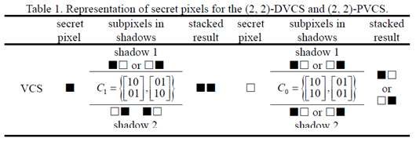
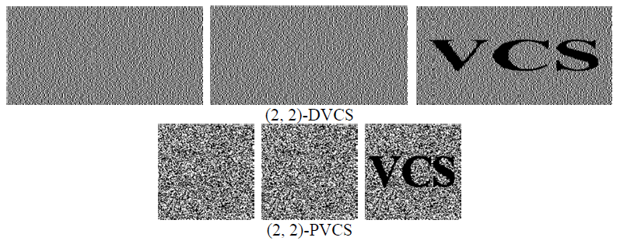
(D)eterministic VCS and
(P)robabilistic VCS
Notes:
1.VCS has two categories, they are Deterministic and Probabilistic.
In here we use (2,2) VCS for explain its method.
2.Both scheme are encoding each binary pixel of original secret image into two shares Shawdo1 and Shadow2 .
…
3. We can obviously see Deterministic has better contrast than Probabilistic.
But it has expance double time drawback, Probabilistic not.

Slide 7
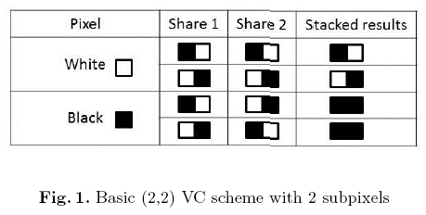
Superimposed
Two shadows(shares) are stacked together
  If secret image pixel is white, will appear the result one black sub-pixel and one white sub-pixel.
  If secret image pixel is black, the result two black sub-pixels will appear as reported in the rightmost column of the figure 1.

Slide 8
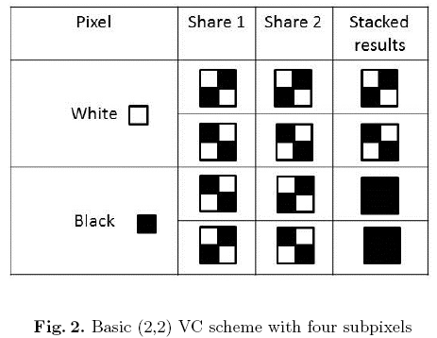
Maintain the Aspect Ratio
To maintain the aspect ratio of the original secret image a larger pixel expansion can be selected, associating to each pixel of the secret image a block composed of 4(=2 × 2) subpixels, as reported in Figure 2.
Notes:
For a (2, 2)-VCS, to maintain the aspect ratio of the original secret image, we may select a larger pixel expansion.
As shown, in the following figure, 4 subpixels are composed in a block.

Slide 9

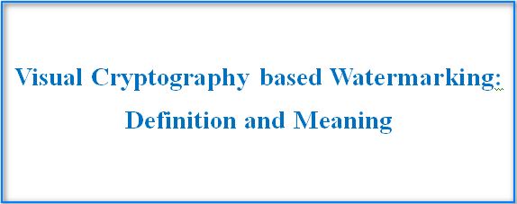
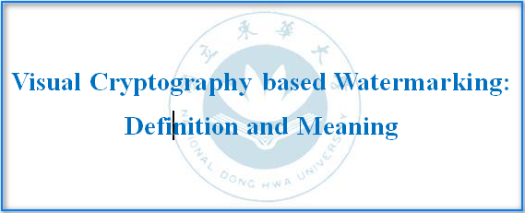
Digital Watermarking Schemes
Digital watermarks are typically used as a method for the protection of Intellectual Property Rights (IPR).
Logo
Original Digital
ENBEDDED

Slide 10
Trusted Authority (TA)
A watermark is composed of another image or logo which can be directly related to the owner of the image.
The relationship between the watermark and the owner can be assessed by storing the watermark at a Trusted Authority (TA) which can intervene in case of dispute.
Logo
Original Digital
ENBEDDED

Slide 11
Watermarking Schemes Requirements
Requirements
  1.Imperceptibility
  2.Robustness
  3. Security
  4. Blindness
  5. Multiple watermarking
  6. Unambiguity

Slide 12
The proposed Visual Cryptography based Watermarking
In a VCS based Watermarking
  Usually the watermark is given as input to the VCS, obtaining a number of shares.
  One of the share is then used as watermark and given in input to the embedding phase of the watermarking algorithm.
  The other ones will be stored and protected at a Trusted Authority (TA) .

Slide 13
Participants
The typical scenario considered in combined watermarking VC based scheme includes three actors.
  The owner of the image
  Trusted Authority (TA)
  Adversary

Slide 14
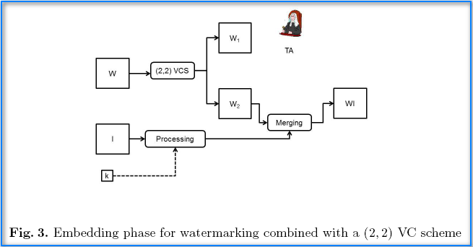
Watermarking with (2,2) VCS
Embedding
Most of the schemes combining watermarking with visual cryptography are based on the use of a (2, 2) VC scheme.
Usually, the use of VC allows the splitting of the watermark into two or more shares, one used as a secret symmetric key, and the other ones embedded in the original image.

Slide 15
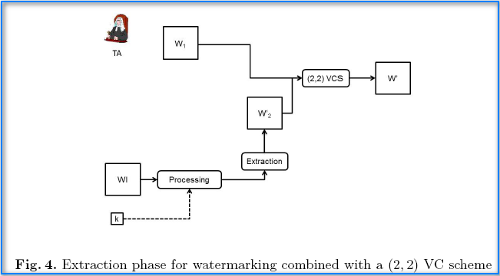
Watermarking with (2,2) VCS
Extraction

Slide 16
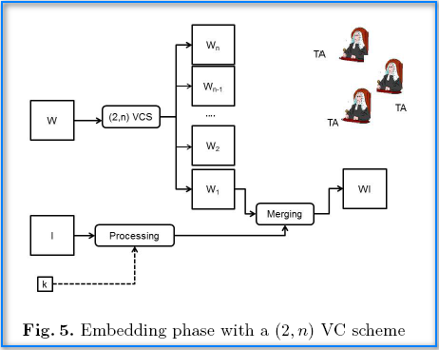
Watermarking with (2,n) VCS
Embedding

Slide 17
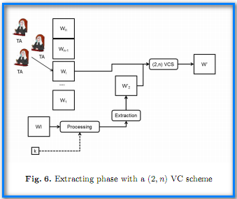
Watermarking with (2,n) VCS
Extraction

Slide 18
Conclusion
The combination of watermarking techniques and visual cryptography provides some interesting solutions to the need of copyright protection for multimedia data.
In this paper a general model, useful to capture most of the proposed watermarking techniques based on visual cryptography, has been provided.
To our knowledge, no watermarking scheme combined with a VC scheme based on (k, n) or general access structure has been presented yet.
Notes:
It is the end of my presentation.
Thank you for your attention.

