Slide 1
Segmented Merge
Chih-Chun Chang
Department of Electrical and Computer Engineering
University of Wisconsin at Madison, Madison, WI
https://github.com/chih-chun-chang/segmerge
Notes:
Hello, everybody. My name is Tsung-Wei Huang. Today, I am going to talk about Intelligent high-performance computing, classical and quantum.
I am going to show you how to overcome new challenges in heterogeneous computing so you can quickly accelerate your application performance.

Slide 2
Outline
Application
Sparse Matrix Multiplication
Graph Partitioning
Parallel Segmented Merge
Related Projects and References

Slide 3
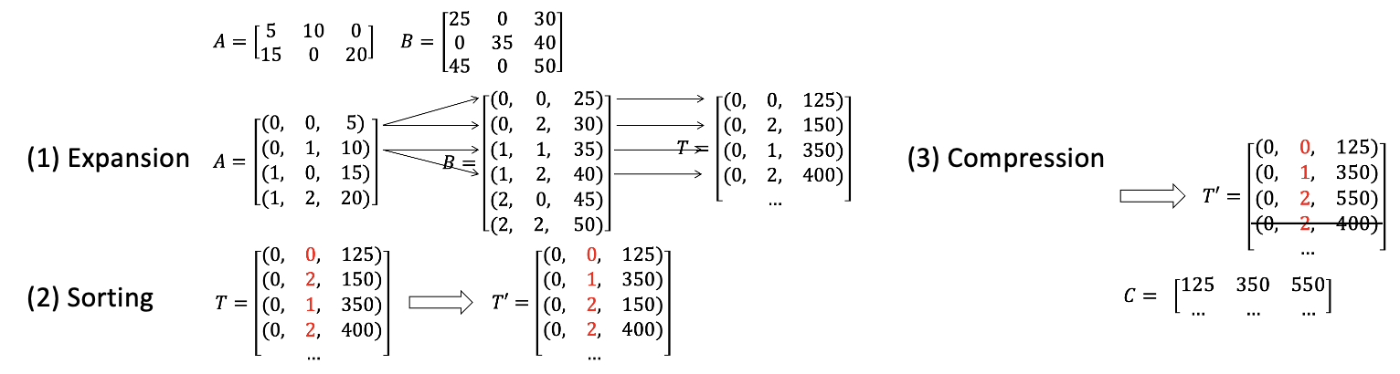
Sparse General Matrix Multiplication
ESC Algorithm
Expansion, Sorting, Compression
Matrix Representation: Coordinate Format (COO)
CUSP: A C++ Templated Sparse Matrix Library
Thrust
cuSPARSE

Slide 4

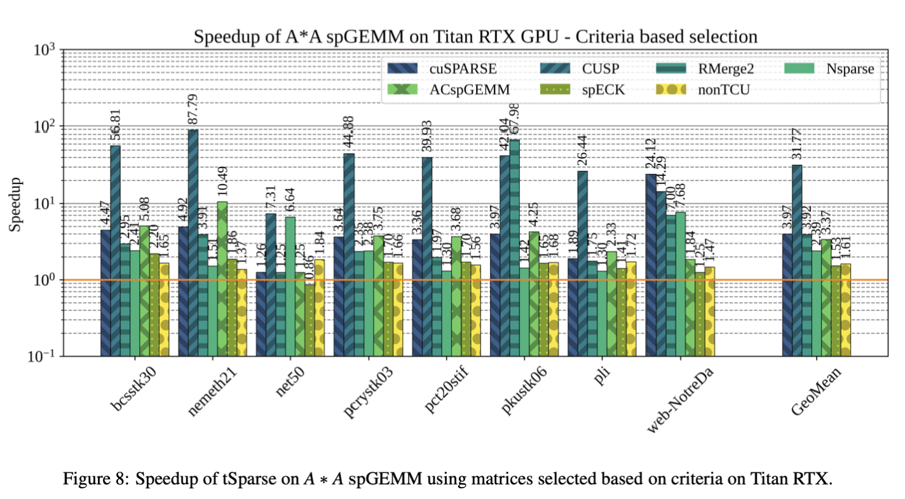
SpGEMM with GPU Tensor Core
Accelerating Sparse Matrix-Matrix Multiplication with GPU Tensor Cores
https://github.com/oresths/tSparse
Computers & Electrical Engineering Volume 88, December 2020, 106848
Authors
Result

Slide 5
Graph Challenge – Streaming Graph Partitioning
Website: http://graphchallenge.mit.edu
Paper: https://arxiv.org/abs/1708.07883
Slides: http://graphchallenge.mit.edu/sites/default/files/documents/GraphPartitionChallenge-2017-03-27.pdf
Champions:
Towards Faster Graph Partitioning via Pre-training and Inductive Inference - Meng Qin (HKUST), Chaorui Zhang (Huawei), Yu Gao (Independent), Yibing Ding, Weipeng Jiang (Huawei), Weixi Zhang (Huawei Technologies), Wei Han (Huawei), Bo Bai (Huawei Technologies)
An Integrated Approach to Accelerating Stochastic Block Partitioning - Frank D Wanye (Virginia Tech), Vitaliy Gleyzer, Edward Kao (MIT Lincoln Laboratory), Wu-chun Feng (Virginia Tech)
uSAP: An Ultra-Fast Stochastic Graph Partitioner - Chih-Chun Chang, Tsung-Wei Huang (Univ. of Wisconsin)

Slide 6
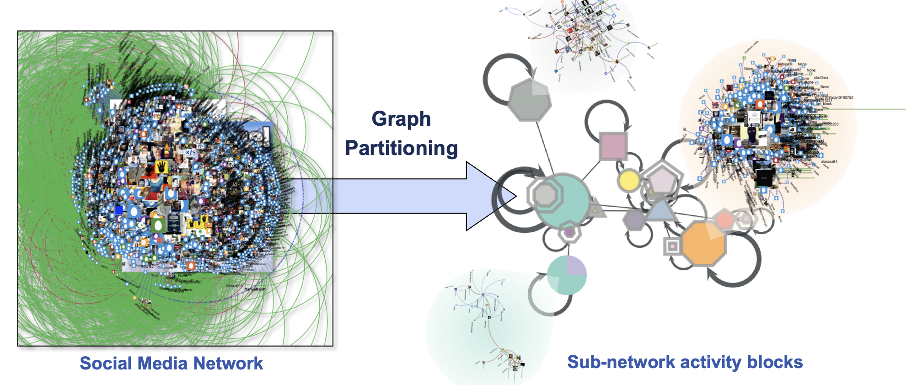
Graph Partitioning
Problem: divide the vertices of a graph into densely-connected blocks.
Application: Identify significant activities within large graphs
Reference: Slide 14 from Graph Challenge

Slide 7
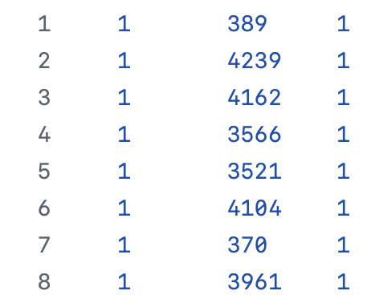
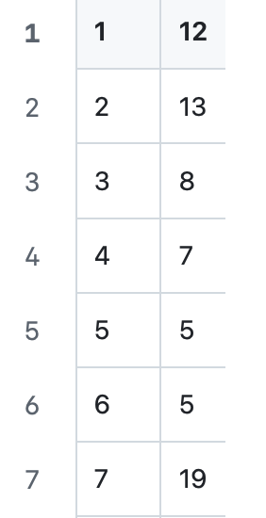
Stochastic Blockmodel Partitioning Algorithm
Input: a graph
Output: a partitioned graph (block ID of each vertex)
Source vertex ID
Sink
Weight of the edge
Vertex ID
Block ID
Dataset: http://graphchallenge.mit.edu/data-sets#PartitionDatasets
https://github.com/chih-chun-chang/GSAP/tree/main/Dataset

Slide 8
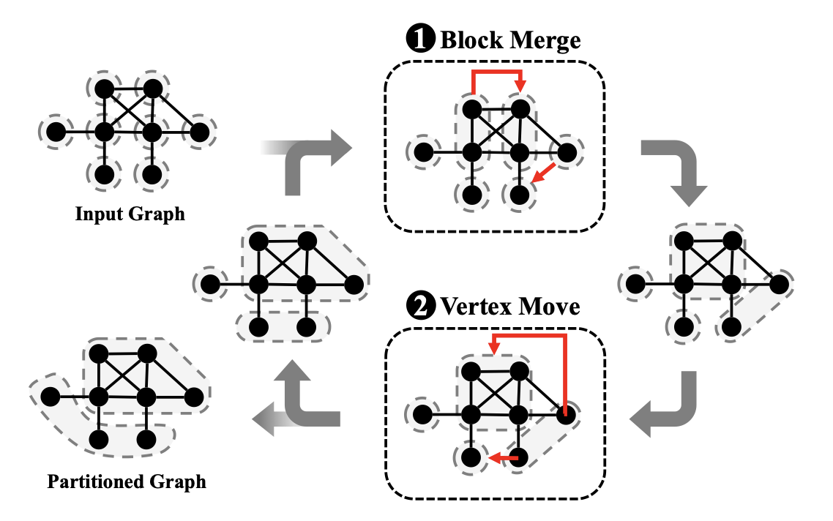

Stochastic Blockmodel Partitioning Algorithm
Construct a block edge count matrix: represented by M of size B*B, where each element M_{ij} represents the number or the total weight of edges going from block i to block j
Keep moving the vertices between blocks to minimize the cost function, minimum description length $\sum_{i, j}{M_{ij}\log{\frac{M_{ij}}{d_{i}^{out}⋅d_{j}^{in}}}}$

Slide 9
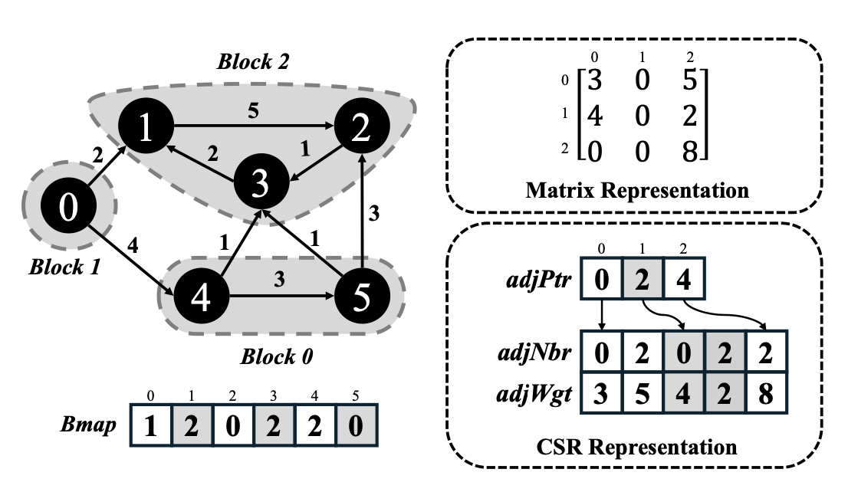
GSAP: A GPU-Accelerated Stochastic Graph Partitioner
Matrix Representation
Compressed Sparse Row (CSR) format
https://tsung-wei-huang.github.io/papers/2024-ICPP-GSAP.pdf

Slide 10
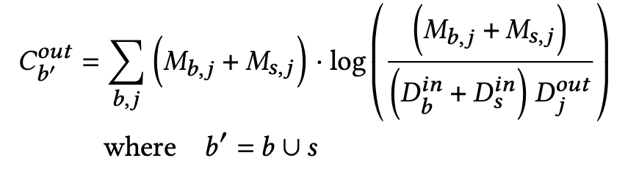
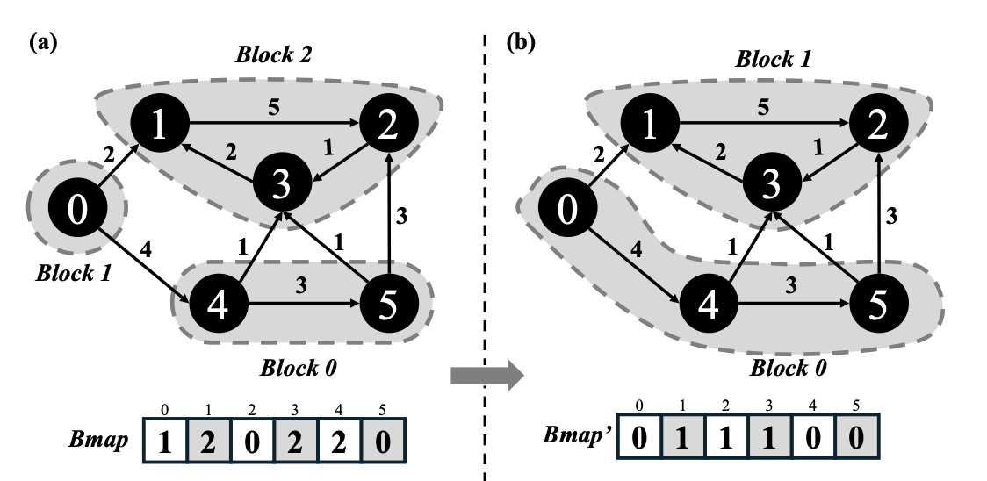
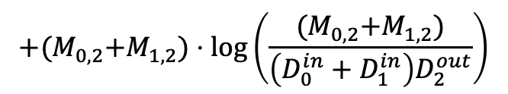
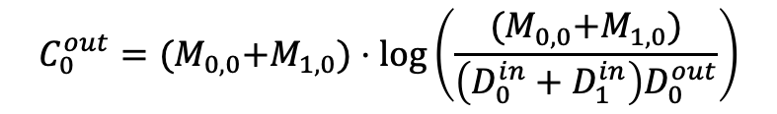
Computation of the Cost Function
To determine the movement is good or bad
$$C_{0}^{out}={(M}_{0,0}+M_{1,0})⋅\log\left(\frac{{(M}_{0,0}+M_{1,0})}{\left(D_{0}^{in}+D_{1}^{in}\right)D_{0}^{out}}\right)$$
$$+{(M}_{0,2}+M_{1,2})⋅\log\left(\frac{{(M}_{0,2}+M_{1,2})}{\left(D_{0}^{in}+D_{1}^{in}\right)D_{2}^{out}}\right)$$
out
0 | 0 | 1
0 | 2 | 0 | 2
3 | 5 | 4 | 2
0 | 0
0 | 2
3+4 | 5+2

Slide 11
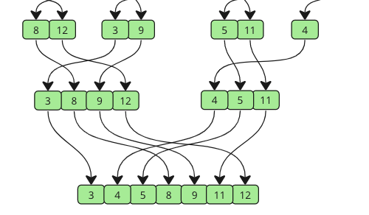
MergeSort
Merging Operation

Slide 12
Parallel Segmented Merge
Example
Input: two segmented arrays with key and value pairs
Output: one segmented array with sorted key (unique) and value pairs
A1 | 0 | A2 |  |  |  | A3
0 | 2 | 0 | 2 | 5 | 7 | 1 | 2 | 3
1 | 1 | 1 | 1 | 1 | 1 | 1 | 1 | 1
Key
Value
B1 | 0 |  | B2 |  | B3 | A3
0 | 1 | 2 | 1 | 2 | 0 | 1 | 2 | 3
1 | 1 | 1 | 1 | 1 | 1 | 1 | 1 | 1
Key
Value
A1∪B1 | 0 |  | A2∪B2 |  |  |  |  | A3∪B3
0 | 1 | 2 | 0 | 1 | 2 | 5 | 7 | 1 | 2 | 3
2 | 1 | 2 | 1 | 1 | 2 | 1 | 1 | 2 | 2 | 2

Slide 13
Related
GPU Merge Path: https://www.cs.ucdavis.edu/~amenta/f15/GPUmp.pdf
Segmented Merge: https://dl.acm.org/doi/10.1007/978-3-030-79478-1_15
Tutorial:
https://youtu.be/GvtgV2NkdVg?si=GxzkE8hZ0Ze-dQDP
https://youtu.be/8i0w_2fryOs?si=5pHif4UN-BUzAvCc

Slide 14
Reference
https://github.com/chih-chun-chang/GSAP/tree/main
https://moderngpu.github.io/intro.html
https://dl.acm.org/doi/10.1145/3079079.3079105

