Slide 1
Hacker #1
Reproduction of GNS on 2D fluid from scratch
Yi-Ruei Liu

Slide 2
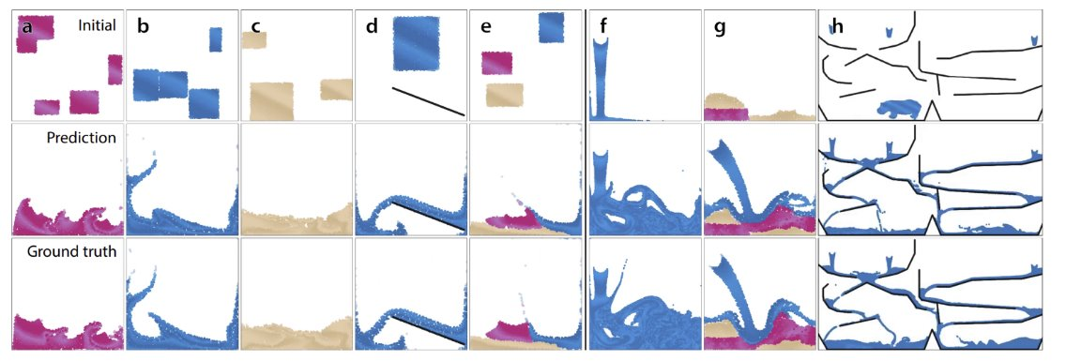
Task
Implement GNS from scratch
Learn the 2D fluid physics

Slide 3

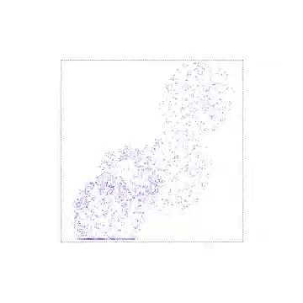
Simulation
Simulator: Taichi-MPM
Record position of all particles at all frames.
Params
# of particles: 1900
# of frames per rollout: 750
# of training rollouts: 1000

Slide 4
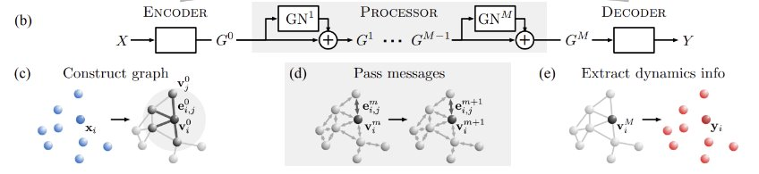
Model Setting & Training
Use "relative" variant: feed distance between two particles as edge feat instead of their absolute positions as node feature.
Train for 2M steps using Adam.

Slide 5
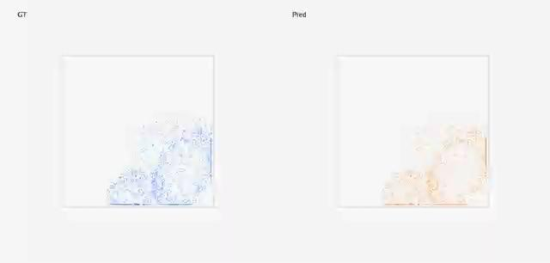
Simulate fluid dynamics on novel init condition

Slide 6
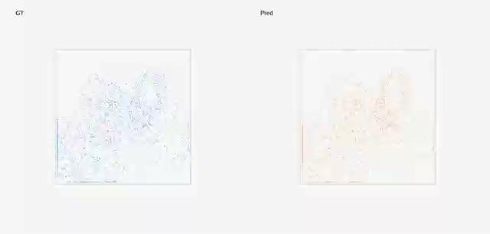
Simulate fluid dynamics on novel init condition

Slide 7

Failure case

Slide 8
Lesson Learned
Learning physics is time and memory consuming
10Mb per rollout for this simple test setting.
Training time ~ 1 day to get good performance.
A small error can cause the physical system become unstable.
Possible solution:

