Slide 1
2D DRAWER Implementation
Hacker: Casey Rodgers

Slide 2
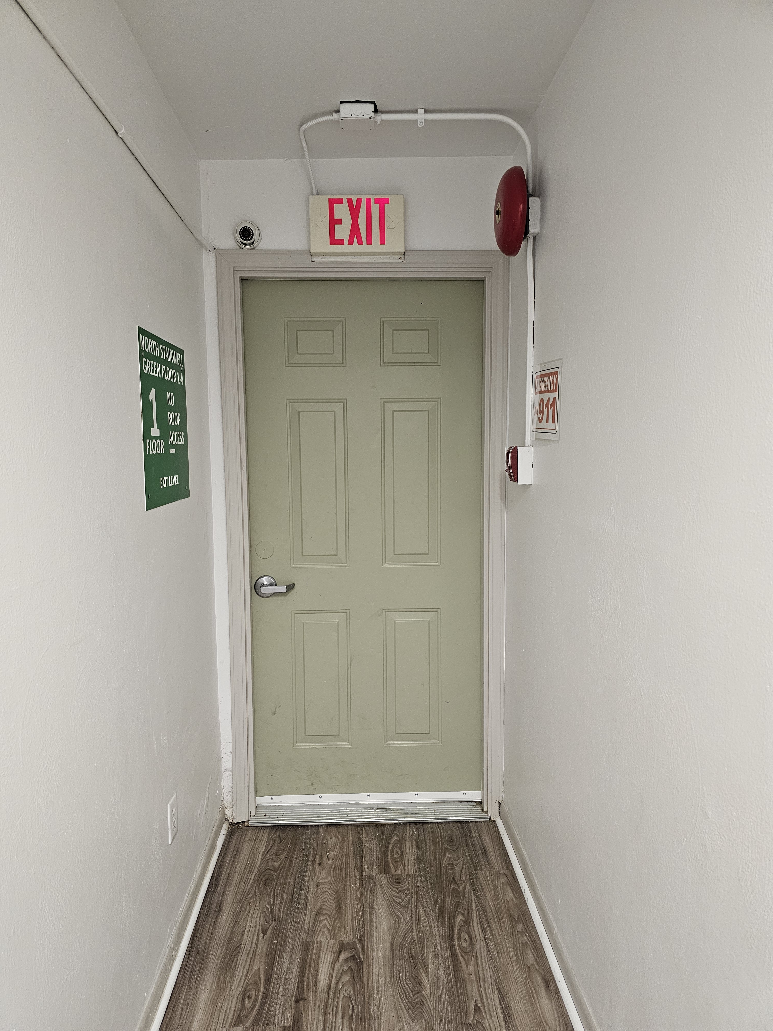
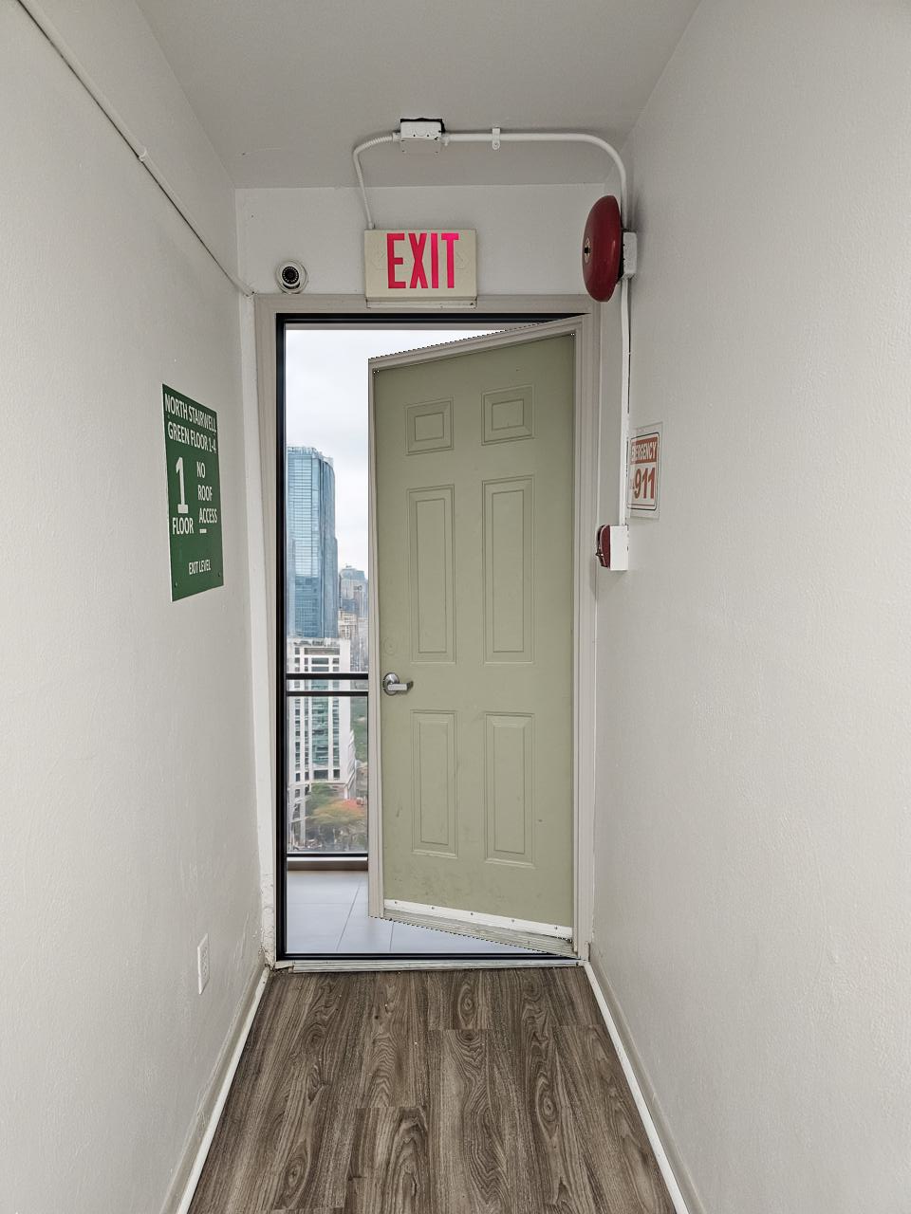
Photo to Openable Objects?
???

Slide 3
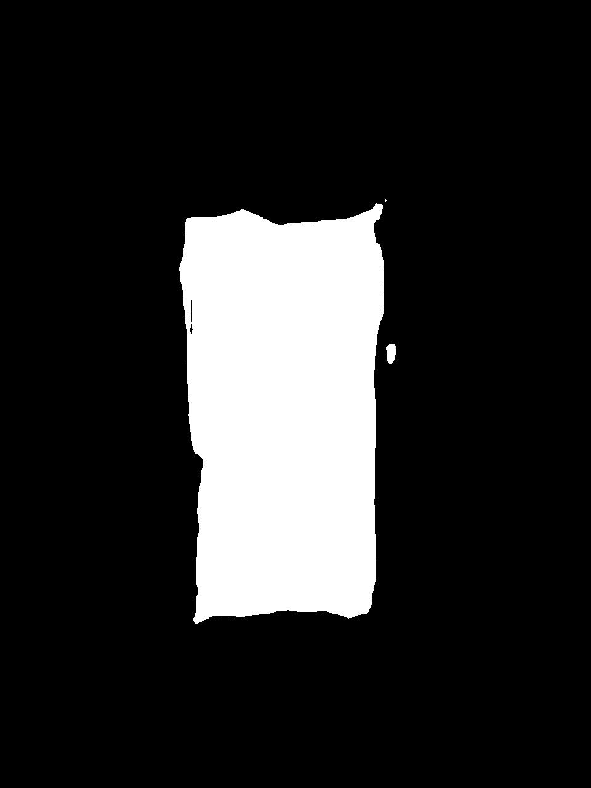
1.) Detect the Openable Objects
Nvidia Segformer

Slide 4
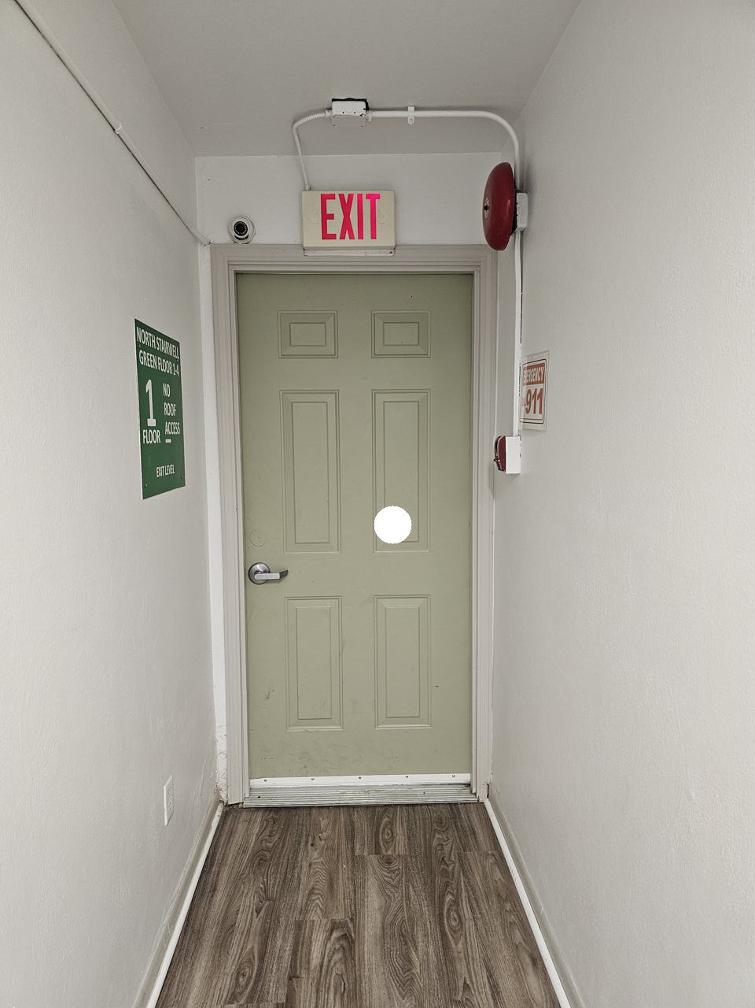
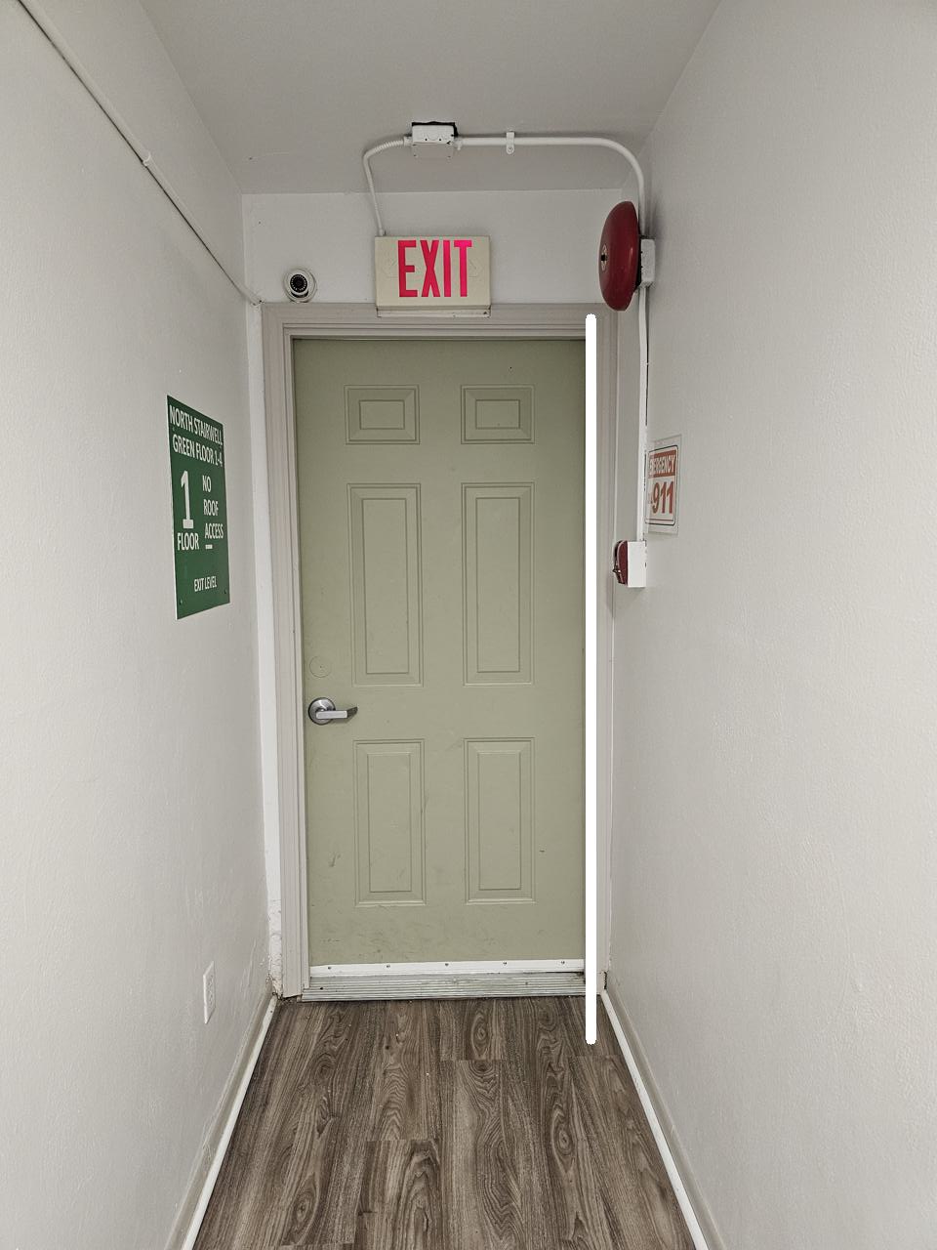
2.) Determine Object Affordances
Movable: one_hand
Rigid: yes
Kinematics: rotation
Action: pull
d
3DOI

Slide 5
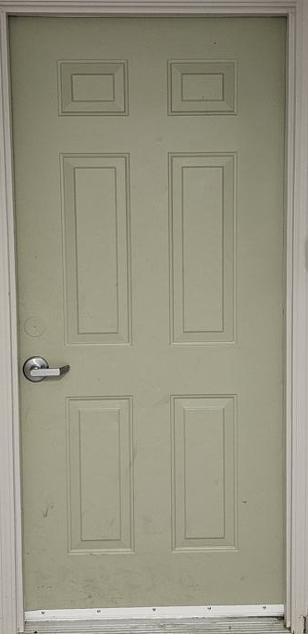
3.) Extract object cleanly
d
OpenCV

Slide 6
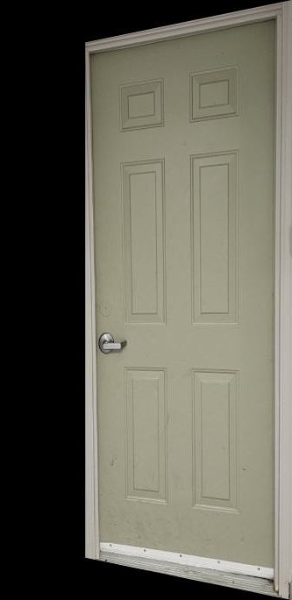
4.) Warp ROI
OpenCV + Homography

Slide 7
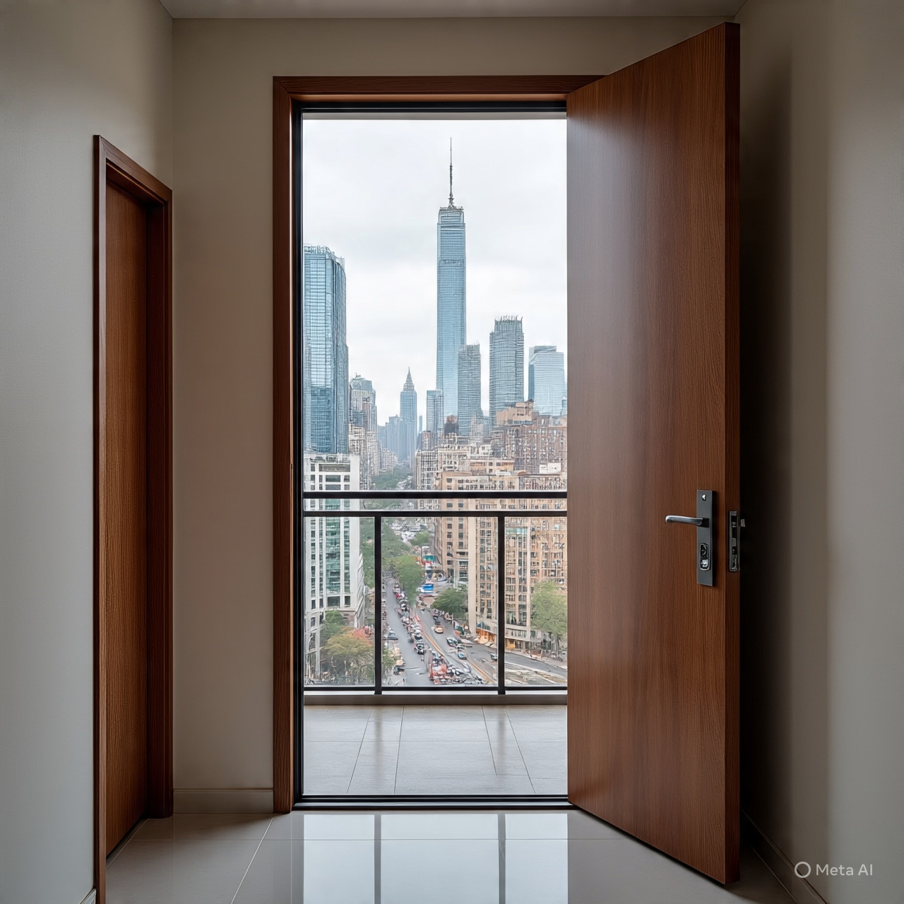
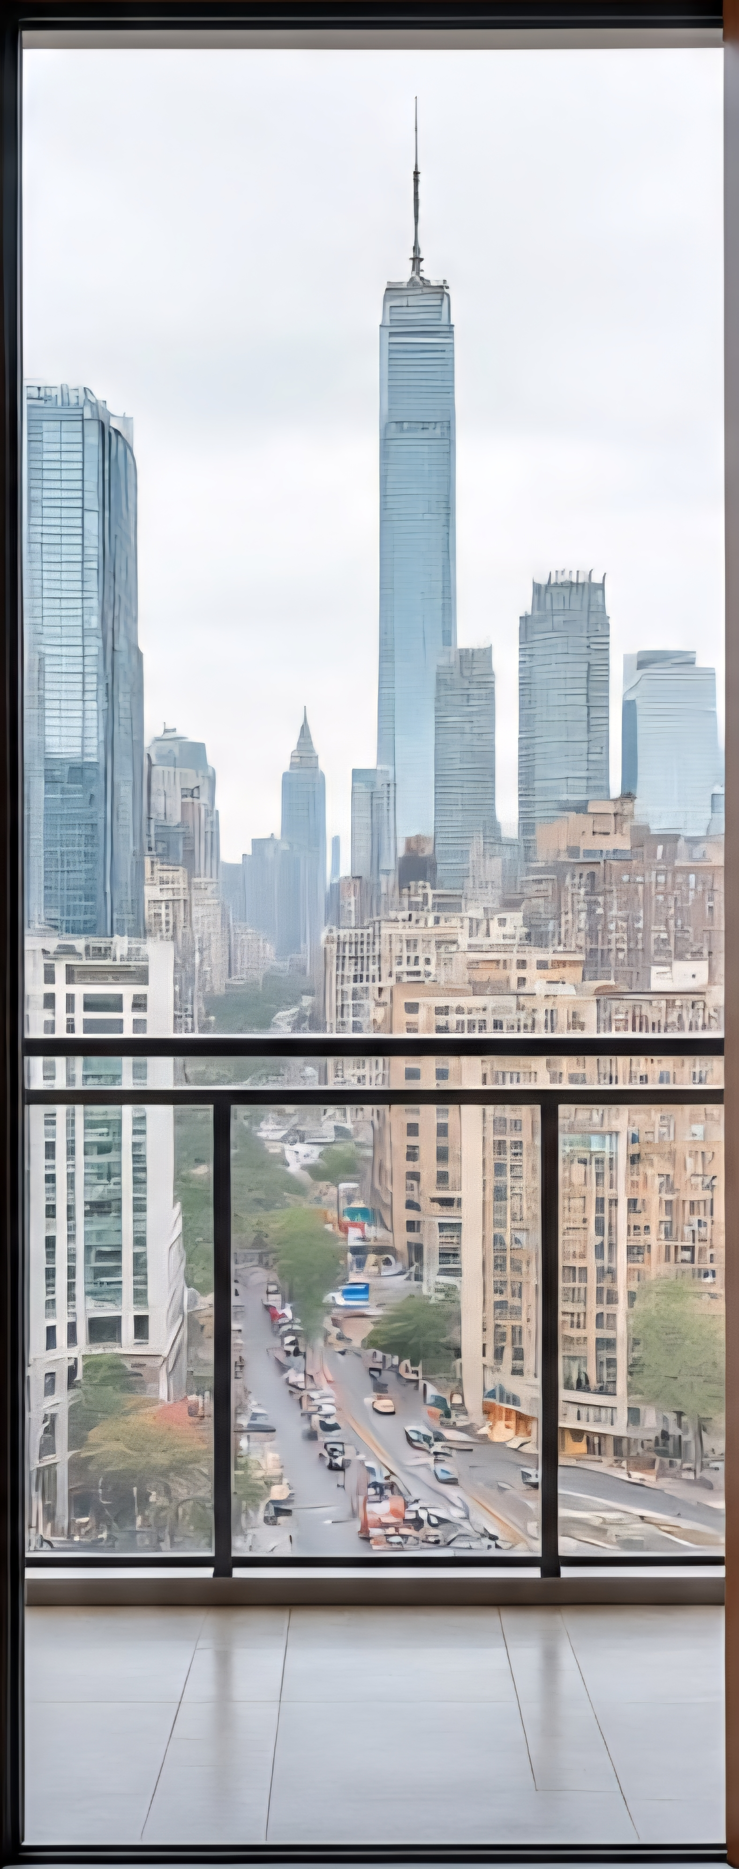
5.) Create background based on object
"Can you generate an image of the most likely image that would be behind an apartment door looking outside the apartment?"
Llama4

Slide 8
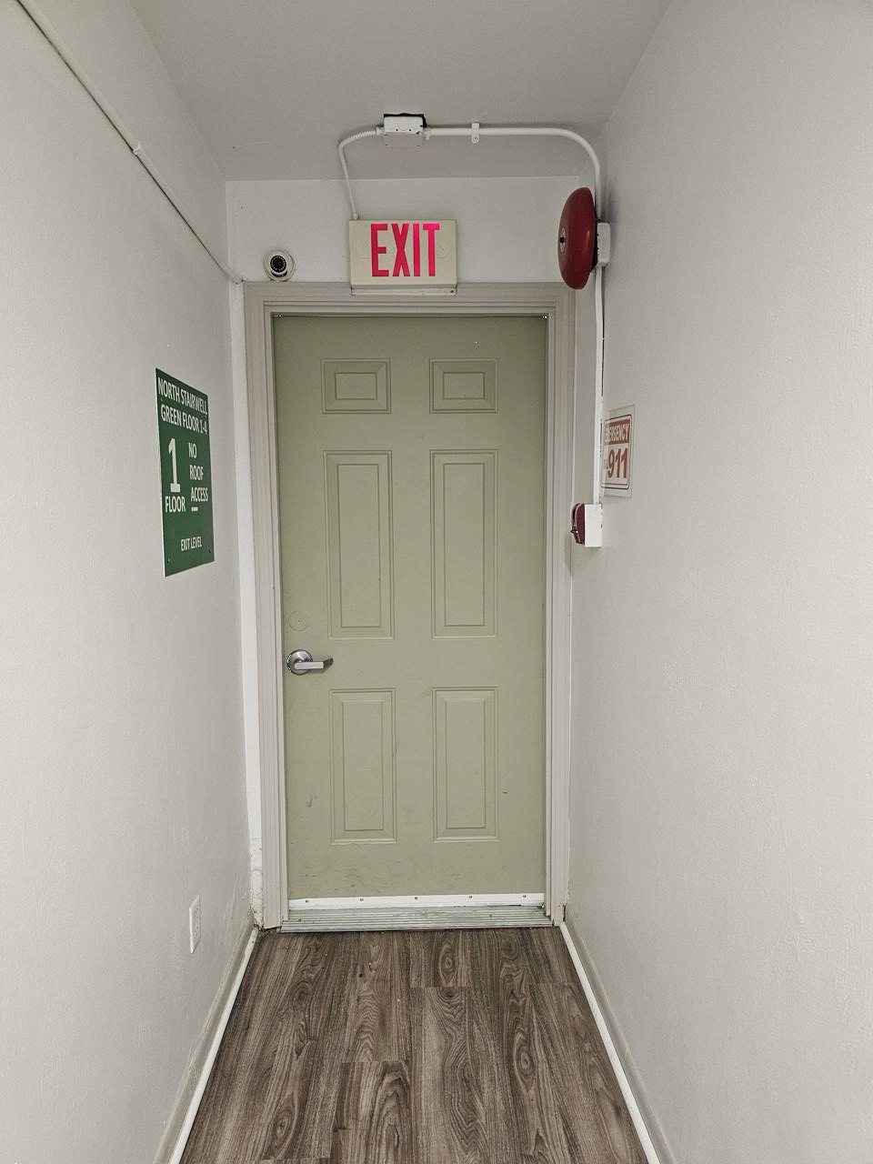
6.) Combine Together with OpenCV

Slide 9
Exploration
Originally tried Colab -> Weird file structure errors -> Local Jupyter Notebook
Spent a lot of time trying to:
Get the model packages to agree
Get the inputs in the right format
Fix minor errors in between each model
Playing with different inputs and settings
Originally tried to directly incorporate a stable diffusion model -> Super slow -> Used an external diffusion model

Slide 10
Lessons Learned / Reflection
Combining existing models into one workflow is difficult
Each one requires inputs in a certain format
Each one produces outputs in a certain format
Each one requires different package versions
Not straight forward to use only certain functions
Beware converting from Pillow images to Numpy to OpenCV
Each model has errors -> These errors propagate

