Slide 1
Hacker 0
Adheesh Juvekar

Slide 2
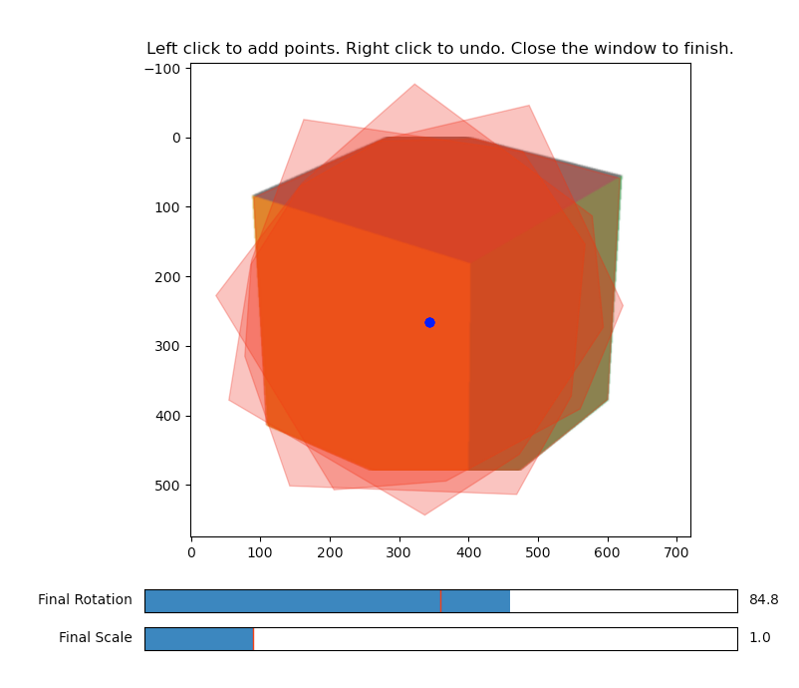
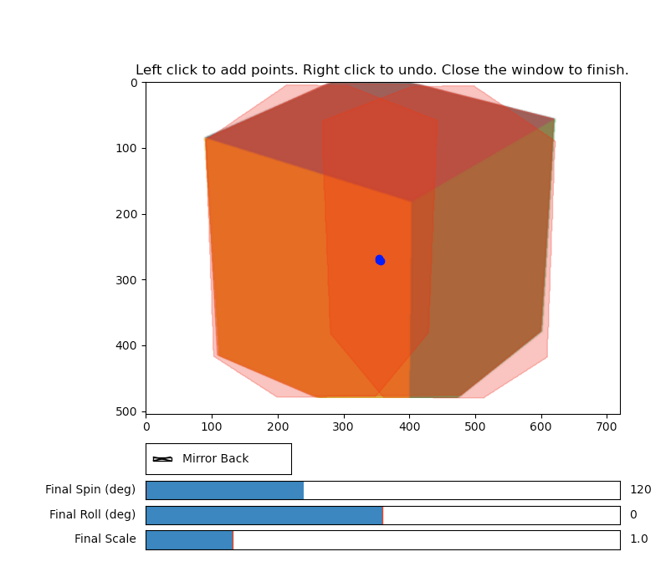
Add rotation around a new axis
Notes:
Patch extraction
Crop a tight rectangle around your polygon and make an RGBA patch whose alpha is the polygon mask
Compute pivot in patch co-ordinates
Get backface as 180 degree flip
Compute trapezoid destination by projecting the left and right edges of the rectangle using a pinhole model, keeping Y unchanged (vertical lines stay vertical).
Build a 3×3 homography from source rectangle to destination trapezoid, and warp with cv2.warpPerspective (cut_and_drag_gui.py:426).

Slide 3
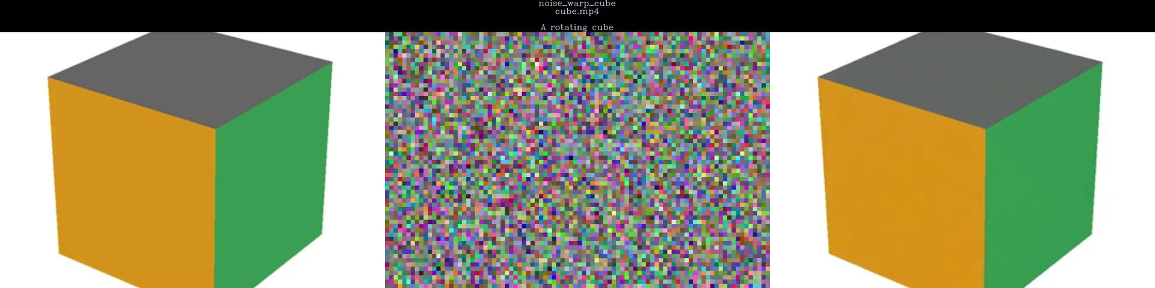
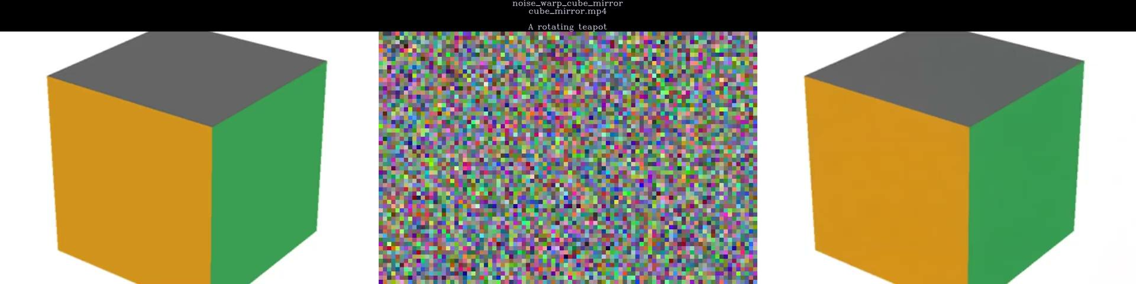
With and without same noise on the back
w/o noise
w/ noise

Slide 4


Teapot example

Slide 5
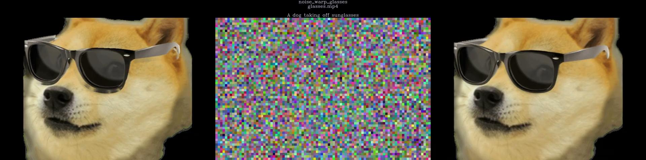
Removing objects/occlusion

