Slide 1
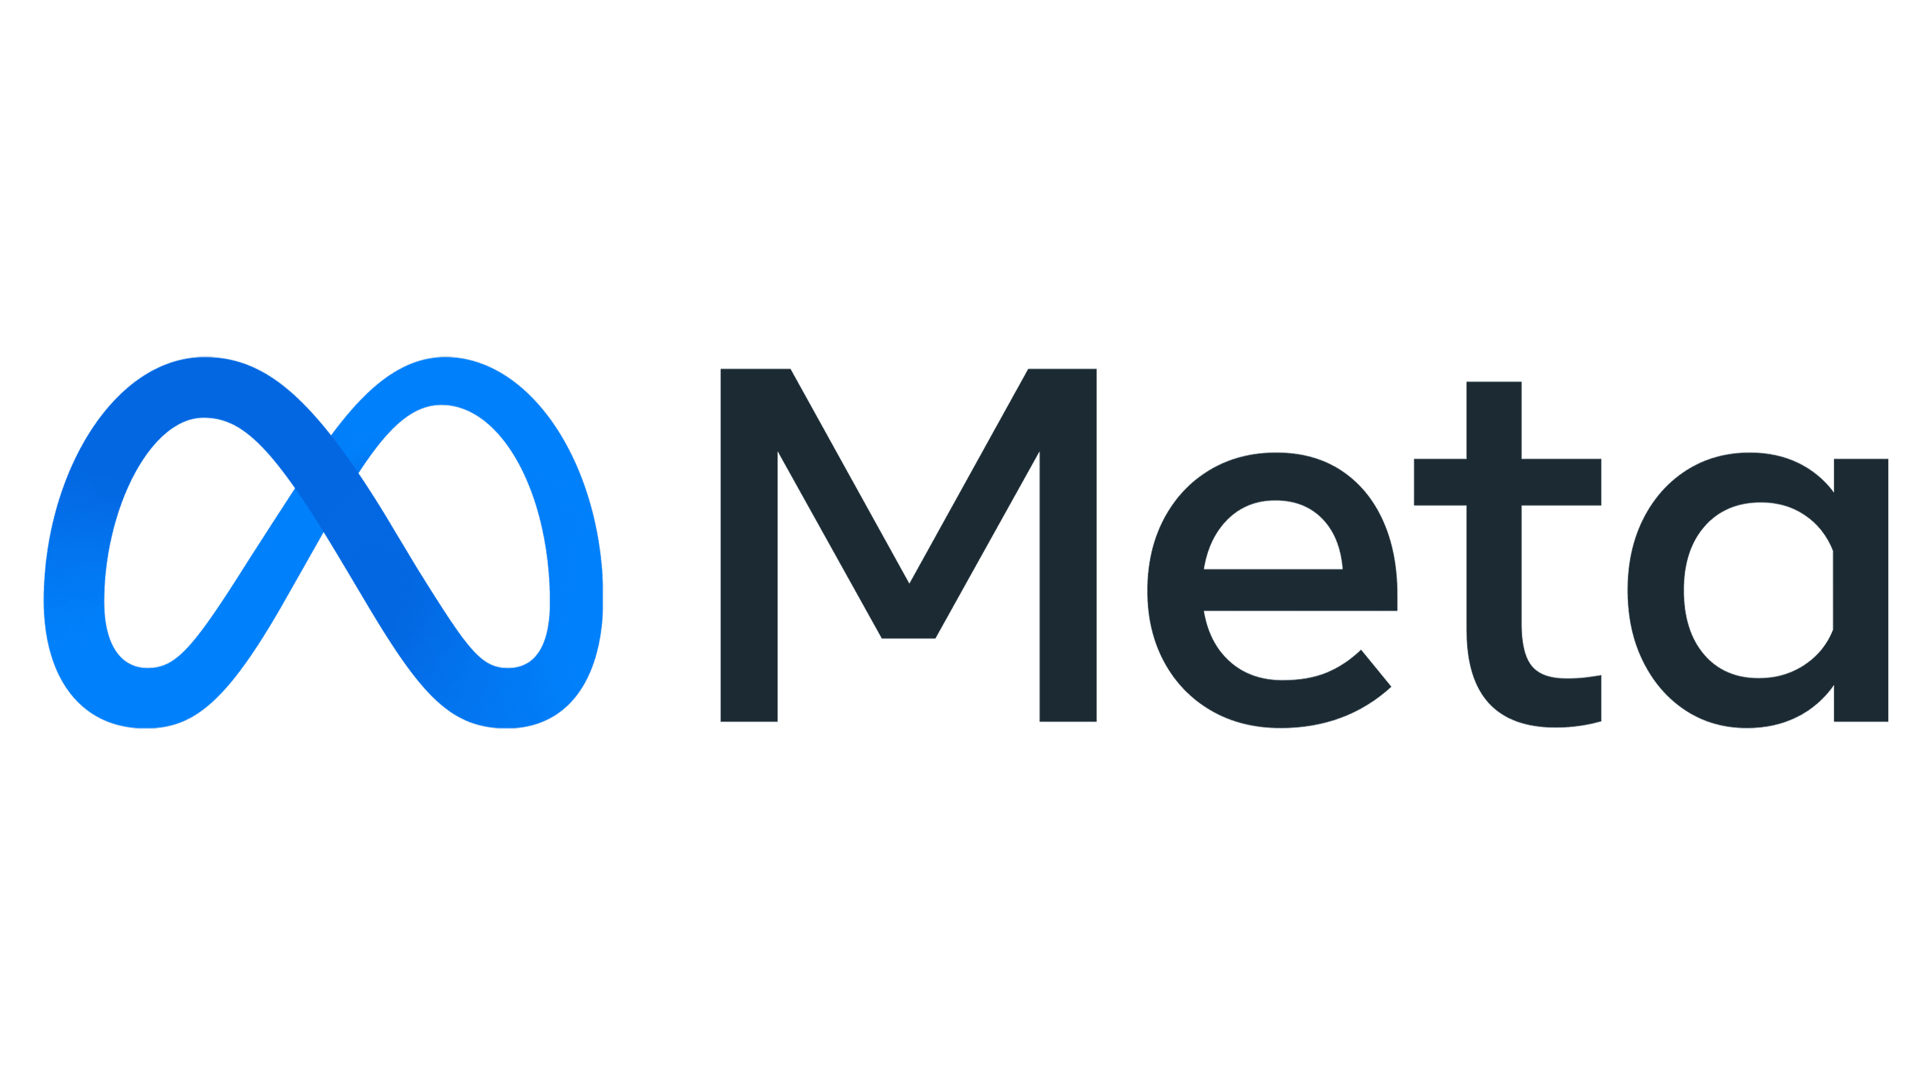
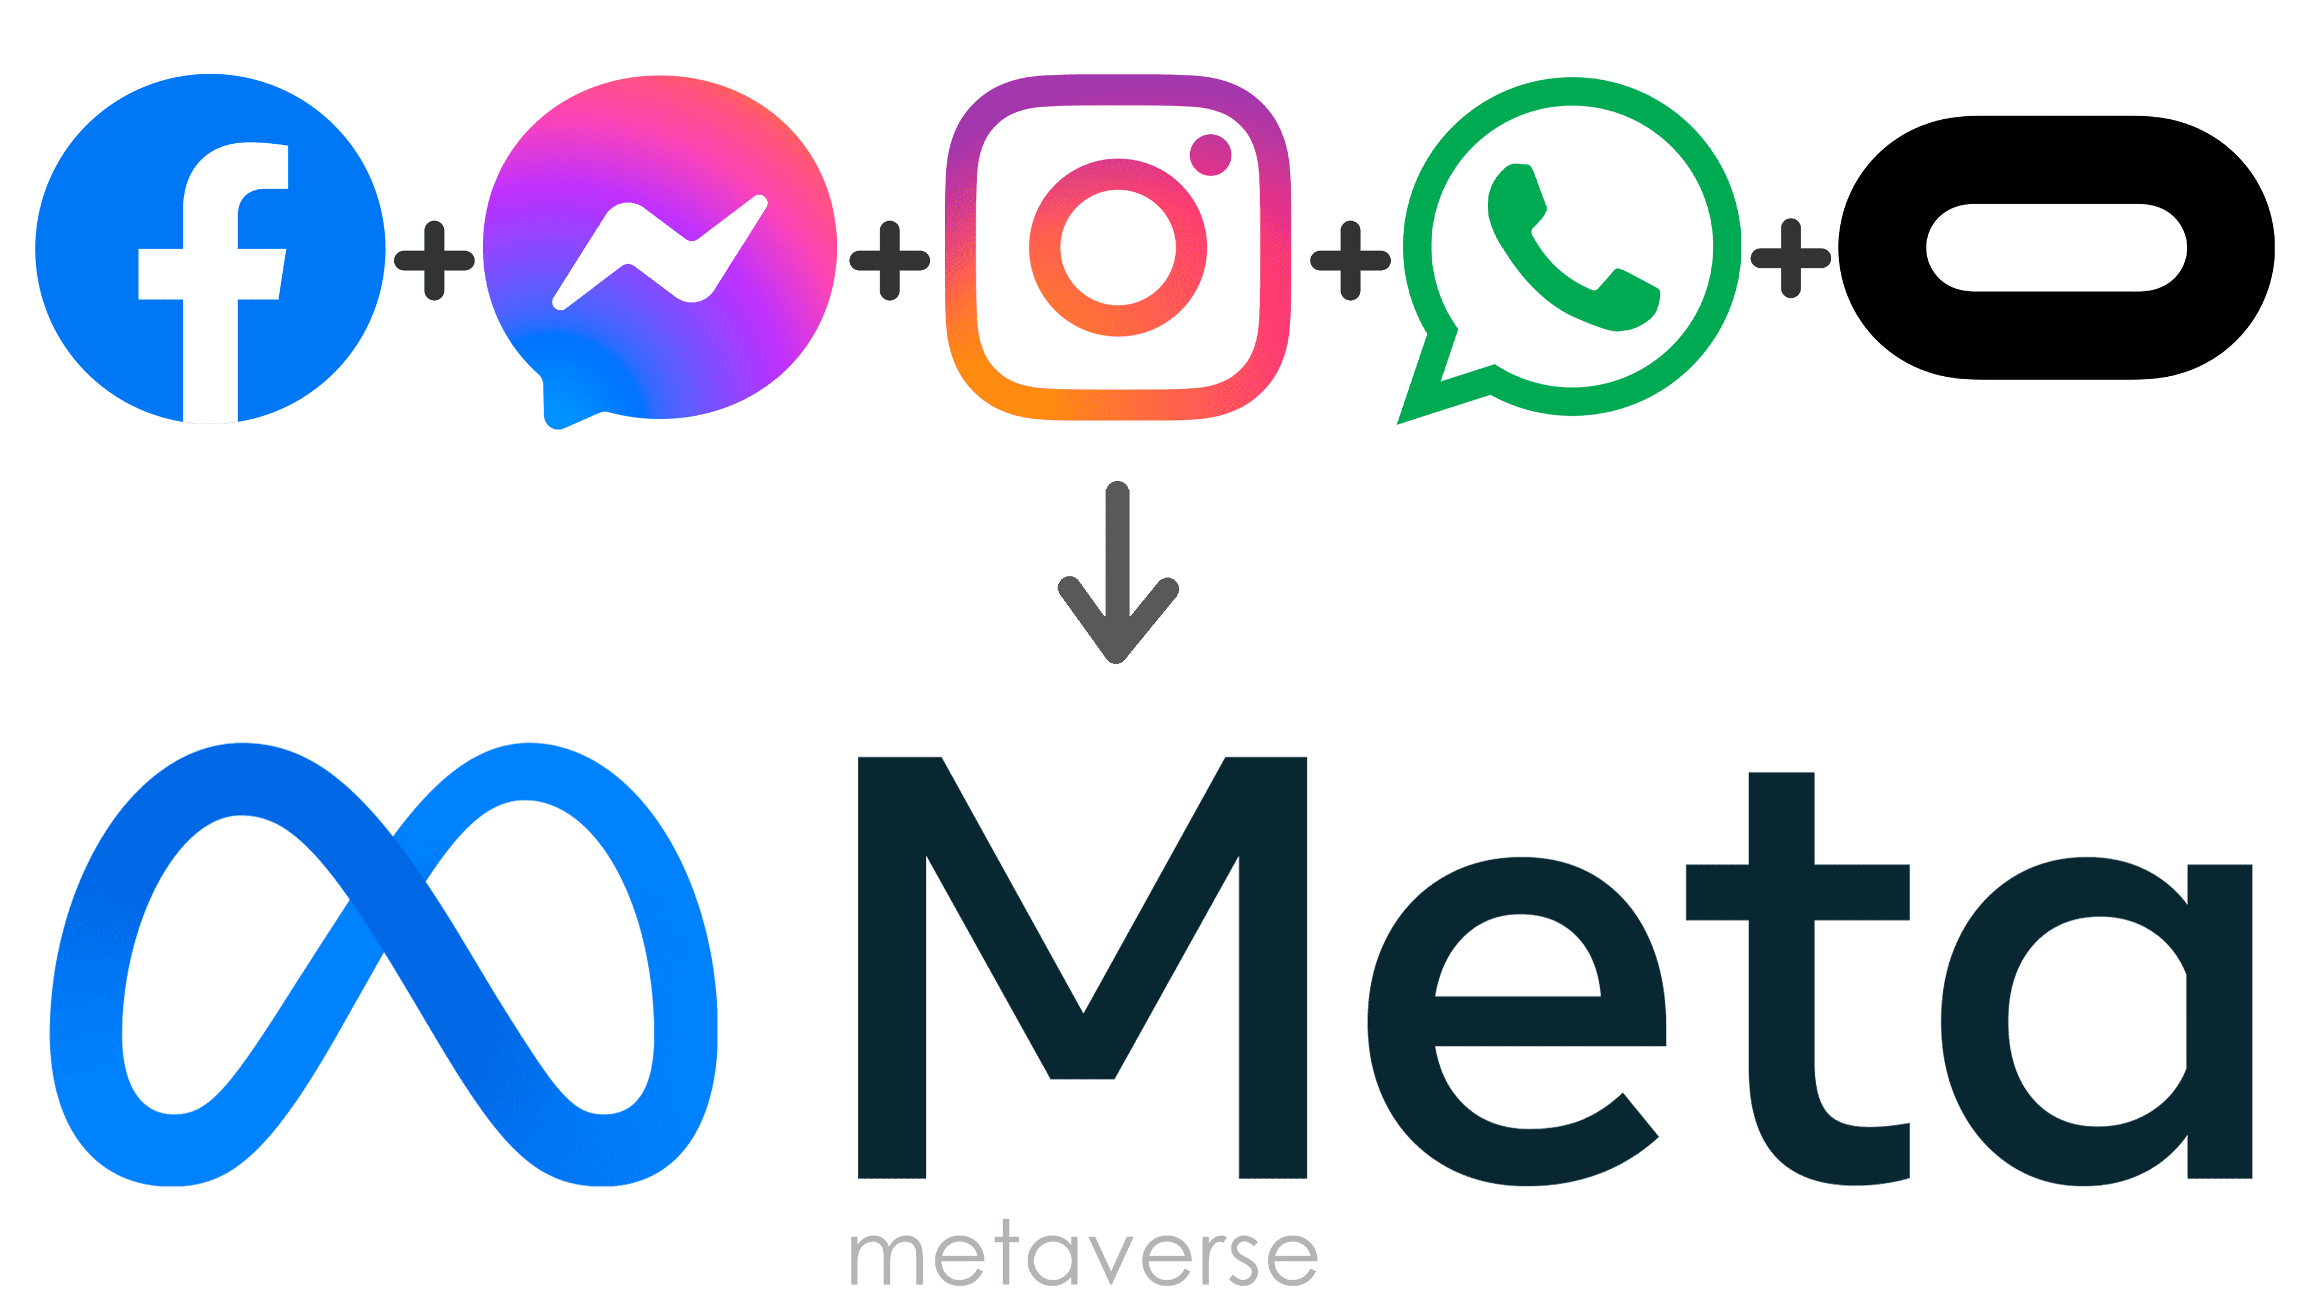
Merabet Chihabeddine
&
Foudili Nasreddine Elmehdi
IGE 45
Research about Meta

Slide 2
Definition:
“Connection is evolving and so are we”
Meta Platforms, Inc (formerly Facebook, Inc) is an American multinational technology company based in Menlo Park, California.
The company is the parent organization of Facebook, Instagram, and WhatsApp…
Meta is one of the world's most valuable companies.
The word Meta has Greek origins “metaphysics” which is a branch in philosophy study the existence of life and things. So Metaverse is the next evolution of social connection.
Meta has a vision to create a virtual reality too similar to our life.

Slide 3

Evolution and changes:
In January 2004, Zuckerberg created a new website, known as "TheFacebook".
On February 4, 2004, Zuckerberg launched it.
In 2005, the company changed its name to Facebook.
In March 2012, Facebook, Inc was founded as an app centre to store selling applications that operate via the website. The store was to be available on iPhones, Android devices.
In April 2012, Facebook Inc. acquired the service of Instagram.
In October 2021, Facebook, Inc. changed its company name to Meta Platforms, Inc., or simply "Meta".

Slide 4
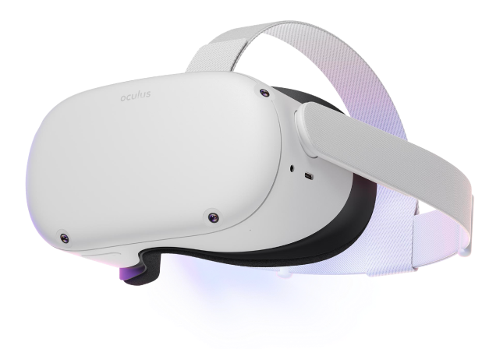
The use of Meta:
Meta Platforms, Inc. has many brands such as Facebook, Instagram, Messenger, WhatsApp, Oculus, Workplace, Portal, Novi and Diem.
Its main brands offer social media services.
Virtual reality, lets you explore new worlds in Oculus and Portal.
Offers a communication tool to connect everyone in a company via Workplace.
Brings the world together.
Send and receive money freely using Novi and Diem.

Slide 5
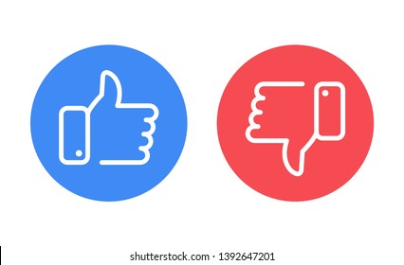
Advantages:
Communications around the world.
Find new friends who share similar interests.
Raise awareness on important issues.
Find an outlet for your creativity.
Help to learn new skills.
Experience new virtual world.
Disadvantages:
Waste time in virtual media than real world.
Depression & anxiety.
No self-reflection.
Cyberbullying and expose to low security hacks.
Lack of self-development.
Producing a generation accustomed to laziness.

Slide 6

Conclusion:
Meta Platforms, Inc. aims to connect the big world and turn it to small village and augment virtual reality by creating a virtual experience of life.
But their vision is fictional and too far from reality
Of our world.
Also, any reasonable person knows how social media affect negatively people life by wasting their time.
Virtual reality (VR) and Augmented reality (AR) will do the same.
People will seek these virtual temporary fake fillings instead of self-development and success in life.

