Slide 1


Machine Learning Case Study
Dataset : NSL-KDD

Slide 2
01
Dataset

Slide 3
Dataset
About
NSL-KDD is refined version of KDD-99
KDD-99 ?
Structure
What’s Wrong ?
It was generated for a datamining competition.
It aimed to develop network intrusion detector.
It is derived from the raw TCP dump data of a simulated military network
It contains records that are labeled as normal or several types of attacks:
DOS
R2L
U2R
Probing
Redundancy
Unbalanced Data
Unrealistic Data Distribution

Slide 4
Dataset
About
what’s new in NSL-KDD ?
Improvements
Features
Duplicate records are removed.
The size of the dataset is manageable.
Balanced Training and Test sets.
It contains 41 features categorized into 3 types:
Basic
Content
Traffic

Slide 5
Dataset
Why this dataset?
Reliable and realistic benchmark for evaluating IDS
Diverse Attack types
Ease of use
Education value

Slide 6
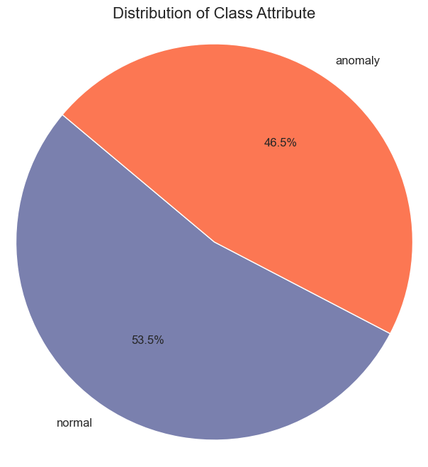
Dataset
Train Set:
125973 item
42 attribute
Attribute name: Class

Slide 7
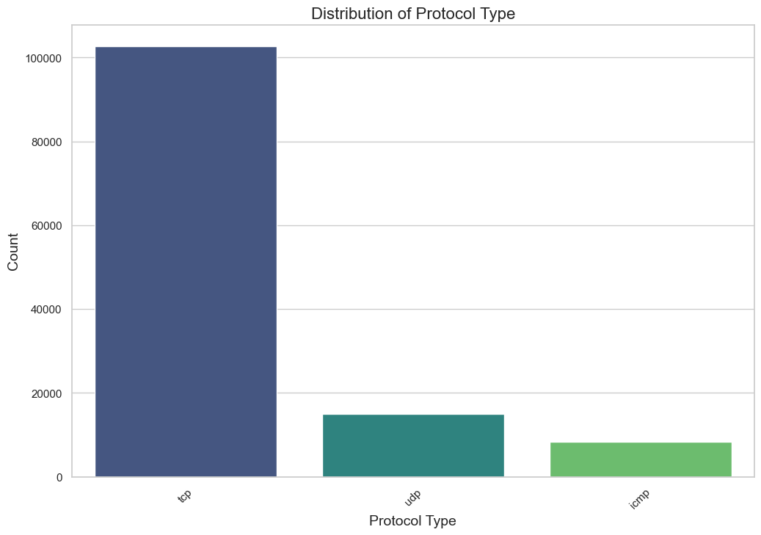
Dataset
Train Set:
125973 item
42 attribute
Attribute name: Protocol Type

Slide 8
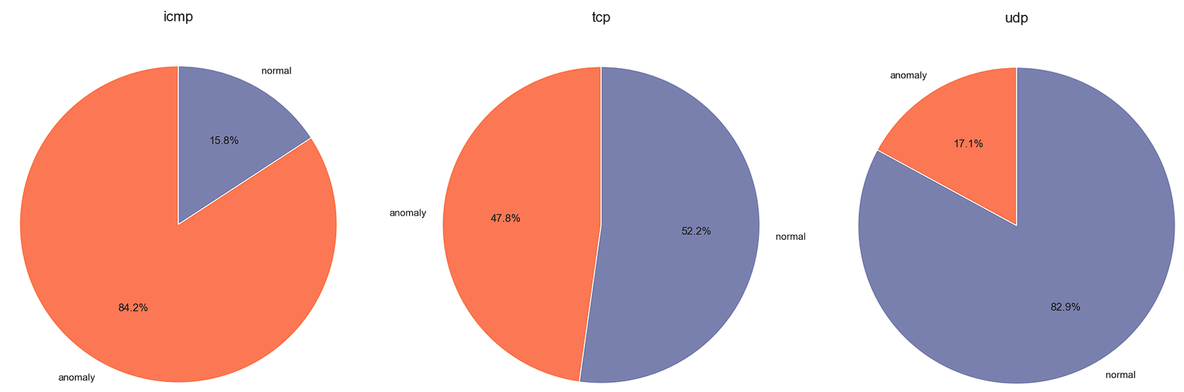
Dataset
Train Set:
125973 item
42 attribute
Attribute name: Class
According the Procotol type

Slide 9
Dataset
Train Set:
125973 item
42 attribute
Attribute name: Service
70 different service type, categorized as follow:
File Transfer Services: ‘ftp_data’, ‘efs’, ‘ftp’, ‘tftp_u’
Email Services: ‘smtp’, ‘imap4’
Web Services: ‘http’, ‘http_443’, ‘http_8001’, ‘http_2784’
Remote Access Services: ‘remote_job’, ‘telnet’, ‘rlogin’, ‘ssh’, ‘klogin’, ‘kshell’
Name Services: ‘name’, ‘netbios_ns’, ‘domain’, ‘domain_u’, ‘hostnames’
Network Services: ‘netbios_dgm’, ‘netbios_ssn’, ‘netstat’, ‘bgp’, ‘sunrpc’, ‘vmnet’, ‘mtp’
Chat Services: ‘IRC’
Other Services: ‘other’, ‘private’, ‘eco_i’, ‘uucp_path’, ‘Z39_50’, ‘csnet_ns’, ‘uucp’, ‘urp_i’, ‘auth’, ‘ldap’, ‘ecr_i’, ‘gopher’, ‘systat’, ‘whois’, ‘iso_tsap’, ‘echo’, ‘link’, ‘login’, etc…

Slide 10
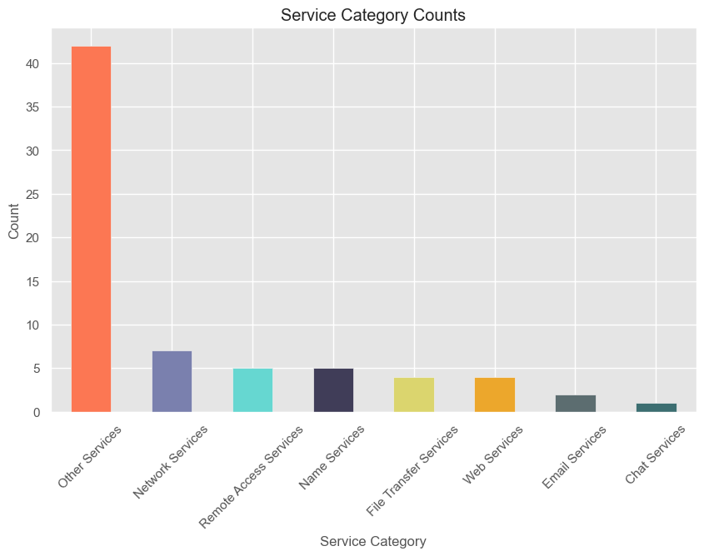
Dataset
Train Set:
125973 item
42 attribute
Attribute name: Service

Slide 11
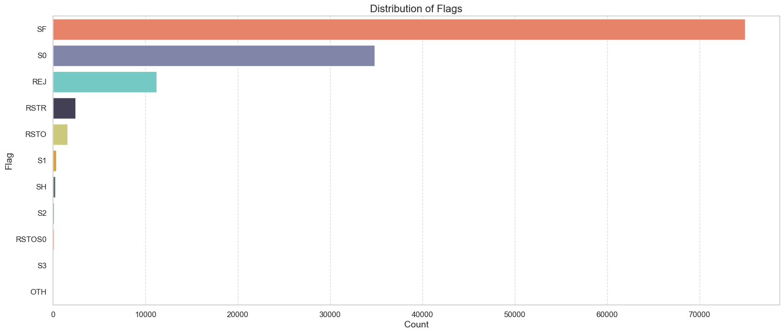
Dataset
Train Set:
125973 item
42 attribute
Attribute name: Flag

Slide 12
02
Experiment

Slide 13




Experiment
Used Tools
ML
Plots

Slide 14
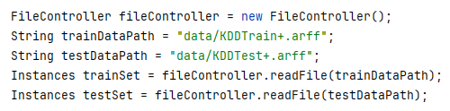
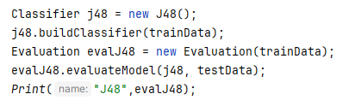

Experiment
Example how to use Weka with Java
Reading .arff files
Build and Evaluate a classifier
Link to code
Change QR

Slide 15
Experiment
Overview
The experiments involved comparing the performance of 6 classifiers:
Decision Tree (DT)
Naive Bayes (NB)
Support Vector Machine (SVM)
Random Forest (RF)
k-Nearest Neighbors (KNN)
Neural Network (NN)
Each classifier was tested under different experimental conditions with different methods of Feature selection and data preprocessing
List of performed Experiments

Slide 16
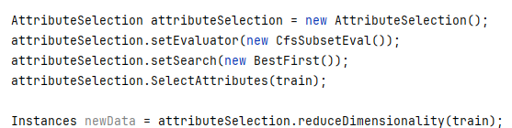
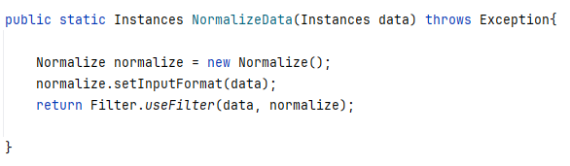
Experiment
Clean the data
Feature Selection
Pre Processing
CSF + BestFirst
InfoGain + Ranker
Normalization
Standardization

Slide 17
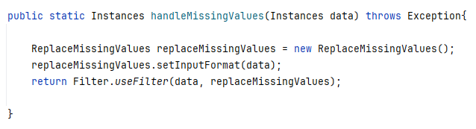
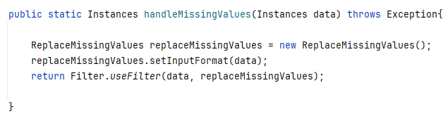
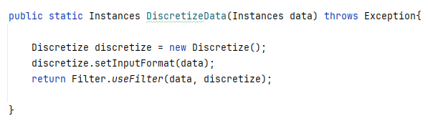
Experiment
Important Note
Pre-Processing
Handle Missing Values
Handle Categorical Data
Discretize Data

Slide 18
Experiment
After Feature Selection
CFS + BestFirst
InfoGain + Ranker
flag
src_bytes numeric
dst_bytes numeric
logged_in
srv_serror_rate
diff_srv_rate
class
This approach just rank attributes

Slide 19
Experiment
Clean the data
Experiments
1
Experiments
4, 5
Feature Selection(NO)
Pre-Processing (NO)
Feature Selection(YES)
Pre-Processing (NO)
Experiments
2, 3
Experiments
6, 7, 8, 9
Feature Selection(NO)
Pre-Processing (YES)
Feature Selection(YES)
Pre-Processing (YES)

Slide 20
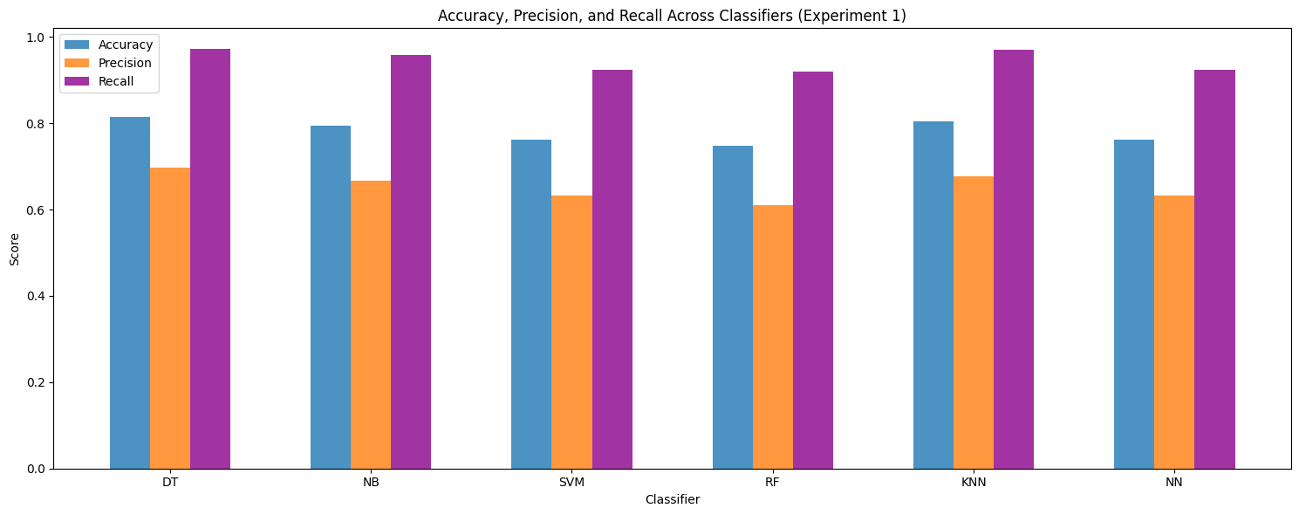
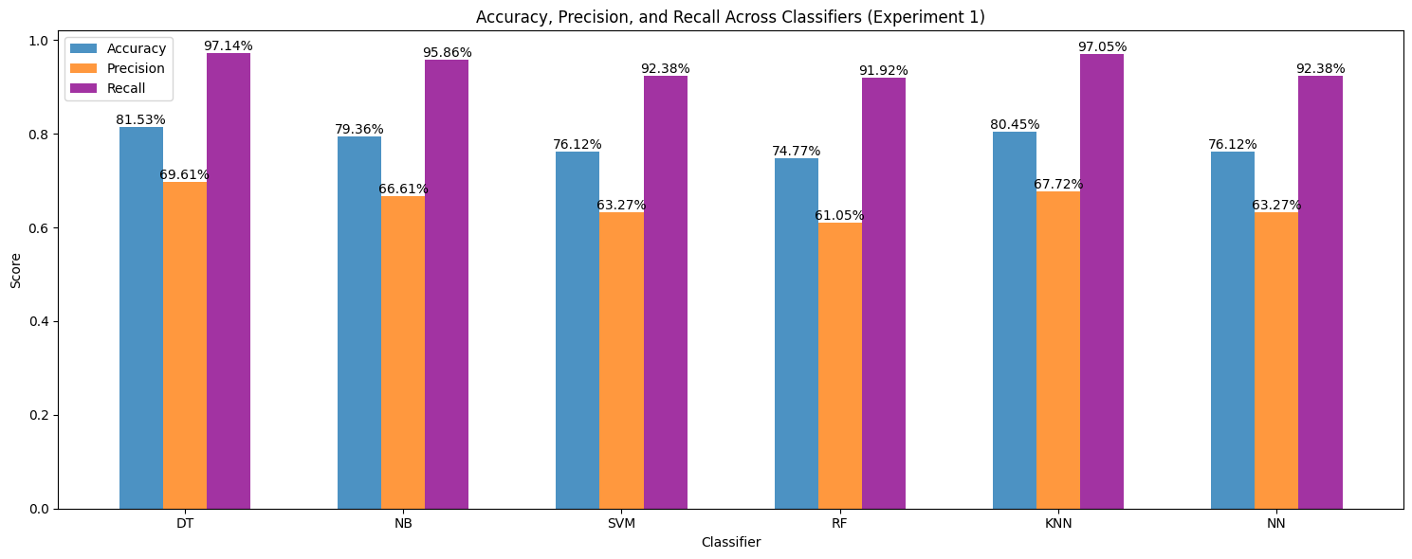
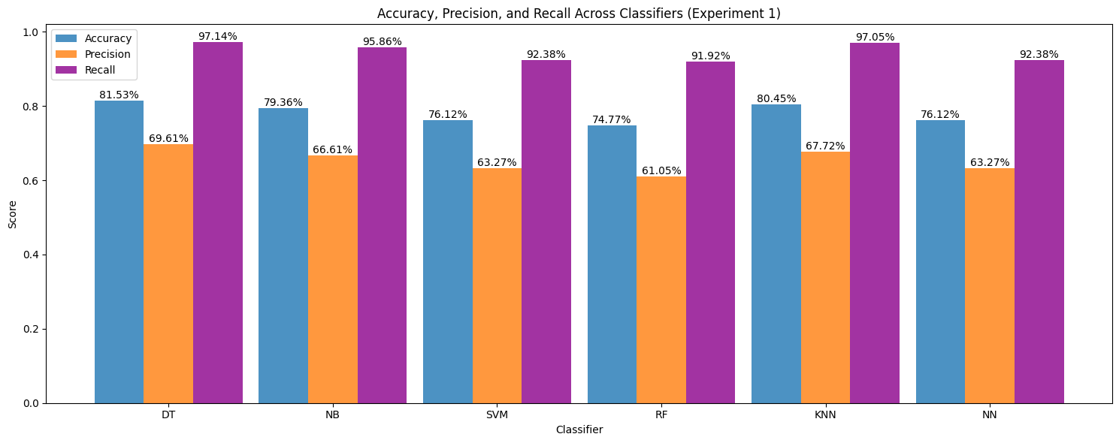
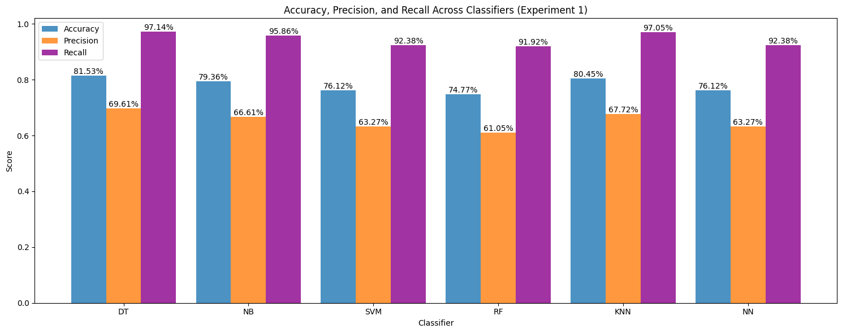
Experiment
Experiment 1
Raw Data

Slide 21
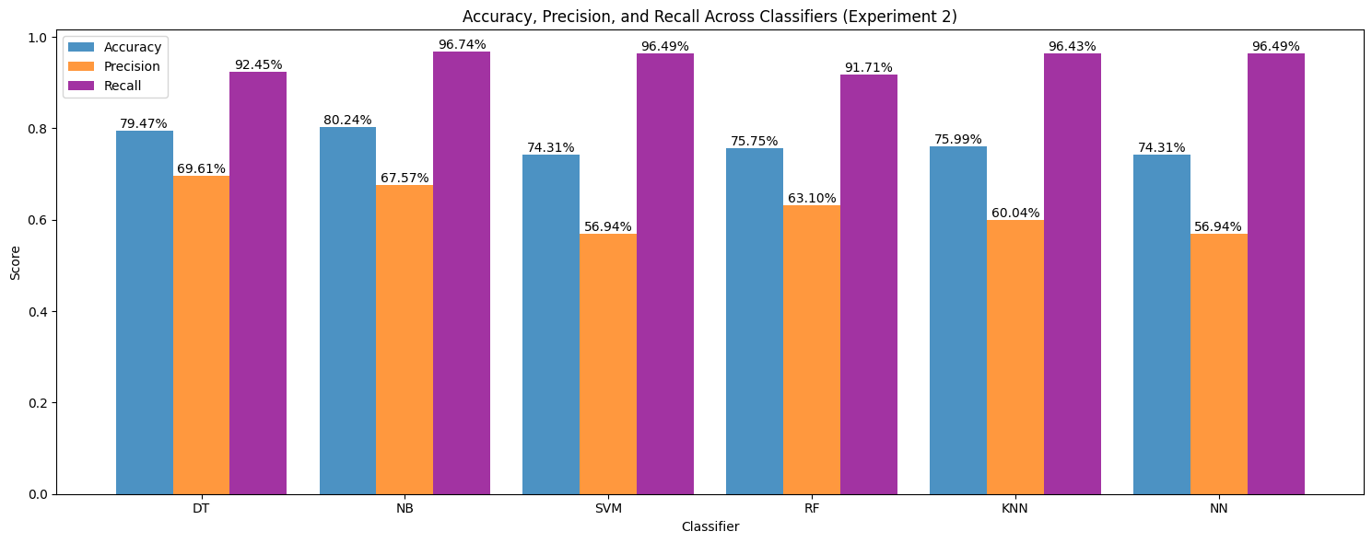
Experiment
Experiment 2
Normalized data with No Feature Selection

Slide 22
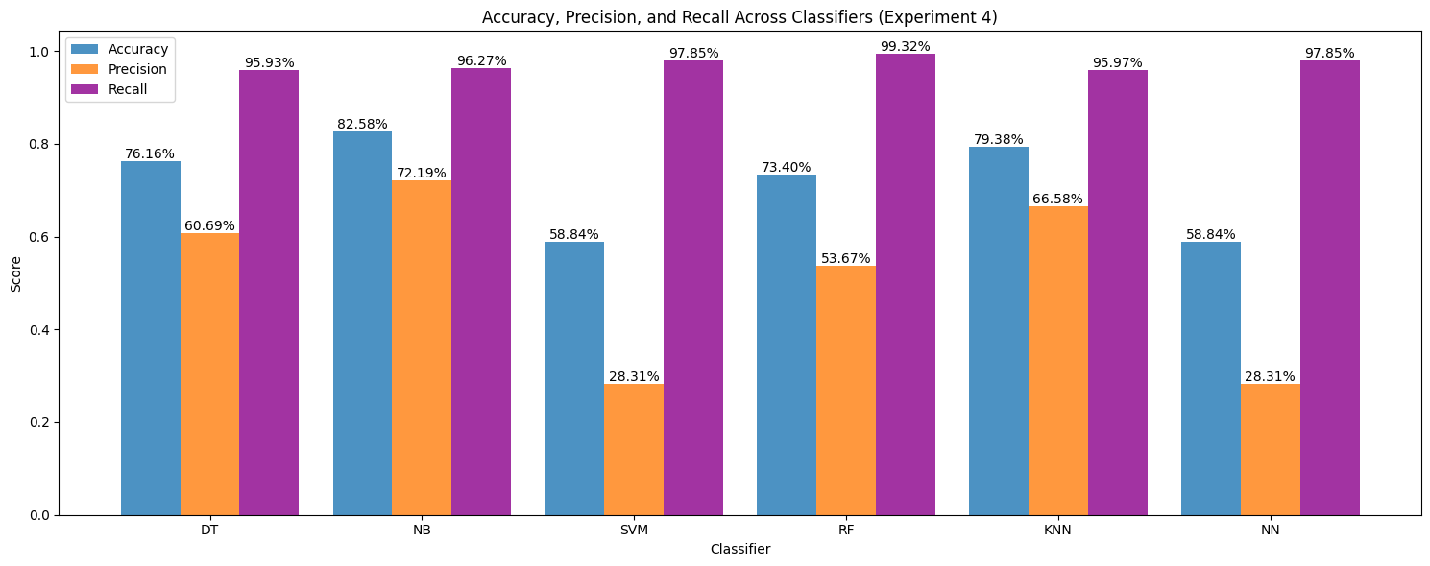
Experiment
Experiment 4
No Pre Processing with Feature Selection(BestFirst + CFS)

Slide 23
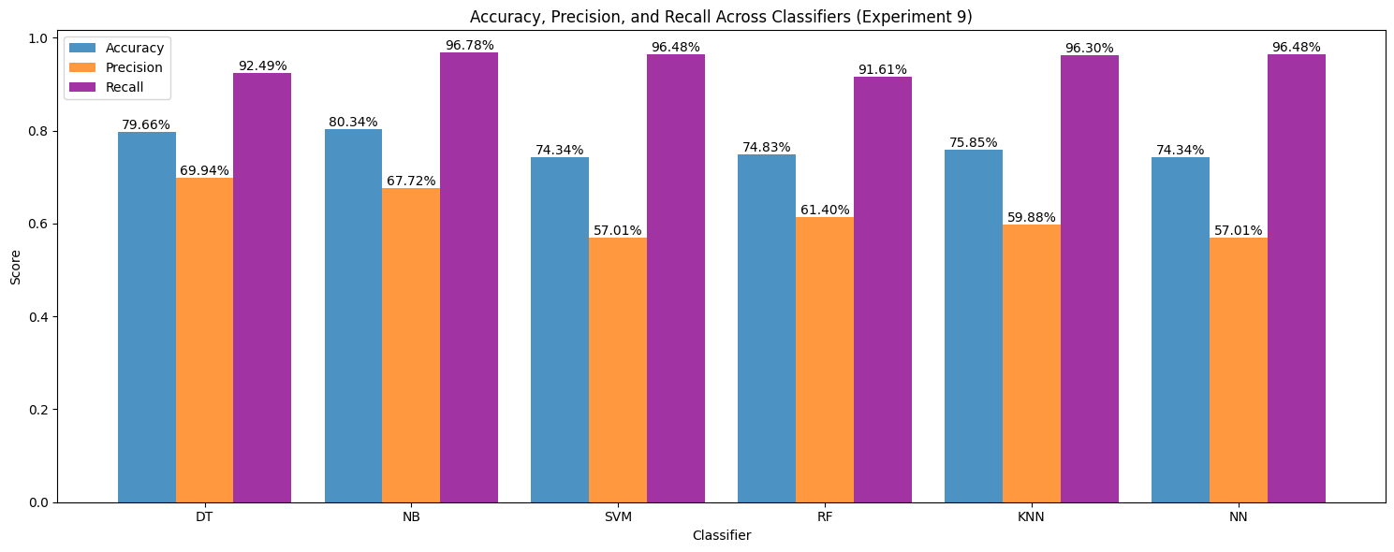
Experiment
Experiment 9
Standardized Data with Feature Selection(Ranker+InfoGain)

Slide 24
03
Observations

Slide 25
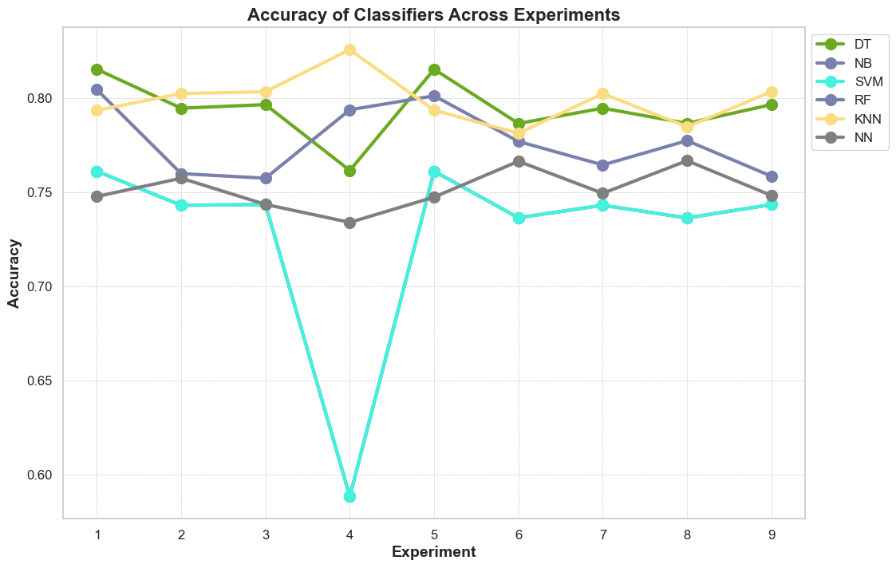
Experiment
General Observation

Slide 26
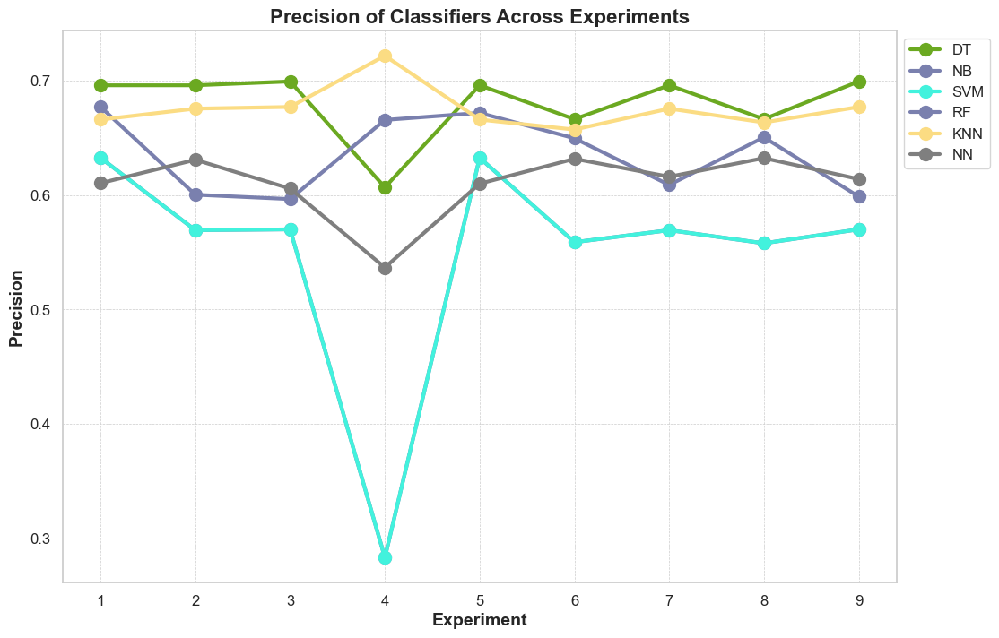
Experiment
General Observation

Slide 27
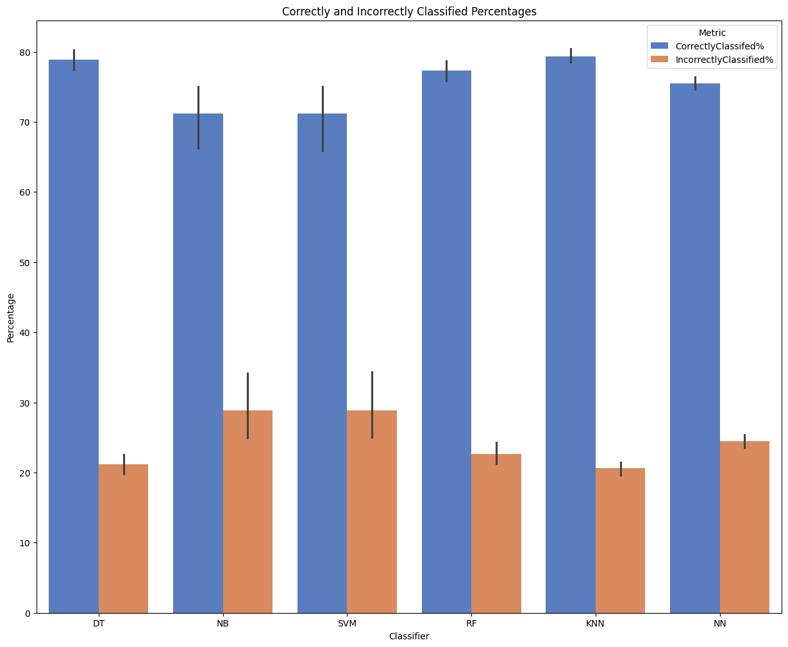
Experiment
General Observation

Slide 28
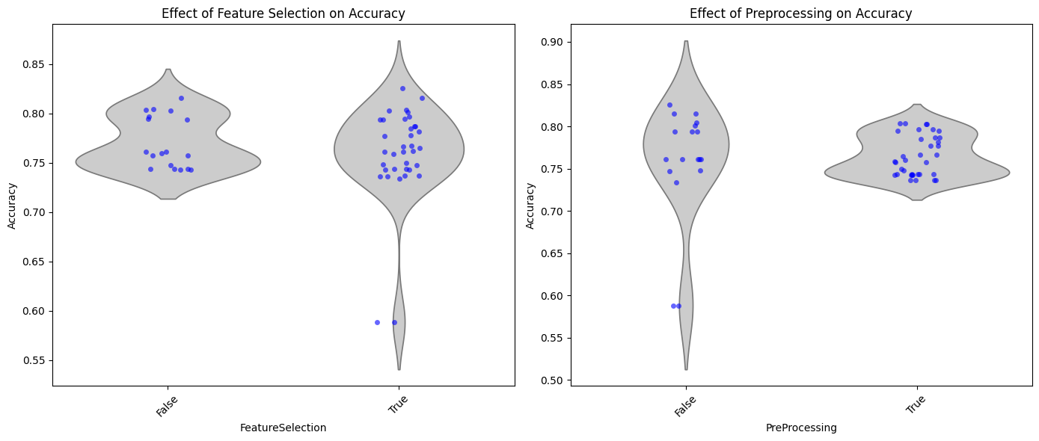
Experiment
General Observation
Notes:
Plot 1: Effect of Feature Selection on Accuracy
Distribution and Spread:
The violin plot shows the distribution of accuracy scores for experiments with and without feature selection.
The density is higher in the middle regions for both "False" and "True" feature selection, indicating where most of the data points are concentrated.
Accuracy without Feature Selection:
For "False" feature selection, accuracy scores are mostly spread between 0.70 and 0.80, with a concentration around 0.75.
There are a few data points above 0.80 but no significant outliers below 0.70.
Accuracy with Feature Selection:
For "True" feature selection, accuracy scores are more varied, ranging from about 0.55 to 0.85.
There is a wider spread and the density is more evenly distributed between 0.70 and 0.80.
A few points are noticeably lower (around 0.55-0.60), which may indicate that feature selection can sometimes result in lower accuracy in certain cases.
Comparison:
The overall accuracy range is broader with feature selection, indicating that it can lead to both higher and lower accuracies.
The median or central tendency for both seems similar, but feature selection introduces more variability in the results.
Plot 2: Effect of Preprocessing on Accuracy
Distribution and Spread:
The violin plot shows the distribution of accuracy scores for experiments with and without preprocessing.
The density is higher in the middle regions for both "False" and "True" preprocessing, but with different spread patterns.
Accuracy without Preprocessing:
For "False" preprocessing, accuracy scores are concentrated between 0.70 and 0.85, with a small number of outliers below 0.60.
The density peak is around 0.75-0.80.
Accuracy with Preprocessing:
For "True" preprocessing, accuracy scores are also spread between 0.70 and 0.85, but with a higher density around 0.75-0.80.
There are fewer low outliers, indicating preprocessing tends to produce more consistently high accuracy scores.
Comparison:
The range of accuracy scores is similar for both, but preprocessing appears to reduce the number of low accuracy outliers.
Preprocessing seems to result in a tighter clustering of accuracy scores around the higher range (0.75-0.80).
General Conclusions
Feature Selection:
Introducing feature selection increases the variability in accuracy scores. This suggests that while feature selection can help improve model performance in some cases, it can also have a detrimental effect in others. Therefore, it's important to carefully evaluate and tune feature selection methods to ensure they are beneficial.
Preprocessing:
Preprocessing generally stabilizes accuracy scores, reducing the occurrence of low accuracy results. This implies that preprocessing steps such as scaling, normalization, or data cleaning are generally beneficial in producing more reliable model performance.
Recommendation:
Feature Selection: Should be used judiciously, as it can lead to both improvements and reductions in model performance. It's best to test multiple feature selection techniques and validate their impact through cross-validation.
Preprocessing: Seems to consistently improve the reliability of the model's accuracy. It is advisable to incorporate preprocessing steps to enhance model performance stability.

Slide 29
04
Conclusions

Slide 30
Conclusions
What have we learnt?
What was the best classifier?
Importance of data preprocessing in machine learning workflows.
Different classifiers have varying strengths and weaknesses.
NSL-KDD serves as a useful benchmark for intrusion detection systems
Best Classifier: k-Nearest Neighbors (k-NN)
Basic Principle: k-NN classifies a sample based on the majority class among its k nearest neighbors in the feature space.
Strengths: Simplicity and Effectiveness
Weaknesses: Computational Cost and Curse of Dimensionality

Slide 31
Thanks!
Do you have any questions?

