Slide 1

Sales Analysis & Marketing Strategy
for Bandcamp
Sales Analysis & Marketing Strategy
for Bandcamp
Datathon Presentation - Team 7
Chih-Hua Chang, Yufei Deng, Martina De Luca, Tiancheng Yang, Xinyi Zhang
April 27th, 2022
Notes:
Hello! This is Team 7. We are excited to have the chance to present and give advice on the future of the Bandcamp. First, let me make a brief introduction to pull up our mind

Slide 2
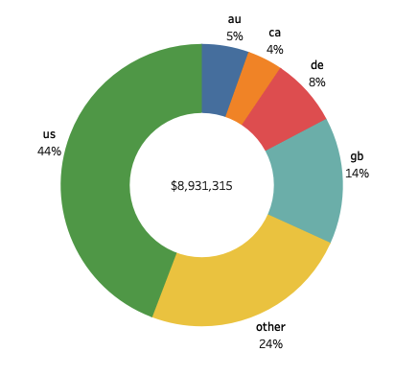
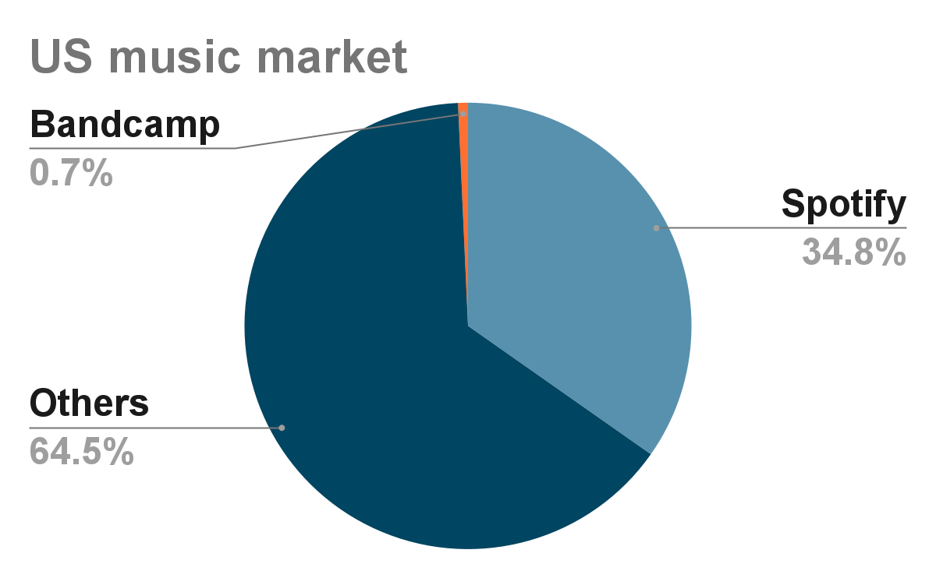
Introduction - Project Overview
We have performed a sales and revenue analysis based on Bandcamp’s historical sales to provide assessment and forecast.
In addition, by identifying market opportunities and our recommendations to increase the market share for the following years.
market share increases by 1%= extra 200 Million
Features
Low processing fee, more artist friendly
Live Stream
Bandcamp Friday
SWOT Analysis
S: Stable profitability since 2012; stronger connection with the artists
W: Small company; behindhand technology
O: Being acquired by EPIC; segment market competition is not fierce
T: Spotify for artists as the competitor, while Spotify has more resources
Notes:
about 59 second
manuscript
We are excited to have the chance to give advice on the future of the Bandcamp. First, let me briefly introduce today’s topic.
Bandcamp is currently in a huge market, according to the roughly estimation, the total music industry’s revenue is more than 20 billion. We just need to earn another 1% market share so that we can get another 200 million. What we need now is to steadily expand our market share and promote our current market.
We should always keep in mind who we are. We are the one who connect fans directly to artists, that’s our key value that enables us to profit in the past 10 years. United States contributes the most revenues, nearly 50%. And we cannot directly compete with other companies like Spotify due to the company size.
Now let’s dive a step further to see the historical data analysis.
who are we? online record store and music community where passionate fans discover, connect with, and directly support the artists they love
what’s our consulting goal? 1% more market share
How to achieve our goal—------ new market opportunity; increase the revenue we currently have
what’s our situation? SWOT analysis
what

Slide 3
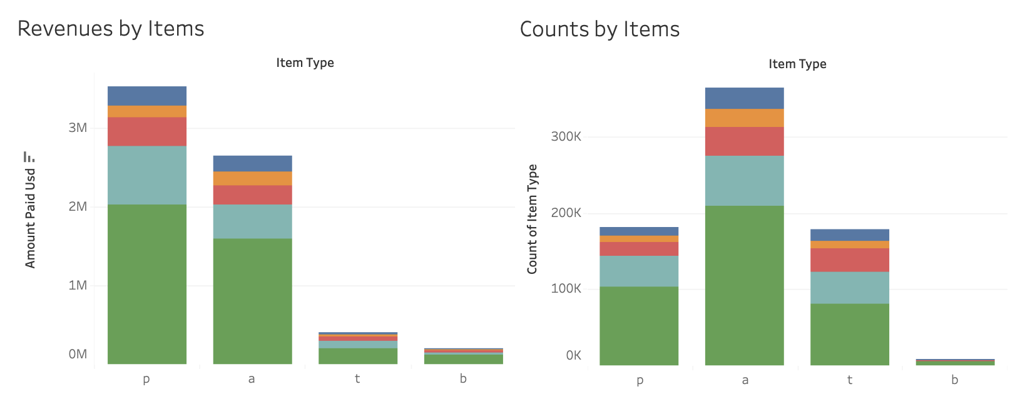
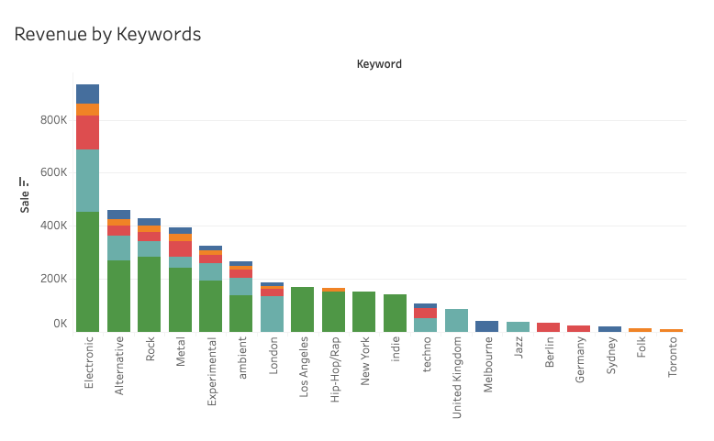
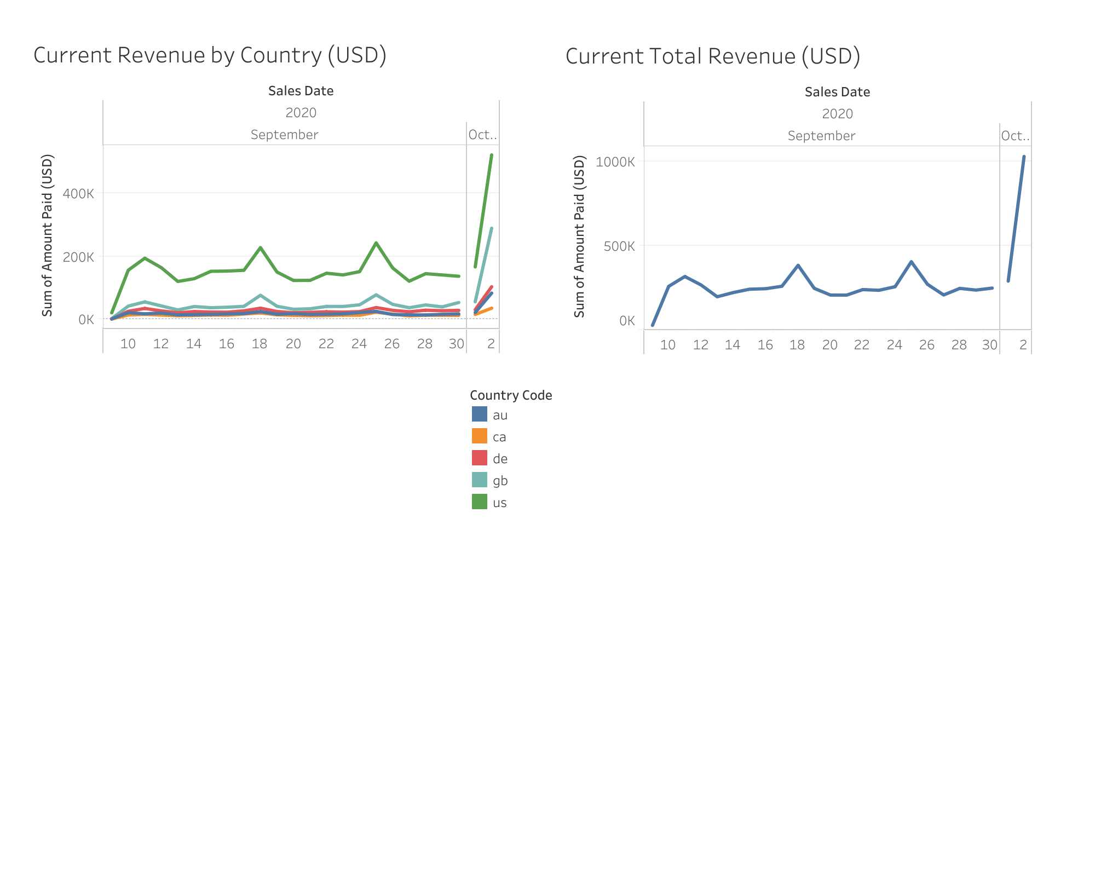
Analysis of Items Sold
Item Type
Keyword
By analyzing the type of the item sold, we can see which type of product is dominating the market.
Physical items and digital albums sales the most in Bandcamp
Although digital albums sales more in the market, physical items makes more revenue than digital albums.
Based on the relationship between keyword and revenue, we can see that which genres are likely to sale more
Electronic, rock, alternative are the keywords that contribute the most in the revenue
Users tend to support local artists, however, music produced in London is considered more widely-spread.
p = physical items; a = digital album; t = digital tracks
Notes:
Based on the data we have, we are going to see which type of the items is the most popular in bandcamp.
On the left hand side is the count and revenue by items, and on the right is the revenue by keywords.
First, the graph on the left shows that digital albums sells the most and physical items sales the second highest.
However, physical items contribute more in the revenue than digital albums.
This may due to the fact that physical items are more expensive than the other two.
On the right side, the graph shows which keyword accounts to the most in revenue, which may reflect which genre the users like the most.
We can see that keywords like ‘electronic’, ‘alternative’, ‘rock’, and ‘metal’ are dominant in the market.
The hypothesis behind the situation is that these genres occupy the most in bandcamp database.
Interestingly, people from different countries tend to support keywords related to their countries.
For example, users from the us tend to buy music with the keywords “Los Angeles” and “New York”
Next, Martina will be forecasting the revenue based on the current data for us.
Unlike other four countries, in Canada, physical items sold less than digital albums
physical times include : Cassette, Vinyl
(Instead of using the count of the items to measure the popularity, we decided to use revenue that brings up by the item to get a deeper understanding that which type of item has more impact on the total revenue.)
Hypothesis
a‘Electronic’ is an element, not a style, so it can be extensively applied to most of the songs and unnecessarily to be the core element
‘Electronic’ was popular during past years among artists and customers bought that
‘Portrait of the user’ determines that they prefer electronic, alternative and rock

Slide 4
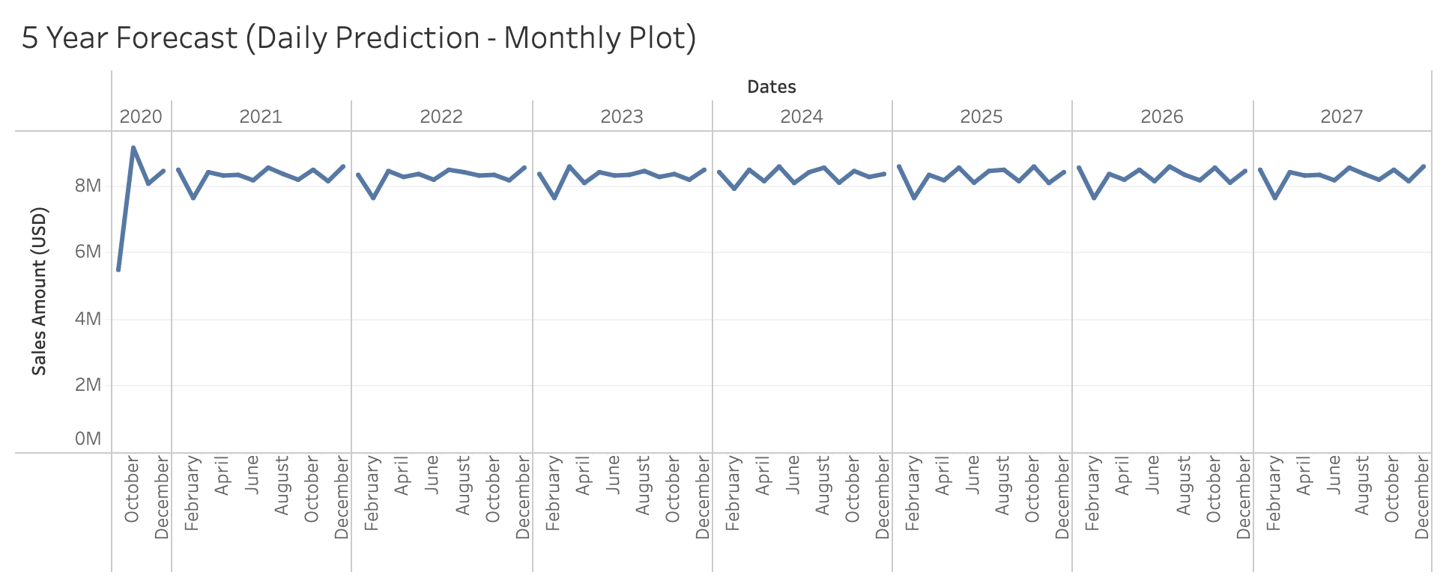
Analysis of Sales Revenue and Forecast
Current State
Future State
By analyzing the Bandcamp sales data from September to October 2020, we can assess the total revenue for the company globally and by country.
Biggest markets: United States, Great Britain, Germany, Australia, Canada.
Highest sales: United States.
Weekly pattern: Sales peak during the weekends.
Highest sales on October 2nd during special promotion.
Based on the initial data, the following 5-year sales revenue forecast was performed.
Multiple models were tested to find the best forecast.
Optimal: XGBoost, an ensemble of machine learning models.
Substantial initial growth in 2020, after the sales peak in October.
Future trend stabilizes.
We provide recommendations for growing revenue further.
Notes:
After the initial analysis of sales, we focused on the analysis of the sales revenue and created a forecast.
Current State:
We performed the analysis of the daily sales in USD for the top 5 countries for September and October of 2020, where we can see a growing trend.
The plot on the left, displays the total revenue grouped for the 5 countries. And the plot on the right shows the contribution from each of them separately. From these plots we can observe that:
The biggest market is the United States, where the revenue is the highest.
Then, for all countries, there is a clear weekly pattern, where on the weekends (particularly on Fridays), the sales increase considerably.
In addition, the high peak on October 2nd is due to a special sale on that day offered by Bandcamp.
Future State:
Based on this initial data, we tested multiple forecasting models to predict the revenue for the following 5 years. From these, we chose the one providing the most accurate results.
From this forecast, we can see a substantial initial increase in revenue for Bandcamp and a stable revenue for the following years.
Next Sherry, will provide some recommendations to increase revenue for current items and proposals for a net new market.

Slide 5
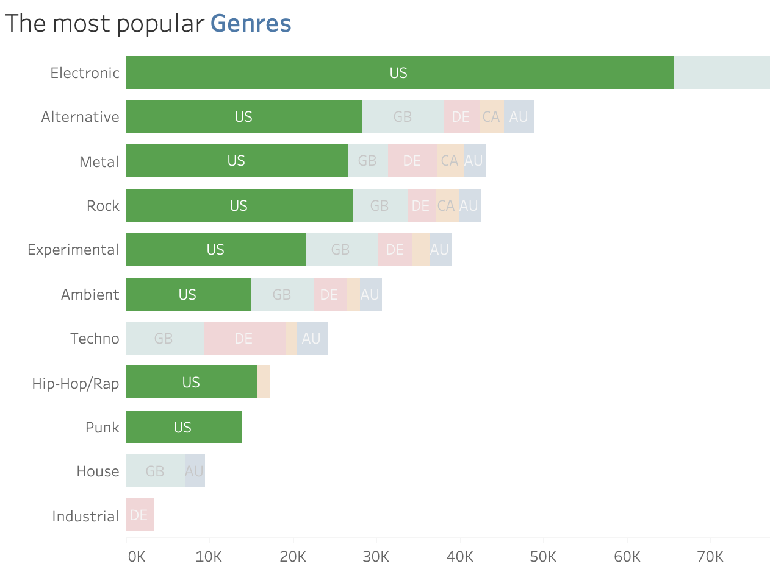
Bandcamp can benefit from the potential items by increasing their exposures
The most popular items:
Among the most popular genres sold in top five countries, Industrial, House and Techno generated no sale count in the US market which are considered undervalued items.
Marketing Approach:
Internal:
Updates: create weekly digital magazines with weekly highlights featuring new artists or best-selling artists; develop undervalued genre music libraries
Pricing: increase the price of the top song and decrease others at the same time but the total value of the songs less than the price of the album
External:
Promotions: posting new songs through KOL to create videos such as reels on social media network to attract new fans; post more of bandcamp on other platform to increase exposure and attract new artists to develop the undervalued genres library
Collaborations: work with tik-tok or Youtube in providing part of the songs for background music of either long videos or short videos
Expectation:
Navigate the fans on other platforms to Bandcamp, form a community, improve user experience and become active users on Bandcamp.
Notes:
According to the data we analyzed previously, we identified three genres including industrial, house, and techno as undervalued item meaning that they generated no sales only in US market, so we believe they have potential to grow and gain more revenue.
For developing these undervalued items, we have developed marketing internal and external approaches.
The internal one is implementing strategies within the bandcamp system, and external one mainly utilizes the outside resources.
Internal strategies include creating weekly digital magazine to give more credits to the artists and help them to gain exposure, also to complete the undervalued genre libraries, because we found that the most popular genres have highly completed music libraries and in contrary, those undervalued genres music libraries are less completed.
Another thing we propose is to implement Pricing strategies which introduce a drastic price difference between the top song and other songs but still has the value less than entire album
External strategy is to promote and collaborate by reaching outside resources to direct and introduce fans from other platforms to bandcamp.

Slide 6
Looking into the future, Bandcamp could consider expand to music-related market by introducing illustration artists as a new branch
Outside of music, podcasts, audiobooks; identify a net-new target market where Bandcamp should expend resources to find new artist
Illustration Market
Illustrations Subcategories on Bandcamp
Niche but promising
An estimated CAGR of 6.2%
Current job market of 28,000 illustrators in the US, estimate to grow by 6.8% between 2016 and 2026
Digital arts(2-D;3-D)
Album Covers
Merchandise
How can Bandcamp differentiate from existing platforms?
Business Model proposed for Bandcamp
Artstation:
A comprehensive marketplace specifying in digital arts
Popular for making 3-D arts in video games
Instagram:
Individual artists with Certain fans bases
Distinct personal styles
Well-designed profile page
Illustrators
①
③
Bandcamp
Musicians
Fans
②
Bandcamp:
Consistency: focus on everything related to music & sounds
Collaboration: help illustrators leverage the popularity of musicians with minimum entry cost
Community: “tags” to gather people with similar preferences
no Constraint: all styles of artworks are welcomed and respected
① Musicians request illustrations for album covers from illustrators; the collaboration would increase popularity for both sides
② Fans follow the illustrators through the album of their loved musicians
③ Fans appreciate the illustrators’ artwork and join their community: buy illustrations for collection, further support the illustrators’ merchandise

Slide 7
Questions?

