Slide 1
Observing the relationship between the Presence of Heart Disease and Sex in Different Age Groups
Data607 HW4
Chih-Hua Chang
118143422

Slide 2
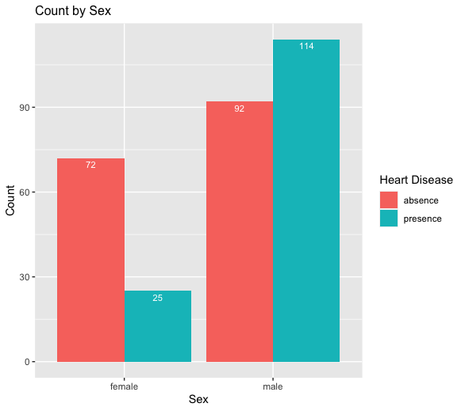
Explore the data
Total number:
Female: 97
Male: 206
Percentage of having heart disease:
Female: 25.8%
Male: 55.3%
Male has a higher percentage of having heart disease
Notes:
The total number of female is 97, and the total number of males is 206,
There are twice amount of male than female in the dataset
The percentage of female having heart disease is about 25% and 55 % in male, which state that male has a higher percentage of having heart disease.

Slide 3
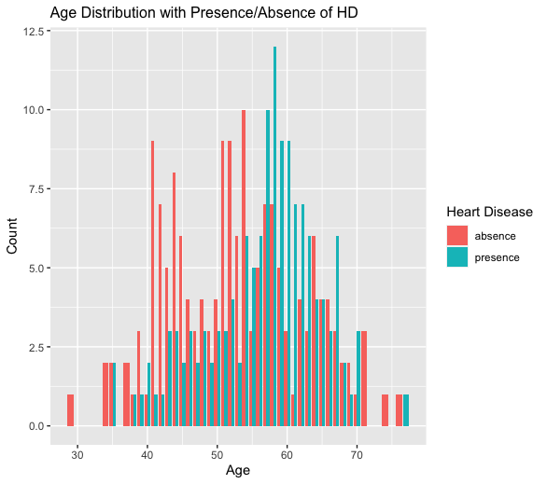
Age Distribution
In the age group of 30-55, there are less present of heart disease
In the age group of 55-65, there are more presence of heart disease than absence of heart disease.
And after age 65, the presence and absence of heart disease is equal
Notes:
Now, let’s take a look at the age distribution of the dataset
On the left-hand side is the age distribution of the dataset regardless of any factor, we can see that there are more data within the age range of 50-60 years old.
On the right-hand side is the age distribution with the presence or absence of heart disease.
The salmon color represent the absence of hd and the blue color represent the presence of heart disease.
In the age group of 30-55, The salmon bar is higher than the blue bar, which is that the the are more absence case than present case
After age 55, there are more presence of heart disease than the absence of heart disease.
And after age 65, it seems that the presence and absence of heart disease is equal
So, in the graph we, can see that age around 55 to 62 are more likely to have heart disease.

Slide 4
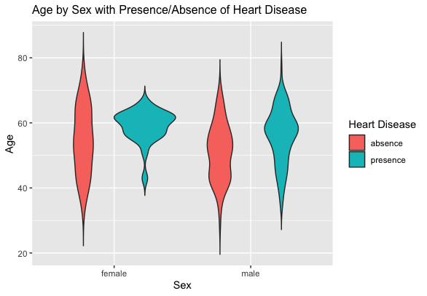
Age by Sex with Present of Heart Disease
Female age within 55~65 has a higher chance of having a heart disease.
Male age around 60 has slightly higher chance of having a heart disease.
The relationship of age and the presence of heart disease is more sensitive in female than in male.
Notes:
Now let’s see the two variables to together in one graph.
In this graph , x axis is sex and y axis is age.
The salmon color represent the absence of hd and the blue color represent the presence of heart disease.
We can see the shape of female and male in th presence of heart disease is very different.
The shape of female is more extreme, the age range of having heart disease are around 55-65, and there is much less case out of the age range
However, the age range of having heart disease in male is more prevalent, though there are still a relatively larger area in age 60’s
The relationship of age and the presence of heart disease is more sensitive in female than in male.

Slide 5
Conclusion
Male has a higher percentage of having heart disease.
Age around 55 to 65 are more likely to have heart disease.
The relationship of age and the presence of heart disease is more sensitive in female than in male.

Slide 6
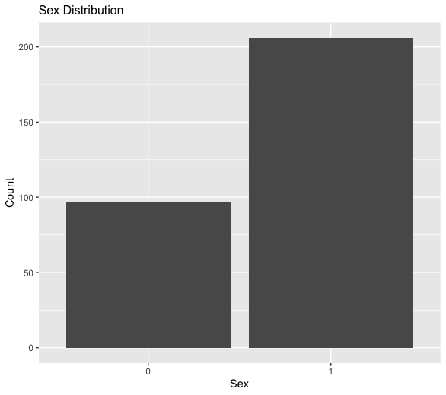
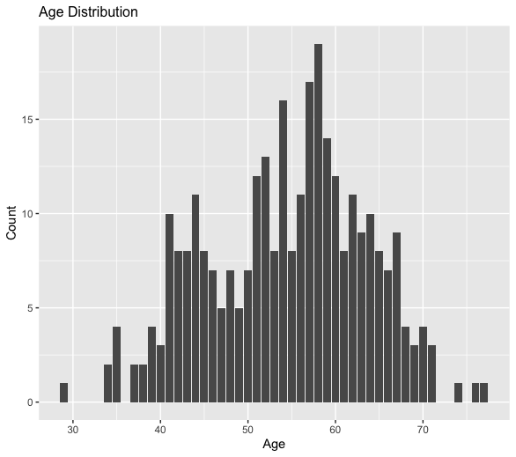
Discussion of Uncertainty
The data set size is not big enough
The numbers of collected female and male are unequal
The numbers of different age groups are unequal
The way these people been selected
Notes:
Discuss the uncertainty in the data set
303 examples
Male data are twice more than female data
The age distribution in the data set is not normal, there are more data in age from 50 to 60
The way people get selected in the dataset is unknown, we don’t know if there is any bias when selecting the data, for example, male with heart disease preferred to provide his information, and that will change the whole game.

