Slide 1
Analysis of
Different ML Models
COMP472 Assignment 1
Contributor: Rhina Kim - 40130779

Slide 2
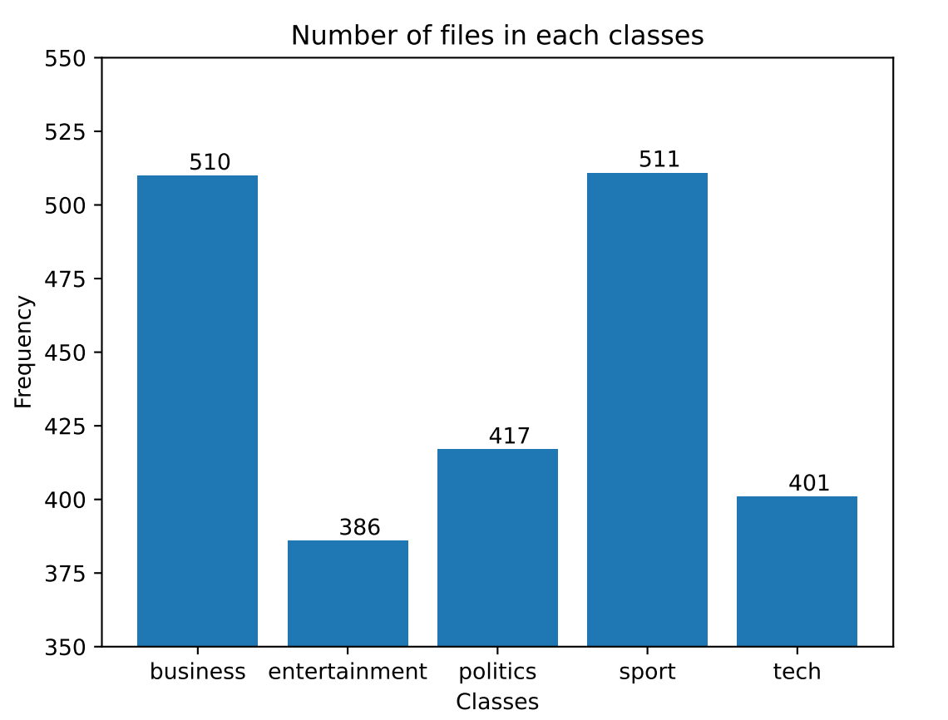
Task 1: Text Classification (Initial Dataset)
Characteristics of initial dataset
There are 5 classes: Business, Entertainment, Politics, Sport, and Tech
Imbalanced datasets (distribution not uniform)
Multinomial Naive Bayes does not perform well on imbalanced datasets
→ May overfit data in favor of the class with more number of examples (Testing error may be high)
Can affect metrics system (F1 measures are superior than accuracy
Notes:
<<An analysis of the initial dataset given on Moodle. If there is anything particular about these datasets that might have an impact on the performance of some models, explain it. >>
Multinomial Naive Bayes does not perform very well on imbalanced datasets. This means that the distribution of examples is not uniform. This type of dataset can be difficult to work with as a model may easily overfit this data in favor of the class with more number of examples.
Techniques used: Supervised Learning (Multinomial naive bayes classifier) since we are using frequency of words to enhance categorization

Slide 3
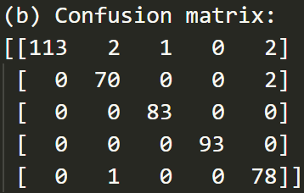
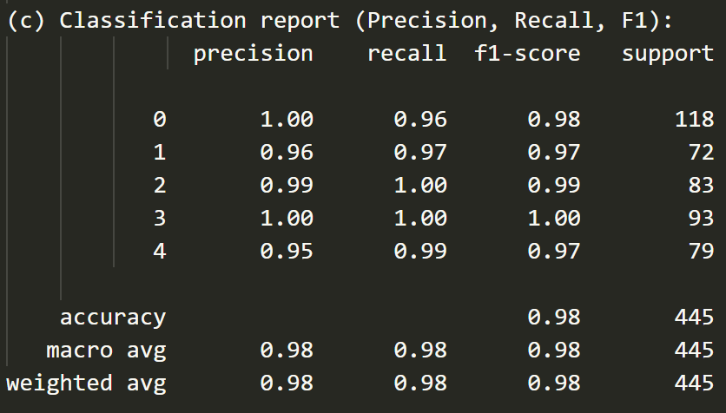
Task 1: Text Classification (Results)
Multinomial default values: Try 1 and Try 2
Classifier: MultinomialNB(smoothing=1.0)
Result:
Same results for both of the trials
High Accuracy (98.2%)
High f1 macro avg (98.14%)
High f1 weighted avg (98.21%)
Reason:
No noisy-inputs
Small features with low-frequency
Classes
business
entertainment
politics
sport
tech
Notes:
<< An analysis of the results of all the models with the data sets. In particular, compare and contrast the performance of each model with one another, and with the datasets. Please note that your presentation must be analytical. This means that in addition to stating the facts (e.g. the macro-F1 has this value), you should also analyse them (i.e. explain why some metric seems more appropriate than another, or why your model did not do as well as expected. Tables, graphs and contingency tables to back up your claims would be very welcome here.>>
Accuracy score: 0.982 (98.2%)
F1-score with macro average: 0.9814 (98.14%)
F1-score with weighted average: 0.9821 (98.21%)

Slide 4
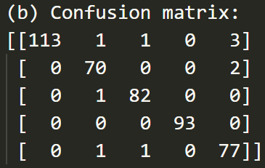
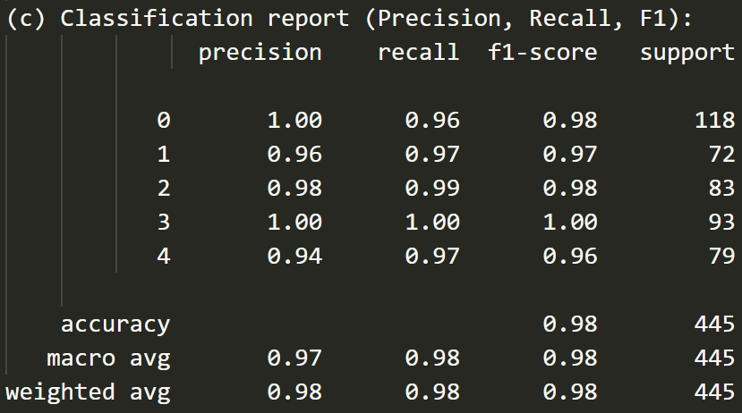
Task 1: Text Classification (Results)
Multinomial with smoothing value = 0.0001
Classifier: MultinomialNB(smoothing=0.0001)
Result:
High Accuracy (97.75%)
High f1 macro avg (97.65%)
High f1 weighted avg (97.76%)
Reason:
Result is lower than default smoothing value
→ the smoothed values are closer to the actual data (Higher possibility of zero probability)
Classes
business
entertainment
politics
sport
tech
Notes:
(d) Accuracy score: 0.9775 (97.75%)
F1-score with macro average: 0.9765 (97.65%)
F1-score with weighted average: 0.9776 (97.76%)
Smaller factors also mean that your smoothed values are closer to the actual data

Slide 5
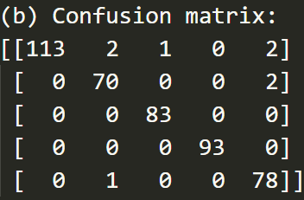
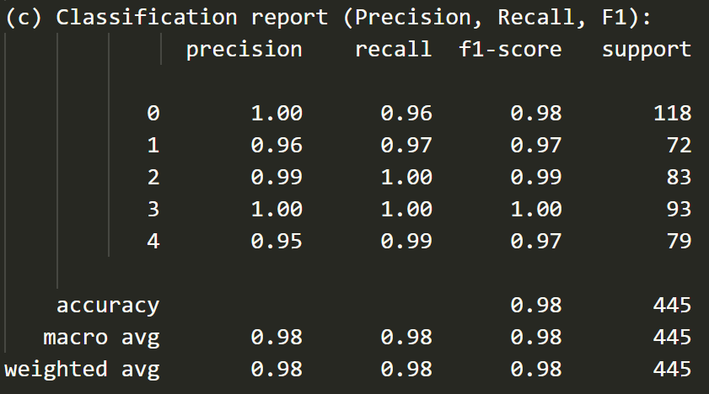
Task 1: Text Classification (Results)
Multinomial with smoothing value = 0.9
Classifier: MultinomialNB(smoothing=0.9)
Result:
Same results for Trial 1 & 2
High Accuracy (98.2%)
High f1 macro avg (98.14%)
High f1 weighted avg (98.21%)
Reason:
Smoothing value is very close to default smoothing value (1.0)
→ Differences in result not significant as first trials
Classes
business
entertainment
politics
sport
tech
Notes:
(d) Accuracy score: 0.982 (98.2%)
F1-score with macro average: 0.9814 (98.14%)
F1-score with weighted average: 0.9821 (98.21%)

Slide 6
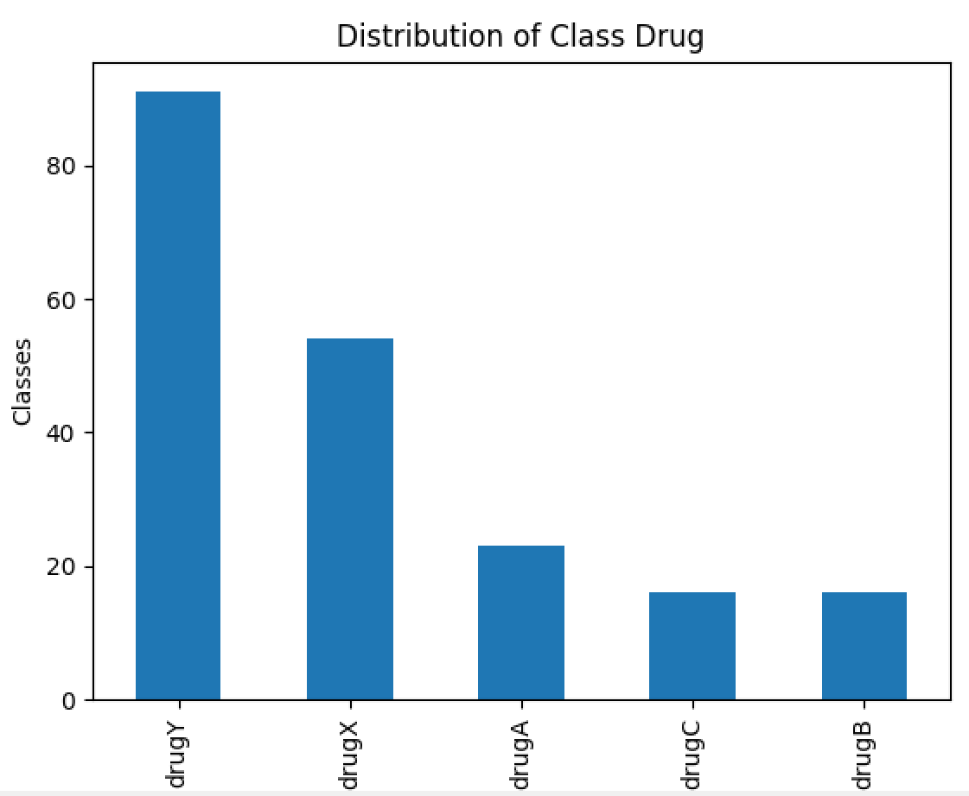
Task 2: Drug Classification (Initial Dataset)
Characteristics of initial dataset
There are 5 classes: drugY, drugX, drugA, drugC, drugB
Imbalanced datasets (distribution not uniform)
Most of the classifiers does not perform well on imbalanced datasets
→ May overfit data in favor of the class with more number of examples (Testing error may be high)
Can affect metrics system (F1 measures are superior than accuracy)
Notes:
<<An analysis of the initial dataset given on Moodle. If there is anything particular about these datasets that might have an impact on the performance of some models, explain it. >>

Slide 7
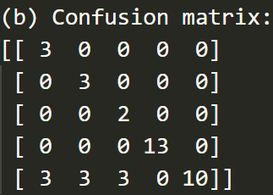
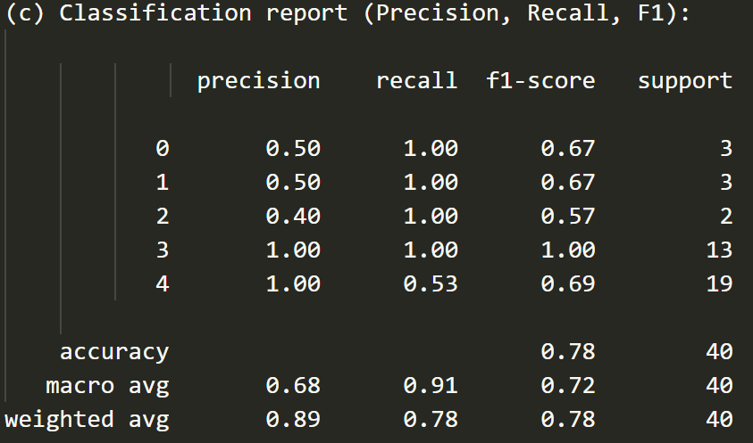
Task 2: Drug Classification (Results)
Classifier: Gaussian(NB)
with Default smoothing value
Result:
Moderate to High Accuracy (77.5%)
Moderate to High f1 macro avg (71.89%)
Moderate to High f1 weighted avg (78.12%)
Reason:
Initial Dataset was unbalanced
Recall higher than precision for most of the classes
→ A lot of predicted instances are labeled correctly
drugX score higher since it has more data available
Classes
drugA
drugB
drugC
drugX
drugY
Notes:
(i.e. explain why some metric seems more appropriate than another, or why your model did not do as well as expected. Tables, graphs and contingency tables to back up your claims would be very welcome here.>>
(d) Accuracy score: 0.775 (77.5%)
F1-score with macro average: 0.7189 (71.89%)
F1-score with weighted average: 0.7812 (78.12%)

Slide 8
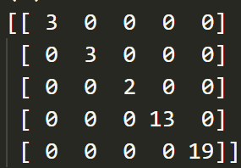
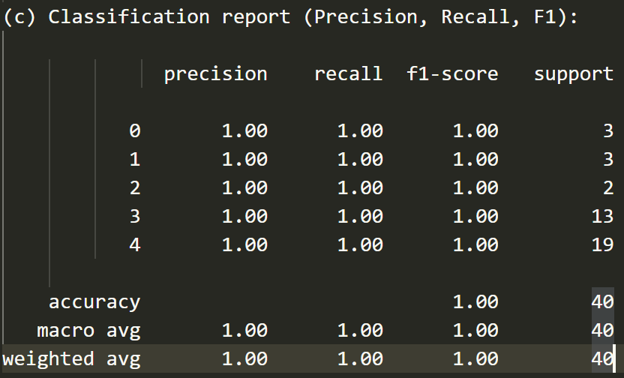
Task 2: Drug Classification (Results)
Classifier: Default DecisionTreeClassifier()
Criterion: gini
Min-split-sample: 2
Max-depth: None
Result:
Highest Accuracy (100%)
Highest f1 macro avg (100%)
Highest f1 weighted avg (100%)
Reason:
Due to its ability to use different feature subsets and decision rules
→ Best for categorical data
Easy to handle categorical and numerical variables
Classes
Notes:
The range of Entropy lies in between 0 to 1 and the range of Gini Impurity lies in between 0 to 0.5. Hence we can conclude that Gini Impurity is better as compared to entropy for selecting the best features.
The main advantage of the decision tree classifier is its ability to using different feature subsets and decision rules at different stages of classification.
Decision trees can handle both categorical and numerical variables at the same time as features, there is not any problem in doing that
(d) Accuracy score: 1.0 (100.0%)
F1-score with macro average: 1.0 (100.0%)
F1-score with weighted average: 1.0 (100.0%)

Slide 9
Task 2: Drug Classification (Results)
Classifier: Best DecisionTreeClassifier()
criterion: gini
max_depth: 6
min_samples_leaf: 0.02
Result: Same as default decision tree classifier
Reason: Same as default decision tree classifier
Range of Entropy : 0 to 1
Range of Gini Impurity: 0 to 0.5
→ Gini Impurity is better since entropy range is small to select the best features
Classes
Notes:
The range of Entropy lies in between 0 to 1 and the range of Gini Impurity lies in between 0 to 0.5. Hence we can conclude that Gini Impurity is better as compared to entropy for selecting the best features.
The main advantage of the decision tree classifier is its ability to using different feature subsets and decision rules at different stages of classification.
Decision trees can handle both categorical and numerical variables at the same time as features, there is not any problem in doing that
(d) Accuracy score: 1.0 (100.0%)
F1-score with macro average: 1.0 (100.0%)
F1-score with weighted average: 1.0 (100.0%)

Slide 10
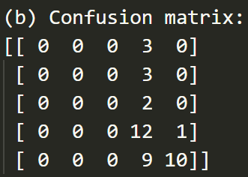
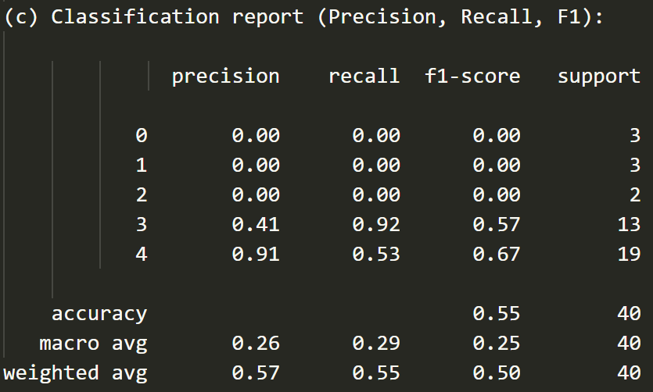
Task 2: Drug Classification (Results)
Classifier: Default Perceptron()
Result:
Low Accuracy (55%)
Low macro avg (24.76%)
Low weighted avg (50.24%)
Reason:
Perceptron was not really suitable for categorical dataset with mainly nominal attributes
→ perceptron is mostly used to classify binary data
Classes
Notes:
Perceptron is usually used to classify the data into two parts. Therefore, it is also known as a Linear Binary Classifier . If you want to understand machine learning better offline too.
(d) Accuracy score: 0.55 (55.0%)
F1-score with macro average: 0.2476 (24.76%)
F1-score with weighted average: 0.5024 (50.24%)

Slide 11
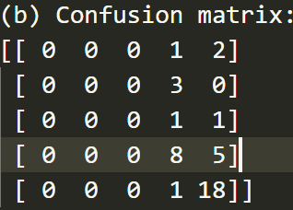
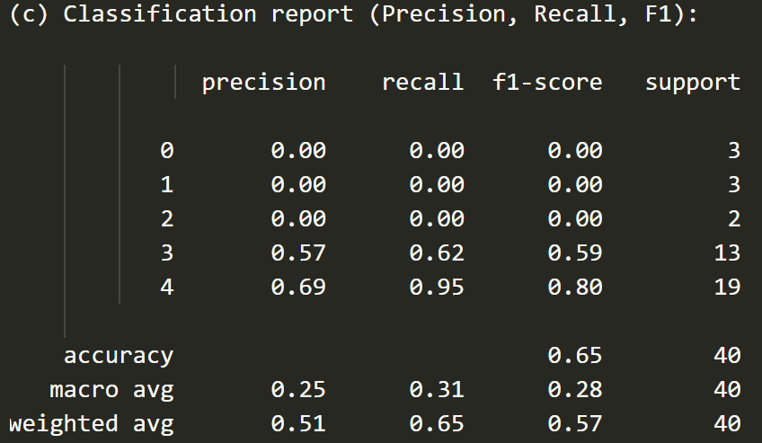
Task 2: Drug Classification (Results)
Classifier: Default MLPClassifier()
hidden_layer_sizes: 100
activation: logistic f(x) = 1 / (1 + exp(-x))
solver: sdg
Result:
Low Accuracy (65%)
Low macro avg (27.85%)
Low weighted avg (57.26%)
Reason:
Classes
Notes:
The default solver ‘adam’ works pretty well on relatively large datasets (with thousands of training samples or more) in terms of both training time and validation score. For small datasets, however, ‘lbfgs’ can converge faster and perform better.
(d) Accuracy score: 0.65 (65.0%)
F1-score with macro average: 0.2785 (27.85%)
F1-score with weighted average: 0.5726 (57.26%)
One-hot encodings represent categorical values as vectors with all but one zero elements.

Slide 12
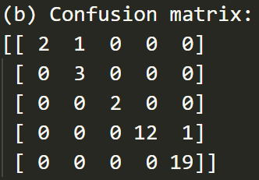
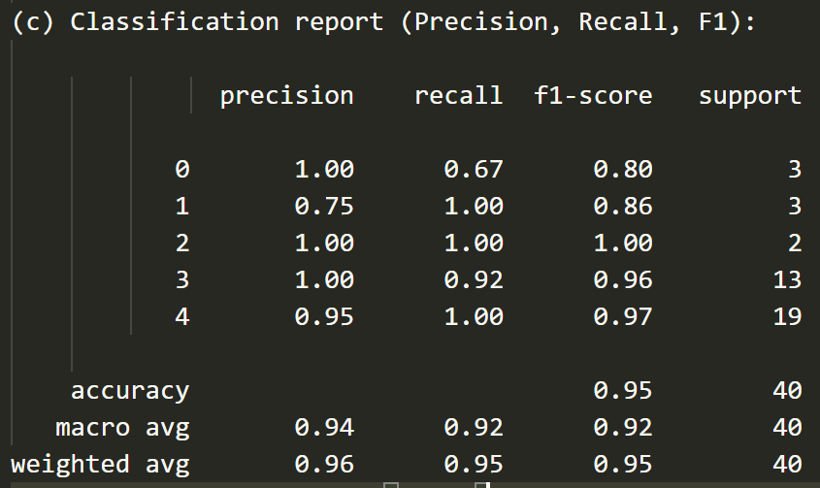
Task 2: Drug Classification (Results)
Classifier: Best MLPClassifier()
hidden_layer_sizes: (30, 50)
activation: tanh
solver: adam
Result:
Low Accuracy (95%)
Low macro avg (91.83%)
Low weighted avg (94.91%)
Reason:
Classes
Notes:
The default solver ‘adam’ works pretty well on relatively large datasets (with thousands of training samples or more) in terms of both training time and validation score. For small datasets, however, ‘lbfgs’ can converge faster and perform better.
(d) Accuracy score: 0.95 (95.0%)
F1-score with macro average: 0.9183 (91.83%)
F1-score with weighted average: 0.9491 (94.91%)
One-hot encodings represent categorical values as vectors with all but one zero elements.

