Slide 1

MP 3 DEMO
Rhina Kim - 40130779

Slide 2
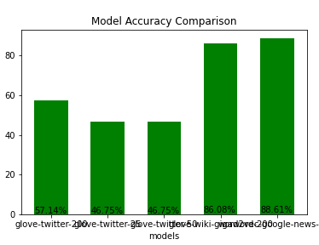
Word2vec Dataset Comparison
From Left:
glove-twitter-25
glove-twitter-50
glove-wiki-gigaword-200
glove-twitter-200
word2vec-google-news-300

Slide 3
Word2vec Dataset Comparison
glove-twitter-25 | glove-twitter-50 | glove-wiki-gigaword-200 | glove-twitter-200 | word2vec-google-news-300
Embedding dimensions (25) | Embedding dimensions (50) | Embedding dimensions (200) | Embedding dimensions (200) | Highest embedding dimensions (300)
1.2M vocab, uncased | 1.2M vocab, uncased | 5.6B tokens, 400K vocab, uncased | 2B tweets, 27B tokens, 1.2M vocab, uncased | Google News (about 100 billion words)
Very low # of dimensions | Very low # of dimensions | Higher # of dimensions and a lot of word choices (higher level words available) → higher accuracy | Higher # of dimensions (words choice unprofessional) | Highest # of dimensions & massive words are used for training → higher accuracy

Slide 4
Quick Note:
Typical word2vec number of dimensions: 100 ~ 200
At least 50 dimensions will achieve lowest accuracy
Increase in number of dimensions will lead to improve in feature / performances
Yet, after certain amount of higher dimensions, features would not improve dramatically
Trade-off between number of dimensions and performance time is important
Notes:
Typical interval is between 100-300. I would say you need at least 50D to achieve lowest accuracy. If you pick lesser number of dimensions, you will start to lose properties of high dimensional spaces. If training time is not a big deal for your application, i would stick with 200D dimensions as it gives nice features. Extreme accuracy can be obtained with 300D. After 300D word features won't improve dramatically, and training will be extremely slow.

