Slide 1


Slide 2
Team members
Matěj Minárik
  Lead programming, additional game design, level design
Jan Rybář
  Game design, graphics, additional programming, level design
David Osička
  Additional programming
Lubomír Šálek (external)
  Music

Slide 3
Game Goal
„Find your way through the immersive space to the mysterious light which will take you to the further levels. The path is not straight and simple though.“
Game charasteristics:
Casual
Puzzle
Pathfinding
3D environment

Slide 4
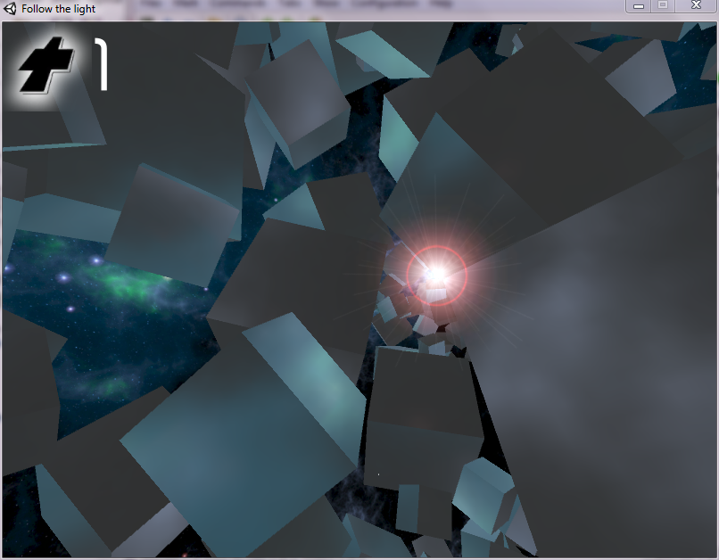
In-Game Screenshot

Slide 5


Key Features
simple, yet enigmatic open 3D world covered in darkness of space (priority 4)
challenge to find the way around visually giant, deadly and dynamic obstacles – giant rotating space cubes
simple control of the movement through 3D world (priority 1)
inspired by space freelancing games like Elite or Descent
cubes are lit by the target „mysterious“ light, which helps to guess the position of the light (priority 1)
limited lifes for player (priority 2)
power-ups like momentary freezing of cubes, short-term disappearance, life-ups, short-term guidance (priority 2)
auto-generated levels with increasing difficulty (faster cubes, moving target light) (priority 3)

Slide 6


Development Plan
Feature | Priority | Finish date
basic world and mechanics | 1 | 13.10.2015
power-up development and mechanics | 2 | 21.10.2015
level generation | 3 | 1.11.2015
graphics content (lights, glow etc.) | 3 | 8.11.2015
gameplay, controls refinement | 4 | 15.11.2015
menu, HUD | 5 | 22.11.2015
sound, music | 5 | 29.11.2015
further ameliorations | 5 | 13.12.2015
port to Android | 6 | if spare time
Final build | 1 | 21.11.2015

