Slide 1
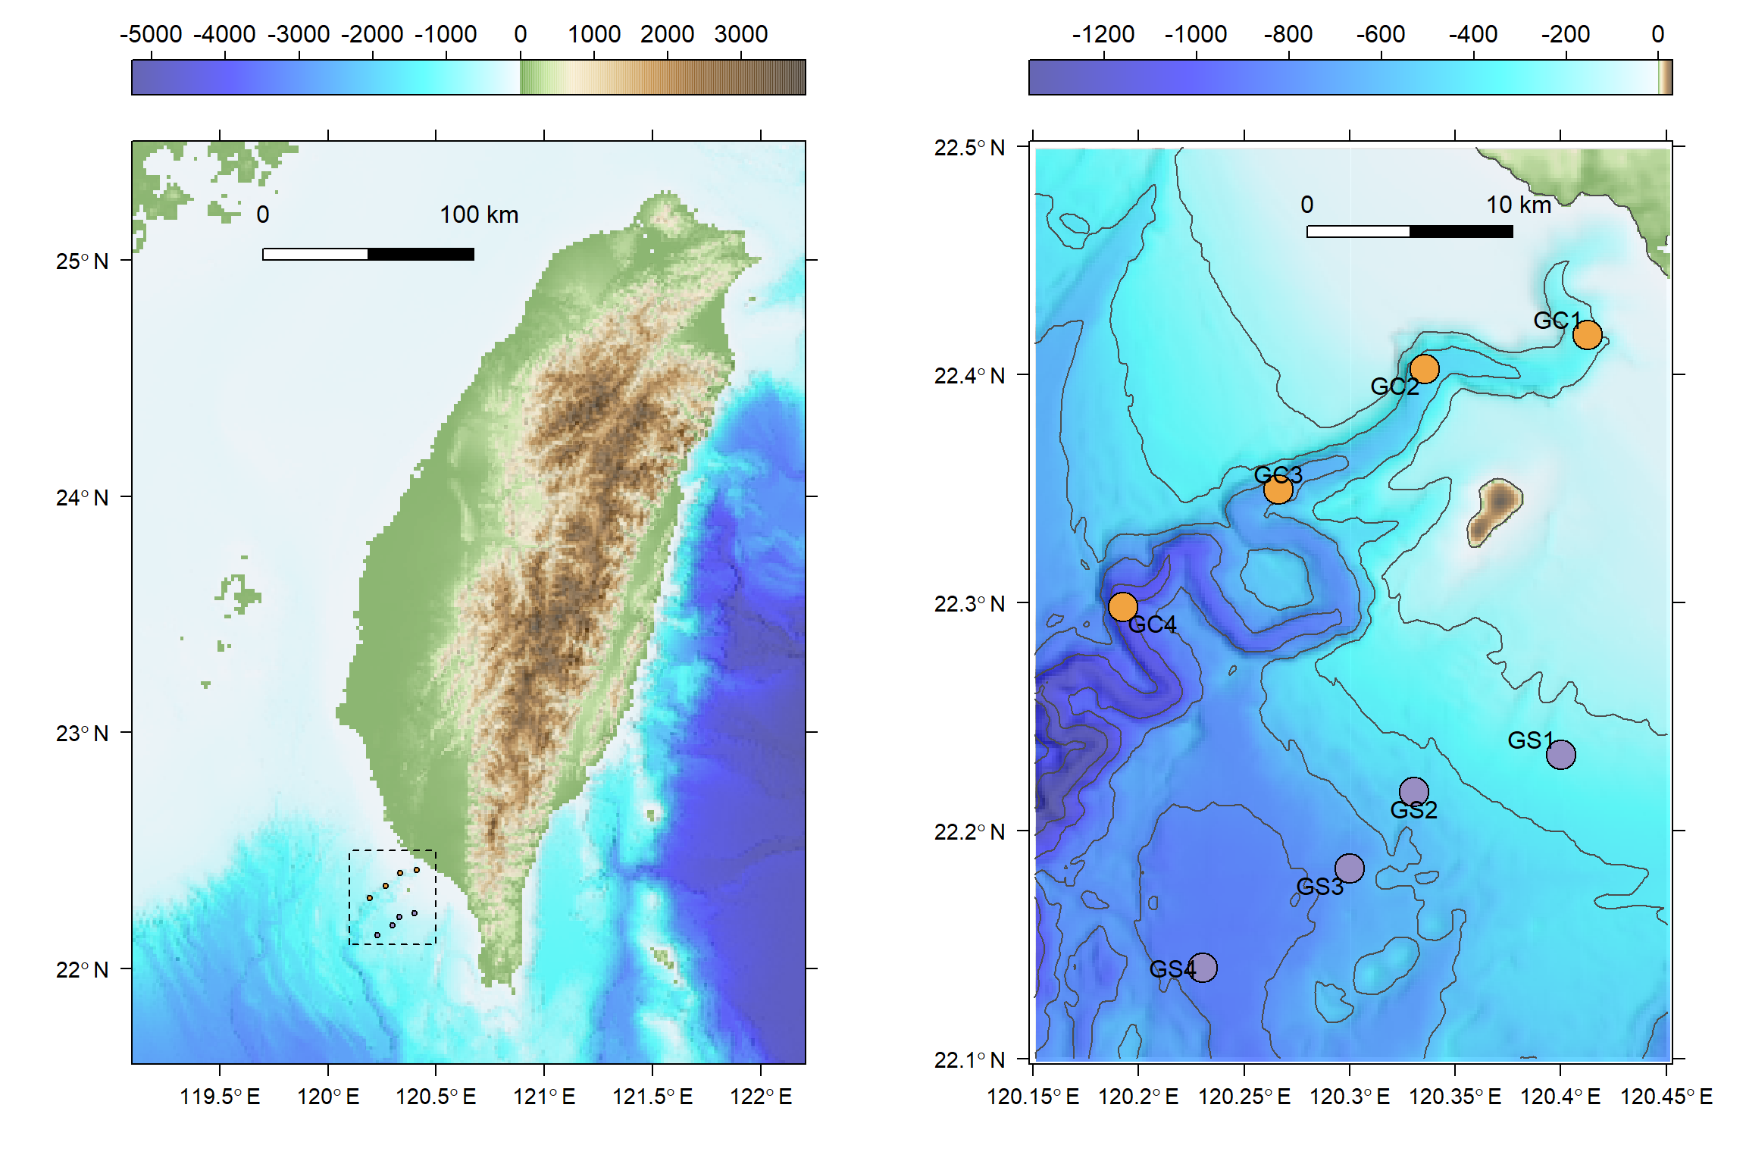
(A)
Elevation (m)
(B)
Elevation (m)
Taiwan Strait
Taiwan
Gaoping Canyon
Pacific Ocean
South China Sea
Notes:
Fig. 1 Sampling map of meiobenthos and macrobenthos

Slide 2
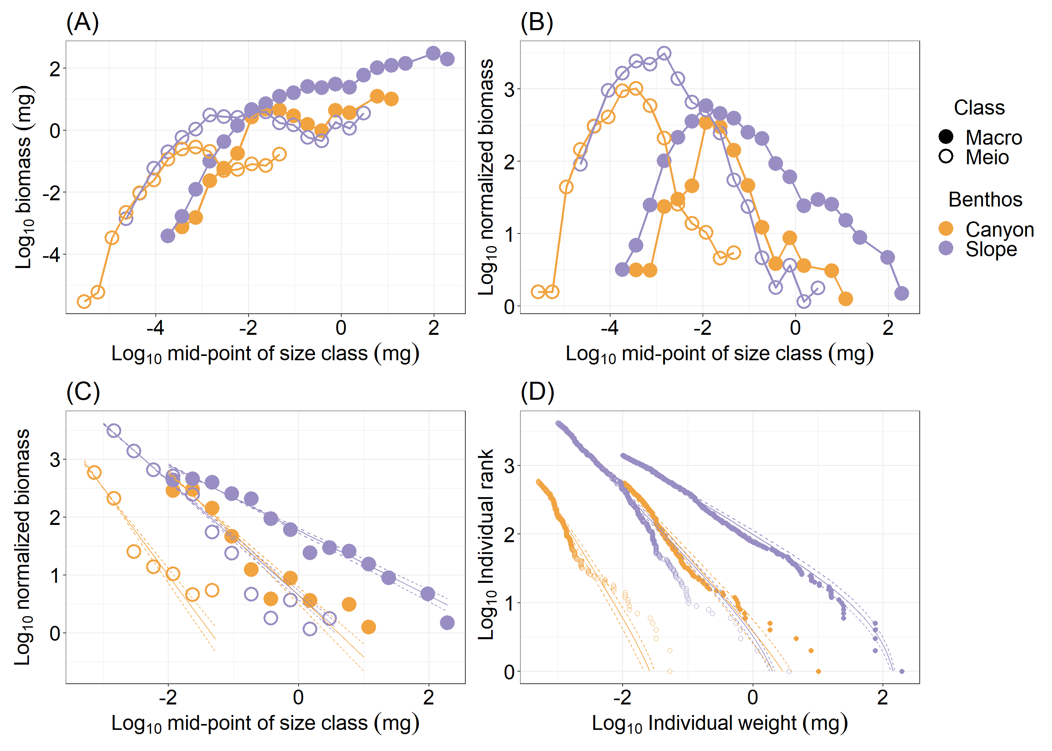
Notes:
Fig. 2 Size spectrum of meiobenthos and macrobenthos.

Slide 3
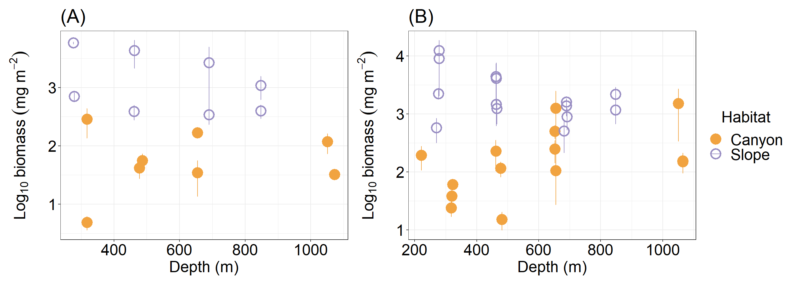
Notes:
Fig. 3. Biomass, annual P/B ratio, annual secondary production of meiobenthos (A, C, E) and macrobenthos (B, D, F)

Slide 4
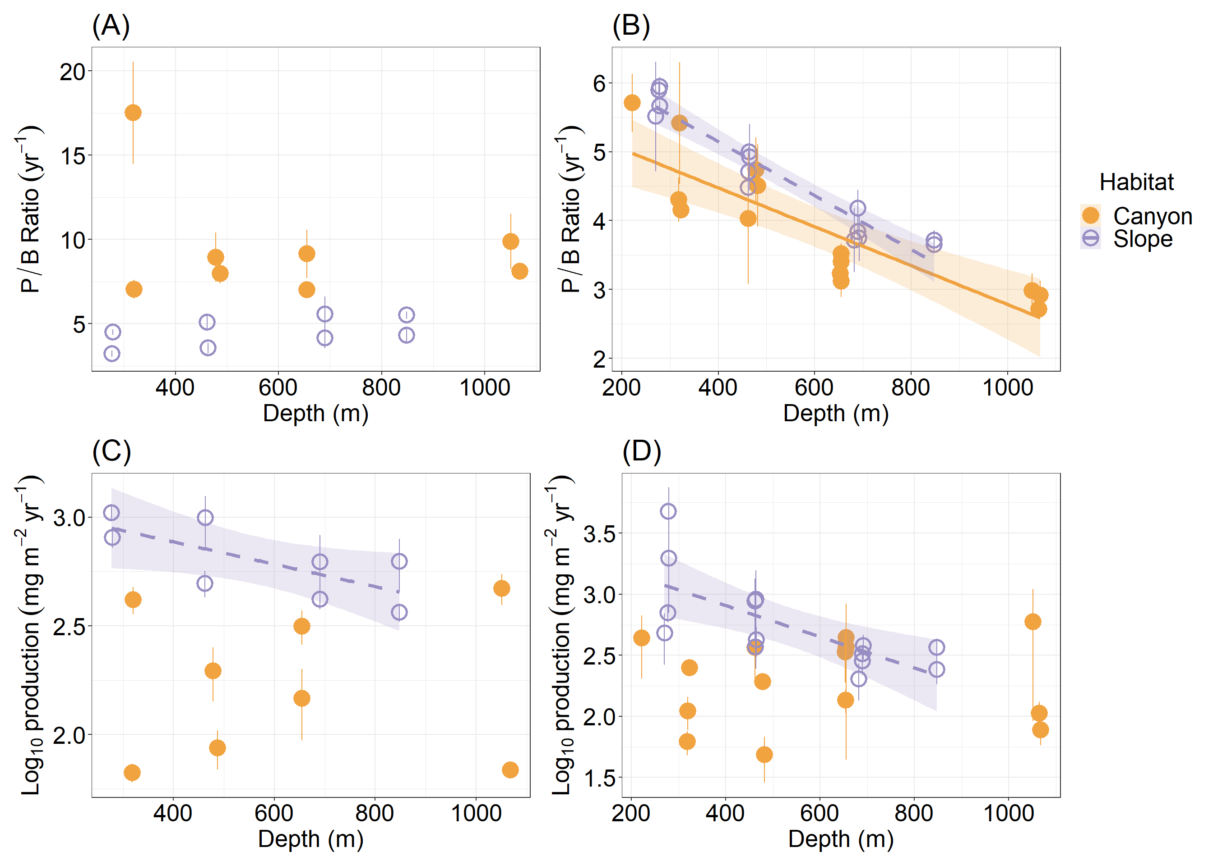
Notes:
Fig. 4. Annual P/B ratio, annual secondary production of meiobenthos (A, C, E) and macrobenthos (B, D, F)

Slide 5
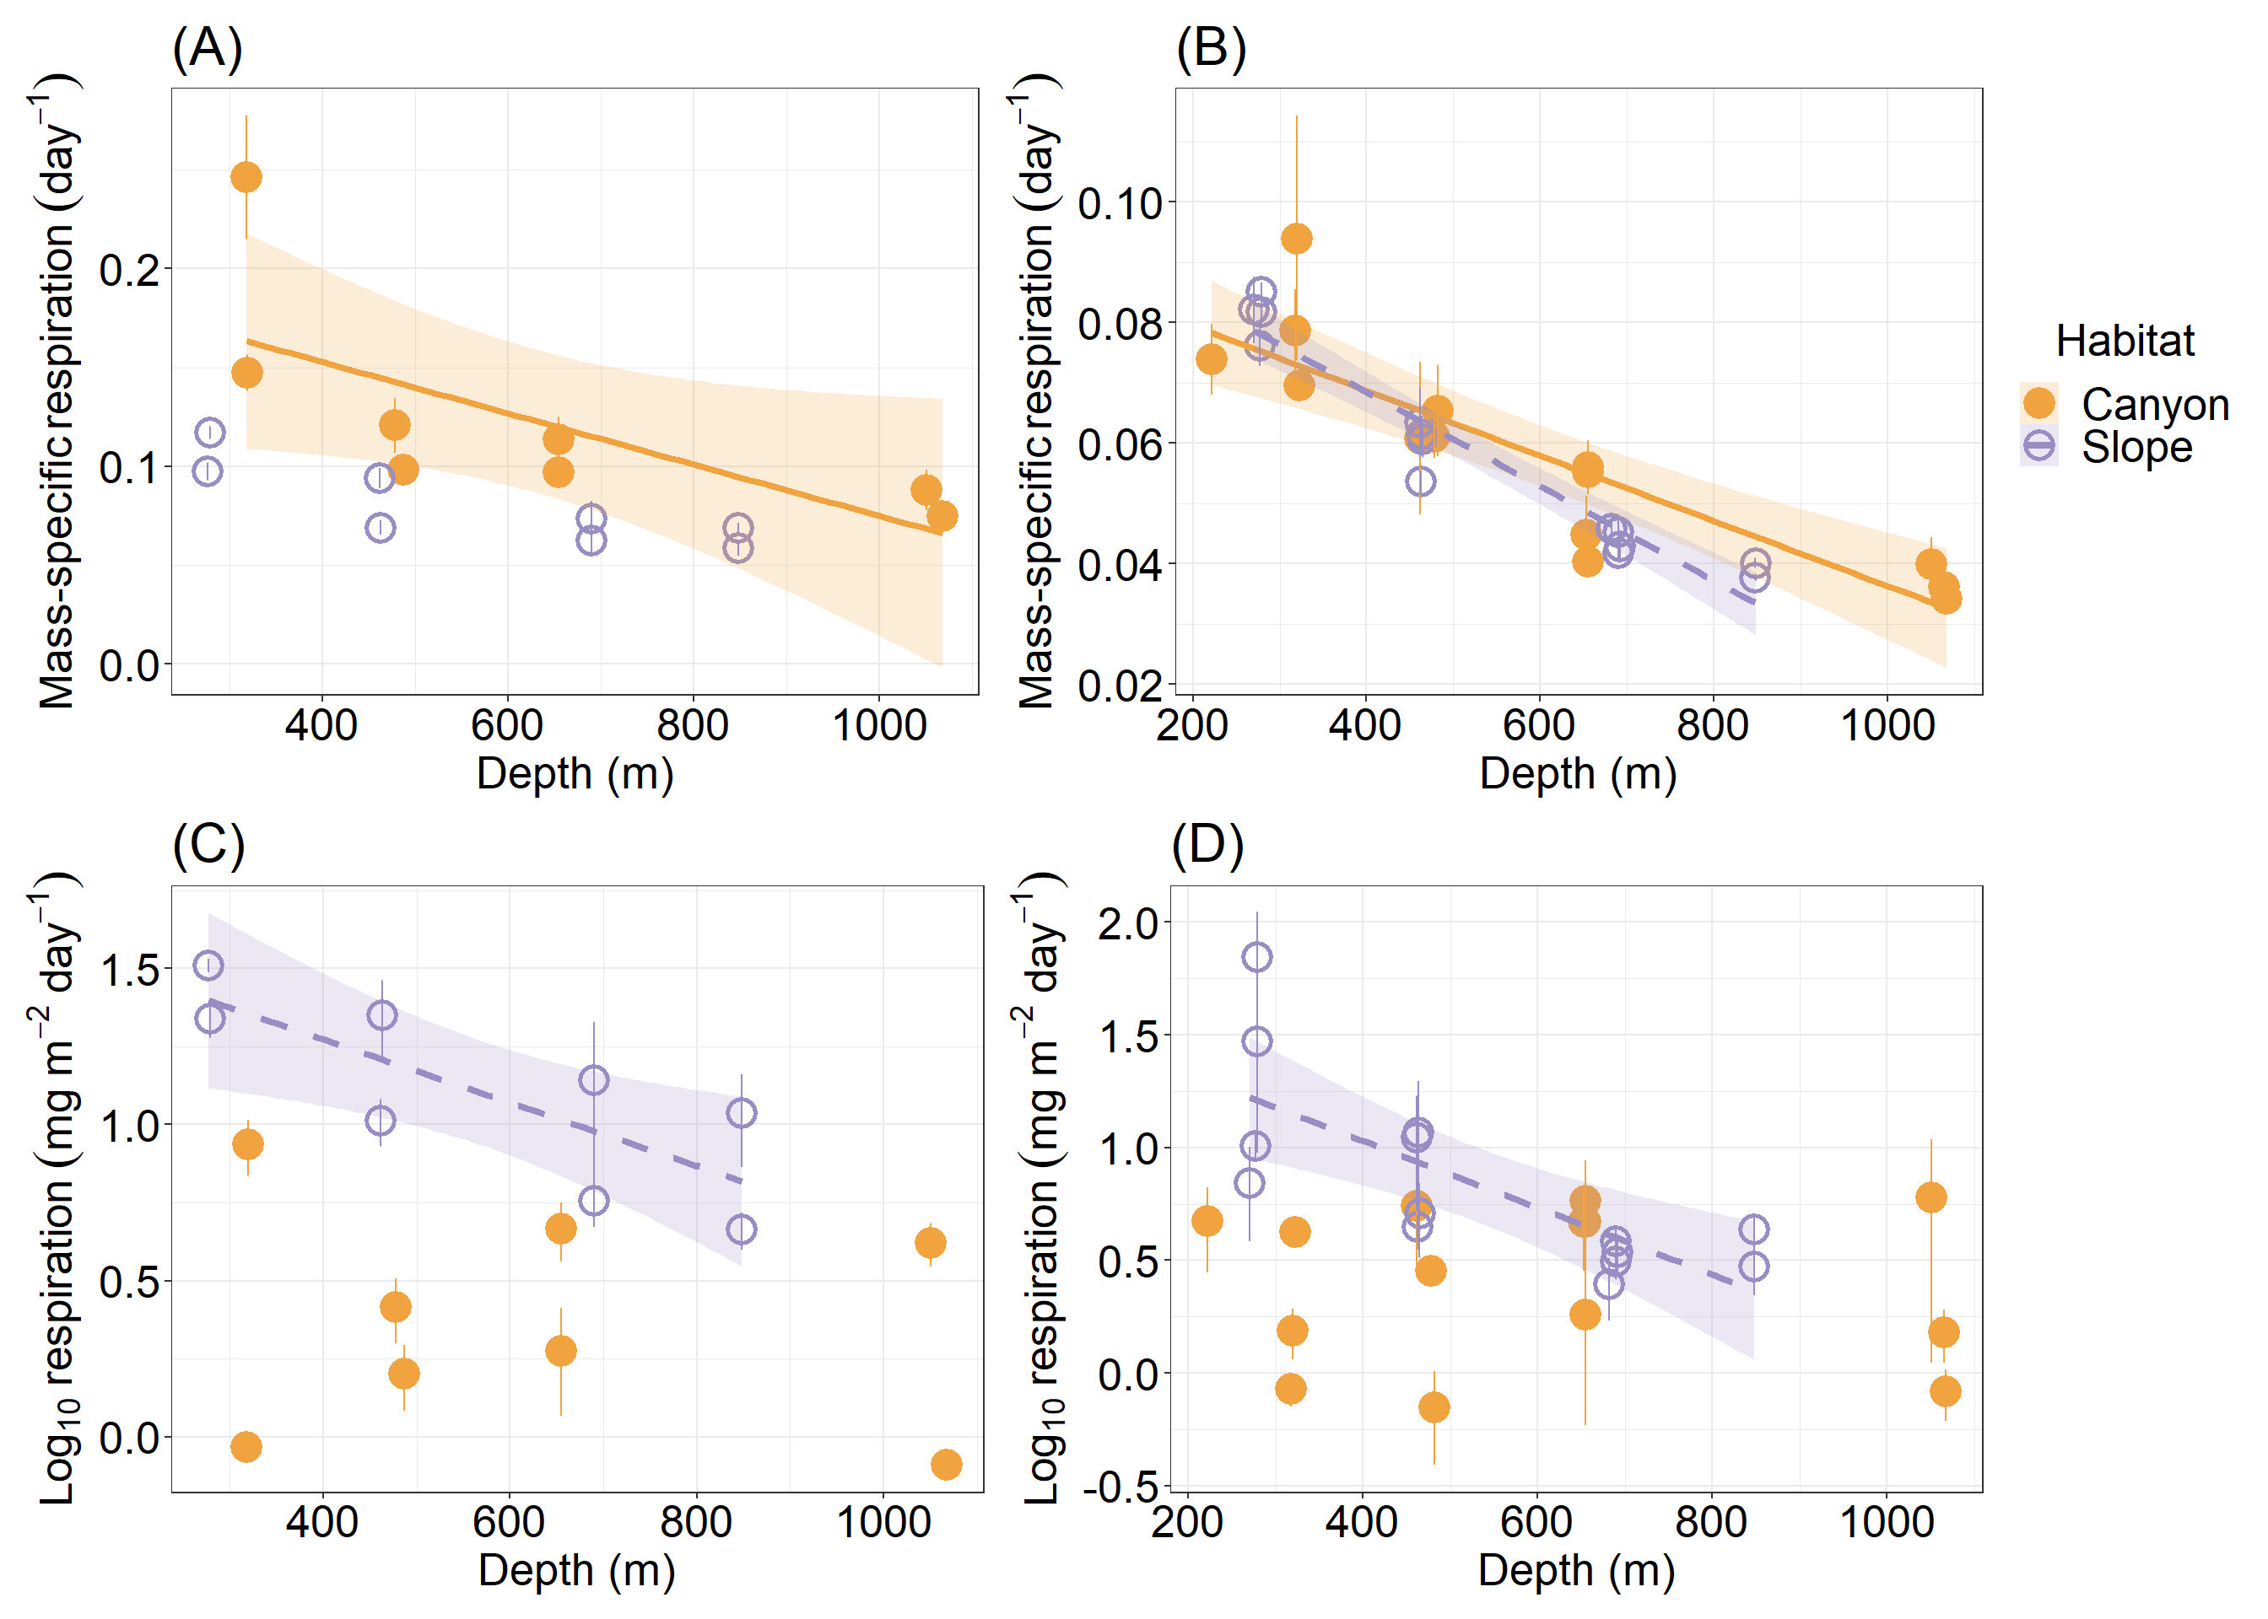
Notes:
Fig. 5. Mass-specific respiration and total respiration rate of meiobenthos (A, C) and macrobenthos (B, D)

Slide 6
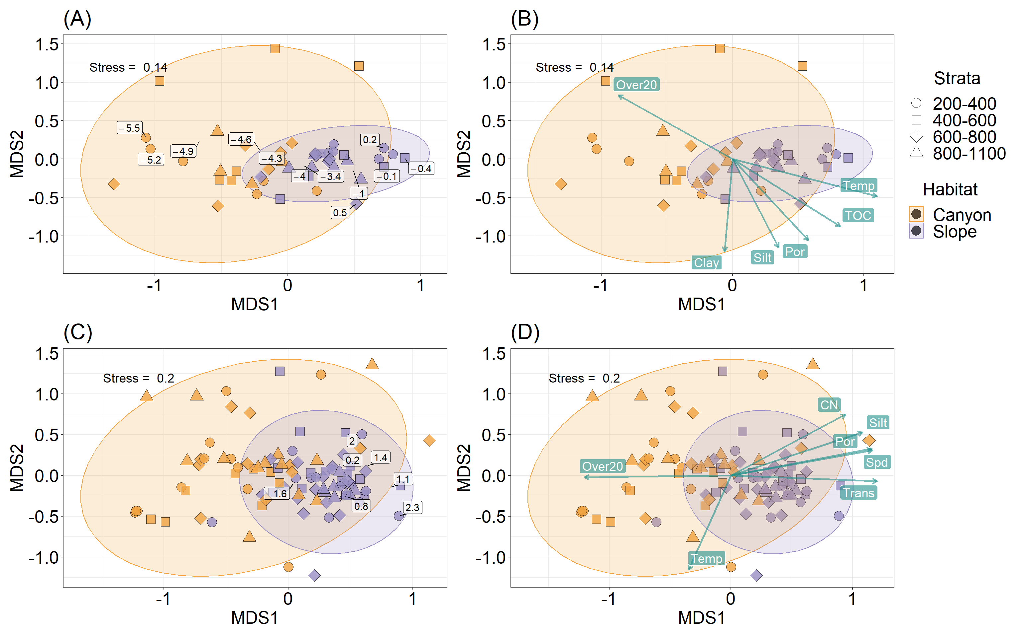
Notes:
Fig. 6 Body size composition of meiobenthos (A-B) and macrobenthos (C-D)

Slide 7
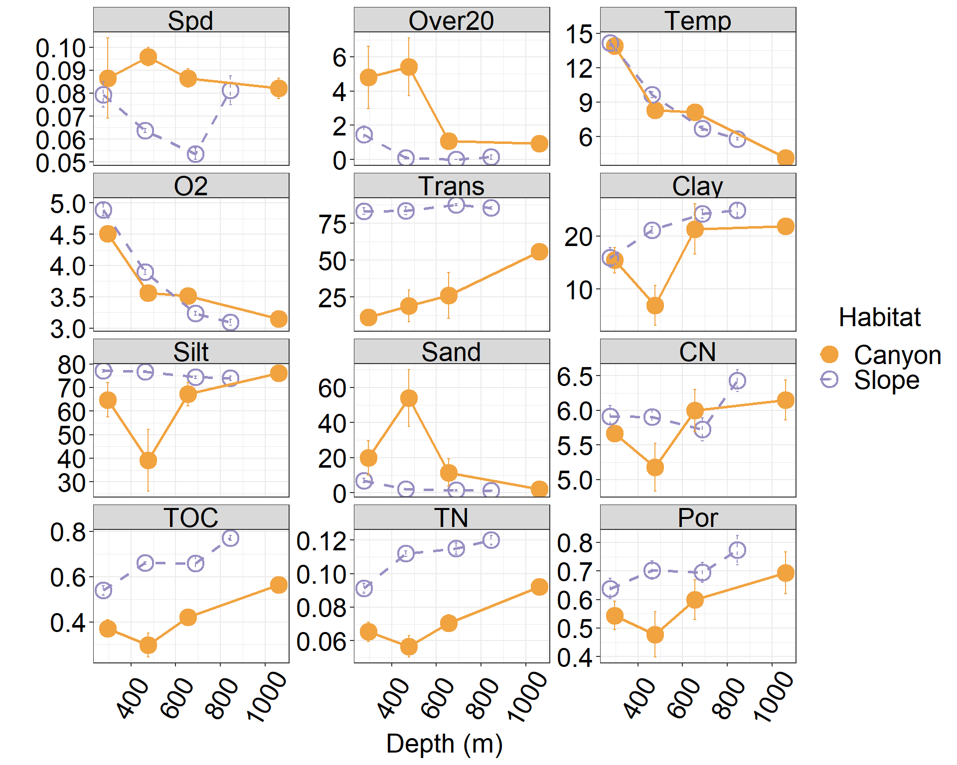
Notes:
Fig. S1

Slide 8
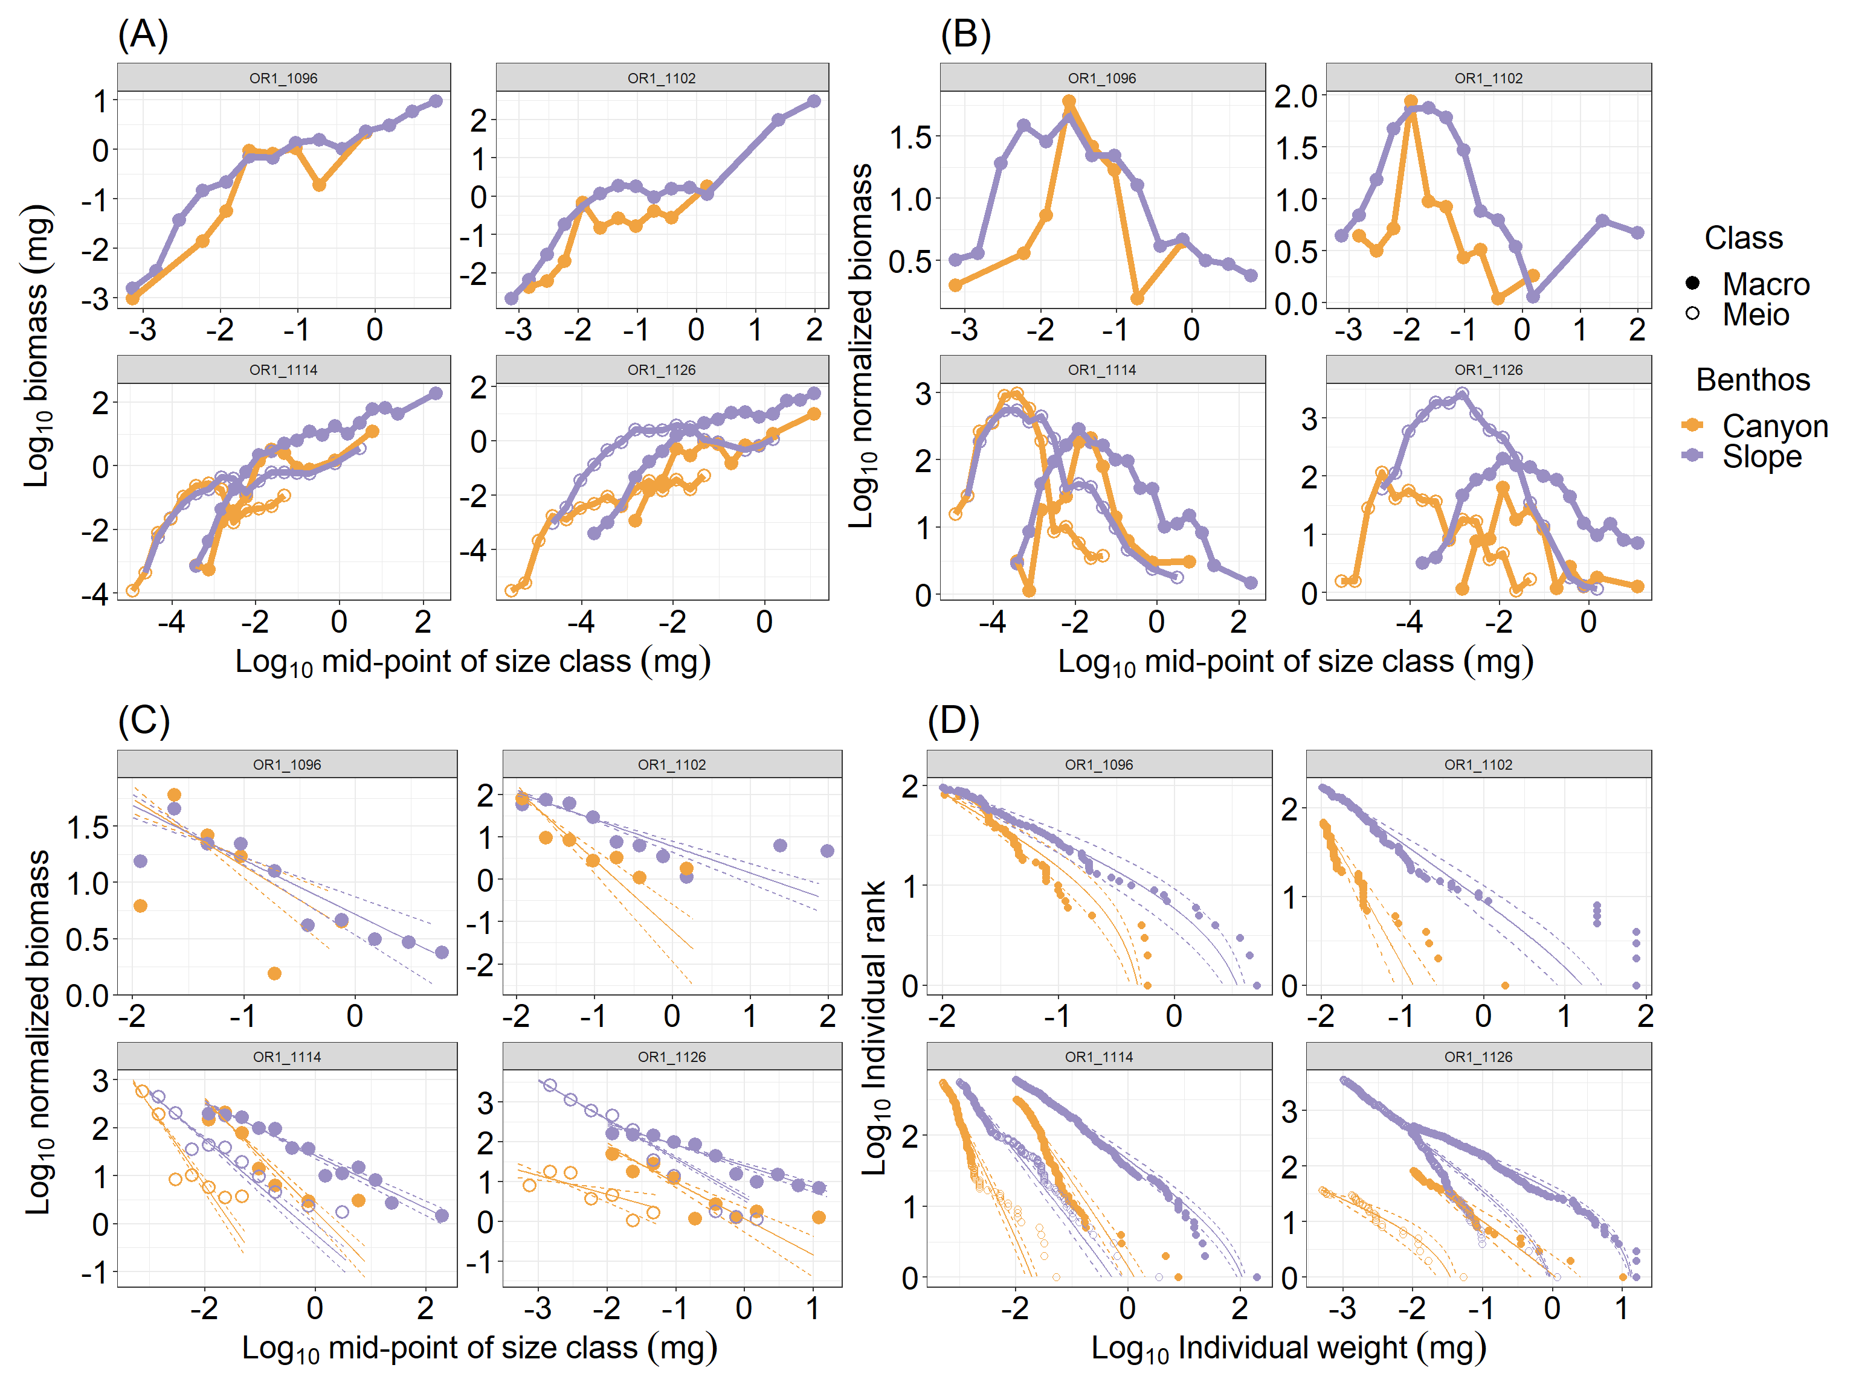

Slide 9
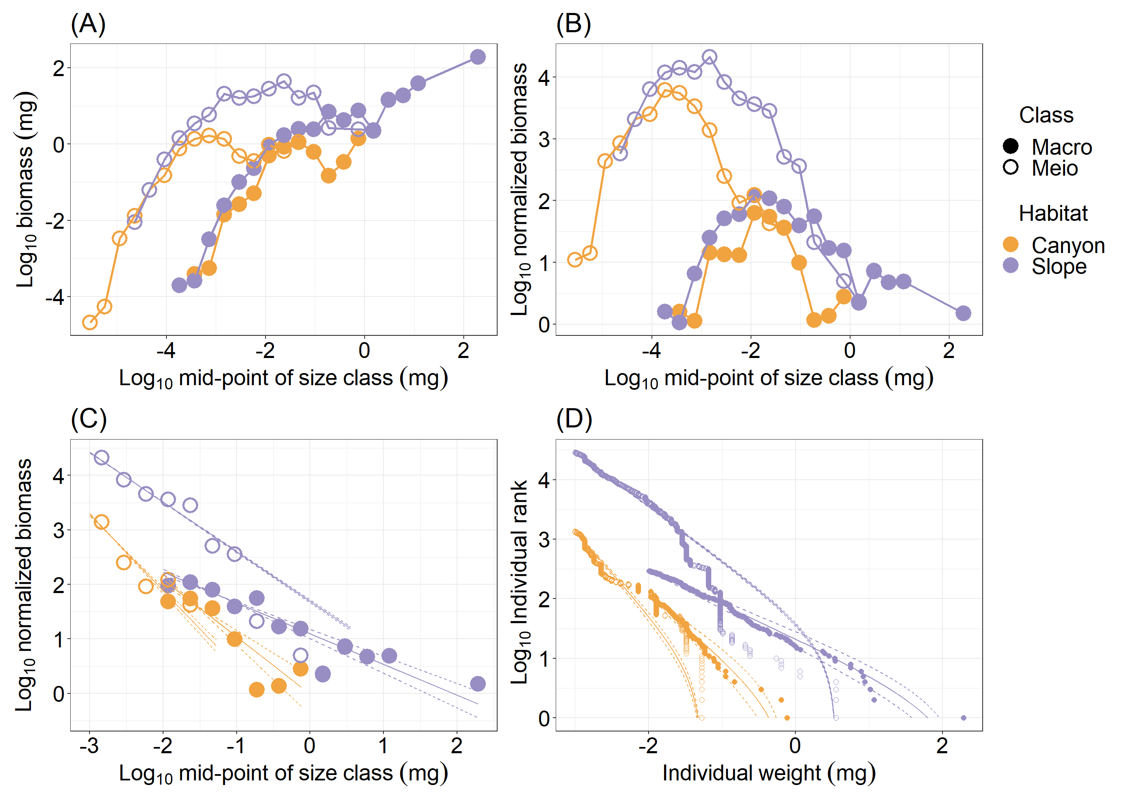
Notes:
Fig. S2 Size spectrum of meiobenthos and macrobenthos. The meiofauna were scaled to the total abundance in three multicore tubes by re-sampling the observed size measurements (with replacement).

Slide 10
