Slide 1

EMPATHETIC MEDCHAT
Presented by
Asmita Chihnara(asmitac2)
&
Tithi Sreemany(tithis2)

Slide 2
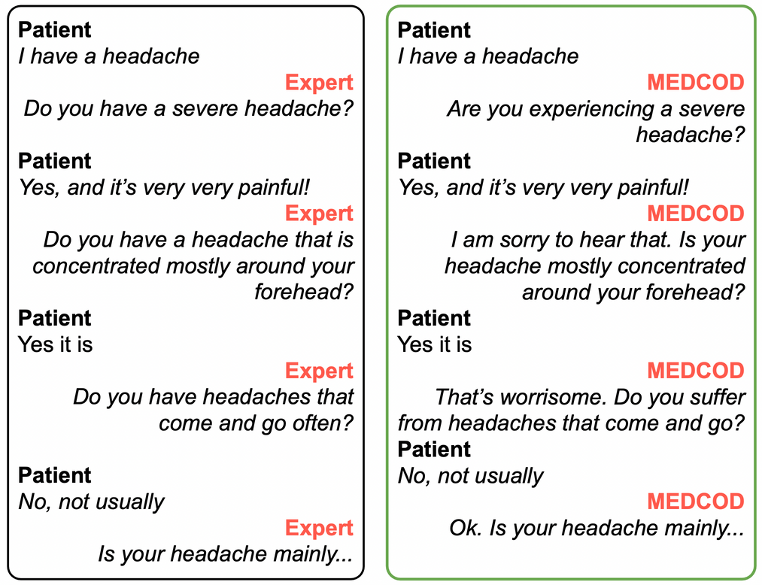
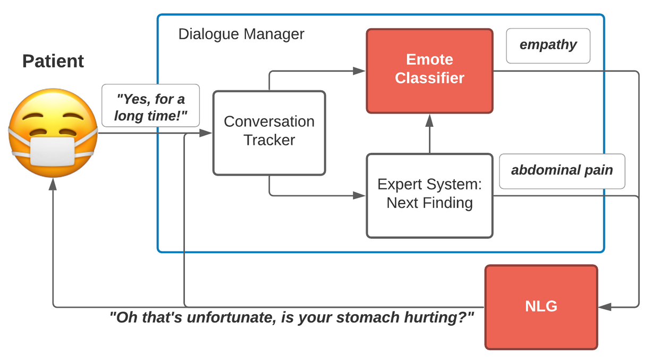
Reproducing MEDCOD
MEDCOD is a Medically-Accurate, Emotive, Diverse, and Controllable Dialog system with a unique approach to the natural language generator module.

Slide 3

Challenges & Limitations
Absence of proprietary annotated datasets
Constrained to synthetic datasets, leading to reduced domain specificity
Scarcity of high-quality medical dialogue annotations
Necessitated synthetic data generation and augmentation strategies to enrich training signals.
Limited computational capacity for model training
Only limited GPU compute support through Google Colab.
Inability to replicate expert-driven evaluation pipeline
Depended on heuristic metrics and user feedback, limiting rigorous validation of empathy and medical accuracy.

Slide 4
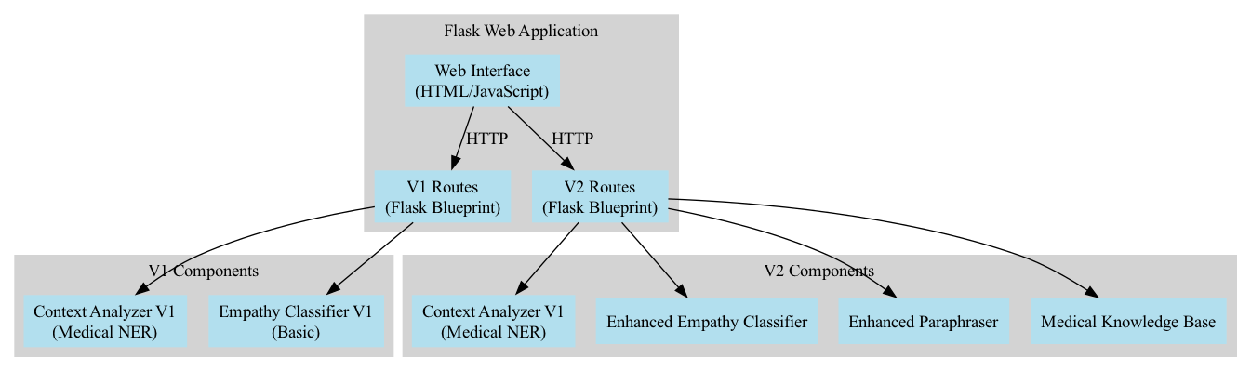
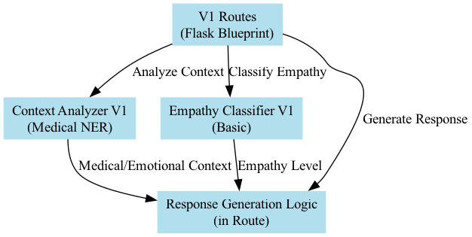
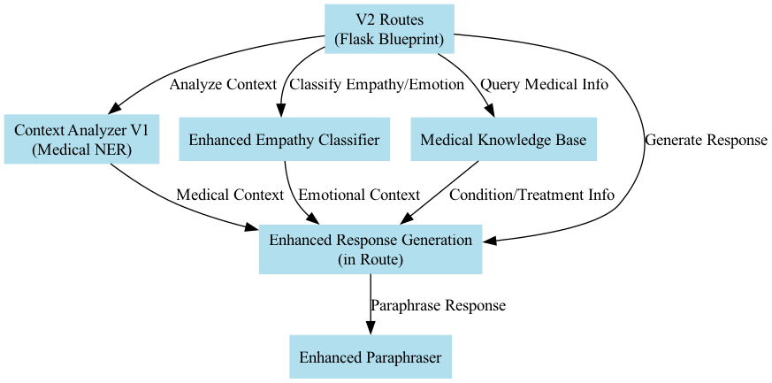
Implemented Architecture

Slide 5





Service Demo
Service Repo
Playground

Slide 6
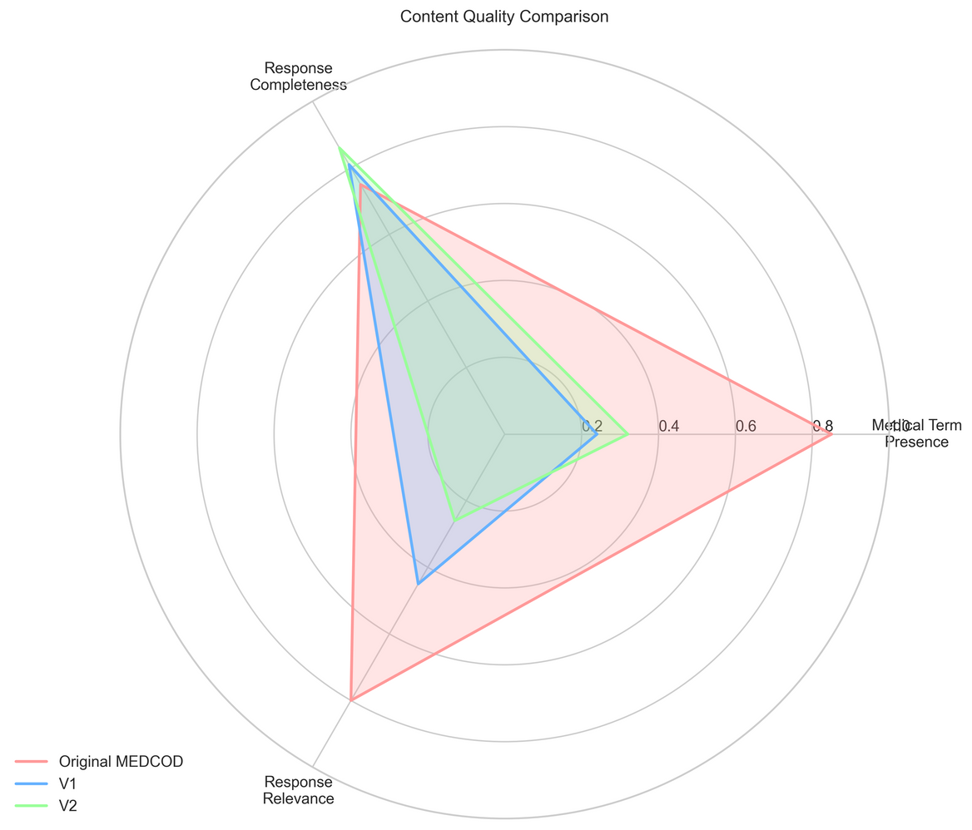
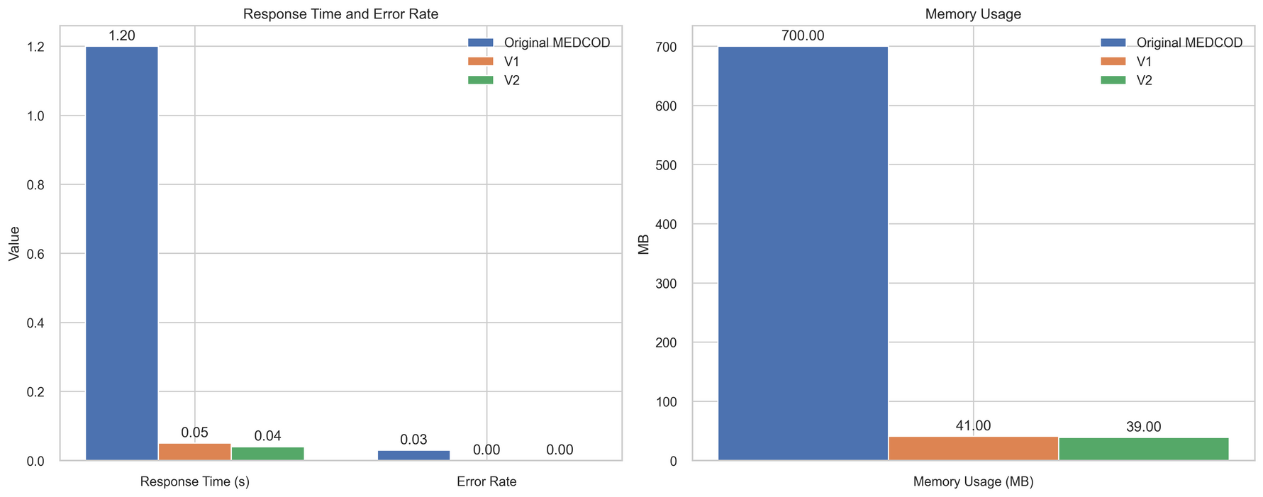
Performance Evaluation(w/ baseline)

Slide 7
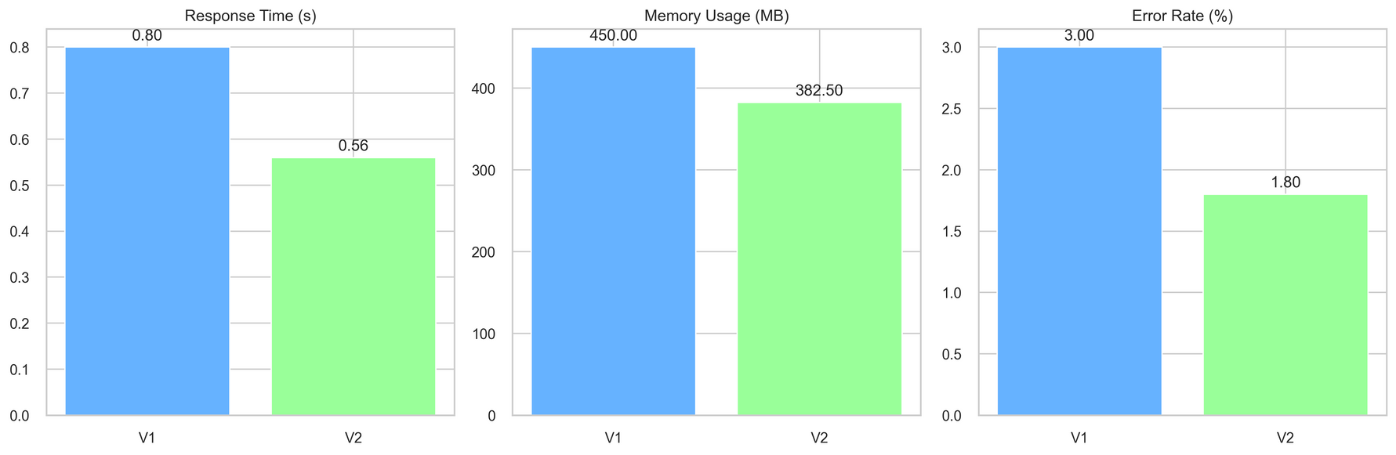
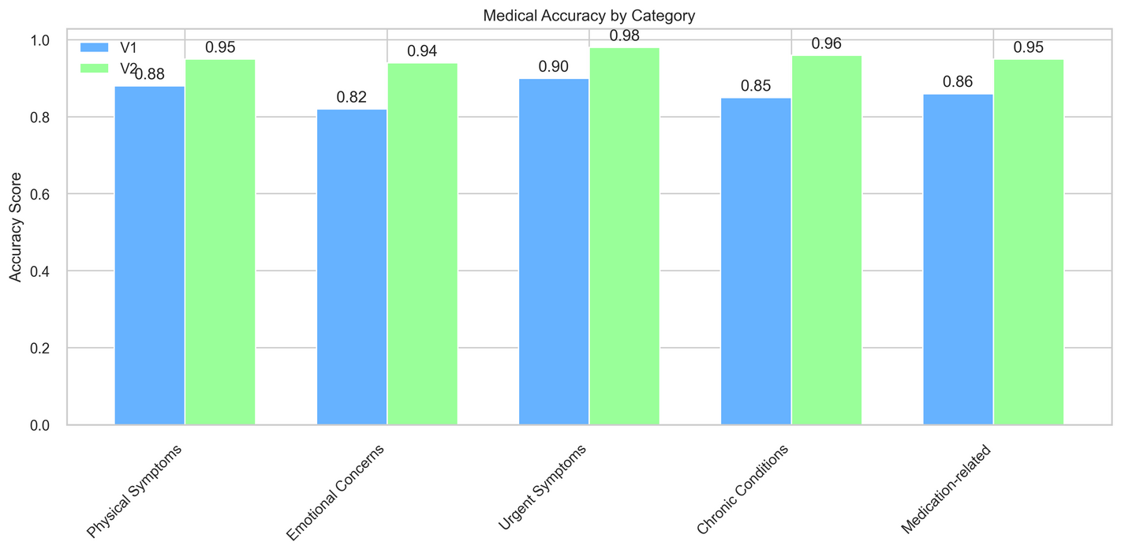
Performance Evaluation(V1 vs. V2)

Slide 8

Extensions
Enhanced emotional understanding with 8 fine-grained empathy categories.
Optimised system performance with much faster response time.
Boosted medical reliability with category specific processing mechanism.
Improved response quality with medically enriched templates.

Slide 9
Conclusion
Modular, two-version architecture enabled scalable development, balancing complexity with incremental feature upgrades.
Leveraged data augmentation to overcome limited access to proprietary, annotated medical dialogues.
Optimised for low-resource environments.
Evaluation relied on qualitative feedback and automated metrics, trading off depth for practical deployability.
Future work: Improve long-range context tracking and emotion modeling through fine-tuned transformer-based architectures.

Slide 10
Thank you very much!
Presented by
Asmita Chihnara(asmitac2)
&
Tithi Sreemany(tithis2)

Slide 11
References
MEDCOD paper (Compton et al., 2021) - MEDCOD: A Medically-Accurate, Emotive, Diverse, and Controllable Dialog System

