Slide 1
INHERITANCE java
Creating a new class from an existing class is called inheritance.
In inheritance, existing class is called super class and new class is called sub class.
Use inheritance in the following situations-
To add new features to existing class.
To modify features of existing class.
Advantages of Inheritance
Modularity
Code Reusability
Extendibility
For Method Overriding (so that runtime polymorphism can be achieved)

Slide 2
Types of Inheritance
Single Inheritance
Multiple Inheritance
Multilevel Inheritance
Hierarchical Inheritance
Multipath Inheritance
Hybrid Inheritance

Slide 3
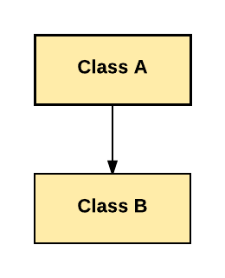
Single Inheritance
Derivation of a class from only one super class is called as single inheritance.

Slide 4
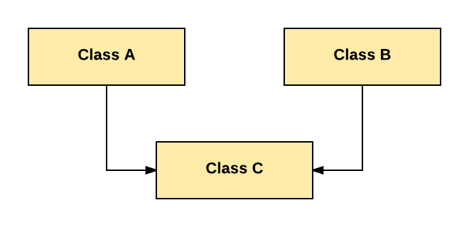
Multiple Inheritance
Derivation of a class from more than one super class is called as multiple inheritance.

Slide 5
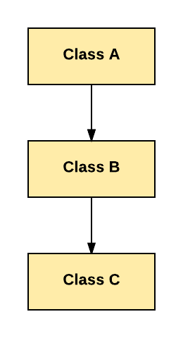
Multilevel Inheritance
Derivation of a class from sub class is called as multilevel inheritance.

Slide 6
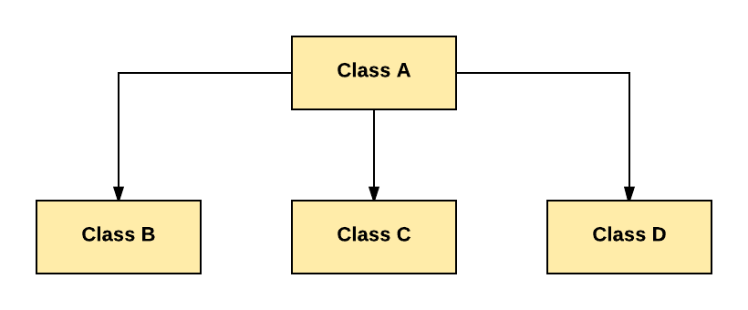
Hierarchical Inheritance
Derivation of several classes from only one super class is called as hierarchical inheritance.

Slide 7
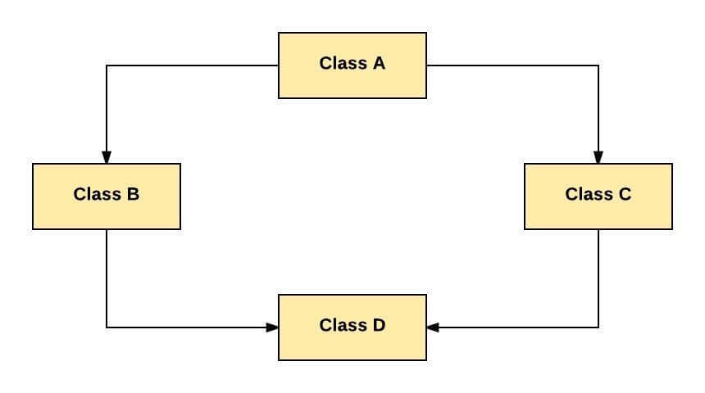
Multipath Inheritance
Derivation of a class from more than one sub class, those sub classes get inherited from the same super class is called as multipath inheritance.

Slide 8
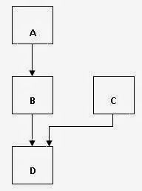
Hybrid Inheritance
Derivation of a class involving more than one form of inheritance is called as hybrid inheritance.

Slide 9
Note 1- Multipath inheritance is also one example of hybrid inheritance
Note 2- Java does not support multiple inheritance, multipath inheritance and hybrid inheritance.
Java does not support multiple inheritance because of ambiguity.
C ob = new C();
ob.show(); ← Here complier gets ambiguity to call either A class show method or B class show method
Java does not support multipath inheritance and hybrid inheritance because both types contain multiple inheritance.

Slide 10
Syntax- class Subclass-name extends Superclass-name
{
//methods and fields
}
Eg:- class A
{
int x=5;
void show()
{
System.out.println(“print() method”);
}
}

Slide 11
Class B extends A
{
int y=10;
void print()
{
System.out.println(“print() method”);
}
public static void main(String args[])
{

Slide 12
B ob = new B();
System.out.println(ob.x);
System.out.println(ob.y);
ob.show();
ob.print();
}
}
Output – 5
10
show() method
print() method

Slide 13
Super Keyword
It is called as object reference or reference variable because it refers super class memory.
It is required to access super class instance variables whenever both super class and sub class instance variables names are same.
Eg. class A
{
int x = 5;
}

Slide 14
class B extends A
{
int x = 10;
void show()
{
int x = 15;
System.out.println(x);
System.out.println(this.x);
System.out.println(super.x);
}

Slide 15
public static void main(String args[])
{
B ob = new B();
ob.show();
}
Output – 15
10
5
Super keyword is also required to access super class method whenever both super class method and sub class method names are same

Slide 16
Eg. class A
{
void print()
{
System.out.println(“A class”);
}
}
class B extends A
{
void print()
{
System.out.println(“B class”);
}

Slide 17
void show()
{
print();
this.print();
super.print();
}
public static void main(String args[])
{
B ob = new B();
ob.show();
Output – B class
B class
A class

Slide 18
Note – static method does not refer this and super keywords in any way(implicitly and explicitly)
super()
It calls default constructor of super class.
It implicitly comes in every constructor as a first statement.
super(arg1, arg2,----)
It calls parameterized constructor of super class.
It is explicitly required to call parameterized constructor of super class.

Slide 19
Eg. class A
{
A()
{
System.out.println(“Core Java”);
}
}
class B extends class A
{

Slide 20
B()
{
super(); ← implicitly
System.out.println(“Advance Java”);
}
public static void main(String args[])
{
new B();
}
}
Output – Core Java
Advance Java

Slide 21
Eg 2- class A
{
A(String s )
{
System.out.println(s);
}
}
class B extends class A
{
B(String s)

Slide 22
{
super(); ← implicitly
System.out.println(s);
}
public static void main(String args[])
{
new B(“Core Java”);
}
}
Output – error because there is no default constructor in A class

Slide 23
To solve the above problems there are three solutions-
Calling parameterized constructor of super class from sub class.
Providing default constructor in super class.
Removing parameterized constructor in super class.
Eg 1. Calling parameterized constructor of super class from sub class
class A
{
A(String s )
{
System.out.println(s);
}
}

Slide 24
class B extends class A
{
B(String s)
{
super(s);
System.out.println(s);
}
public static void main(String args[])
{
new B(“Core Java”);
}
}
Output – Core Java
Core Java

Slide 25
Eg 2. By providing default constructor in super class
class A
{
A()
{
System.out.println(“Java”);
}
A(String s)
{
System.out.println(s);
}
}

Slide 26
class B extends class A
{
B(String s)
{
super(); ← implicitly
System.out.println(s);
}
public static void main(String args[])
{
new B(“Core Java”);
}
}
Output – Java
Core Java

Slide 27
Eg 3. Removing parameterized constructor in super class
class A
{
}
class B extends class A
{
B(String s)
{
super(); ← implicitly
System.out.println(s);
}

Slide 28
public static void main(String args[])
{
new B(“Core Java”);
}
}
Output – Core Java
Note – this();, this(arg1,arg2,------), super(), super(arg1, arg2,-----) must be a first statement in a constructor.

Slide 29
Final Keyword
It is called as modifier because it modifies the behavior of a variable, method and class.
By using final keyword, we can prevent value of the variable, method overriding and inheritance.
If you make any variable as final, you cannot change the value of final variable(It will be constant).
Eg- final int x = 5;
x++; error because final values cannot be changed
Final keyword can be applied to instance variable, class variable and local variable.

Slide 30
Class Demo
{
int x;
public static void main(String args[])
{
System.out.println(new Demo().x);
}
}
Output – 0

Slide 31
2. class Demo
{
final int x;
public static void main(String args[])
{
System.out.println(new Demo().x);
}
}
Output – error because final variables must be initialized before access

Slide 32
Blank or uninitialized final variable
A final variable that is not initialized at the time of declaration is known as blank final variable.
If you want to create a variable that is initialized at the time of creating object and once initialized may not be changed, it is useful.
It can be initialized only in constructor.

Slide 33
eg. Class Demo
{
final int x;
Demo()
{
x = 5;← It is called as intialization
}
public static void main(String args[])
{
System.out.println(new Demo().x);
}
}
Output – 5

Slide 34
Note – Final variables cannot be initialized inside a method, it will be an assignment.
Class Demo
{
final int x;
void set()
{
x = 5; ← It is called as assignment
}
public static void main(String args[])
{
Demo ob = new Demo();
ob.set();
System.out.println(ob.x);
}
}
Output – error because final variables must be initialized before access

Slide 35
Static Blank Final Variable
A static final variable that is not initialized at the time of declaration is known as static blank final variable. It can be initialized only in static block.
Class Demo
{
X=5; ← It is called as an initialization
}
public static void main(String args[])
{
System.out.println(new Demo().x);
}
}

Slide 36
Java final method
If you make any method as final, you cannot override it.
Eg. Class A
{
final void show()
{
________
________
}
}

Slide 37
class B extends A
{
void show()
{
________
________
}
}
Output – error because final methods cannot be overridden.

Slide 38
Java Final Class
If you make any class as final, you cannot extend it.
Eg. Final class A
{
----------
----------
}
Class B extends A
{
----------
----------
}
Output – error because final methods cannot be inherited

Slide 39
Note
1. final method is inherited but you cannot override it.
2.You cannot declare a constructor as final because constructor is never inherited.

