Slide 1
Doubly Linked List – Create & Display

Slide 2
Doubly Linked List - Creation
It first checks whether the head is null, then it will insert the node as the head.
Both head and tail will point to a newly added node.
Head's previous pointer will point to null and tail's next pointer will point to null.
If the head is not null, the new node will be inserted at the end of the list such that new node's previous pointer will point to tail.
The new node will become the new tail. Tail's next pointer will point to null.

Slide 3
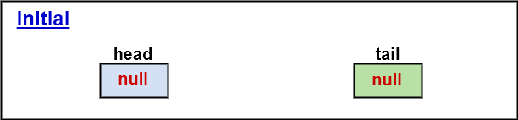
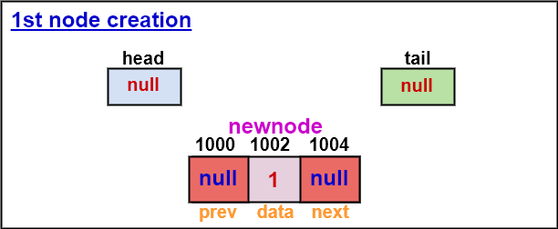
Doubly Linked List - Creation

Slide 4
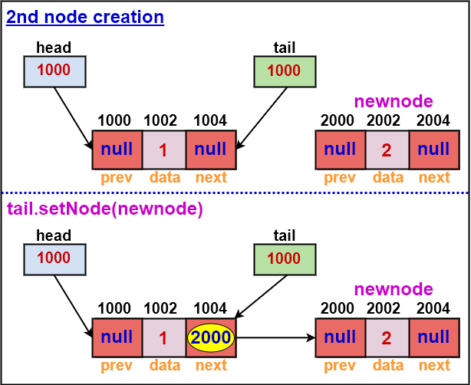
Doubly Linked List - Creation

Slide 5
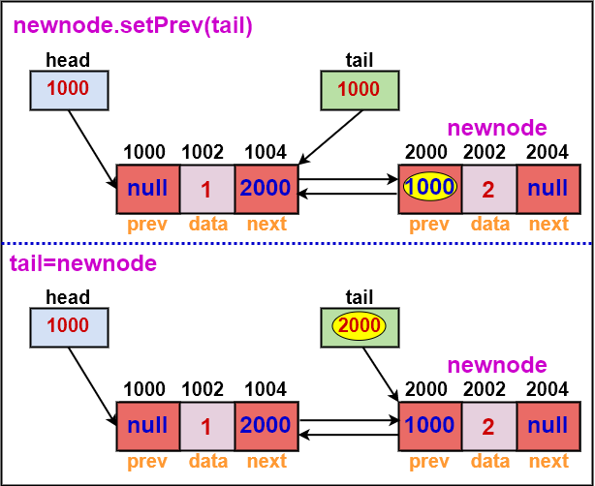
Doubly Linked List - Creation

Slide 6
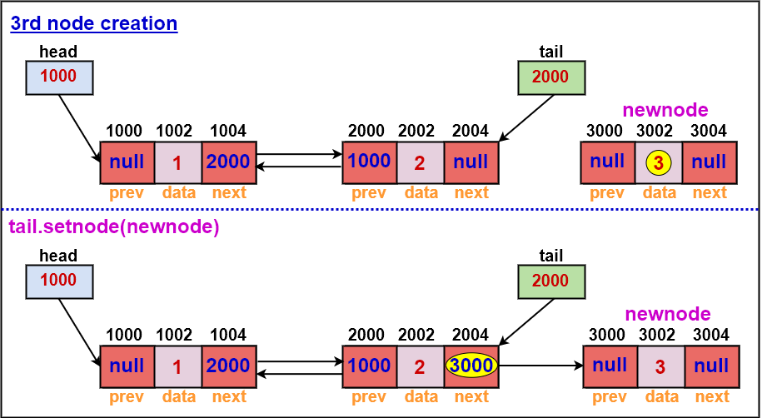
Doubly Linked List - Creation

Slide 7
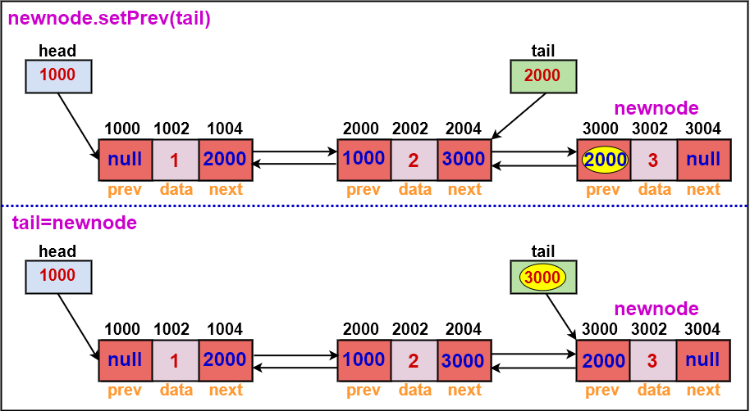
Doubly Linked List - Creation

Slide 8
Doubly Linked List - Display
Define a new node 'current' that will point to the head.
Print current.data till current points to tail.
Current will point to the next node in the list in each iteration.

Slide 9
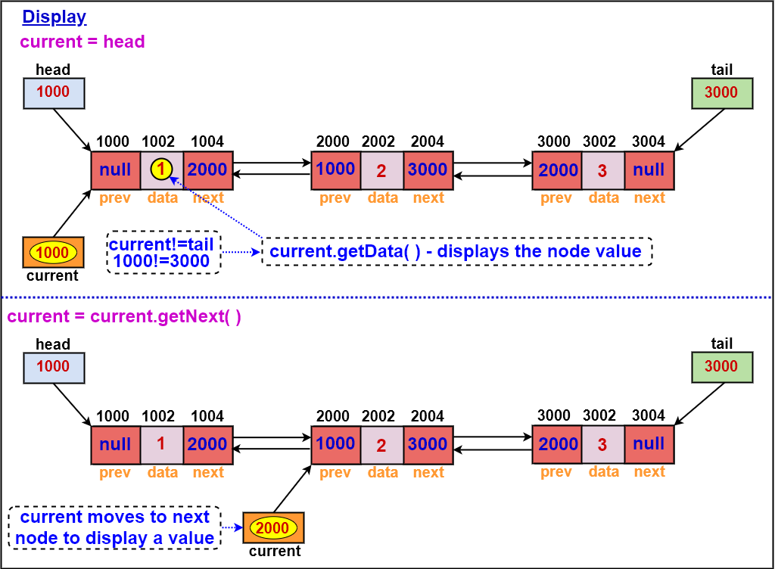
Doubly Linked List - Display

Slide 10
THANK
YOU

