Slide 1
Linked List

Slide 2
Session Outcomes
At the end of this session Single linked list operations students will be able to:
Explain SINGLE LINKED LIST : CREATE Operations
2. Explain SINGLE LINKED LIST : Display Operations
Single Linked List
Create
Display

Slide 3
Learning Objectives
1. To provide the knowledge of basic concept of linked list and their implementations.
2. To understand importance of single linked list in context of writing efficient programs.
3. To develop skills to apply appropriate single linked list Create and display operations in problem solving.

Slide 4
Need of the session
It used for data storage.
To perform creating nodes in single lined list effectively.
To perform display operations.

Slide 5
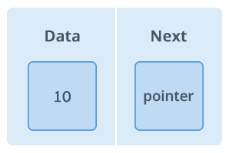
Linked List
A node is a collection of two sub-elements or parts. A data part that stores the element and a next part that stores the link to the next node or NULL.
Node

Slide 6
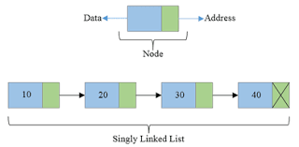
Singly Linked List
Singly linked lists contain nodes which have a data part as well as an address part i.e. next, which points to the next node in the sequence of nodes.

Slide 7
Singly Linked List
Singly linked lists contain nodes which have a data part as well as an address part i.e. next, which points to the next node in the sequence of nodes.
KLEF P-1(CTD) BES-1

Slide 8
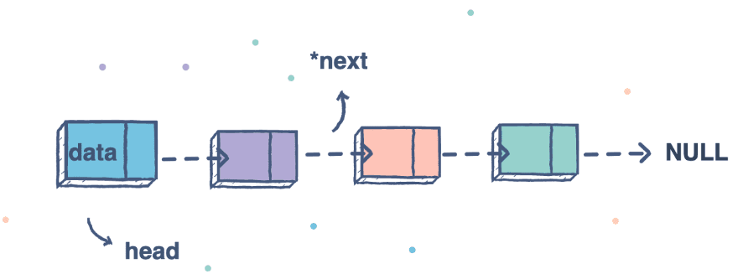
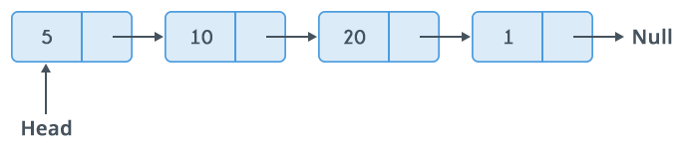
Singly Linked List Representation

Slide 9
Singly Linked List operations
Create
Insertion
Deletion
Display

Slide 10
SINGLE LINKED LIST
create
display

Slide 11
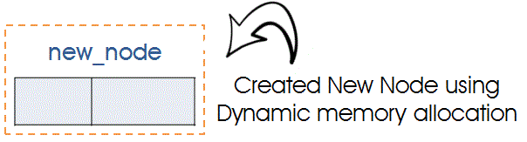
Singly Linked List create
Step1: Create Node using Dynamic Memory Allocation

Slide 12
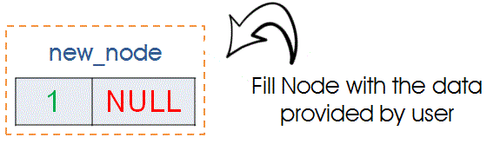
Singly Linked List create
Step2: Fill Information in newly Created Node

Slide 13
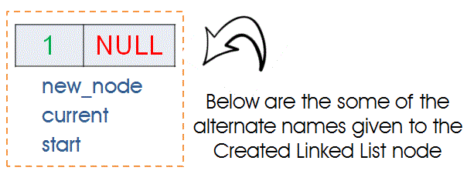
Singly Linked List create
Step3: Creating Very First Node
If node created in the above step is very first node then we need to assign it as Starting node. If start is equal to null then we can identify node as first node.

Slide 14
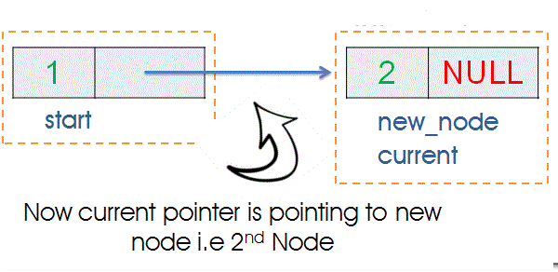
Singly Linked List create
Step4: Creating Second or nth node
Lets assume we have 1 node already created i.e we have first node. First node can be referred as “new_node”,”curr”,”start”.
Now we have called create() function again

Slide 15
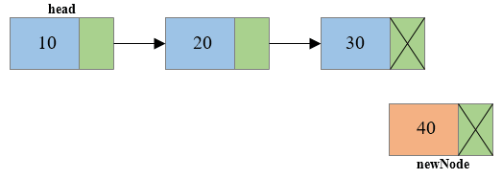
Singly Linked List create
Step5: Creating nth node
Create a new node and make sure that the address part of the new node points to NULL i.e. newNode->next=NULL

Slide 16
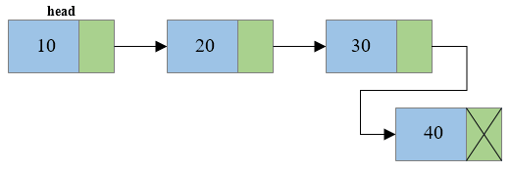
Singly Linked List create
Step6: Creating nth node
Traverse to the last node of the linked list and connect the last node of the list with
the new node, i.e. last node will now point to new node. (lastNode->next = newNode).

Slide 17
Singly Linked List create an display
Steps for Displaying the single Linked List :
In order to write the program for display, We must create a linked list using create(). Then and then only we can traverse through the linked list.
Traversal Starts from Very First node. We cannot modify the address stored inside global variable “start” thus we have to declare one temporary variable -“temp” of type node.
In order to traverse from start to end you should assign Address of Starting node in Pointer variable i.e temp

Slide 18
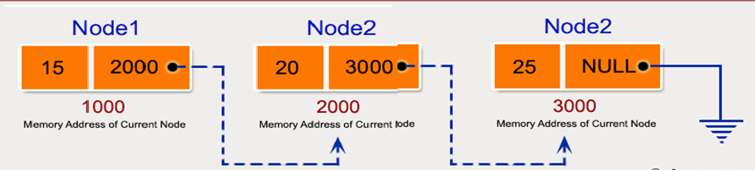
Singly Linked List display
Display the values for this single linked list as
15→20→25→NULL

Slide 19
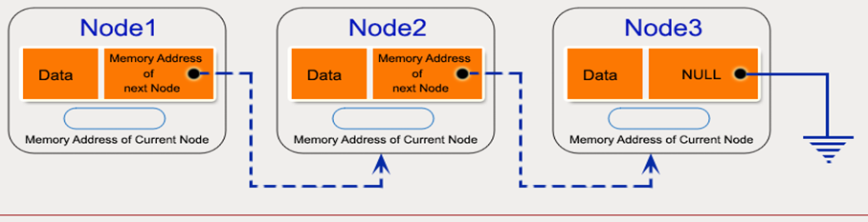
Singly Linked List create and display

Slide 20
Practice Session
Write a program in C to create a Singly Linked List and display it in order.
Write a program in C to create a singly linked list of n nodes and display it in reverse order.

Slide 21
Thank You

