Slide 1
Hash Table Data Structure

Slide 2
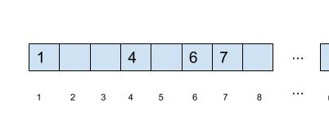
Suppose we wanted to store a set of unique numbers within the range 1 – 1,000
Is there a structure and storage scheme that would permit searching, inserting and removing in Constant time i.e., O(1) time.
Simply use an array with indices 1 – 1000. Inserting, searching and deletion can be done in constant time
The above array is called hash table. A hash table is an array of some fixed size. It is good idea to ensure the table size is prime.
This works well if we are storing integers, but what about non-integer data types or values that are not within a good indexing range…?

Slide 3
Hash Functions
In our simple example, the key (which is the data itself) is also the index. That is, each data value, directly maps to an appropriate index.
Solution: find a function f that data of arbitrary size to data of fixed size. The values returned by the hash function are called hash values, hash codes etc..
Hash Functions must be chosen in such a way that they are
simple/fast to compute,
Avoid collisions
have keys distributed evenly among cells.
Collision occur when two keys hash to same index.
You will understand this when you actually work out on an example in the later part of the video
No blanks
No collisions
(ex. When know entire data set ahead of time – like in compilers keyword lookup)

Slide 4
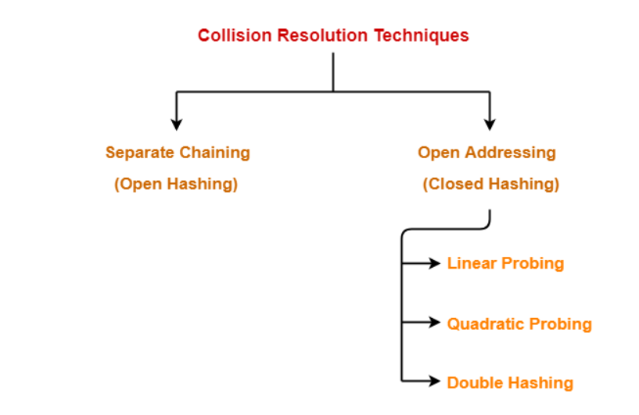

Slide 5
Insert 89
Linear Probing
0
1
2
3
4
5
6
7
8
9
Hash function is a function that tell you the index in which key has to be inserted. Here the Hash function is (key+i)%TABLE_SIZE
index = (key+i)%TABLE_SIZE
Index = (89+0) % 10 = 89%10 = 9
So we insert 89 at index 9
89
Home bucket for 89

Slide 6
Insert 18
Linear Probing
0
1
2
3
4
5
6
7
8
9
index = (key+i)%TABLE_SIZE
Index = (18+0) % 10 = 18%10 = 8
So we insert 18 at index 8
18
89
Home bucket for 18

Slide 7
Insert 49
Linear Probing
0
1
2
3
4
5
6
7
8
9
49
index = (key+i)%TABLE_SIZE
Index = (49+0) % 10 = 49%10 = 9
So insert 49 at index 9
Index 9 is not free so collision occurs and this is the first collision so i becomes 1.
Index = (49+1)%10 = 50%10 = 0
So insert 49 at index 0
18
89
First Collision occurs

Slide 8
Insert 58
index = (key+i)%TABLE_SIZE
Index = (58+0) % 10 = 58%10 = 8
So insert 58 at index 8
index 8 is not free so collision occurs and this is the first collision so i becomes 1.
Index = (58+1)%10 = 59%10 = 9
So insert 58 at index 9
0
1
2
3
4
5
6
7
8
9
49
Third Collision occurs
58
index 9 is not free so collision occurs and this is the second collision so i becomes 2.
Index = (58+2)%10 = 60%10 = 0
So insert 58 at index 0
index 0 is not free so collision occurs and this is the third collision so i becomes 3.
Index = (58+3)%10 = 61%10 = 1
So insert 58 at index 1
18
First Collision occurs
89
Second Collision occurs

Slide 9
Insert 69
index = (key+i)%TABLE_SIZE
Index = (69+0) % 10 = 69%10 = 9
So insert 69 at index 9
Second Collision
index 9 is not free so collision occurs and this is the first collision so i becomes 1.
Index = (69+1)%10 = 70%10 = 0
So insert 69 at index 0
0
1
2
3
4
5
6
7
8
9
49
third Collision
58
69
index 0 is not free so collision occurs and this is the second collision so i becomes 2.
Index = (69+2)%10 = 71%10 = 1
So insert 69 at index 1
index 1 is not free so collision occurs and this is the third collision so i becomes 3.
Index = (69+3)%10 = 72%10 = 2
So insert 69 at index 2
The efficiency of any collision resolution technique depends on the type of hash function used
18
89
First Collision occurs

Slide 10
Insert 89
Quadratic Probing
0
1
2
3
4
5
6
7
8
9
Hash function is a function that tell you the index in which key has to be inserted. Here the Hash function is (key+i²)%TABLE_SIZE
index = (key+i²)%TABLE_SIZE
Index = (89+0²) % 10 = 89%10 = 9
So we insert 89 at index 9
89

Slide 11
Insert 18
Quadratic Probing
0
1
2
3
4
5
6
7
8
9
index = (key+i²)%TABLE_SIZE
Index = (18+0²) % 10 = 18%10 = 8
So we insert 18 at index 8
18
89

Slide 12
Insert 49
Quadratic Probing
0
1
2
3
4
5
6
7
8
9
49
index = (key+i²)%TABLE_SIZE
Index = (49+0²) % 10 = 49%10 = 9
So insert 49 at index 9
Index 9 is not free so collision occurs and this is the first collision so i becomes 1.
Index = (49+1²)%10 = 50%10 = 0
So insert 49 at index 0
18
89
First Collision occurs

Slide 13
Insert 58
index = (key+i²)%TABLE_SIZE
Index = (58+0) % 10 = 58%10 = 8
So insert 58 at index 8
index 8 is not free so collision occurs and this is the first collision so i becomes 1.
Index = (58+1²)%10 = 59%10 = 9
So insert 58 at index 9
0
1
2
3
4
5
6
7
8
9
49
58
index 9 is not free so collision occurs and this is the second collision so i becomes 2.
Index = (58+2²)%10 = (58+4)%10 = 62%10=2
So insert 58 at index 2
18
First Collision occurs
89
Second Collision occurs

Slide 14
Insert 69
index = (key+i²)%TABLE_SIZE
Index = (69+0²) % 10 = 69%10 = 9
So insert 69 at index 9
Second Collision
index 9 is not free so collision occurs and this is the first collision so i becomes 1.
Index = (69+1²)%10 = 70%10 = 0
So insert 69 at index 0
0
1
2
3
4
5
6
7
8
9
49
58
index 0 is not free so collision occurs and this is the second collision so i becomes 2.
Index = (69+2²)%10 = (69+4)%10 = 73%10=3
So insert 69 at index 3
69
18
89
First Collision occurs

Slide 15
Insert 89
Double Hashing
0
1
2
3
4
5
6
7
8
9
Hash function here is key+I *(hash2(key))%TABLE_SIZE
Hash2(key) = R-(key%R) where R is a prime number less than the TABLE_SIZE
Here the Hash function is
(key+i*(R-(key%R)%TABLE_SIZE
index = (key+i*(R-(key%R))%TABLE_SIZE
Index = (89+0*(7-(89%7)) % 10 = 89%10 = 9
So we insert 89 at index 9
89

Slide 16
Insert 18
0
1
2
3
4
5
6
7
8
9
index = (key+i*(R-(key%R))%TABLE_SIZE
Index = (18+0*(7-(18%7)) % 10 = 18%10 = 8
So we insert 18 at index 8
18
89

Slide 17
Insert 49
index = (key+i*(R-(key%R))%TABLE_SIZE
Index = (49+0*(7-(49%7)) % 10 = 49%10 = 9
So insert 49 at index 9
0
1
2
3
4
5
6
7
8
9
Index 9 is not free so collision occurs and this is the first collision so i becomes 1.
index = (key+i*(R-(key%R))%TABLE_SIZE
Index = (49+1*(7-(49%7))%10
=( 49+1*(7-0))%10
= (49+1*7)%10
=(49+7)%10
=56%10
=6
So insert 49 at index 6
49
18
89
First Collision occurs

Slide 18
Insert 58
index = (key+i*(R-(key%R))%TABLE_SIZE
Index = (58+0*(7-(58%7)) % 10 = 58%10 = 8
So insert 58 at index 8
index 8 is not free so collision occurs and this is the first collision so i becomes 1.
index = (key+i*(R-(key%R))%TABLE_SIZE
Index = (58+1*(7-(58%7))%10
=( 58+1*(7-2))%10
= (58+1*5)%10
=(58+5)%10
=63%10
=3
So insert 58 at index 3
0
1
2
3
4
5
6
7
8
9
58
49
18
First Collision occurs
89

Slide 19
Insert 69
index = (key+i*(R-(key%R))%TABLE_SIZE
Index = (69+0*(7-(69%7)) % 10 = 69%10 = 9
So insert 69 at index 9
index 9 is not free so collision occurs and this is the first collision so i becomes 1.
index = (key+i*(R-(key%R))%TABLE_SIZE
index = (69+1*(7-(69%7))%10
=( 69+1*(7-6))%10
= (69+1*1)%10
=(69+1)%10
=70%10
=0
So insert 69 at index 0
0
1
2
3
4
5
6
7
8
9
69
58
49
18
89
First Collision occurs

Slide 20
Animation links
http://www.cs.armstrong.edu/liang/animation/web/LinearProbing.html
https://yongdanielliang.github.io/animation/web/QuadraticProbing.html
https://liveexample.pearsoncmg.com/dsanimation/DoubleHashingeBook.html
https://yongdanielliang.github.io/animation/web/SeparateChaining.html
https://www.cs.usfca.edu/~galles/visualization/ClosedHash.html
Exercise questions
Insert the following elements into initially empty hash table of size 10
50, 700, 76, 85, 92, 73 and 101
Use linear probing, quadratic probing, double hashing and separate chaining technique for collision resolution.

Slide 21
Program links
Linear probing
http://enthusiaststudent.blogspot.com/2017/03/hashing-using-linear-probing-c-program.html
Quadratic probing
http://enthusiaststudent.blogspot.com/2017/03/quadratic-probing-c-program.html
Double hashing
http://enthusiaststudent.blogspot.com/2017/03/double-hashing-c-program.html
Separate Chaining
http://enthusiaststudent.blogspot.com/2017/03/hashing-with-separate-chaining-c-program.html

