Slide 1
PAYPAL HACKATHON · 2026
FlexPrice AI
A plug-and-play pricing advisor and adaptive billing framework that lets subscription businesses charge customers the way they actually use the product — on PayPal.
Plug-and-play adapter framework
Deterministic pricing engine
AI-powered explanations
PayPal Orders · Vault · Webhooks
Repository: framework/ (the product) · demo/ (simulation) · docs/ (FRAMEWORK, ADAPTER_CONTRACT, AI, SCALABILITY, REVIEW)
Notes:
FlexPrice AI: a framework merchants plug into their existing subscription backend to offer flexible, usage-aware pricing, explained by Claude and paid through PayPal.

Slide 2
THE PROBLEM
One price for everyone fits almost no one
Light users overpay, then cancel
Discounts become a habit
A customer who watches 6 hours a month pays the same $15.99 as one who watches 60. Perceived waste drives cancellations.
"Click cancel, get 25% off" retains briefly, teaches discount-seeking, and ends in a price shock when the promo expires.
Flexible plans are hard to evaluate
Billing systems resist change
Customers can't tell whether pay-as-you-go would be cheaper for them; merchants can't show it per customer.
Adding usage-based plans usually means replacing the subscription platform — a non-starter for most merchants.
In our 600-customer StreamFlix simulation, 532 customers (89%) are on a plan that doesn't fit their usage.
FlexPrice AI · Pricing intelligence & adaptive billing on PayPal
2
Notes:
Fixed subscriptions charge the same regardless of use. Light users feel they overpay and cancel; merchants answer with discounts, which train discount-seeking and create price shock. Merchants rarely have a per-customer view of which plan fits.

Slide 3
THE CORE IDEA
Decide deterministically, explain with AI, bill on PayPal
For every customer: forecast usage, compare every eligible plan over the same horizon, recommend the best fit, and collect payment.
1 Decide
2 Explain
3 Bill
Deterministic decision engine
Claude, grounded in the engine
PayPal end to end
• Forecast usage from history (trend + seasonality) with an 80% range
• Price every plan: fixed, annual, usage, hybrid, tiered, caps
• Rank on risk-adjusted cost × customer preference
• Policy engine: eligibility, caps, consent, fair offers
• Plain-language "why this plan"
• Chat: "2 movies a week, no commitment" → engine inputs
• Merchant copilot proposes catalog experiments
• Any $ or % not produced by the engine is rejected
• Orders v2 checkout, verified server-side
• Vault: saved account for renewals & usage invoices
• Proration credits, notices, retries, reconciliation
• Signed webhooks both ways (PayPal → us → merchant)
Design principle: deterministic money, AI words. The merchant's backend stays the source of truth.
FlexPrice AI · Pricing intelligence & adaptive billing on PayPal
3
Notes:
Three pillars. The decision layer is deterministic code — every price is computed in integer cents. Claude explains and converses but cannot invent numbers or move money. PayPal handles all payments including saved-account renewals and usage invoices.

Slide 4
WHO WINS
Value for customers, merchants and PayPal
Customers
Merchants
PayPal
• See what each plan would cost them, with a range — before paying
• Pay for what they use, never above a spending cap
• Fair credit for unused time when switching
• Reminders before every renewal and usage charge
• No pressure tactics; cancellation is always available
• Usage, hybrid, tiered and annual plans without replacing billing
• Thin adapter; their backend stays the source of truth
• Fewer cancellations: cheaper fitting plans before "cancel"
• Honest revenue impact + a revenue-neutral pricing solver
• Webhooks to email customers and manage entitlements
• New usage-based and recurring payment volume
• Vault adoption: saved accounts charged merchant-initiated
• A billing-intelligence layer that differentiates PayPal for subscription merchants
• Built on Orders, Vault, Webhooks, Subscriptions
• Distributable via PayPal Commerce Platform
FlexPrice AI · Pricing intelligence & adaptive billing on PayPal
4
Notes:
Customers get transparency and fair prices. Merchants get flexible pricing without replacing their billing system, honest revenue analytics and retention tools. PayPal gets new recurring and usage-based payment volume on Vault, and a differentiated merchant offering.

Slide 5
PLUG-AND-PLAY FRAMEWORK
One adapter contract — any merchant backend
Merchants write a thin translation layer and declare what they support. FlexPrice never assumes an undeclared capability.
Capability | Adapter method | Unlocks
plans | getPlans() | Pricing Advisor (required)
customer_context | getCustomerContext() | Current plan, tenure, eligibility
usage_history | getUsage() | Personalised forecasts
usage_metering | recordUsage() | Usage-based plans
change_plan | changePlan() | In-widget switching
subscription_status | getSubscriptionStatus() | Post-payment verification
pause / cancel | pause/cancelSubscription() | Retention alternatives
retention_offers | applyRetentionOffer() | Policy-approved discounts
cohort_usage | getCohortUsage() | Anonymised pricing insights
The merchant keeps
• Customers, identity & login
• Plans, entitlements, usage data
• Its own subscription system for existing customers
The gateway enforces
• Declared capabilities only
• Schema validation of every response
• Timeouts, plan caching, health metrics
12 capabilities · conformance: GET /merchant/validate
FlexPrice AI · Pricing intelligence & adaptive billing on PayPal
5
Notes:
The adapter contract is language-agnostic REST (or an in-process JS object). Only 'plans' is required. Each capability unlocks features; missing ones are hidden automatically — e.g. no metering means usage plans are not shown. A conformance suite validates any adapter.

Slide 6
PLUG-AND-PLAY FRAMEWORK
Proven with three integration styles
Same framework, same widget — three very different merchants.
HTTP adapter
SDK adapter
Zero-code catalog
StreamFlix · streaming
CodeCloud · developer API
LearnHub · online learning
• Separate backend, own data model (cents, SKUs, minutes)
• Exposes the REST contract; any language
• Full adaptive billing: metering, pause, retention, webhooks
• In-process JavaScript object
• Graduated tiered pricing on API calls
• No pause capability → never offered
• Only a plan list + checkout URL
• Advice from customer-entered estimates
• Pay-per-lesson hidden: no metering declared
Integrating in six steps
1 Register merchant (JSON; secrets via env vars)
2 Expose adapter (REST, or createAdapterRouter() in Node)
3 Sign widget sessions after your own login
4 Embed <flexprice-advisor> on the plans page
5 Push usage + schedule POST /billing/run
6 Receive signed events; run validation
FlexPrice AI · Pricing intelligence & adaptive billing on PayPal
6
Notes:
StreamFlix is a separate backend with its own data model exposing the REST contract. CodeCloud plugs in an in-process JavaScript adapter with tiered pricing. LearnHub supplies only a catalog — zero code — and its metered plan is hidden automatically. The SDK lets Node merchants expose the contract with one function.

Slide 7
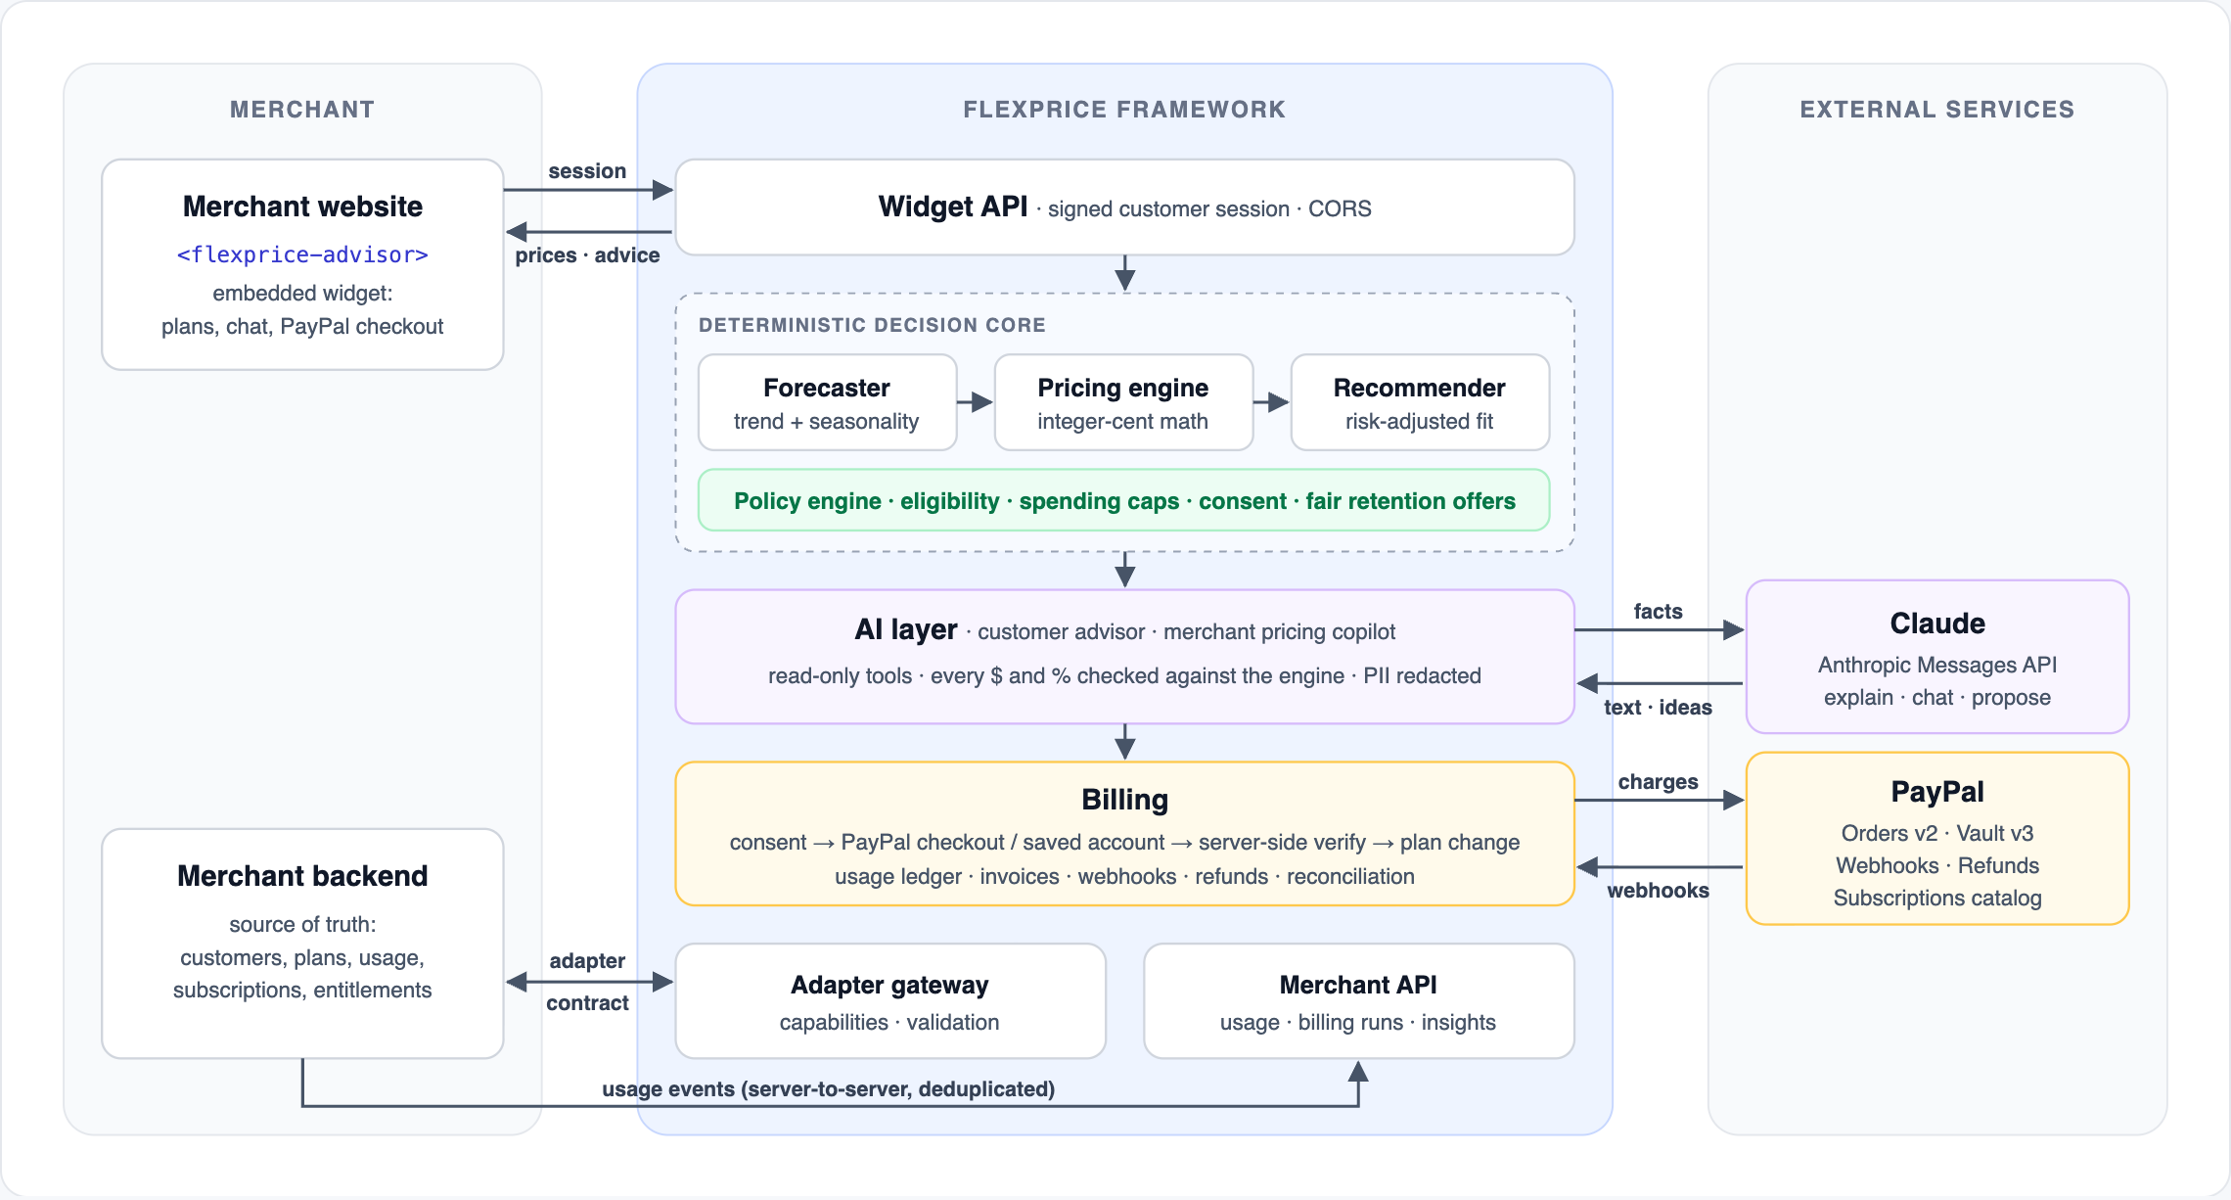
ARCHITECTURE
Three zones, clean boundaries
FlexPrice AI · Pricing intelligence & adaptive billing on PayPal
7
Notes:
Left: the merchant — website with the embedded widget, and the backend which stays the source of truth. Middle: the FlexPrice framework — Widget API, the deterministic decision core, the AI layer, billing, the adapter gateway and the merchant API. Right: Claude and PayPal. Only PayPal and, optionally, Anthropic calls leave the merchant's network in a self-hosted deployment.

Slide 8
HOW IT WORKS
From "view plans" to a renewed subscription
1
2
3
4
5
6
Sign in
Gather
Decide
Explain
Pay
Bill
Merchant backend signs a short-lived customer session; page embeds the widget.
Plans + usage history read through the adapter; cached per customer.
Forecast → price every plan over 12 months → recommend; policy applied.
Claude explains with read-only tools; numbers verified against the engine.
Exact terms accepted → PayPal checkout or saved account → server verifies → plan changed → read back.
Usage streamed; month-end invoices and renewals charged to saved PayPal after a notice.
Customer action | What FlexPrice does | Merchant calls | LLM calls
Opens plans page | Serves the precomputed recommendation for this customer | First view only | ≤ 1 per snapshot
Moves the usage slider | Recomputes on the fly (~0.05 ms) | 0 | 0 (template; AI on request)
Watches / uses the product | Records event; checks break-even thresholds | 0 | 0
FlexPrice AI · Pricing intelligence & adaptive billing on PayPal
8
Notes:
Six steps. Note the merchant's data never moves: FlexPrice reads it through the adapter. A browser redirect is never treated as proof of payment — the server verifies the PayPal capture, asks the merchant to change the plan and reads it back.

Slide 9
THE HEART OF THE SYSTEM
A deterministic decision engine — no LLM in the loop
Pure functions, integer-cent math, ~0.05 ms per customer (~20,000 customers/second on one core). Also shipped as an embeddable library.
Forecaster
Pricing engine
Recommender
Policy engine
Usage history →
trend + seasonality
→ low / expected / high
Every plan priced over
the same 12 months;
caps, tiers, break-evens
Risk-adjusted cost ×
preference (balanced,
cheapest, predictable…)
Eligibility, caps, consent,
anti-gaming cooldown,
fair retention offers
Customer (12-month history) | Forecast | Recommendation | Why
Asha · occasional viewer | 7.1 h/month | Pay-As-You-Watch · ~$4.26/mo | Saves ~$141/yr vs Standard Monthly; capped at $17.99
Ben · binge watcher | 45.2 h/month | Standard Annual · $13.33/mo | Cheapest at high usage; break-even vs PAYG at 22.2 h
Chen · seasonal viewer | 14.9 h/month | Lite + Hours · ~$9.18/mo | Flips with PAYG at 16.6 h; range shown
Nova Labs · growing API usage | 53k calls/month | Builder (base + overage) · ~$17.61/mo | Rising trend detected; saves ~$137/yr vs the $29 flat plan
FlexPrice AI · Pricing intelligence & adaptive billing on PayPal
9
Notes:
This is the core. Forecaster: Holt damped trend with seasonal indices and a residual-based 80% range; history first, then the customer's own estimate, then a merchant default. Pricing engine: integer cents, tiers, included usage, minimums, caps, annual terms, break-even points. Recommender: risk-adjusted cost over a common 12-month horizon, weighted by the customer's preference. Policy engine gates everything.

Slide 10
WHERE AI FITS — AND WHERE IT DOESN'T
Claude explains, converses and proposes. It never prices.
Called through the Anthropic Messages API; every feature has a deterministic fallback.
Feature | Input to Claude | Claude's tools | Output
Explain recommendation | ~1–2 KB of engine-computed facts; no identity | — | 3–4 sentence explanation
Conversational advisor | PII-redacted customer message + history | compare_plans, usage_summary, retention_options (read-only) | Reply + UI actions (set usage, preference, highlight plan)
Merchant pricing copilot | Catalog + aggregated usage histograms + guardrails | simulate_catalog, submit_proposals | ≤ 3 catalog experiments, each re-simulated server-side
Grounding guard
Read-only tools
Data minimisation
Cost & latency
Every $ and % must come from the engine, or the reply is replaced.
AI cannot change plans, apply discounts or charge.
No names, emails, IDs or payment data; chat PII redacted.
Prices never wait on the LLM; ≤ 1 explanation per customer snapshot.
ML roadmap: trained tabular models for usage forecasting and churn/price sensitivity once data exists; elasticity measured by experiments. The pricing math stays deterministic.
FlexPrice AI · Pricing intelligence & adaptive billing on PayPal
10
Notes:
Claude receives compact facts, never the customer base's raw logs. The grounding guard rejects any dollar amount or percentage not produced by the engine — tested with a prompt injection asking for '$1.99'. Customer names, emails and payment data are never sent; chat text is PII-redacted. The AI cannot change plans or charge — the policy engine rejects the ai_agent actor.

Slide 11
PAYPAL INTEGRATION
Built on PayPal rails, verified on the server
PayPal product | How FlexPrice uses it
Orders v2 (create · capture · get) | Buyer-present payments; server-computed amounts; PayPal-Request-Id idempotency
Vault v3 (save with purchase · setup tokens · payment tokens) | Saved account for renewals & usage invoices; merchant-initiated charges with vault_id
JS SDK Smart Buttons | Buyer approval (separate namespaces for checkout and vault)
Webhooks + verify-webhook-signature | Verified, deduplicated; recovers approved-but-uncaptured orders
Payments v2 refunds | Idempotent refunds from the merchant dashboard
Subscriptions v1 catalog | Mirror fixed plans into PayPal Products & Plans
Payment you can trust
1. Consent bound to exact terms (hash)
2. PayPal order for server-computed amount
3. Buyer approves in PayPal
4. Server captures & verifies amount, currency, custom_id
5. Merchant changes plan (idempotent)
6. FlexPrice reads the plan back
A browser redirect is never proof of payment. Paid-but-unfulfilled changes are reconciled without charging twice.
FlexPrice AI · Pricing intelligence & adaptive billing on PayPal
11
Notes:
Orders v2 for buyer-present payments, with PayPal-Request-Id idempotency on every mutation. The amount is always computed server-side. After capture we verify status, amount to the cent, currency and custom_id, then change the plan at the merchant and read it back. Vault v3 saves the PayPal account — with the purchase, or via a setup token when nothing is due — so renewals and usage invoices are charged merchant-initiated with vault_id. Webhooks are signature-verified and deduplicated; CHECKOUT.ORDER.APPROVED recovers abandoned captures.

Slide 12
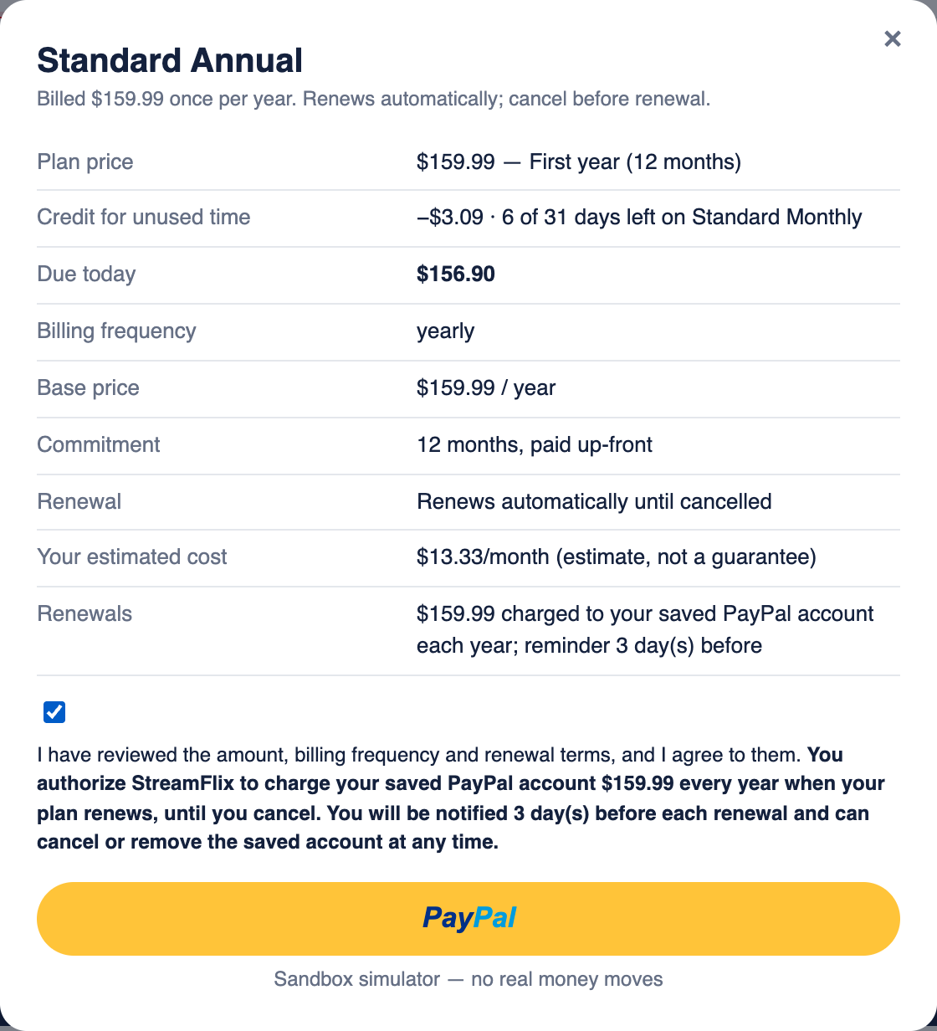
ADAPTIVE BILLING
Renewals, usage invoices and fair switching — on saved PayPal
• Billing schedule: fixed plans renew on their anniversary; usage plans close monthly
• Notice before every charge: renewal reminder and usage invoice notice (configurable days)
• Saved PayPal (Vault): explicit authorization text bound into consent; customer can remove it anytime
• Spending caps: usage charges never exceed the cap; invoices re-rated before charging
• Proration: unused days credited on switch — merchant-billed or FlexPrice-billed
• Account credit: leftover credit pays future renewals and invoices first
• Retries & fallback: 3 attempts, then past-due + manual PayPal payment
• Mid-month switch: usage so far billed at the old plan's rates — never lost, never double-billed
FlexPrice AI · Pricing intelligence & adaptive billing on PayPal
12
Notes:
FlexPrice runs a billing schedule for plans sold through it. Fixed plans renew on their anniversary: a notice N days before, then a charge to the Vault saved account. Usage plans are invoiced monthly within the spending cap, charged after a notice. Failures retry then fall back to manual payment. When customers switch mid-period, unused days are credited — the screenshot shows Ben moving to annual: $159.99 minus a $3.09 credit.

Slide 13
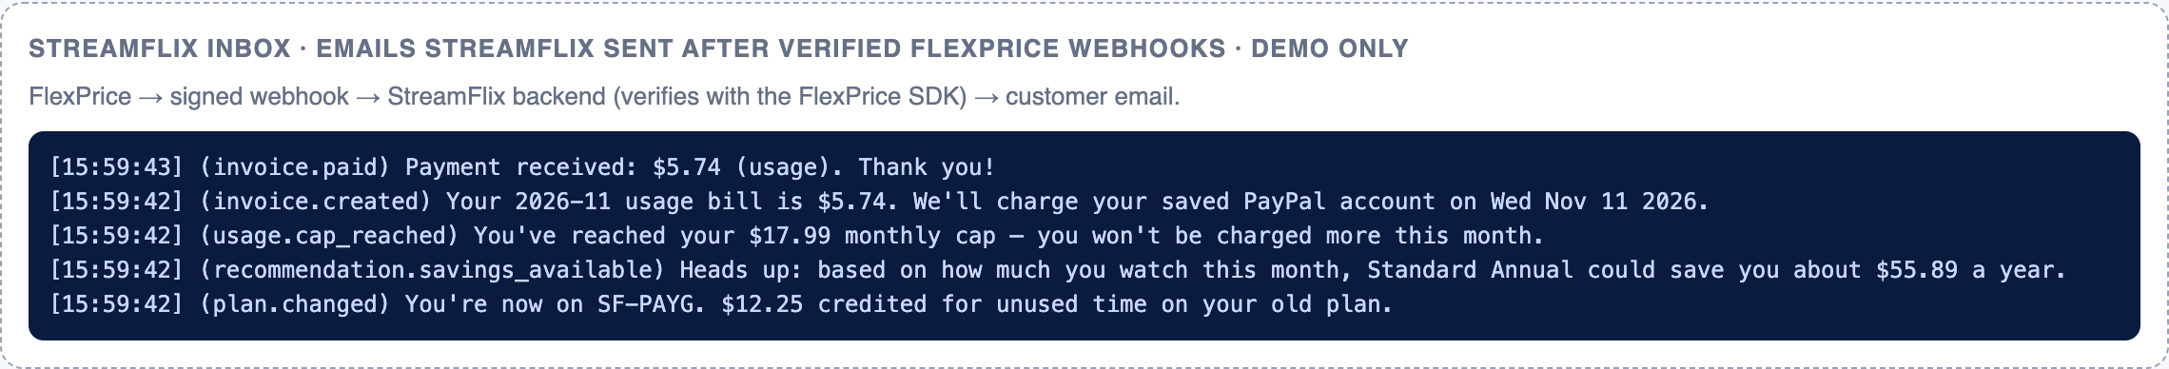
MERCHANT EVENTS
Signed webhooks keep the merchant in control
FlexPrice records every billing event in an outbox and delivers it to the merchant's backend — signed, retried and deduplicated.
plan.changed
payment.captured
invoice.created
invoice.paid
invoice.payment_failed
invoice.past_due
subscription.renewal_upcoming
subscription.renewed
Above: StreamFlix's backend verifies each FlexPrice event with the SDK and emails the customer — including a proactive "Standard Annual could save you ~$56/yr" nudge triggered when live usage crossed a break-even point.
subscription.past_due
usage.cap_reached
refund.issued
recommendation.savings_available
• Signature: FlexPrice-Signature: t=…, v1=HMAC-SHA256
• Retries: 1 m → 5 m → 30 m → 2 h → 6 h; manual redelivery
• SDK: verifyEventSignature({ payload, header, secret })
FlexPrice AI · Pricing intelligence & adaptive billing on PayPal
13
Notes:
Outbox pattern: events are stored before delivery, so nothing is lost if the merchant is down. HMAC-SHA256 signature over timestamp + raw body; the SDK provides verifyEventSignature. Retries with backoff: 1 min, 5 min, 30 min, 2 h, 6 h. The screenshot is StreamFlix's mock backend turning verified events into customer emails — including a proactive savings nudge when live usage crossed a break-even point.

Slide 14
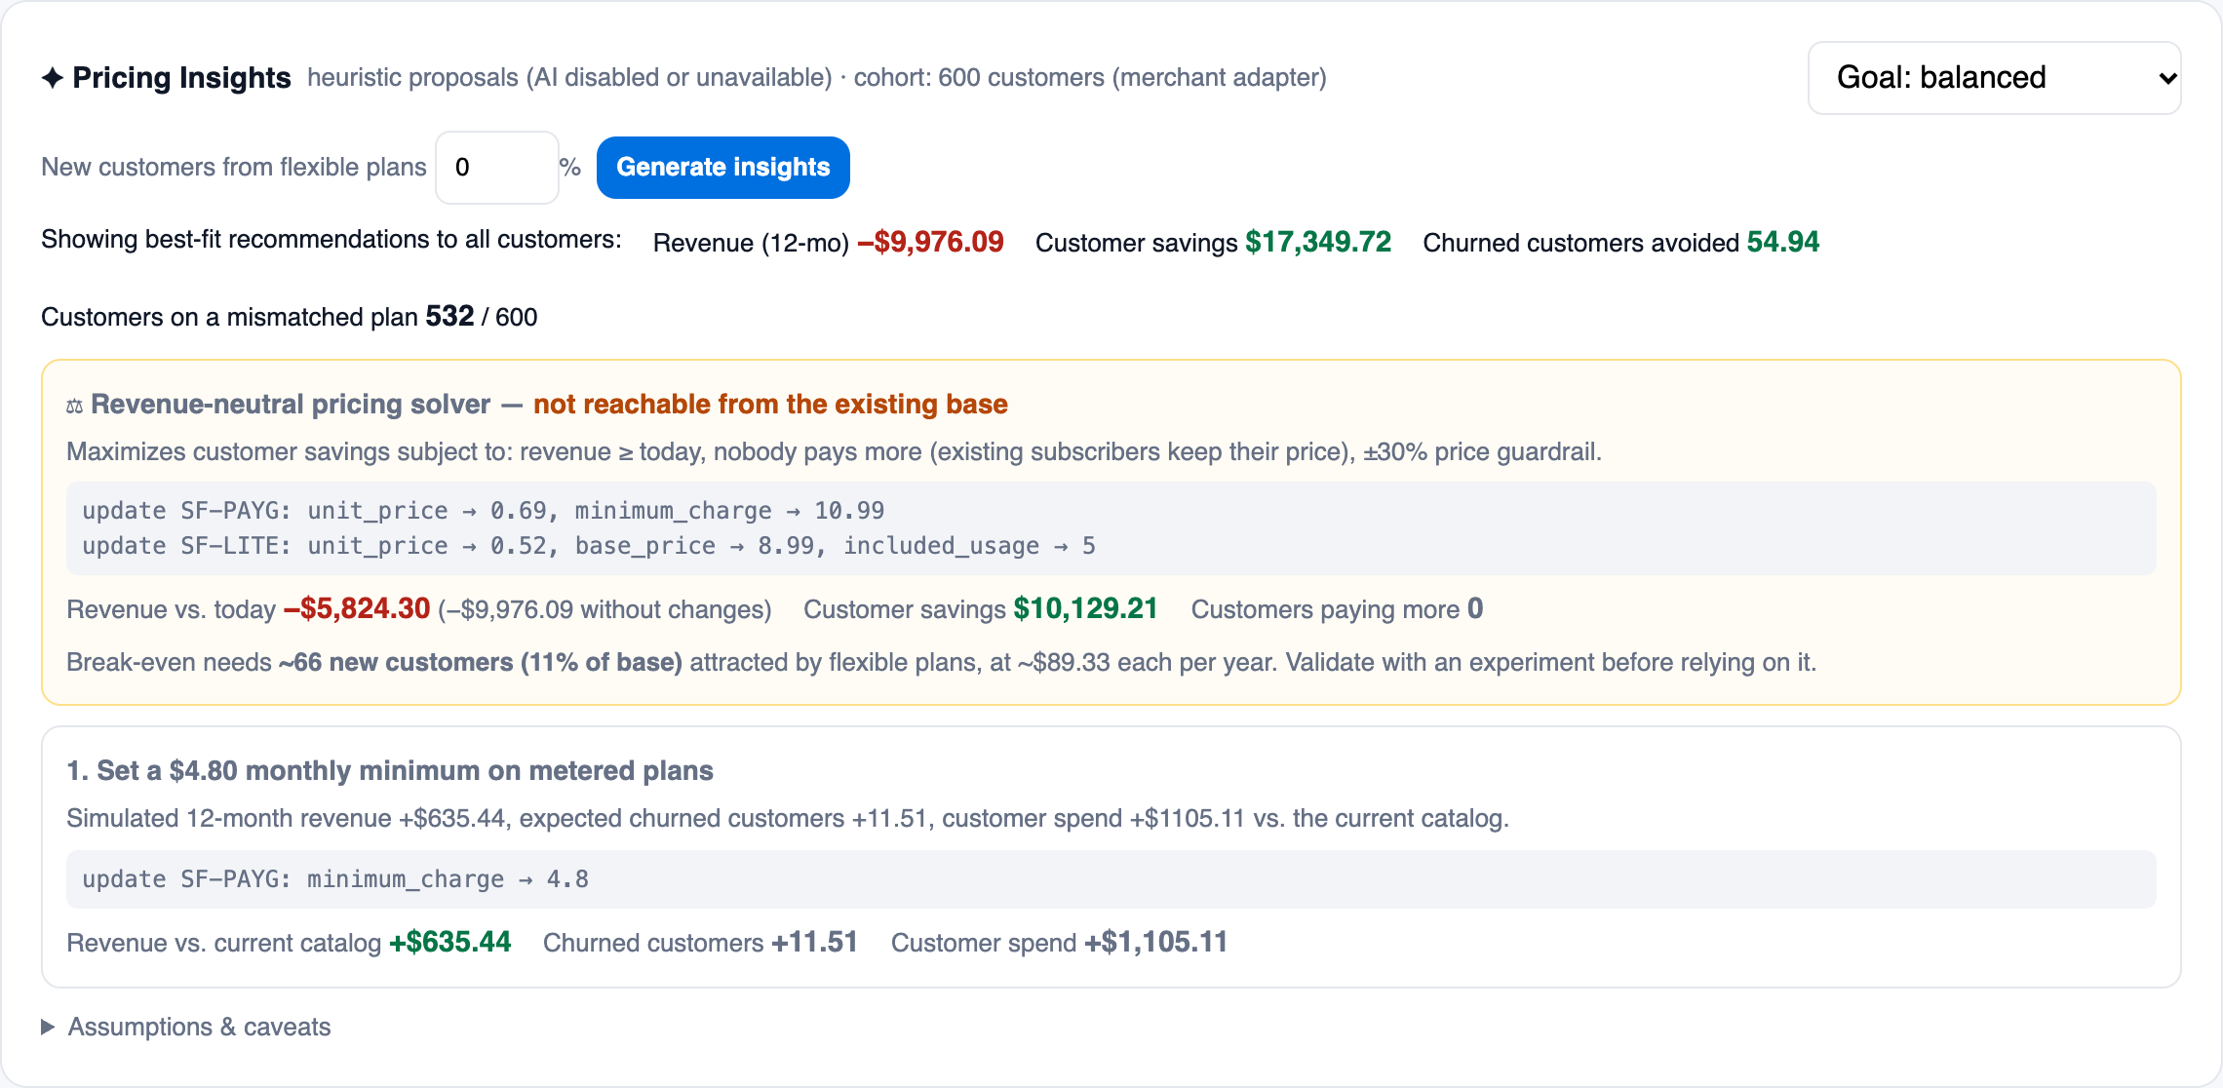
HONEST MERCHANT ECONOMICS
We show merchants the revenue trade-off — and how to fix it
−$9,976
12-month revenue if every customer sees their best fit (600-customer simulation)
$17,350 · 55
customer savings · churned customers avoided
−$5,824
with the revenue-neutral solver's pricing — nobody pays more
66 customers (11%)
new sign-ups from flexible plans needed to break even
FlexPrice AI · Pricing intelligence & adaptive billing on PayPal
14
Notes:
Recommending cheaper plans saves customers money but costs the merchant revenue: in the 600-customer simulation, about $10k a year, while avoiding ~55 churned customers. The revenue-neutral solver searches usage pricing that maximises customer savings with nobody paying more and existing subscribers grandfathered; it halves the gap and states the break-even: about 66 new customers (11%) attracted by flexible plans. Assumptions are explicit and must be validated with experiments.

Slide 15
BENEFITS TO PAYPAL
A billing-intelligence layer that grows PayPal volume
More transactions
Vault adoption
Lower involuntary churn
Usage plans create monthly merchant-initiated charges; renewals run on PayPal instead of leaving for card-on-file billing tools.
Every metered or auto-renewing plan saves a PayPal account with explicit consent — durable, reusable payment credentials.
Notices before charges, retries, manual-payment fallback and past-due events keep more renewals paid.
Merchant stickiness
Distribution
Low data risk
Flexible pricing + revenue analytics + retention tools give subscription merchants a reason to choose — and stay on — PayPal.
Packaged as a PayPal Commerce Platform offering: partner onboarding pays each merchant directly.
Self-hosted by merchants: PayPal remains the payments layer; usage data stays with the merchant.
FlexPrice AI · Pricing intelligence & adaptive billing on PayPal
15
Notes:
Mechanisms, not projections: usage-based and recurring charges run as merchant-initiated PayPal transactions on Vault; every FlexPrice merchant processes through PayPal; the framework differentiates PayPal for subscription merchants evaluating billing platforms; it is distributable as a PayPal Commerce Platform offering; and PayPal stays the payments layer without taking custody of merchant usage data.

Slide 16
SCALABILITY
Cheap on read, recompute only on change
What costs time on "view plans" | Cost
Deterministic engine (forecast + price + recommend) | ~0.05 ms per customer
Fetching customer + 24-month usage from the merchant | 2 network calls (20–200 ms typical)
Claude explanation (optional) | ~1–3 s and per-token cost
What triggers a recomputation
• Plan change, pause or cancel
• Billing month closes (new history)
• Plan catalog changes (version hash)
• Merchant calls /customers/:ref/invalidate
• Live usage crosses a break-even point — each usage event is a few comparisons, not a recomputation
• Bulk precompute after month close: POST /precompute
1 view + 20 slider moves: before → after
42 → 2
21 → 1
≤ 1
merchant calls
analytics rows
LLM call per snapshot
At Netflix/Prime scale: same interfaces backed by Redis (snapshots), Postgres (state), Kafka (usage events), a batch job writing precomputed recommendations, CDN for the widget.
FlexPrice AI · Pricing intelligence & adaptive billing on PayPal
16
Notes:
The engine costs ~0.05 ms per customer — not the bottleneck. The real costs are network calls to the merchant and LLM calls. So the default view is a precomputed per-customer snapshot; what-ifs reuse cached data; LLM explanations are generated at most once per snapshot. Usage events don't trigger recomputation: the recommendation can only change when monthly usage crosses a break-even point, so each event is a handful of comparisons.

Slide 17
DEPLOYMENT
Run it where the data lives
Recommended
Zero hops
Small merchants
Self-hosted service
Embedded library
Hosted multi-tenant
• Merchant runs npm run start:framework in its VPC
• Adapter calls stay internal; widget served from the merchant's domain
• Only PayPal (and optional Anthropic) calls leave the network
• Stateless; scales horizontally
• import { recommendPlan } from 'flexprice-ai/engine'
• Pure functions — no network, storage or LLM (enforced by tests)
• Runs inside the plans-page backend or a Spark/Flink batch
• Adapter exposed over HTTPS (bearer key + mTLS / allow-list)
• Tenant isolation by merchant API key
• PayPal Commerce Platform onboarding so each merchant is paid directly
Who maintains it? The merchant (self-hosted or library) — or a hosted provider. PayPal's role is payments: Orders, Vault, webhooks. Merchant usage data never has to leave the merchant.
FlexPrice AI · Pricing intelligence & adaptive billing on PayPal
17
Notes:
For large merchants we recommend self-hosting: a stateless service in their own network, with the widget served from their domain. Teams that only want the decision engine can embed the library in-process. Smaller merchants can use a hosted multi-tenant service; in that mode each merchant should be onboarded via PayPal Commerce Platform so funds go directly to them. PayPal's role is payments in every model.

Slide 18
SECURITY & TRUST
Safe by construction
Identity
Tenant isolation
Consent
• Merchant-signed short-lived customer sessions (HMAC)
• Browser can never pick another customer
• Every record partitioned by merchant
• The merchant API key alone selects the tenant
• Bound to a hash of the exact disclosed terms
• Changed terms or amount → re-consent
Payments
Webhooks
AI
• Server-computed amounts; verified captures
• Idempotency keys on every PayPal mutation
• PayPal → FlexPrice: signature verified, deduplicated
• FlexPrice → merchant: HMAC-signed, raw-body verified
• Cannot mutate plans or move money
• Grounded numbers; PII redacted; aggregates only
Demo-only endpoints (fake logins, demo keys) live in demo/ and are never mounted by the framework — enforced by tests.
FlexPrice AI · Pricing intelligence & adaptive billing on PayPal
18
Notes:
Highlights of the security model. All of these are covered by automated tests: forged sessions rejected, stale terms rejected, cross-tenant keys rejected, AI actor rejected, grounding guard, PII redaction, webhook signature verification in both directions, idempotent captures and plan changes.

Slide 19
ROADMAP
What comes next
Measure
Learn
Scale
Grow
• Holdout experiments: advisor shown to X% of customers
• Measured adoption, churn and acquisition replace assumptions
• Trained usage-forecast model across customers
• Churn / price-sensitivity models; monthly retrain with backtests
• Postgres + Redis + Kafka behind existing interfaces
• Batch precompute job; CDN-served widget
• PayPal Commerce Platform onboarding (multi-tenant payouts)
• Tax/VAT, multi-currency, invoice documents
Already done in this build: recurring billing on PayPal Vault, proration and account credits, signed merchant webhooks, revenue-neutral pricing solver, precompute + event-driven invalidation.
FlexPrice AI · Pricing intelligence & adaptive billing on PayPal
20
Notes:
Honest next steps. Most important: measure the behavioural assumptions with holdout experiments, then train small tabular models. Commercially: PayPal Commerce Platform onboarding for the hosted model.

Slide 20
FlexPrice AI
Plug-and-play: one adapter contract, any merchant backend, data stays with the merchant
Deterministic core: every price computed in cents — AI explains, never prices
PayPal-native billing: Orders, Vault renewals & usage charges, verified webhooks
Honest economics: revenue impact shown; fairest pricing and break-even computed
Built to scale: precomputed snapshots, event-driven recomputation, self-hostable
Thank you
npm install && npm start → http://localhost:4000 · docs/DEMO_SCRIPT.md for the 6-minute walkthrough

