Slide 1
PAYPAL HACKATHON · 2026
FlexPrice AI
A plug-and-play pricing advisor and adaptive billing framework that lets subscription businesses charge customers the way they actually use the product — on PayPal.
Plug-and-play adapter framework
Deterministic pricing engine
Claude-powered explanations
PayPal Orders · Vault · Webhooks
Notes:
FlexPrice AI: a framework merchants plug into their existing subscription backend to offer flexible, usage-aware pricing, explained by Claude and paid through PayPal.

Slide 2
THE PROBLEM
One price for everyone fits almost no one
Light users overpay, then cancel
Discounts become a habit
Occasional users pay the same flat price as heavy users. Perceived waste drives cancellations.
"Click cancel, get a discount" retains briefly, teaches discount-seeking, and ends in a price shock when the promo expires.
Flexible plans are hard to evaluate
Billing systems resist change
Customers can't tell whether pay-as-you-go would be cheaper for them; merchants can't show it per customer.
Adding usage-based plans usually means replacing the subscription platform — a non-starter for most merchants.
The gap: nobody can see, per customer, which plan actually fits — and merchants can't add flexible plans without rebuilding billing.
FlexPrice AI · Pricing intelligence & adaptive billing on PayPal
2
Notes:
Fixed subscriptions charge the same regardless of use. Light users feel they overpay and cancel; merchants answer with discounts, which train discount-seeking and create price shock. Merchants rarely have a per-customer view of which plan fits, and adding usage-based plans usually means replacing billing.

Slide 3
THE CORE IDEA
Decide deterministically, explain with AI, bill on PayPal
For every customer: forecast usage, compare every eligible plan over the same horizon, recommend the best fit, and collect payment.
1 Decide
2 Explain
3 Bill
Deterministic decision engine
Claude, grounded in the engine
PayPal end to end
• Forecast usage from history (trend + seasonality) with an 80% range
• Price every plan: fixed, annual, usage, hybrid, tiered, caps
• Rank on risk-adjusted cost × customer preference
• Policy engine: eligibility, caps, consent, fair offers
• Plain-language "why this plan"
• Chat: "2 movies a week, no commitment" → engine inputs
• Merchant copilot proposes catalog experiments
• Any $ or % not produced by the engine is rejected
• Orders v2 checkout, verified server-side
• Vault: saved account for renewals & usage invoices
• Proration credits, notices, retries, reconciliation
• Signed webhooks both ways (PayPal → us → merchant)
Design principle: deterministic money, AI words. The merchant's backend stays the source of truth.
FlexPrice AI · Pricing intelligence & adaptive billing on PayPal
3
Notes:
Three pillars. The decision layer is deterministic code — every price is computed in integer cents. Claude explains and converses but cannot invent numbers or move money. PayPal handles all payments including saved-account renewals and usage invoices.

Slide 4
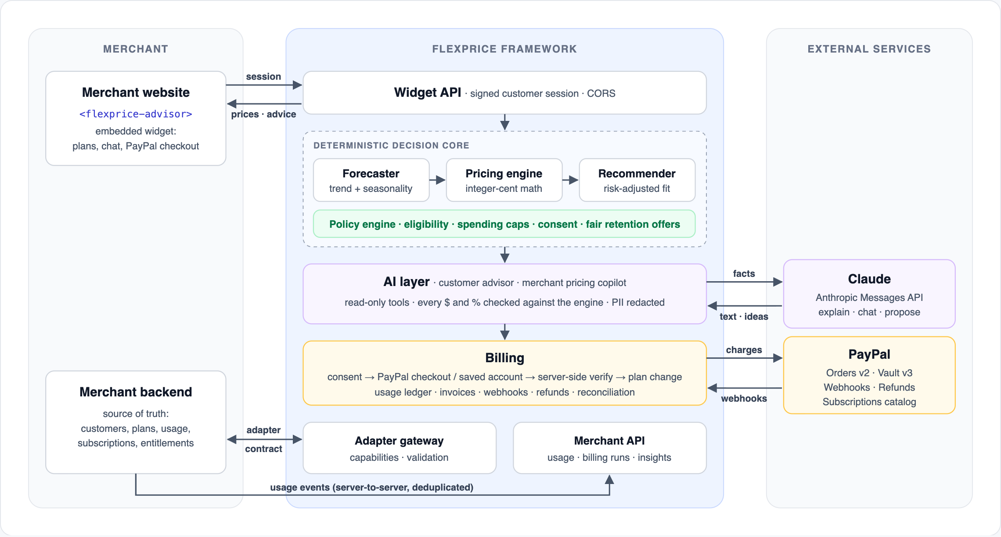
ARCHITECTURE
Three zones, clean boundaries
FlexPrice AI · Pricing intelligence & adaptive billing on PayPal
4
Notes:
Left: the merchant — website with the embedded widget, and the backend which stays the source of truth. Middle: the FlexPrice framework — Widget API, the deterministic decision core, the AI layer, billing, the adapter gateway and the merchant API. Right: Claude and PayPal. In a self-hosted deployment only PayPal and, optionally, Anthropic calls leave the merchant's network.

Slide 5
HOW IT WORKS
From "view plans" to a renewed subscription
1
2
3
4
5
6
Sign in
Gather
Decide
Explain
Pay
Bill
Merchant backend signs a short-lived customer session; page embeds the widget.
Plans + usage history read through the adapter; cached per customer.
Forecast → price every plan over 12 months → recommend; policy applied.
Claude explains with read-only tools; numbers verified against the engine.
Exact terms accepted → PayPal checkout or saved account → server verifies → plan changed → read back.
Usage streamed; month-end invoices and renewals charged to saved PayPal after a notice.
Customer action | What FlexPrice does | Merchant calls | LLM calls
Opens plans page | Serves the precomputed recommendation for this customer | First view only | ≤ 1 per snapshot
Adjusts expected usage | Recomputes on the fly (~0.05 ms) | 0 | 0 (template; AI on request)
Uses the product | Records event; checks break-even thresholds | 0 | 0
FlexPrice AI · Pricing intelligence & adaptive billing on PayPal
5
Notes:
Six steps. The merchant's data never moves: FlexPrice reads it through the adapter. A browser redirect is never treated as proof of payment — the server verifies the PayPal capture, asks the merchant to change the plan and reads it back. The table shows what each customer action costs.

Slide 6
PLUG-AND-PLAY FRAMEWORK
One adapter contract — any merchant backend
Merchants write a thin translation layer and declare what they support. FlexPrice never assumes an undeclared capability.
Capability (declared by adapter) | Unlocks
plans | Pricing advice (required)
customer_context | Current plan, tenure, eligibility
usage_history | Personalised forecasts
usage_metering | Usage-based plans
change_plan · subscription_status | Switching, with read-back verification
pause · cancel · retention_offers | Fair retention alternatives
cohort_usage | Anonymised pricing insights
Three ways to plug in
HTTP adapter
Expose the REST contract from any backend, in any language.
SDK adapter
Node merchants implement methods; createAdapterRouter() serves the contract.
Zero-code catalog
Just a plan list and checkout URL — advice from customer estimates.
The merchant keeps customers, login, plans, entitlements, usage data and its existing billing system. The gateway enforces declared capabilities, schema validation, timeouts and health checks.
FlexPrice AI · Pricing intelligence & adaptive billing on PayPal
6
Notes:
The adapter contract is language-agnostic REST, or an in-process JavaScript object. Only 'plans' is required; each declared capability unlocks features and missing ones are hidden automatically — no metering means usage plans are not shown. The gateway validates every response, and a conformance suite checks any adapter before go-live. The merchant keeps customers, plans, entitlements and its existing billing.

Slide 7
THE HEART OF THE SYSTEM
A deterministic decision engine — no LLM in the loop
Pure functions, integer-cent math, ~0.05 ms per customer (~20,000 customers/second on one core). Also shipped as an embeddable library.
Forecaster
Pricing engine
Recommender
Policy engine
Usage history →
trend + seasonality
→ low / expected / high
Every plan priced over
the same 12 months;
caps, tiers, break-evens
Risk-adjusted cost ×
preference (balanced,
cheapest, predictable…)
Eligibility, caps, consent,
anti-gaming cooldown,
fair retention offers
Inputs
Outputs
• Plan catalog from the adapter (any pricing model)
• Customer's usage history, or their own estimate
• Customer preference: balanced, cheapest, predictable, no commitment
• Merchant policy: eligibility, caps, proration, offers
• Expected cost and low–high range for every plan
• Recommended plan, savings and decision factors
• Break-even usage points between plans
• Policy decisions: what may be shown, offered or charged
FlexPrice AI · Pricing intelligence & adaptive billing on PayPal
7
Notes:
Forecaster: Holt damped trend with seasonal indices and a residual-based 80% range; uses history first, then the customer's own estimate, then a merchant default. Pricing engine: integer cents, tiers, included usage, minimums, caps, annual terms, break-even points. Recommender: risk-adjusted cost over a common 12-month horizon, weighted by the customer's preference. Policy engine gates everything.

Slide 8
WHERE AI FITS — AND WHERE IT DOESN'T
Claude explains, converses and proposes. It never prices.
Called through the Anthropic Messages API; every feature has a deterministic fallback.
Feature | Input to Claude | Claude's tools | Output
Explain recommendation | ~1–2 KB of engine-computed facts; no identity | — | 3–4 sentence explanation
Conversational advisor | PII-redacted customer message + history | compare_plans, usage_summary, retention_options (read-only) | Reply + UI actions (set usage, preference, highlight plan)
Merchant pricing copilot | Catalog + aggregated usage histograms + guardrails | simulate_catalog, submit_proposals | ≤ 3 catalog experiments, each re-simulated server-side
Grounding guard
Read-only tools
Data minimisation
Cost & latency
Every $ and % must come from the engine, or the reply is replaced.
AI cannot change plans, apply discounts or charge.
No names, emails, IDs or payment data; chat PII redacted.
Prices never wait on the LLM; ≤ 1 explanation per customer snapshot.
ML roadmap: trained tabular models for usage forecasting and churn/price sensitivity once data exists; elasticity measured by experiments. The pricing math stays deterministic.
FlexPrice AI · Pricing intelligence & adaptive billing on PayPal
8
Notes:
Claude receives compact facts, never the customer base's raw logs. The grounding guard rejects any dollar amount or percentage not produced by the engine. Customer names, emails and payment data are never sent; chat text is PII-redacted. The AI cannot change plans or charge — the policy engine rejects the AI actor. For forecasting and price sensitivity, the roadmap is trained tabular models once real data exists; the pricing math stays deterministic.

Slide 9
BILLING ON PAYPAL
Built on PayPal rails, verified on the server
PayPal product | How FlexPrice uses it
Orders v2 | Buyer-present payments; server-computed amounts; PayPal-Request-Id idempotency
Vault v3 | Saved account (with purchase or setup token) for renewals & usage invoices; merchant-initiated charges
JS SDK Smart Buttons | Buyer approval for checkout and for saving PayPal
Webhooks | Signature-verified, deduplicated; recovers approved-but-uncaptured orders
Refunds · Subscriptions catalog | Idempotent refunds; fixed plans mirrored into PayPal Products & Plans
Billing lifecycle
• Consent bound to a hash of the exact terms
• Capture verified on the server, then plan read back
• Renewals charged to saved PayPal after a reminder
• Usage invoices monthly, never above the spending cap
• Proration credits unused days when switching
• Retries then past-due + manual payment fallback
• Signed webhooks tell the merchant about every event
A browser redirect is never proof of payment. Paid-but-unfulfilled changes are reconciled without charging twice.
FlexPrice AI · Pricing intelligence & adaptive billing on PayPal
9
Notes:
Orders v2 for buyer-present payments, with PayPal-Request-Id idempotency and server-computed amounts; after capture we verify status, amount, currency and custom_id, change the plan at the merchant and read it back. Vault v3 saves the PayPal account so renewals and month-end usage invoices are charged merchant-initiated after a notice, with retries and manual fallback. Switching plans credits unused days. Every billing event is sent to the merchant as a signed webhook.

Slide 10
ADVANTAGES
Value for customers, merchants and PayPal
Customers
Merchants
PayPal
• See what each plan would cost them — with a range — before paying
• Pay for what they use, never above a spending cap
• Credit for unused time when switching
• Reminder before every renewal and usage charge
• No pressure tactics; cancellation always available
• Usage, hybrid, tiered and annual plans without replacing billing
• Thin adapter; their backend stays the source of truth
• Fewer cancellations: fitting plans offered before "cancel"
• Revenue impact shown + revenue-neutral pricing solver
• Signed events to email customers and manage access
• More transactions: monthly usage and renewal charges on PayPal
• Vault adoption: saved accounts with explicit consent
• Lower involuntary churn: notices, retries, fallback
• Merchant stickiness: a billing-intelligence layer on PayPal rails
• Distribution via PayPal Commerce Platform; no usage-data custody
FlexPrice AI · Pricing intelligence & adaptive billing on PayPal
10
Notes:
Customers get transparency and fair prices. Merchants get flexible pricing without replacing billing, retention without discount habits, and honest revenue analytics. For PayPal: usage-based and recurring charges run as merchant-initiated transactions on Vault; billing reliability features reduce involuntary churn; the framework gives subscription merchants a reason to choose and stay on PayPal; it is distributable through PayPal Commerce Platform; and PayPal stays the payments layer without holding merchant usage data.

Slide 11
SCALABILITY
Cheap on read, recompute only on change
What costs time on "view plans" | Cost
Deterministic engine (forecast + price + recommend) | ~0.05 ms per customer
Fetching customer + 24-month usage from the merchant | 2 network calls (20–200 ms typical)
Claude explanation (optional) | ~1–3 s and per-token cost
What triggers a recomputation
• Plan change, pause or cancel
• Billing month closes (new history)
• Plan catalog changes (version hash)
• Merchant signals a change (invalidate API)
• Live usage crosses a break-even point — each usage event is a few comparisons, not a recomputation
• Bulk precompute after month close
1 view + 20 usage adjustments: before → after
42 → 2
21 → 1
≤ 1
merchant calls
analytics rows
LLM call per snapshot
At large scale: same interfaces backed by Redis (snapshots), Postgres (state), Kafka (usage events), a batch job writing precomputed recommendations, CDN for the widget.
FlexPrice AI · Pricing intelligence & adaptive billing on PayPal
11
Notes:
The engine costs ~0.05 ms per customer — not the bottleneck. The real costs are network calls to the merchant and LLM calls. So the default view is a precomputed per-customer snapshot; what-ifs reuse cached data; LLM explanations are generated at most once per snapshot. Usage events don't trigger recomputation: the recommendation can only change when monthly usage crosses a break-even point, so each event is a handful of comparisons.

Slide 12
DEPLOYMENT
Run it where the data lives
Recommended
Zero hops
Small merchants
Self-hosted service
Embedded library
Hosted multi-tenant
• Runs inside the merchant's own network
• Adapter calls stay internal; widget served from the merchant's domain
• Only PayPal (and optional Anthropic) calls leave the network
• Stateless; scales horizontally
• Decision engine imported as a library
• Pure functions — no network, storage or LLM
• Runs inside the plans-page backend or a batch job
• Adapter exposed over HTTPS (key + mTLS / allow-list)
• Tenant isolation by merchant API key
• PayPal Commerce Platform onboarding so each merchant is paid directly
Who maintains it? The merchant (self-hosted or library) — or a hosted provider. PayPal's role is payments: Orders, Vault, webhooks. Merchant usage data never has to leave the merchant.
FlexPrice AI · Pricing intelligence & adaptive billing on PayPal
12
Notes:
For large merchants we recommend self-hosting: a stateless service in their own network, with the widget served from their domain. Teams that only want the decision engine can embed the library in-process. Smaller merchants can use a hosted multi-tenant service, onboarded through PayPal Commerce Platform so funds go directly to them. PayPal's role is payments in every model.

Slide 13
FlexPrice AI
Plug-and-play: one adapter contract, any merchant backend, data stays with the merchant
Deterministic core: every price computed in cents — AI explains, never prices
PayPal-native billing: Orders, Vault renewals & usage charges, verified webhooks
Fair for everyone: transparent prices for customers, honest revenue analytics for merchants
Built to scale: precomputed snapshots, event-driven recomputation, self-hostable
Thank you

