Slide 1
Lightning Talk – Python’s * operator on string
Date: Thursday, January 21, 2016
By: Chi Kin Ho

Slide 2
About Myself
Live in Canada
Work as a high school teacher (Math and Computer Studies)
Like to constantly:
Explore different ways of solving high-school mathematical problems and presenting them to my students
Learn new computer technologies and teach them to my students
recently learned how to wire a Bluetooth module on an Arduino board and connect it to an Android phone
plan to teach my students how to do this in the upcoming semester

Slide 3
In Tonight’s Lightning Talk
Talk about Python’s * operator on strings (learned in the last week)
Present a typical high school programming question
Explain how simple it is to use Python’s * operator to solve this question, rather than using the traditional method (e.g., nested loops in Java).

Slide 4
Grade 11: Computer Programming
A typical programming question is to ask the students to write a Java program to print the following triangles using for-loops:
*
**
***
****
*****
******

Slide 5
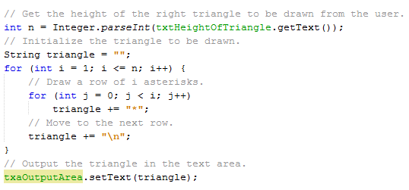
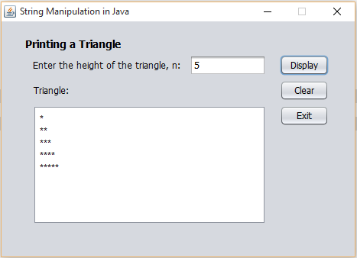
Java
Need to use nested loops

Slide 6

Confusion
Many students found it difficult to understand how nested loops work in this triangle example.
However, Python provides students with an easier way to code this triangle example by using the * operator on string.
In the last lecture, our professor presented the following Python example to illustrate how the * operator works in string:

Slide 7
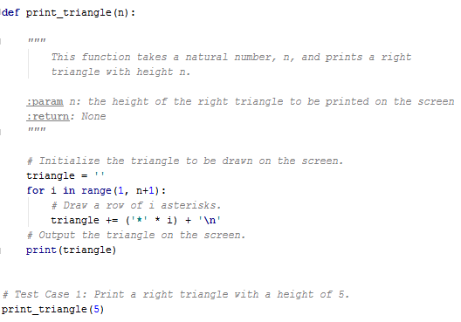
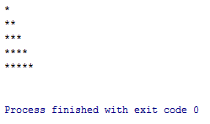
Python
Here is how we can apply the * operator in Python to the triangle example:

Slide 8
Conclusion
Python’s * operator eliminates the confusion of nested loops, although it is possible to implement nested loops in Python.
Students will likely enjoy using the * operator in Python over the traditional method (i.e., nested for-loops) in Java.

Slide 9
The End!

