Slide 1
MFP FY21
12/18/20
Overview

Slide 2
Bus revenue mileage and total mileage calculation based on the GTFS file and route division file.
Revenue miles
Deadhead miles (trace each bus trajectory by block#, based on OSM)
Facility to/from bus terminals mileage
En-route deadhead mileage
MFP FY21
12/18/20
Mileage Calculation

Slide 3
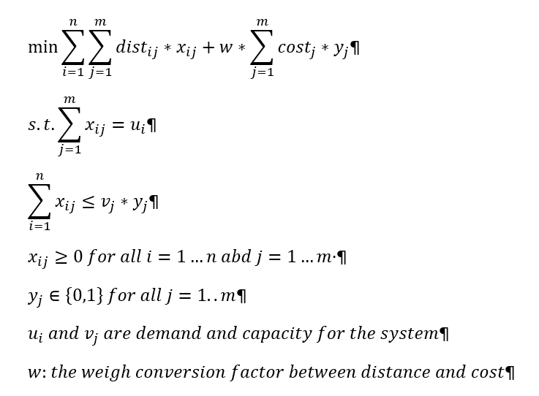
Modified Capacity constrained transportation problem
The model can assign bus considering the facility operation cost and deadhead distance
MFP FY21
12/18/20
Bus Allocation

Slide 4
MFP FY21
12/18/20
Bus Bay Utilization

