Slide 1
Robotic cyberdog Patrol System Development
Core Technology Stack
ROS2 Distributed Framework
Advanced distributed architecture decomposing complex functions into independent nodes, enabling high-efficiency communication and coordinated motion control through DDS middleware integration.
Navigation 2 System
Precision localization algorithms
Global path planning optimization
Dynamic obstacle avoidance
Real-time map management
Multi-waypoint navigation
Sensor integration:
AUO IoT sensors and thermal imaging devices
Dynamic temperature scanning
Measurement of temperature, humidity, PM2.5, particles, and methane concentration

Slide 2


Field applications of robotic dogs
"Safety and inspection requirements for the warehouse at AUO's L5A warehouse."
Thermal imaging inspection
Autonomous inspection and
self-charging
Environmental safety
Requirement:
Inspection of the PPBOX storage area
Inspection of the forklift charging zone
Requirement:
Autonomous patrol scheduling with self-charging
Navigation and localization in complex environments
Requirement:
Real-time personnel detection and verification
Obstacle detection in walk ways
Current capabilities
Current capabilities
Current capabilities
Summary:
The current Cyberdog robotic system faces several limitations in environmental safety inspection, including insufficient identification accuracy, limited autonomous task execution, and inadequate personnel recognition. To address these challenges and meet the operational requirements of AUO's L5A facility, efforts are underway to evaluate next-generation robotic dogs and develop enhanced AI algorithms.

Slide 3

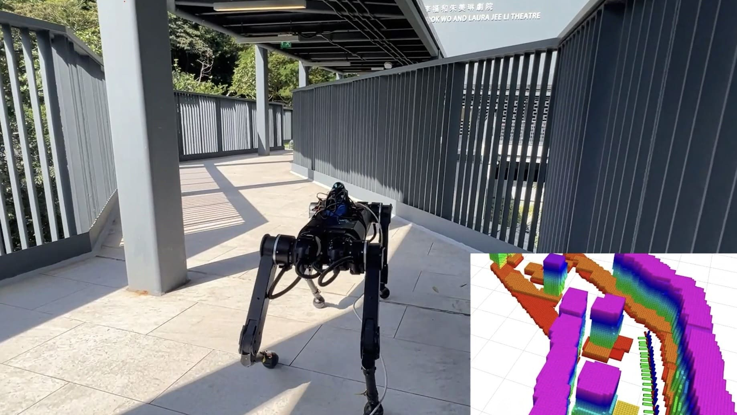


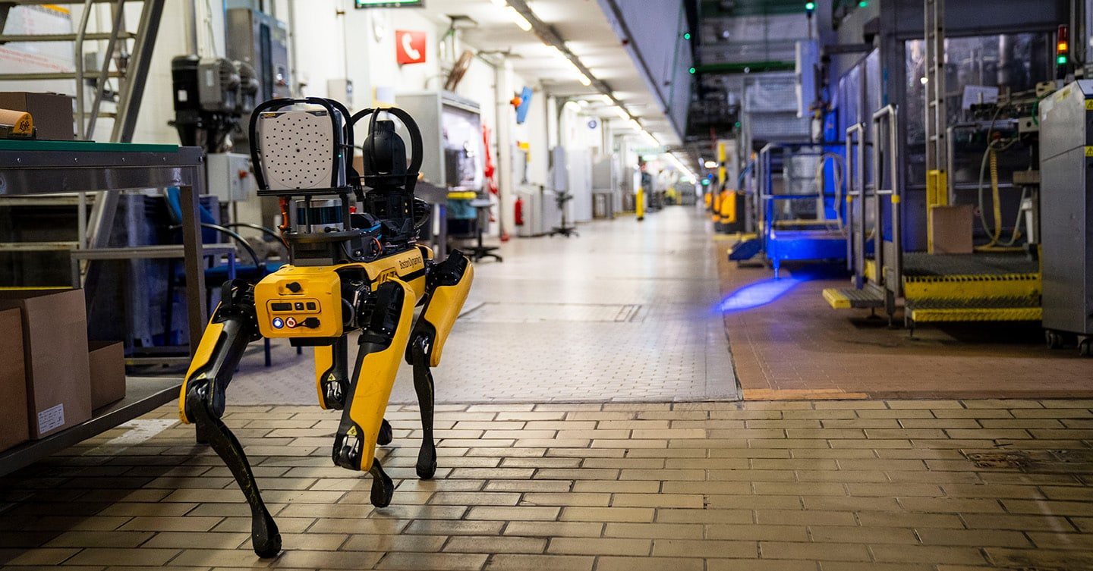
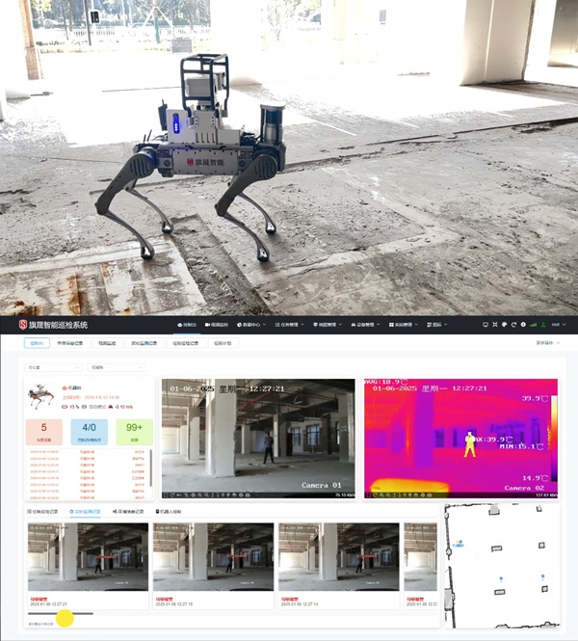
Future Technology Roadmap
Development Objective: Enhance autonomous operation capabilities, environmental perception, and data analysis to achieve more efficient and intelligent inspection missions with expanded application scenarios.
Navigation Enhancement
Sensor Integration
Platform Integration
High-precision SLAM integration
AI-powered thermal analysis
Cloud-based management platform
Advanced dynamic obstacle avoidance
Automated leak detection systems
Multi-robot task scheduling
Digital gauge reading capability
Predictive analytics engine
Multi-floor autonomous navigation
Multi-sensor data fusion
Standardized API integration
Collaborative multi-robotic dog coordination
1
Phase 1: Core Integration
ROS2 foundation with Navigation 2 and thermal imaging capabilities
2
Phase 2: AI Enhancement
Advanced computer vision and predictive maintenance algorithms
3
Phase 3: Platform Unification
Cloud-based management with multi-robot coordination
4
Phase 4: Expansion
Standardized solutions for diverse industrial applications

Slide 4
Field applications of robotic dogs
"Safety and inspection requirements for the warehouse at AUO's L5A warehouse."
Thermal imaging inspection
Autonomous inspection and
self-charging
Environmental safety
Requirement:
Inspection of the PPBOX storage area
Inspection of the forklift charging zone
Requirement:
Autonomous patrol scheduling with self-charging
Navigation and localization in complex environments
Requirement:
Real-time personnel detection and verification
Obstacle detection in walk ways
Current capabilities
Current capabilities
Current capabilities
Current system cannot reliably classify routine objects versus anomalies
Current algorithm is unable to accurately perform localization and execute scheduled autonomous charging tasks.
"Current system cannot reliably identify human presence during patrol operations."
Summary:
The current Cyberdog robotic system faces several limitations in environmental safety inspection, including insufficient identification accuracy, limited autonomous task execution, and inadequate personnel recognition. To address these challenges and meet the operational requirements of AUO's L5A facility, efforts are underway to evaluate next-generation robotic dogs and develop enhanced AI algorithms.

Slide 5
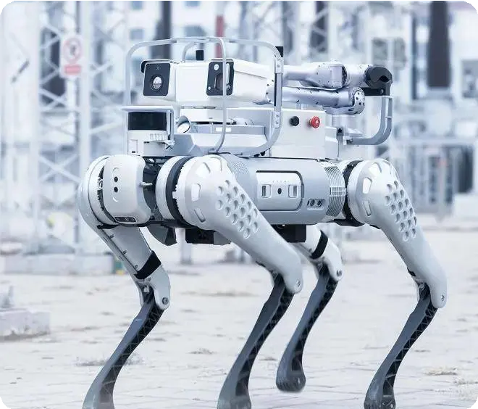
機器狗巡檢功能技術開發
ROS2 核心架構
採用分散式架構，將複雜功能分解為多個獨立節點，透過DDS實現高效通訊與協同運動。
Navigation 2 導航系統
定位 (Localization)
全局路徑規劃 (Global Path Planning)
局部路徑規劃與避障 (Local Path Planning & Obstacle Avoidance)
地圖管理 (Map Management)
多點導航 (Waypoint Navigation)
系統整合效益
全方位目標區域監測
動態溫度掃描
異常即時響應
靈活巡檢路線調整
AUO 熱顯像儀整合
實現精準異常檢測的关键元件：驅動程式開發
數據融合架構建立巡檢任務流程設計
溫度數據建模分析
預防性維護管理

Slide 6
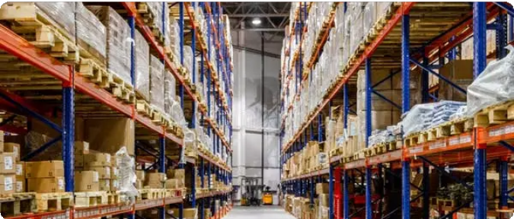
倉庫巡檢需求分析
基於OSHA標準及國內法規，庫房巡檢需滿足以下安全需求：
火災預防
早期火災偵測熱點監控
消防通道暢通
設備安全
叉車操作安全設備溫度監測電氣線路檢查
環境安全
溫濕度監控通風狀況
有害氣體偵測
物品存儲
貨物堆疊穩定性重量限制遵守 儲存區域整潔
智能異常檢測技術
熱成像檢測
利用紅外線熱像儀實時監測設備溫度分佈
計算機視覺
自動識別貨物異常與人員行為
聲紋識別
分析設備聲紋特徵，判斷機械故障
環境感測網絡
多感測器監控環境條件

Slide 7
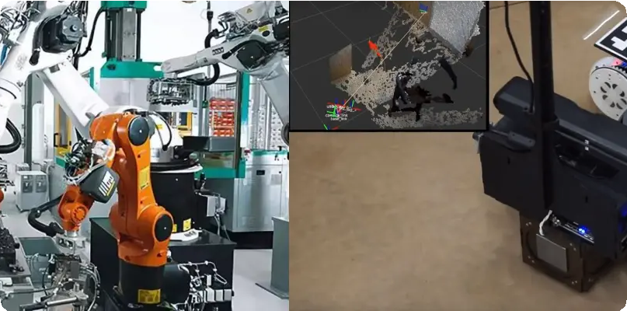
未來技術開發計劃
導航能力升級
高精度定位與地圖構建
結合視覺慣性里程計與腿部里程計技術，實現更精確定位
動態避障與路徑規劃
更強大的避障演算法，確保機器狗在複雜環境中靈活避開障礙
跨樓層自主導航
研發機器狗在多樓層環境中的自主導航能力
多機器人協同導航
協同導航與任務分配機制，多隻機器狗共同完成大規模巡檢
感測與視覺增強
開發目標
熱顯像分析能力提升
基於AI的故障模式識別，自動判斷設備過熱原因
洩漏檢測
利用高解析度攝像頭與AI影像分析，自動識別設備洩漏跡象
提升機器狗巡檢系統的自主作業能力、環境感知能力與數據分析能力，實現更高效、更智能的巡檢任務，進一步擴大應用場景。
儀表讀取與識別
自動讀取指針式或數字式儀表盤數據，識別異常讀數
多感測器融合
整合氣體、聲學等多種感測器，提供更豐富的環境感知數據
一體化巡檢平台
雲端一體化管理平台
作為機器狗巡檢系統的「大腦」，提供全面監控與分析功能
多機器人協同任務調度
支援多機器人協同作業，單一介面下分配監控任務
強大數據分析能力
深度學習與趨勢分析，自動生成預測性維護建議
標準化API介面
與現有工單系統、倉儲管理系統無縫整合

