Slide 1
Surface Leakage Current
Chih-Hsiang Yeh

Slide 2
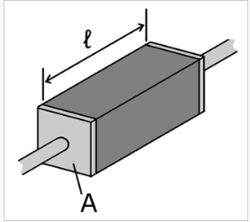

Basic knowledge of the current
$V=I R$
$R= \frac{ρ ∗l}{A}$
$ρ \left( Resistivity \right) ( E, T, Doping)$
$l \left( Length \right) \left( T \right)$
$A \left( Area \right) ( T )$

Slide 3
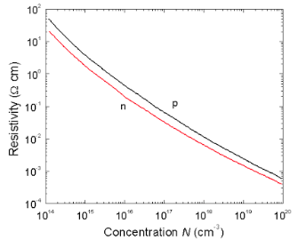
Resistivity(Doping)
Why?
Higher Impurity concentration
More carriers flowing in the crystal
More electrons running in it
Lower resistivity we get
The lower impurity concentration, the higher resistivity

Slide 4
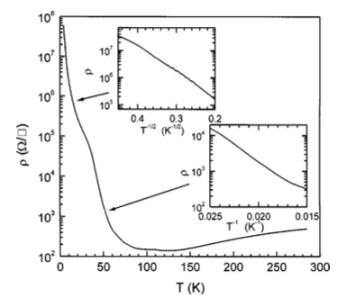

Resistivity(Temperature)

