Slide 1
Solid State Physics in Germanium Internal Amplification (GeIA) for Light Dark Matter Searches
Chih-Hsiang Yeh
2/21

Slide 2
Introduction for the studies
(1)Purpose: Discover the “Weakly Interacting Massive Particle (WIMP)” dark matter(DM) interacting with the detector through the nuclei recoil putting tens-of-pairs e-h in it.
(2)Principle: Apply the voltage on the detector with amplifying the holes ionized by the dark matter with a gain factor within the avalanche region.
(3)Threshold: Decrease the noise for the lower-mass detection with the lowering temperature and fully-depleted detector for extending the lower reach of light WIMP.

Slide 3
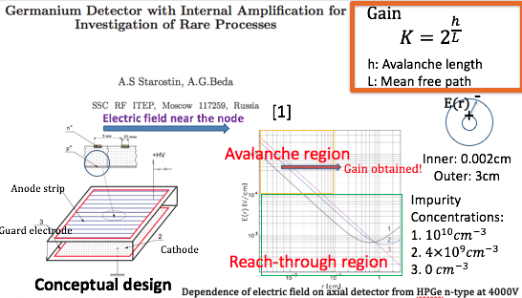
Pioneer: Russian investigation[2000]

Slide 4
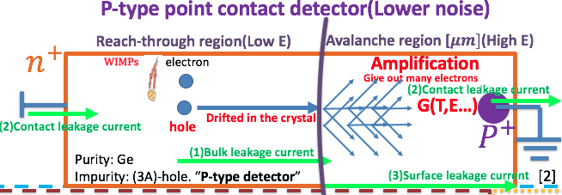
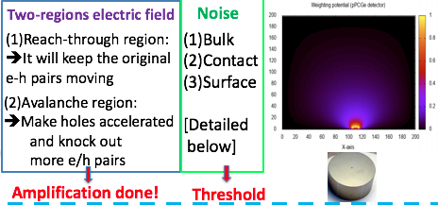
Schematic layout of a totally-depleted high-purity Ge detector with high voltage applied

Slide 5
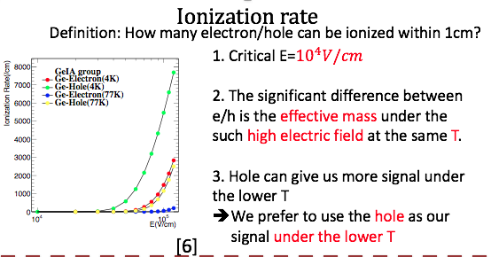
Amplification :e/h comparison at both temperatures

Slide 6
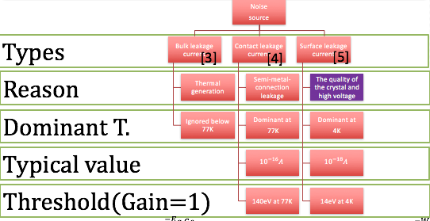
Noise estimation(1/2)

Slide 7
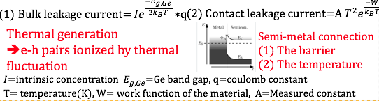
Noise estimation(2/2)

Slide 8
Goal
~10eV threshold can be achieved at 4K, and the surface leakage current will be the dominant term
Goal: Gain=1000, threshold of the detector is less than 10eV, the measured challenge is the surface leakage current

