Slide 1


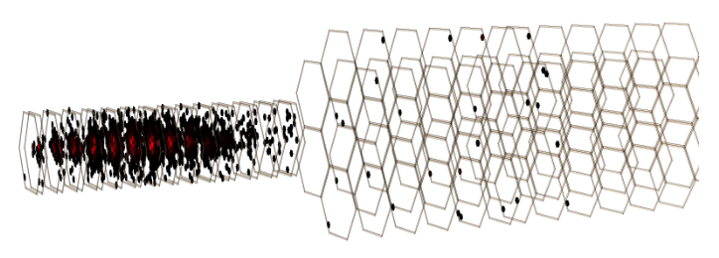
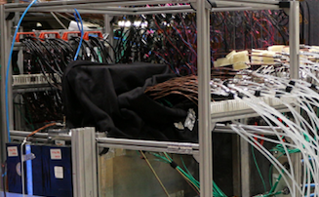
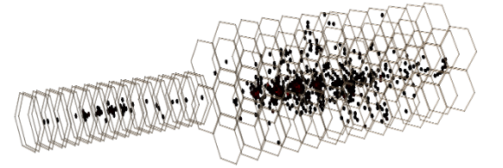
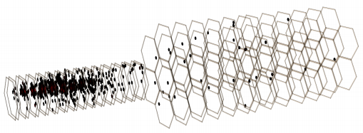
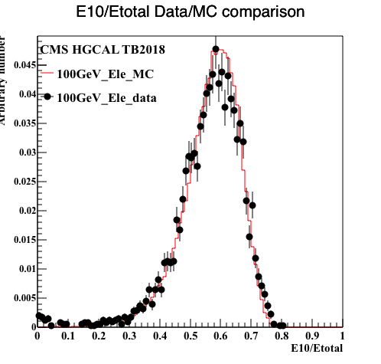


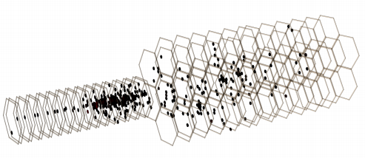






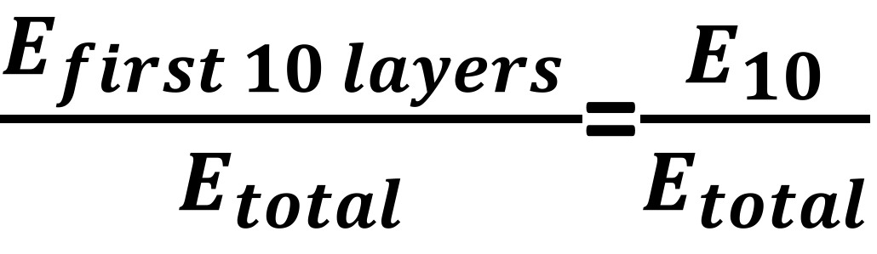


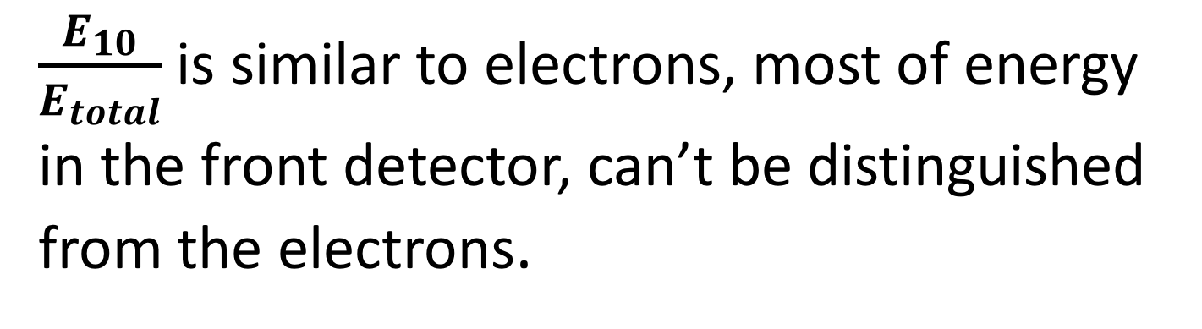
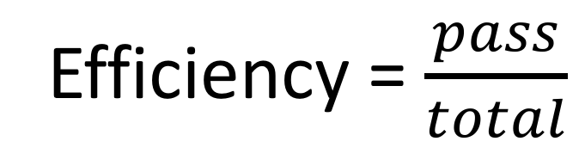
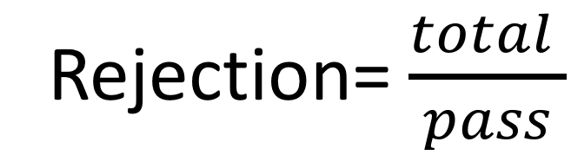
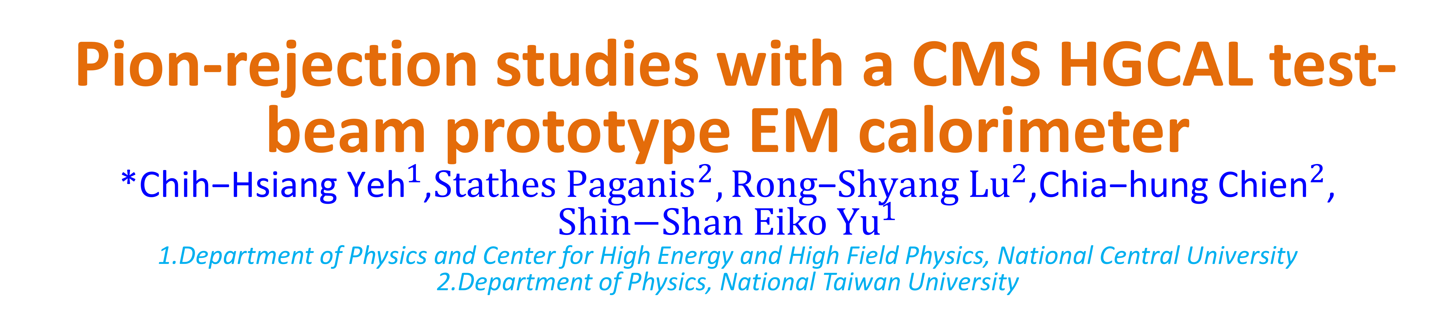
Pion-rejection studies with a CMS HGCAL test-beam prototype EM calorimeter
*${\text{Chih}\text{−}\text{Hsiang} \text{Yeh}}^{1}$,${Stathes Paganis}^{2},{Rong\text{−}Shyang Lu}^{2}$,${\text{Chia}\text{−}\text{hung} \text{Chien}}^{2}$,${\text{Shin}\text{−}\text{Shan} \text{Eiko} \text{Y}u}^{1}$
1.Department of Physics and Center for High Energy and High Field Physics, National Central University
2.Department of Physics, National Taiwan University
Introduction
The CMS experiment at LHC will replace the current Endcap calorimeter with a Si-pad High Granularity Calorimeter (HGCAL), a new generation state-of-the-art calorimeter, which can perform 3D imaging of the shower as well as provide ~30ps timing resolution. Charged-pion tagging and rejection are one of the strong points of HGCAL. Our main result is that HGCAL can provide a powerful discrimination between such pions that start showering after traveling a distance as Minimum Ionizing Particles inside the calorimeter, and incident electrons. This discrimination is achieved by introducing simple longitudinal shower variables.
Motivation
Exploit the fine granularity of HGCAL to reject pions that leave most of their energy in ECAL:
。They cannot be removed by energy leakage cut in the HADRONIC calorimeter
。They cannot be rejected by tight electron selection.
Here we use the longitudinal segmentation of HGCAL to reject some of these pions.
Beam
Normal Electron
$$e^{−},π^{+}$$
CE-E: (ECAL) Passive absorber: Lead
CE-H: (HCAL) Passive absorber: Steel
Active layer for both: silicon
Normal Pion
e-like Pions(1)
Results
。 Early EM showering:
$\frac{E_{first 10 layers }}{E_{total}}$=$\frac{E_{10}}{E_{total}}$
We used the MC sample from October test beam. After tight electron selection with a pion rejection factor of 3600, we apply an additional selection using our proposed discriminating variable.
Our goal is to achieve a very high efficiency at the level of 99.9% for a significant pion rejection. The results are shown below.
$\frac{E_{10}}{E_{total}}$is similar to electrons, most of energy in the front detector, can’t be distinguished from the electrons.
Discriminant variable
Efficiency = $\frac{pass}{total}$
Rejection= $\frac{total }{pass}$
e-like Pions(2)
。 Late EM showering :
Pions travel as MIPs for a few layers and then shower. Therefore, the energy fraction in the front of the calorimeter is small. We require at least ~20% of energy be deposited in the first 10 layers
Data/MC comparison for $\frac{E_{10}}{E_{total}}$
Conclusion
Event selection
A pion rejection of 1.5 is achieved for a 99.6+/-0.2% electron efficiency. This discriminant can be used by analyses in which pion induced backgrounds are very high.
EM Shower Containment Cuts
Energy Leakage to the Hadronic Calorimeter Cut
a. [Energy in five rings/ Total energy] need. to bigger than 99%
b.
/
> 0.85
References
No more than 0.4% energy fraction in the Hadronic Part.
[1]First beam tests of prototype silicon modules for the CMS High Granularity Endcap Calorimeter, N. Akchurin et al.,
JINST 13 (2018) no.10.
After this selection, we can tag “e-like pions”

