Slide 1


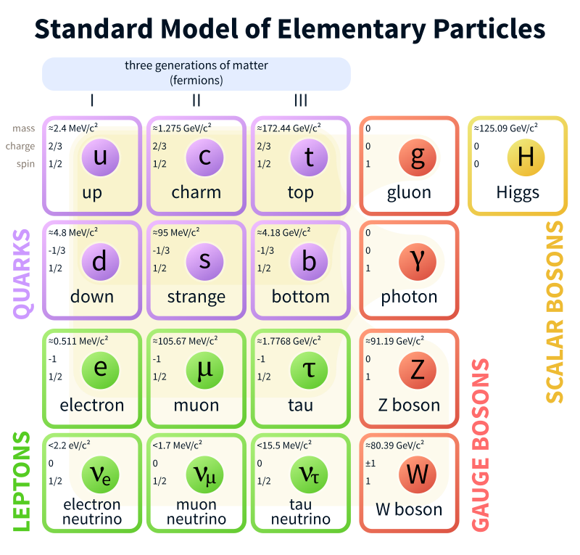
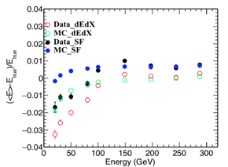
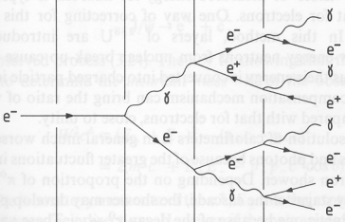
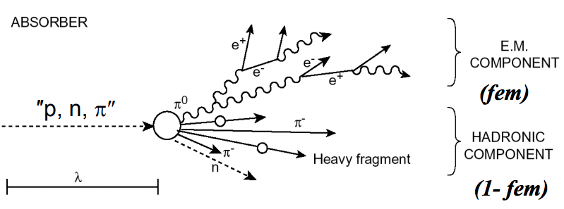
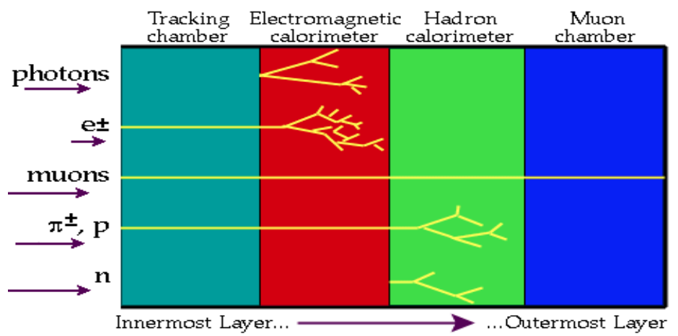
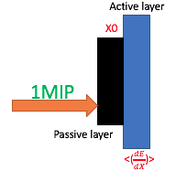
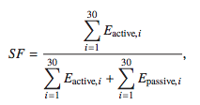
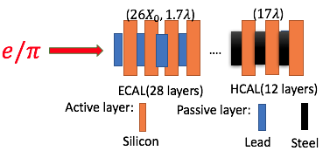




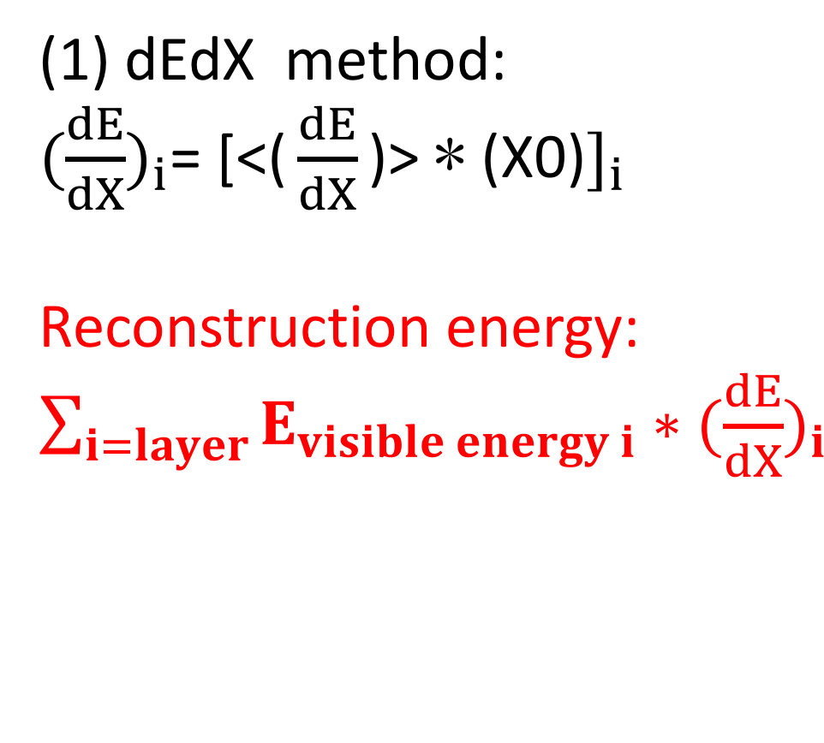

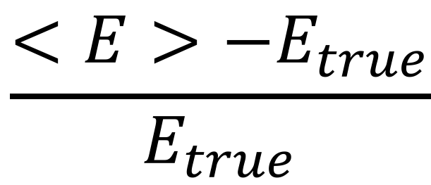
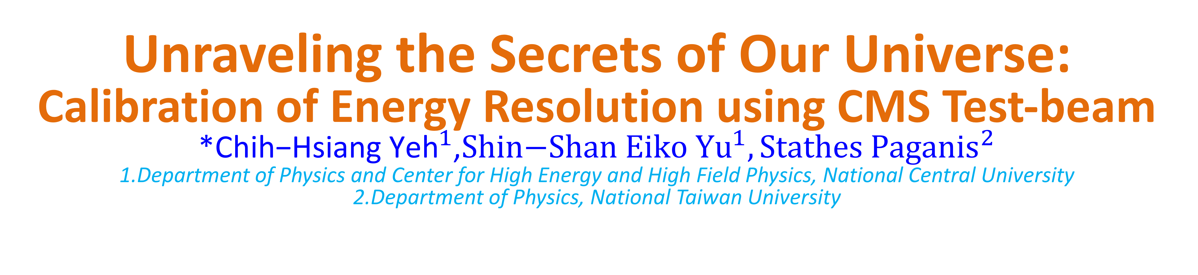
國立中央大學理學院 X
日本広島大学理学部
Poster- NCU X HU -Symposium
Unraveling the Secrets of Our Universe:
Calibration of Energy Resolution using CMS Test-beam
*${\text{Chih}\text{−}\text{Hsiang} \text{Yeh}}^{1}$,${\text{Shin}\text{−}\text{Shan} \text{Eiko} \text{Y}u}^{1}, {Stathes Paganis}^{2}$
1.Department of Physics and Center for High Energy and High Field Physics, National Central University
2.Department of Physics, National Taiwan University
Introduction
The discovery of Higgs boson at the Large Hadron Collider (LHC) in 2012 has led curious scientists to ask more questions about our Nature: Is there any deep structure behind the universe? Is there any simpler principle that we can follow up beyond the knowledge we know? With the enthusiastic heart in looking into the universe, I did the research on the detector performance in Compact Muon Solenoid(CMS) of LHC and try to help the facilities to reconstruct the events and to improve the energy resolution with calibrations. Finally, we can know more about the universe with the data we collect!
1
2
3
4
5
6
Hi, I’m Proton!
Let me guide you in the beautiful world
of high energy Physics(HEP) with 1~6 stations!
Purpose
Words definition:
Visible energy: What is seen by the detector
Reconstruction energy: calibrated energy
True energy: Real energy of particle
Out of the depths of space and time
Even the bosons cannot hide
Out of the mess we leave behind
What will they find
You and I
Collide
~LHC<Collide>
2013 Nobel prize!
Results and Conclusion
Beyond standard model particle exist(s)?
Dark matter exist(s)?
Deep structure in our universe?
$$\frac{<E>−E_{true}}{E_{true}}$$
1
• SF calibrations results in higher reconstruction efficiency with the higher energy resolution.
• If we can improve the energy calibration, our physics analysis will have better results.
2
6
Electromagnetic showering
Welcome to the travel of my studies with the proton of the guidance in this collider!
Get started to see what happens!
CMS detector
(One of detectors in LHC)
• Tracking detector: Measure the trajectory of the charged particles (observe : momentum)
• Calorimeter: Measure the energy of the particles, including electromagnetic part(ECAL) and hadronic part(HCAL) (observe : energy)
• Muon chamber: Measure Muon momentum
What are the methods of calibration?
3
Since a particle won’t leave all of the energy
in the detector
➔we need to use calibrations to
convert the visible energy back to its real energy
5
Hadronic showering
(1) dEdX method:
${(\frac{dE}{dX})}_{i}$= [${\text{<(}\frac{dE}{dX}\text{)> ∗ (}\text{X}\text{0)}]}_{i}$
Reconstruction energy: $\sum_{i=layer}{E_{visible energy i}{∗(\frac{dE}{dX})}_{i}}$
Tracking detector
4
What’s test beam?
• Since the era of High-Luminosity LHC is coming, the issue in CMS:
High radiation damage (b)Pileup
We focus on this one!!
• We need to introduce the new detector – High Granularity Calorimeter (HGCAL):
(2) SF method:
Use active and passive layer energy to estimate
Reconstruction energy:
SF*$E_{visible energy}$
Fire $e/π$ to test HGCAL!
Called “test-beam”!
HGCAL prototype
20,30,50,80,100
150,200,250,300(GeV)
Thank you for your participation!
If you are interested, please contact me.
Focus on e performance in ECAL!

