Slide 1
Internal Amplification Ge(GeIA) Theory of predicting the necessary gain
*Chih-Hsiang Yeh, Tze-Tzing Henry Wong

Slide 2
The reminder of the previous results
At the first place, the ionization rates of electron and hole were predicted by some of the formulae:
Signal(Ge)
Signal(Impurities)
Ionization rate
Give us the “Gain” in the end.
Great! But what‘s the next?
Debut of our “BKG”!!
Umm…It seems complicated!
Let me map out the blueprint first!

Slide 3
Three steps
Gain
SIG estimation
BKG estimation
Ionization rate
Gain(E,T)
Theory of BKG
Signal threshold
Type of the detector?
Temperature?
Electric field?
Know our predicted gain for signal
Under the certain T and E
Know the threshold of the signal
(Signal ➔ Gain)
Predicted by BKG (Theory)

Slide 4
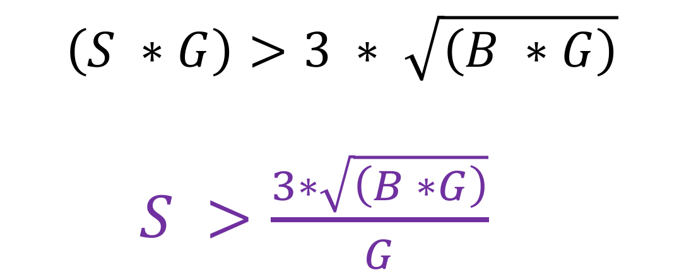
Raw/Observable
(SIG) > (3 * sigma of BKG)
No Amplification
Raw SIG/BKG
With Amplification
Obs SIG/BKG
$$\left(S ∗G\right)>3 ∗ \sqrt{\left(B ∗G\right)}$$
$S >\frac{3∗\sqrt{\left(B ∗G\right)}}{G}$
S
S*G
B
B*G
Various thresholds (Given the dark matter energy) ➔ All can be predicted.

Slide 5

Confirm the circumstance
 | G | S(GS) | B(GB) | Threshold
(1)USD | 1 | 1(1) | 1(1) | 3
(2)China-THU | 100 | 1(100) | 100(10000) | 3
(SIG) > (3 * sigma of BKG)
$$\left(S ∗G\right)>3 ∗ \sqrt{\left(B ∗G\right)}$$
$S >\frac{3∗\sqrt{\left(B ∗G\right)}}{G}$

Slide 6
Purpose of this study
*The important issue:
Can we predict “the necessary gain” by the signal we expect?
Next step:
Find out the right BKG and find out the right threshold plots.
➔ Then, we can apply it on our detector
➔ Even design the different type of the detector compared with other people.

Slide 7
Theory of BKG

Slide 8
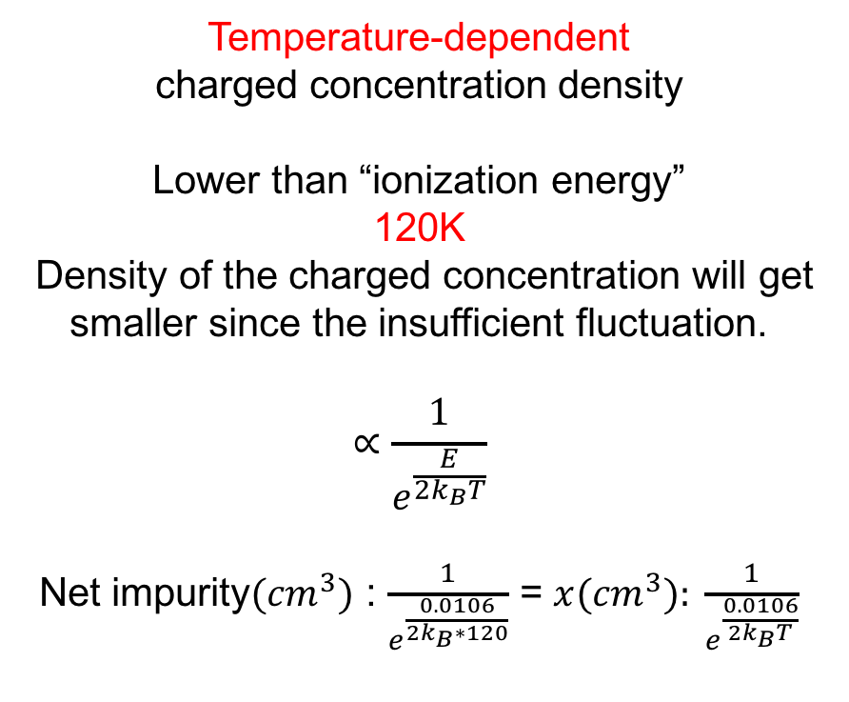
Charged concentration density
No-electric-field-zone
Temperature-dependent
charged concentration density
Lower than “ionization energy”
120K
Density of the charged concentration will get smaller since the insufficient fluctuation.
$$∝\frac{1}{e^{\frac{E}{2k_{B}T}}}$$
Net impurity$({cm}^{3})$ : $\frac{1}{e^{\frac{0.0106}{2k_{B}∗120}}}$ = $x({cm}^{3}): \frac{1}{e^{\frac{0.0106}{{2k}_{B}T}}}$
We can get the charged concentration correlated with the temperature!

Slide 9

BKG contribution
$\frac{Δn(T)}{τ}= \frac{x ({cm}^{3})}{100μ(s)}$
$∆n (T):Net Impurity concentration$
$τ:Carrier Lifetime$

Slide 10
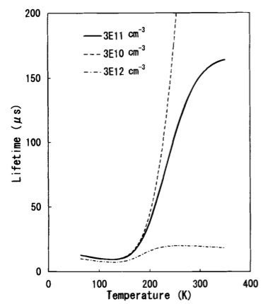

Carrier lifetime
Normal concentration ( Level:${10}^{10}−{10}^{15}$ $({cm}^{3})$ )
➔ Lifetime won’t be changed under the low temperature
Below 100K, The $τ$ of the material will remain the same value.

Slide 11
How do we know we are right? The standard case as follows:

Slide 12

The standard Germanium
1 x 1 x 1 (${cm}^{2}$)
To see if the threshold of the detector is reasonable
-
Velocity?
➔ The next one we need to know
1 cm
+

Slide 13
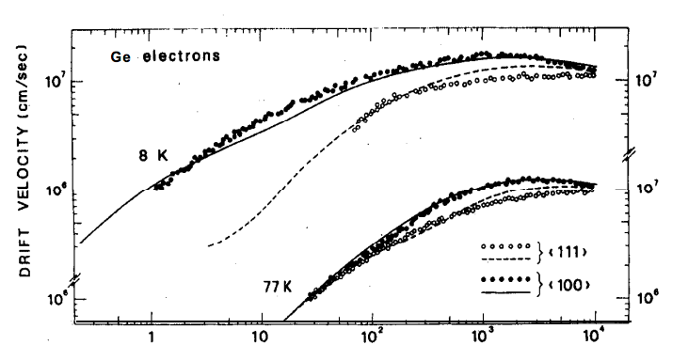
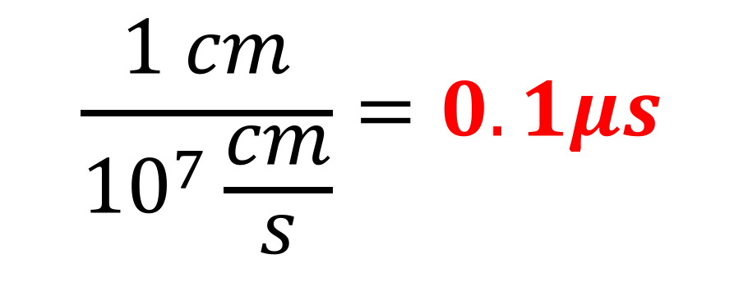
The velocity of the electron in Ge
Gain: 0-1000 case
4K
77K
$$\frac{1 cm}{{10}^{7}\frac{cm}{s}}=0.1μs$$
The electron crosses the detector within 1cm

Slide 14
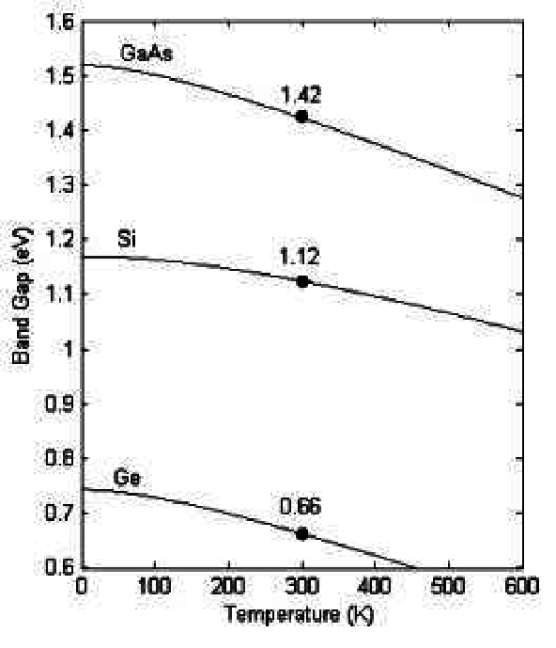
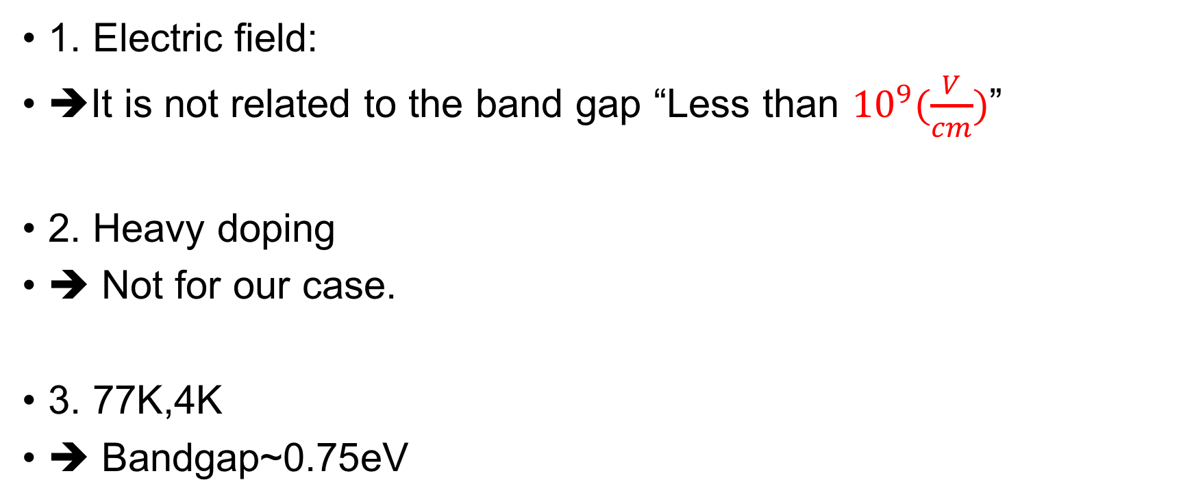
Band gap ( E, T, dopant )
1. Electric field:
➔It is not related to the band gap “Less than ${10}^{9}(\frac{V}{cm})$”
2. Heavy doping
➔ Not for our case.
3. 77K,4K
➔ Bandgap~0.75eV

Slide 15
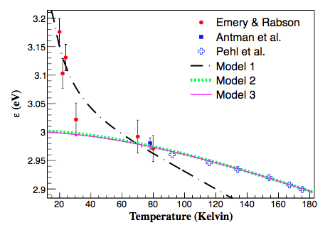

E-h pair extension- consider the phonon
Consider the phonon – Losing the energy by the phonon
$E_{detectable}= E_{real} ∗ \frac{E_{g}}{ε}$
$E_{g}=0.75eV$
$ε(77K)=3eV$
$ε(4K)=3.5eV$

Slide 16

New material ( e-h pair )
77K : $\left(S ∗G∗\frac{0.75}{3}\right)>3 ∗ \sqrt{\left(B ∗G∗\frac{0.75}{3}\right)}$
4K : ($\left(S ∗G∗\frac{0.75}{3.5})\right)>3 ∗ \sqrt{\left(B ∗G∗\frac{0.75}{3.5}\right)}$

Slide 18
Backup

Slide 19
Image….
Generate rate
(Evaporate)
Water
Recombination rate
(Condensate)
T equilibrium
G=R
Take off the cover
G>R
The same as our experiment!

Slide 20
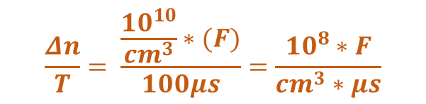
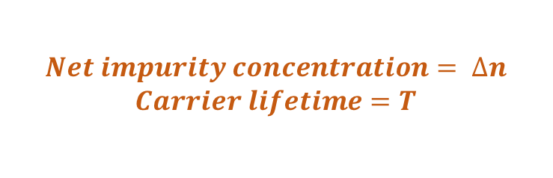
Image again….
$$Net impurity concentration= ∆n$$
$$Carrier lifetime=T$$
$$\frac{Δn}{T}= \frac{\frac{{10}^{10}}{{cm}^{3}}∗(F)}{100μs}=\frac{{10}^{8}∗F}{{cm}^{3}∗μs}$$
Generate rate (e pop up)
Electron sea
Recombination rate
(e absorbed)
T equilibrium
(Electric field off)
G=R
Take off the cover
(Electric field on)
G>R

Slide 21

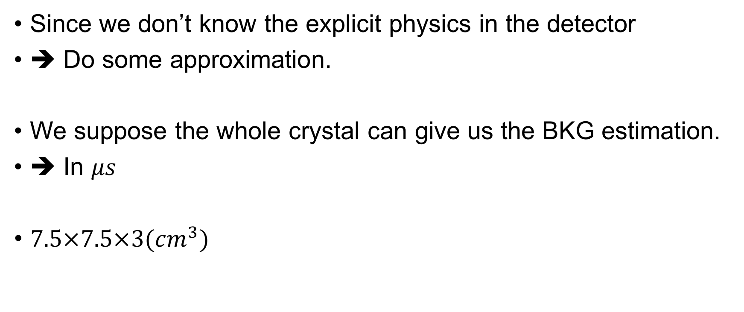
Give us the sense
$$\frac{Δn}{T}= \frac{\frac{{10}^{10}}{{cm}^{3}}∗(F)}{100μs}=\frac{{10}^{8}∗F}{{cm}^{3}∗μs}$$
Since we don’t know the explicit physics in the detector
➔ Do some approximation.
We suppose the whole crystal can give us the BKG estimation.
➔ In $μs$
$7.5×7.5×3({cm}^{3})$
$\frac{Δn}{T}= \frac{ (F)}{100μs}=\frac{0.01∗F}{{cm}^{3}∗μs}=\frac{{10}^{−3}∗F}{{cm}^{3}∗0.1μs}={10}^{−3}∗F$ (/${cm}^{3}∗0.1μs$)

Slide 22

Threshold
$$\left(S ∗G\right)>3 ∗ \sqrt{\left(B ∗G\right)}$$
$S >\frac{3∗\sqrt{\left(B ∗G\right)}}{G}$
8.221keV
5.64eV

Slide 23
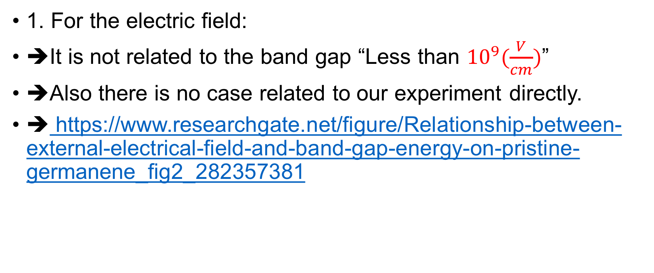
Band gap ( E, T, dopant )
1. For the electric field:
➔It is not related to the band gap “Less than ${10}^{9}(\frac{V}{cm})$”
➔Also there is no case related to our experiment directly.
➔ https://www.researchgate.net/figure/Relationship-between-external-electrical-field-and-band-gap-energy-on-pristine-germanene_fig2_282357381

Slide 24
Band gap ( E, T, dopant )
2. For the dopant and temperature:
sci-hub.tw/10.1103/PhysRevB.24.1971 (dopant)
https://ecee.colorado.edu/~bart/book/eband5.htm (temperature)
http://folk.uio.no/ravi/cutn/semiphy/21.Borstein-Moss.pdf (dopant)
Heavy doping ➔ Not for our case.
77K,4K ➔ Bandgap~0.75eV

Slide 25
Carrier lifetime
The period of the time that
“The electron pops up and is absorbed by the atom”
https://arxiv.org/pdf/1907.05067.pdf
https://www.google.com/search?q=Carrier+lifetime+concentration&sxsrf=ACYBGNRX_-wf-0_XGePwPz3r-STAx-jnXw:1572081781847&source=lnms&tbm=isch&sa=X&ved=0ahUKEwissaiBzbnlAhVRI6YKHd8gCPAQ_AUIEigB&biw=1280&bih=605#imgrc=ZFkOn2ay1IHZ9M:
Normal concentration (Level: 10^10~15 ) ➔ Lifetime won’t be changed
http://jes.ecsdl.org/content/145/9/3265.full.pdf+html

