Slide 1
Depletion Surface/Contact Leakage current
*Chih-Hsiang Yeh , Tze-Tzing Henry Wong

Slide 2
Part1: Depletion consideration

Slide 3
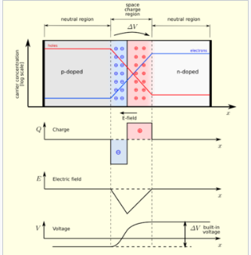
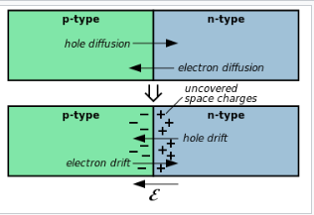
What’s “depletion”?
This is the basic phenomenon happening in the PN-junction.
The following picture is the simplest case:

Slide 4
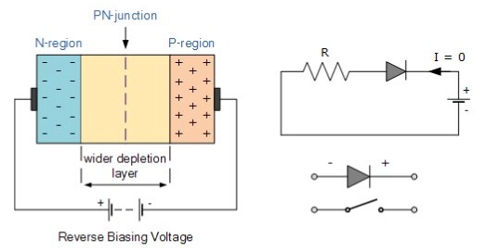
Why is “Bias voltage”?

Slide 5
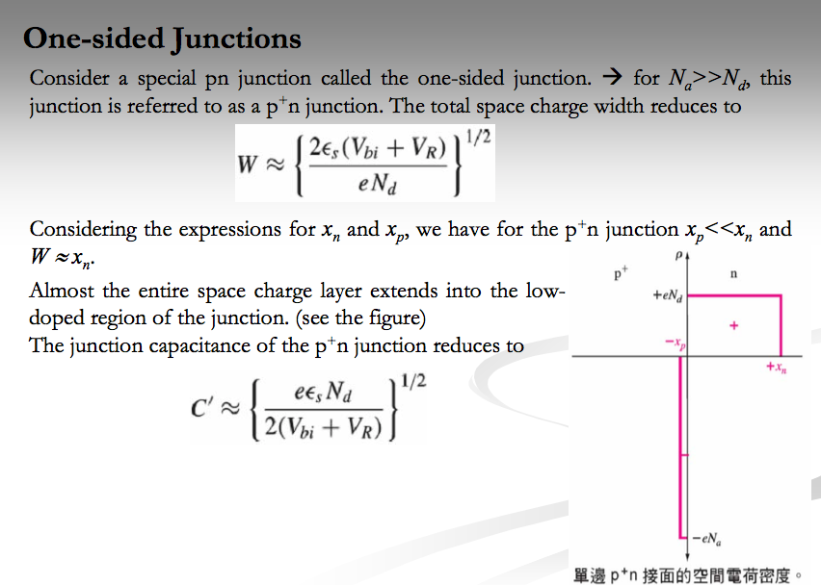
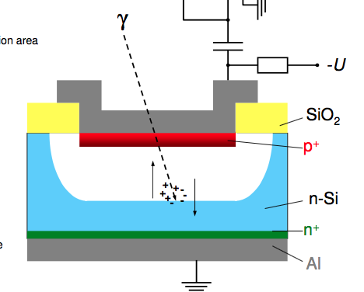
In our case
We can do the calculation of transforming between the Electric field and voltage by applying the conservation of the energy.
➔ Depend on the geometry of the detector as well.

Slide 6
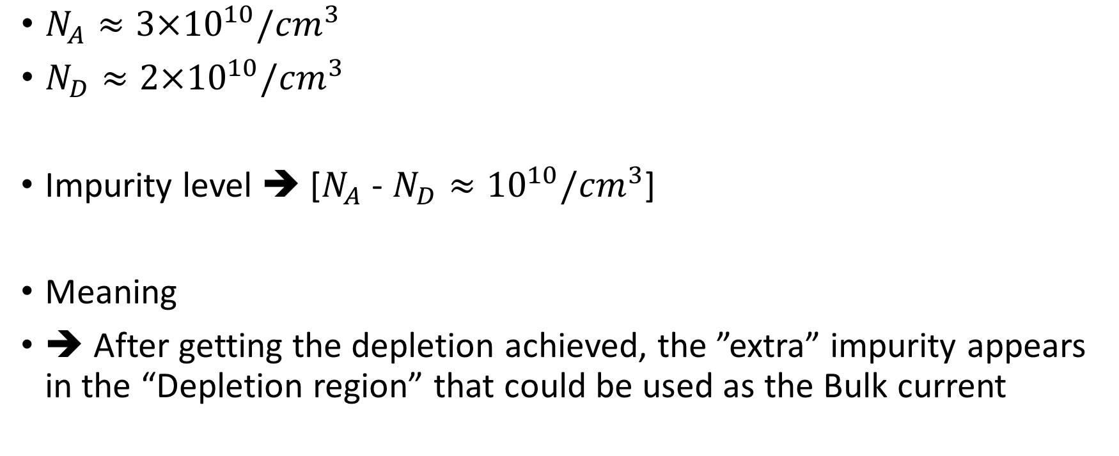
Let take some calculations – p-type
$N_{A}≈3×{10}^{10}/{cm}^{3}$
$N_{D}≈2×{10}^{10}/{cm}^{3}$
Impurity level ➔ [$N_{A}$ - $N_{D}≈{10}^{10}/{cm}^{3}$]
Meaning
➔ After getting the depletion achieved, the ”extra” impurity appears in the “Depletion region” that could be used as the Bulk current

Slide 7
Got some modifications
Basically, the scale is the same as before, but concept should be modified to make the following works sound reasonable.
Let see some retrospect of the signal threshold studies!

Slide 8
The standard Germanium
1 x 1 x 1 (${cm}^{3}$)
To see if the threshold of the detector is reasonable
-
Velocity?
➔ The next one we need to know
1 cm
+

Slide 9
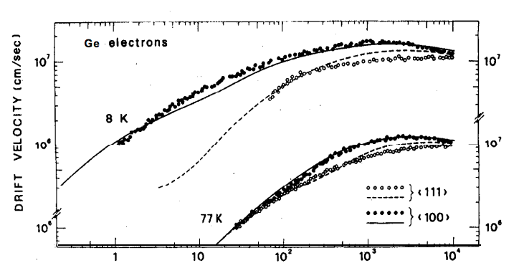
The velocity of the electron in Ge
Gain: 0-1000 case
4K
77K
$$\frac{1 cm}{{10}^{7}\frac{cm}{s}}=0.1μs$$
The electron crosses the detector within 1cm

Slide 10
Charged concentration density
No-electric-field-zone
Temperature-dependent
charged concentration density
Lower than “ionization energy”
120K
Density of the charged concentration will get smaller since the insufficient fluctuation.
$$∝\frac{1}{e^{\frac{E}{2k_{B}T}}}$$
Net impurity$({cm}^{3})$ : $\frac{1}{e^{\frac{0.0106}{2k_{B}∗120}}}$ = $x({cm}^{3}): \frac{1}{e^{\frac{0.0106}{{2k}_{B}T}}}$
We can get the charged concentration correlated with the temperature!

Slide 11
New material ( e-h pair )
77K : $\left(S ∗G∗\frac{0.75}{3}\right)>3 ∗ \sqrt{\left(B ∗G∗\frac{0.75}{3}\right)}$
4K : ($\left(S ∗G∗\frac{0.75}{3.5})\right)>3 ∗ \sqrt{\left(B ∗G∗\frac{0.75}{3.5}\right)}$

Slide 12
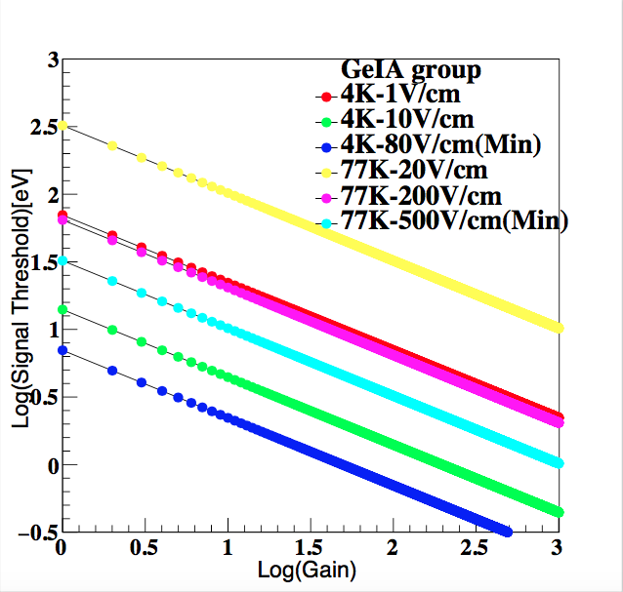
The plot without considering the Surface/Contact Leakage current!

Slide 13
Part2: Contact leakage current consideration

Slide 14
Rationale
Since we have p+ layer
➔ The depletion process will commence from there.
➔ Note! Now there is no electric field at the positive side.
➔ After we get the detector fully-depleted
➔ Electric field is filled in this detector
➔ The positive side(contact) of the node could give out the leakage current
➔ Well-measured stuff, can see it in the paper clearly.

Slide 15


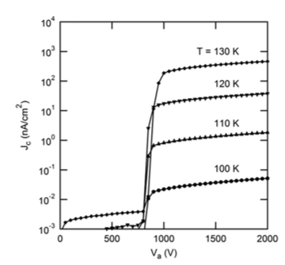

Formulae of the top and the bottom nodes
Partial-depleted region
fully-depleted region
Top
Bottom
$J_{0}$is experiment-dependent,

Slide 16
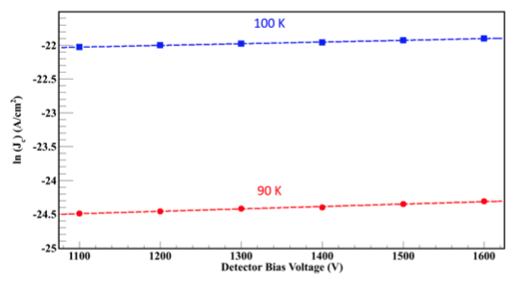
Consistent with Prof. Dongimng’s paper

Slide 17
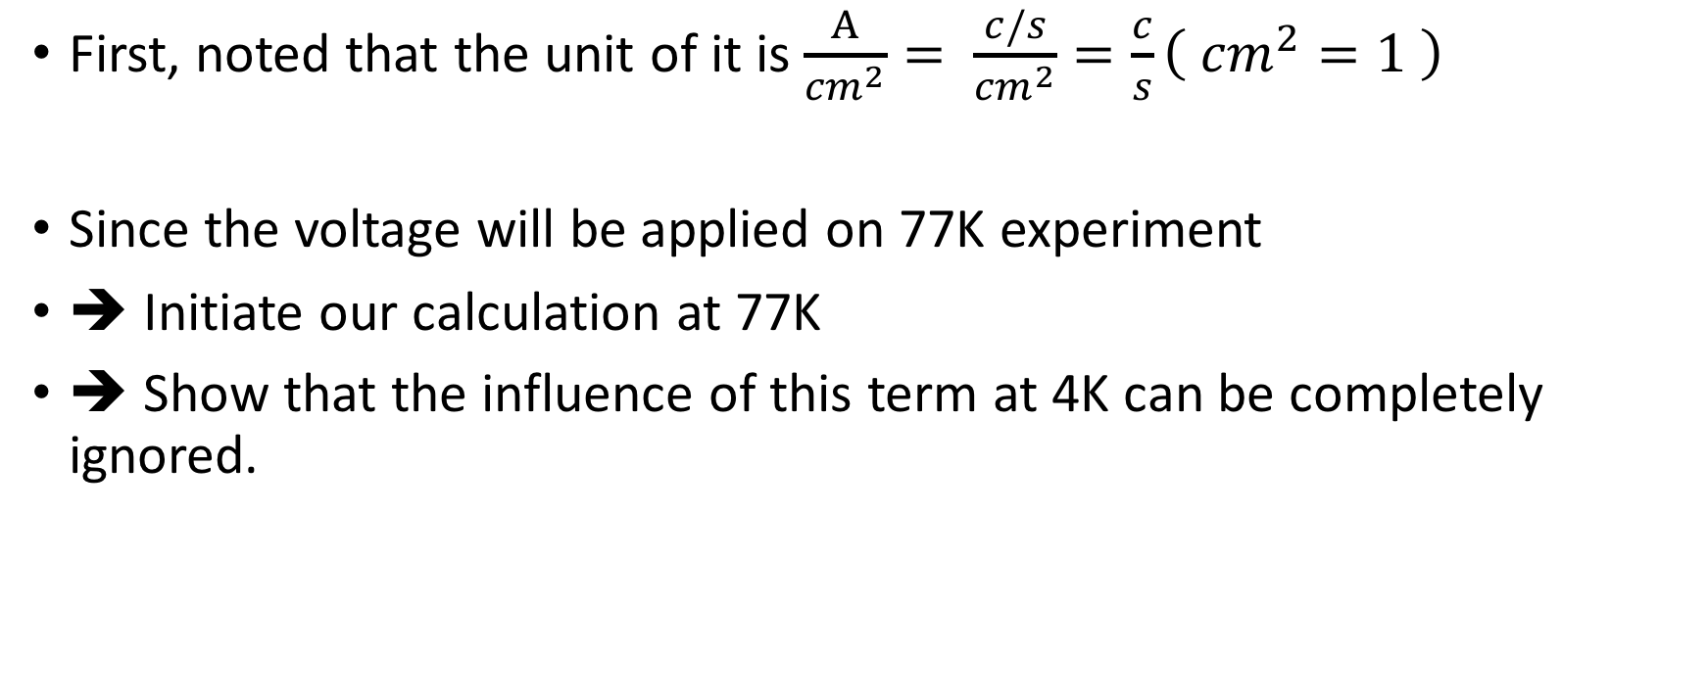
Let us do the calculations
First, noted that the unit of it is $\frac{A}{{cm}^{2}}= \frac{c/s}{{cm}^{2}}=\frac{c}{s}\left( {cm}^{2}=1 \right)$
Since the voltage will be applied on 77K experiment
➔ Initiate our calculation at 77K
➔ Show that the influence of this term at 4K can be completely ignored.

Slide 18

77K
${10}^{−1}×{10}^{−9}×{10}^{−2}={10}^{−12}\left(\frac{c}{s}\right)= {10}^{−19}(\frac{c}{0.1μs})$
1c * 1V = 1J
${10}^{−19}\left(\frac{c}{0.1μs}\right)∗\frac{{10}^{3}\left(V\right)}{1.6∗{10}^{−19}} ∗\frac{0.75}{3}= \frac{1}{6.4}∗{10}^{3} (個)$

Slide 19
Part3: Surface leakage current consideration

Slide 20

The formulae related to the surface

