Slide 1
Development of the physics process in Ge detector
Chih-Hsiang Yeh

Slide 2
Luke phonon amplification
1. Luke phonon ➔ Come out from e-h pair
2. Those e-h pair ➔ Give out more Luke phonon
➔ Something like “Quenching function”
➔ But not under this “doping effect” research?
➔ Maybe we can predict some beyond the previous research?
➔ Any help in our experiment?
➔ Expand our experiment.

Slide 3
Luke phonon amplification
Nuclear recoil vs. Give out phonon+ e-h as a function of temperature
Nuclear recoil vs. Give out phonon+ e-h as a function of field
Something like breakdown voltage or others?

Slide 4

Definition clarification
Since in the most of the paper
➔ Electron-hole pair used for both “ionization” and “excitation”
➔ Check with the definitions
➔ “Ionization” is for “An electron gets rid of the nuclear and goes to infinite place” ( Ion-electron pair => electron-hole pair)
➔ “Excitation” is for “An electron jumps from valence band to conductive band”
Electron (~infinite)
Out of the crystal
Conduction band
0.01eV
0.67eV
Atom
Valence band
Ionization
Excitation

Slide 5
Extreme temperature-20K
ionization energy of the dopants!
Require some energy to ionize and produce carriers in the semiconductor. This energy is usually thermal! ( From temperature fluctuation )
If the temperature is too low, the dopants will not be sufficiently ionized and there will be insufficient carriers.
The result is a condition called "freeze-out." For example, Si (dopant ionization energy ~0.05 eV) freezes out at about 40 K and Ge (ionization energy ~0.01 eV) at about 20 K. Thus, for example, Ge devices in general operate to lower temperatures than Si devices.

Slide 6
4K and 77K different – 20K different
In 77K
➔ Thermally, carrier (electron/hole) will pop up without any signal
➔ It need to totally depletion with the high voltage
In 4K
➔ It will be in a low temperature
➔ It needs only a low voltage to drift the electron-hole pair
➔ Below the 20K

Slide 7
Bulk leakage current Surface leakage current
Below 20K
➔ There is no thermal excitation
➔ No leakage current to be supposed
Higher than this one
➔ Need to find out the relation between.

Slide 8
Well-defined! The initial process
When the dark matter comes….
Nuclear recoil v.s Electron recoil
Let define it well to see how we can process

Slide 9

Nuclear recoil
dEdX only!
t
After Nuclear recoil
➔ It will collide with electrons and atoms
Dark matter
Dark matter
Electrons ➔ e-h pairs
(Effective ionization energy)
Electronic stopping of heavy ion
Atoms➔ phonons
Nuclear stopping of heavy ion
Non-SM Weak interaction
${10}^{−4}\sim {10}^{2}$eV
Event rate dependent
Nuclear
Nuclear
Fake-Feynman diagram of DM-Nuclear scattering
What’s the fraction of them?
We need to know this to initiate!
Depend on the velocity of DM
Nuclear recoil (scattering off)
NR

Slide 10
Electron recoil
t
After the Electron recoil
➔ It will collide with electrons
Dark matter
Dark matter
Electrons ➔ e-h pairs
(Effective ionization energy)
Since 50eV DM➔ e-h pair 3eV
(Impact Ionization)
Non-SM Weak interaction
${10}^{−4}\sim {10}^{2}$eV
Event rate dependent
Electron
Electron
No phonon basically! Can’t give nuclear much energy
Fake-Feynman diagram of DM-electron scattering
Too big….
Come on!
Electron recoil (scattering off)
ER
e
Nuclear

Slide 11
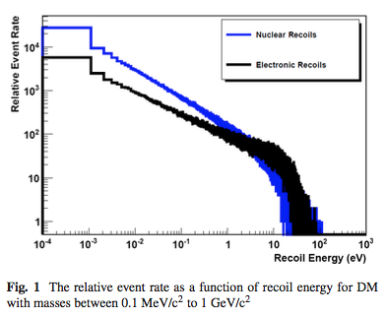
Different DM Mass
Different Recoil energy
Different Relative event rate!
Mostly we care this range.
➔ Ionization limitations with impurities

Slide 12
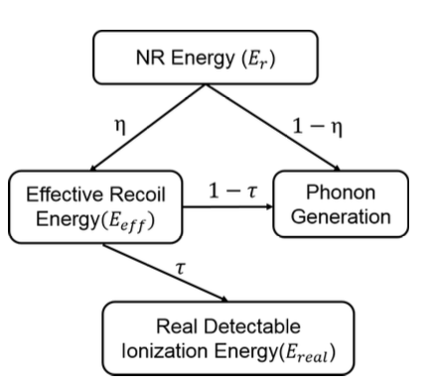
Initiated by Prof. Dongming
Effective ionization energy

Slide 13
Initiated by Prof. Dongming
Electronic and nuclear stopping power (dEdX)
Primary phonon
Not related to temperature!
Effective ionization energy

Slide 14
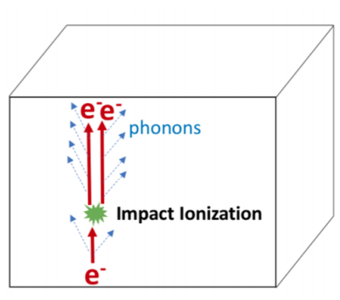
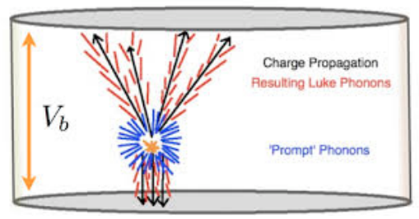
Initiated by Prof. Dongming
Effective ionization energy
Recombination(ignored) phonon, Luke effect phonon
Impact ionization(Non-uniform effect?)

Slide 15


Initiated by Prof. Dongming
??
Effective ionization energy
$$1−ε$$
Trash Phonon
Nothing but heat
$$ε$$
Signal Phonon (Luke amplified)
Phonon amplified to ionize e-h pair
Luke calibration?

Slide 16
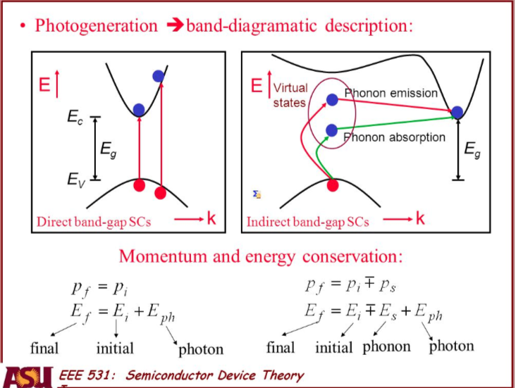

Slide 17
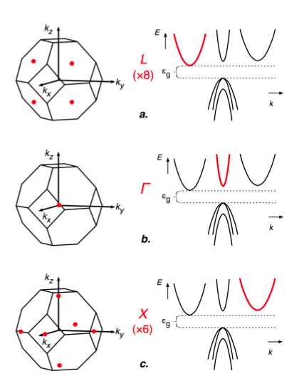
Direct band gap
The energy produce e-h pair
➔ Bandgap
Indirect band gap
The energy produce e-h pair
➔ Average all the gap

Slide 18

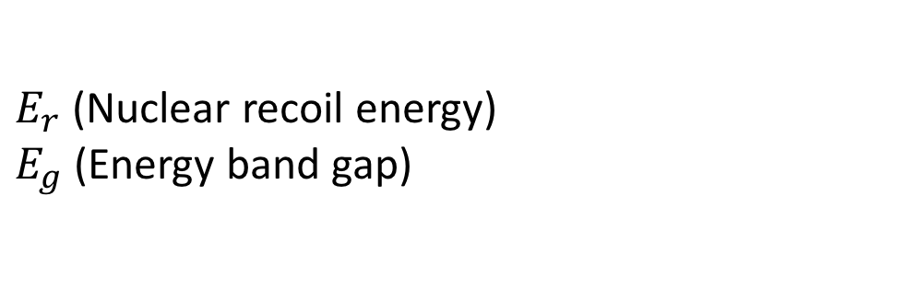
Let define the parameters
$N_{pair}′=\frac{E_{r}∗η}{E_{g}}$ ( Expected – non phonon )
$N_{pair}=\frac{E_{r}∗η}{ε}$ ( Consider Phonon )
$E_{r}$(Nuclear recoil energy)
$E_{g}$(Energy band gap)

Slide 19
The issue we can concern to explore
1. Explore the total signal
➔ Since in our experiment, we don’t try to divide our signal into two types – electron recoil and Nuclear recoil, but add them together
➔ a. Do we need to distinguish them by some other things?
➔ ( Maybe we can have a shield outside. )
➔ b. Or maybe we can think of the other method to do it?

Slide 20
The issue we can concern to explore
2. Luke phonon calibration
➔ Since in our case of the shallow doping, we can give out many electron-hole pair
➔ Also it will give us much Luke-phonon
➔ Those phonon could also give us the electron-hole pair
➔ Under “High voltage”! – In superCDMS ( ignored )

Slide 21
Problem
1. Since we know the impurities (Shallow doping), do we need to care about the band gap for ionization?
2. Phonon emission and absorption
3. Ionization energy and bandgap

Slide 22
First: Basic Solid-State Physics in Crystal

Slide 23
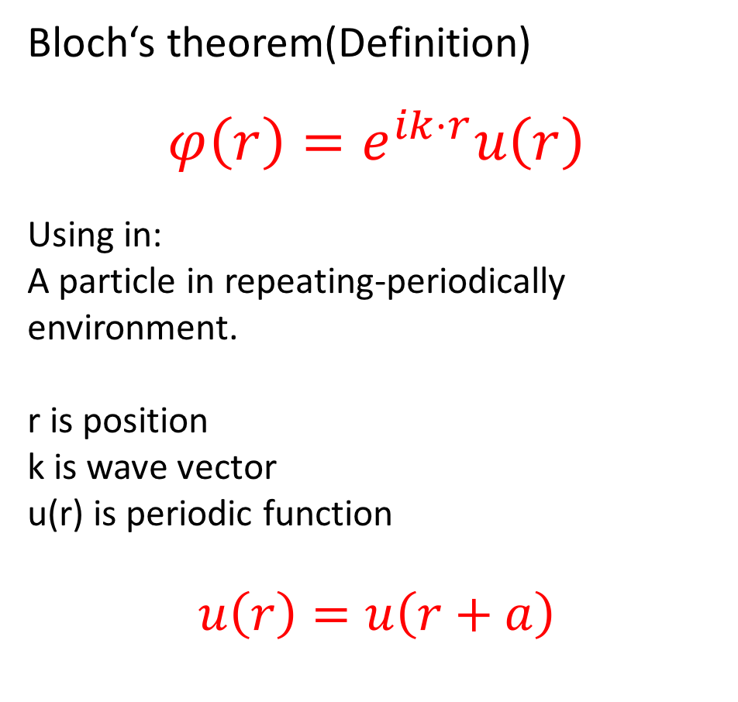
Bloch’s theorem- Electron wave function
Electron
Electron
Electron
Bloch‘s theorem(Definition)
$$φ\left(r\right)=e^{ik⋅r}u\left(r\right)$$
Using in:
A particle in repeating-periodically environment.
r is position
k is wave vector
u(r) is periodic function
$$u\left(r\right)=u\left(r+a\right)$$
Atom
Atom
Atom
(Next page will show the wave)
Electron
Electron
Electron
MORE
Atom
Atom
Atom
MORE
Atom-Atom distance=a
Crystal

Slide 24
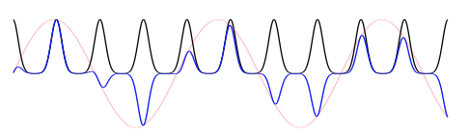
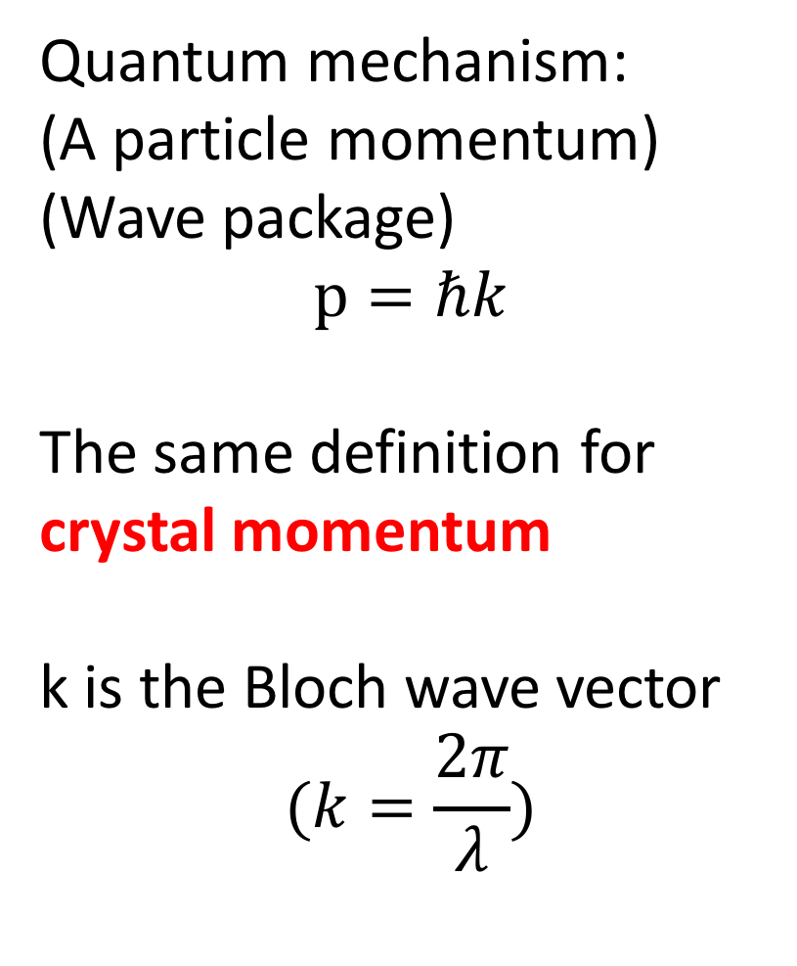

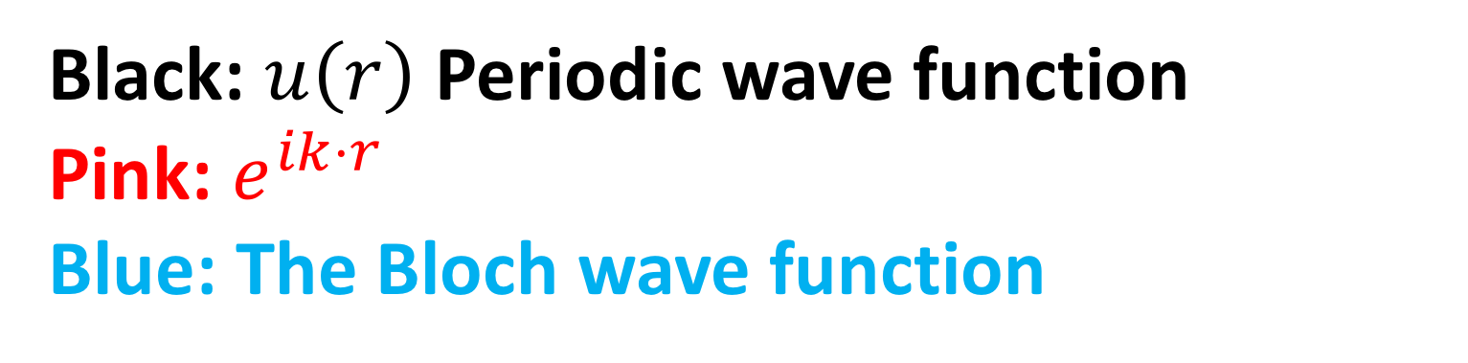
The picture for the Bloch wave
Quantum mechanism:
(A particle momentum)
(Wave package)
$$p=ℏk$$
The same definition for crystal momentum
k is the Bloch wave vector
$$(k=\frac{2π}{λ})$$
Black: $u\left(r\right)$Periodic wave function
Pink: $e^{ik⋅r}$
Blue: The Bloch wave function
Temperature, voltage
➔ Change the wave vector k
➔ Because: Change the status of electrons
$$φ\left(r\right)=e^{ik⋅r}u\left(r\right)$$

Slide 25
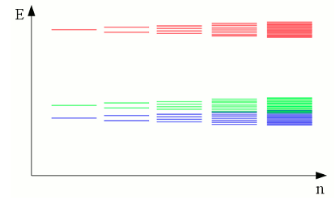
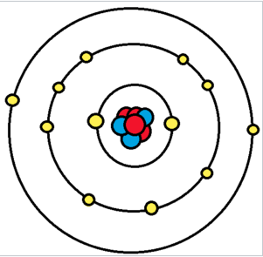
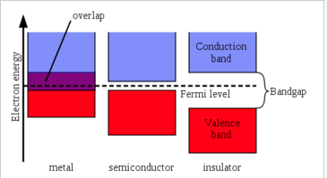
Band theory and Band gap
Outermost electrons: valence electron
n=3
Crystal:
Many orbital electrons overlap
n=2
n=1
Lowest unoccupied
Fermi level:
0K, the electron can fill the highest level in valence band
Highest occupied

Slide 26
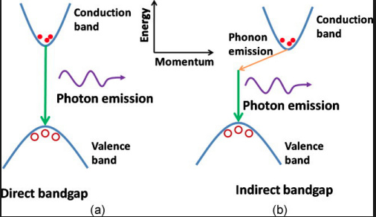
Direct and indirect band gap -Energy and momentum conservation
Dispersion relation
E versus. k
Momentum conserves.
Momentum don’t conserve.
Same k or not.
Photon will be absorbed/emitted !
Photon will be absorbed/emitted !
Phonon will be absorbed/emitted !

Slide 27
Direct and indirect band gap -Energy and momentum conservation
**Important point 1**:
Under 4K(liquid Helium) and 77K(liquid Nitrogen), what’s the different of the band gap between this two temperature?

Slide 28



Debye model – Debye temperature
Estimate the phonon contribution in specific heat.
Low temperature➔ Specific heat proportional to $T^{3}$
What’s the standard of this specific heat issue?
Proportional to $T^{3}$
Proportional to T
0K
Bigger K
Debye temperature:
$$θ_{D}=\frac{ℏ}{k_{B}}ω_{D}$$
$${ω_{D}}^{3}=6π^{2}ρ{υ_{s}}^{3}$$
$ρ$ is crystal density, $υ_{s}$ is sound wave speed in crystal
Connection between:
Phonon and temperature
➔ Our band gap also involve in!
Next page

Slide 29
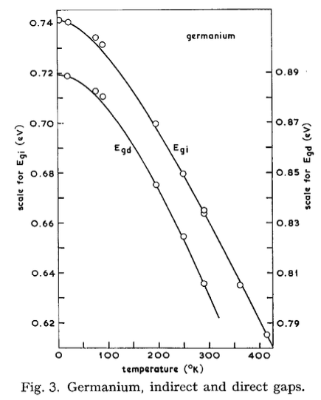

Band gap under the 4K and 77K
Indirect band gap
Lower band gap
Prefer to use it!
$E_{g}=E_{0}−α\frac{T^{2}}{T+β}$
$E_{g}$ is direct or indirect band gap
$E_{0}$ is the band gap of 0K
$α$ and $β$ are the constants in experiment
$T≪θ$ ➔ $∆E_{g}∝T^{2}$
Since it will go down
Higher temperature(77K)
Can get more electron-hole pair
[Paper]

Slide 30
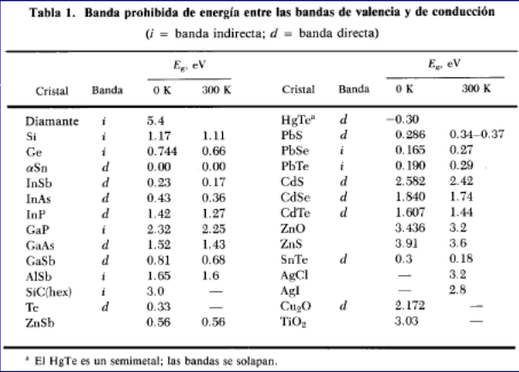
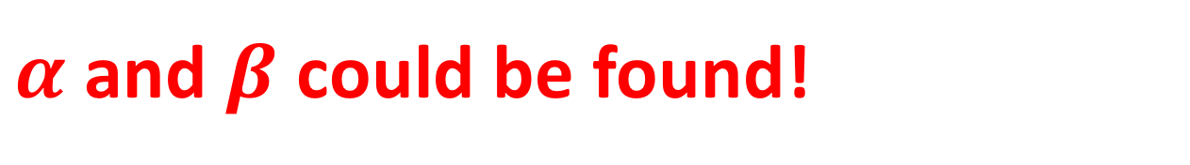
$α$ and $β$ could be found!

Slide 31
Second: Our study topic of Ge detector

Slide 32
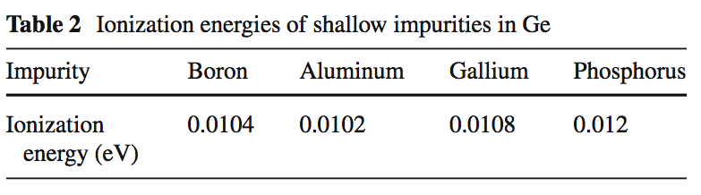
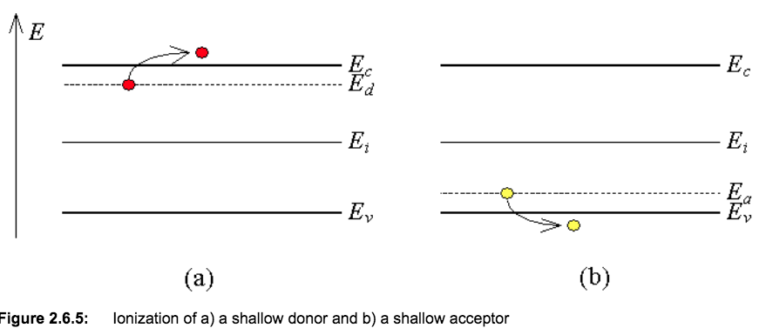
Shallow doping Trap
Donor from impurities ( available free electron)
N-type
Acceptor from impurities ( available free hole)
P-type

Slide 33
Let us divide the topic into two parts: Nuclear recoil and Electron recoil

Slide 34
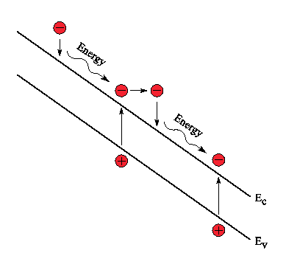
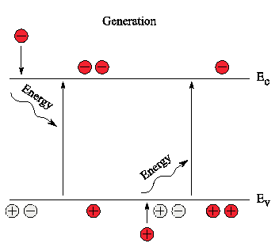
Auger recombination-electron and hole pair Impact ionization
High energy electron under the high voltage
Electron will have high energy
Ionize the nearby atom
Give out many electron-hole pair
Give out many electron-hole pairs
➔ Then?
Avalanche Auger generation

Slide 35
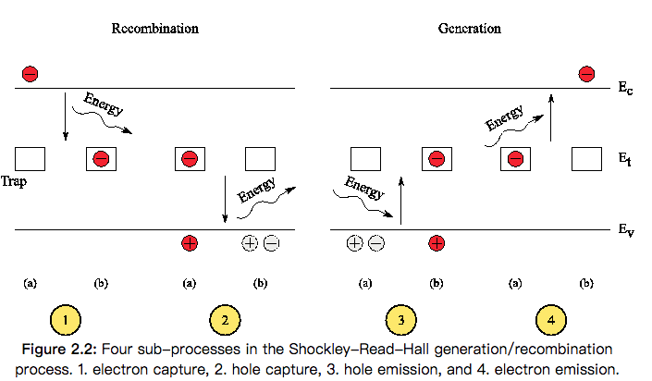
Phonon emission/absorption- Shockly-Read-Hall(SRH) recombination
Trap:
The defect of crystal
impurity

Slide 36
Reverse bias Breakdown
Maximum reverse bias voltage
Two type of breakdown
- Avalanche breakdown
Charge Multiplication ( impact ionization ) under the electric field
In the depletion of the region
- Zener breakdown
Quantum mechanical tunneling of carriers through the bandgap
Highly doped p-n junctions.

Slide 37
What’s Depletion layer in this case?

