Slide 1
Impurities issue -Ionization rate
Chih-Hsiang Yeh
9/13

Slide 2
Issues
As the report before, we can shed the light on “the ionization rate” to figure out the “Gain”.
➔ Note! We only discuss about the signal now.
Upon the knowledge of the Ge ionization rate
➔ Based on them and build the similar structure to see
➔ Reminder: We found that “Mobility” is the key to this issue
➔ We need to know the exact processes affecting it.

Slide 3
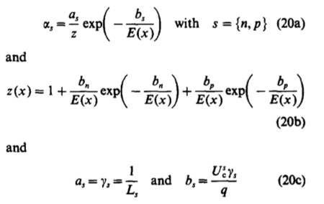

Just in case ( Right! )
$\frac{μ × m∗}{e}=τ$
$τ×v_{d}=MFP(L$
Important point: (1) Mean free path (2)Ionization energy

Slide 4
How to know?
Mobility
➔ More the scatterings happens, less the mobility will be.
First of all, due to the complicated processes, we need to cut them into many pieces to see it clearly!
Then, we need to sum them up for getting the “total mobility”!

Slide 5
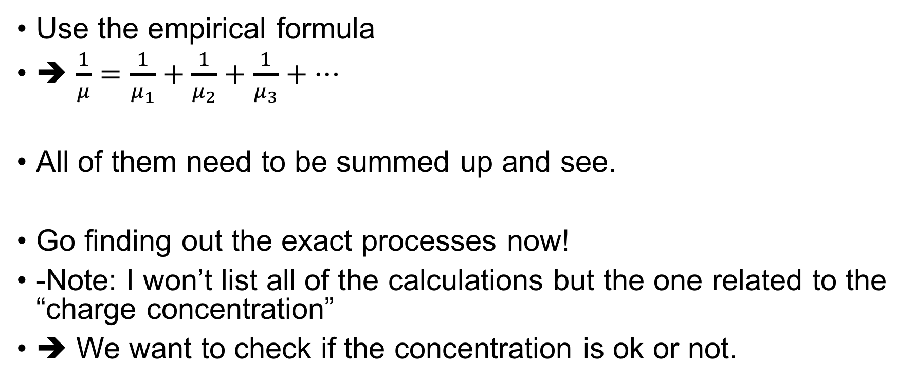
Total Mobility
Other good question:
We always said “Low-concentration”
Is it possible for it to be too low to produce the process?
Use the empirical formula
➔ $\frac{1}{μ}=\frac{1}{μ_{1}}+\frac{1}{μ_{2}}+\frac{1}{μ_{3}}+…$
All of them need to be summed up and see.
Go finding out the exact processes now!
-Note: I won’t list all of the calculations but the one related to the “charge concentration”
➔ We want to check if the concentration is ok or not.

Slide 6
Note! The cases as follows are “No electric field”
No-electric-field-zone
I will tell you when going to the “Saturation cases”

Slide 7



Ionized impurities scattering
No-electric-field-zone
Charged impurities ➔ The issue of the temperature!
Highly depend on the temperature
CW model ➔ Well describe the phenomenon!
$$∝ \frac{T^{\frac{3}{2}}}{\ln{T^{2}}}$$

Slide 8
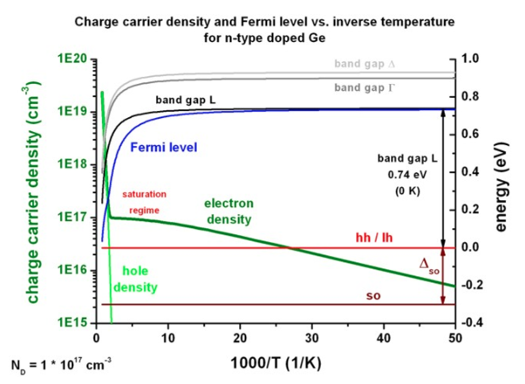
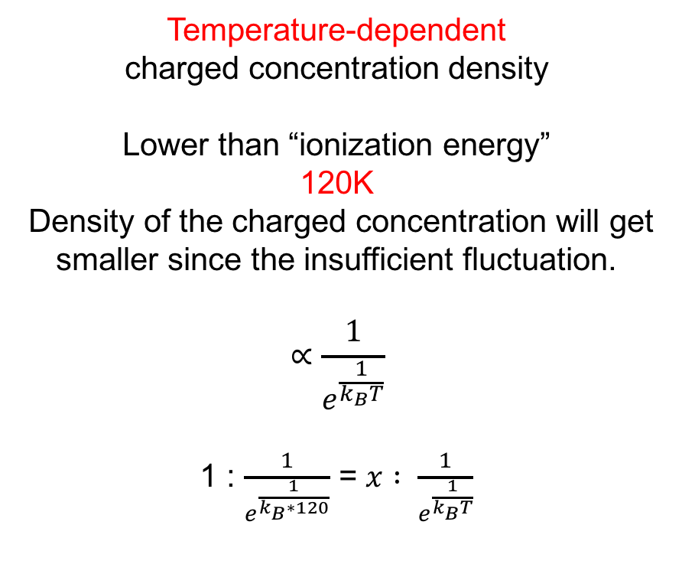
Charged concentration density
No-electric-field-zone
Temperature-dependent
charged concentration density
Lower than “ionization energy”
120K
Density of the charged concentration will get smaller since the insufficient fluctuation.
$$∝\frac{1}{e^{\frac{1}{k_{B}T}}}$$
1 : $\frac{1}{e^{\frac{1}{k_{B}∗120}}}$ = $x : \frac{1}{e^{\frac{1}{k_{B}T}}}$
We can get the charged concentration correlated with the temperature!

Slide 9

Acoustic phonon scattering
No-electric-field-zone
“Quantized” energy package ( vibration )
Related to the temperature
Obviously, it only depends on the temperature.

Slide 10




Neutral impurity scattering
No-electric-field-zone
Basically, since we have already known the concentration of the neutral impurity, we assumed the value of it is $2×{10}^{15}/{cm}^{3}$
We have the formula:
It depends on the temperature.

Slide 11
Note! The cases as follows are “Induced electric field”
Electric-field-zone

Slide 12
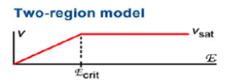
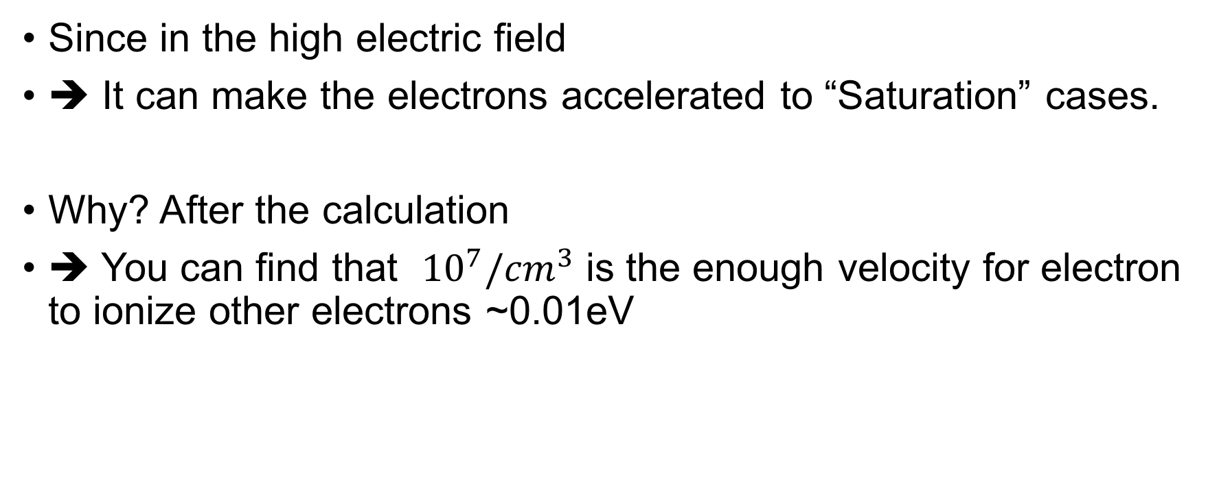
High-electric-field approximation
Electric-field-zone
Since in the high electric field
➔ It can make the electrons accelerated to “Saturation” cases.
Why? After the calculation
➔ You can find that ${10}^{7}/{cm}^{3}$ is the enough velocity for electron to ionize other electrons ~0.01eV
Two-region model approximation

Slide 13
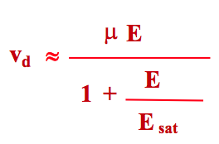
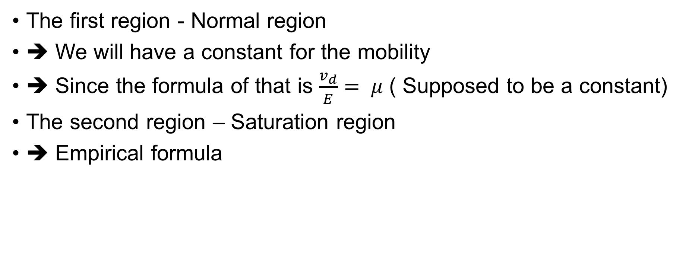
What’s the real mobility of the electrons under this condition?
Electric-field-zone
The first region - Normal region
➔ We will have a constant for the mobility
➔ Since the formula of that is $\frac{v_{d}}{E}= μ$ ( Supposed to be a constant)
The second region – Saturation region
➔ Empirical formula
Two-region model approximation

Slide 14
What’s the issue now?
We want to discuss whether the concentration of the charged impurity is enough for the signal to have the avalanche process.
! First, we need to find out the ionization rate
Correlated to the concentration and the temperatures (4,77K)
But…..
I found that it is not so related to that….
Check this issue with Prof. Dongming first, since it will directly influence the gain factor.

Slide 15
Because….
1. The same temperature
➔ For the phonon and neutral impurity, they have the same mobility
2. The different “charged impurities concentration”
➔ It can only affects “ionized impurity scattering”
➔ When the temperature goes down
➔ The mobility will be bigger.
➔ The effect of it will be smaller for the total mobility!

Slide 16
My results ( Not sure )
E_Saturation
E_Saturation
4K
The same
77K
Very little difference

Slide 17
Next Step
Will discuss with Prof. Dongming tomorrow first.
After figuring it out, and we just finish paving the way for getting out the “pure” gain without the noise.
Then I will have a chat on this issue with Prof. Henry Wong, and see the next step of the project.
➔ I think the next step is to take the leakage current into account.

