Slide 1
Idea of Luke phonon amplification
Chih-Hsiang Yeh

Slide 2
Clarification- SuperCDMS vs. ours
SuperCDMS ( GeV mass ➔ 100 eV energy recoil )
➔ Under mili-Kelvin
➔ Band-gap 3eV ➔ Many e-h pairs!
➔ Phonon effect – Luke phonon only (no amplification)
Ours ( MeV mass ➔ 1eV energy recoil )
➔ Under 4, 77K
➔ Only can produce e-h pair by phonon-scattering with impurity

Slide 3
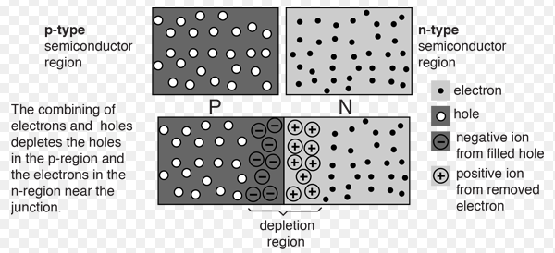
Process of the experiment
Depletion region
Normally, we need a neutral crystal
➔ It can be ionized
➔ Give out e-h pair.
From 77K
➔ 4000 V to do it!

Slide 4
Process of the experiment
After 77K depletion
➔ We can lower the temperature to 4K
➔ Phonon scatter off neutral impurities ( Dominant )
➔ Only need 60-100V to amplify the signal of the ionizations

Slide 5
Purpose

