Slide 1
Direct Detection of the Dark Matter: Germanium detector Internal Amplification(GeIA) (Battle between “liquid Ne-77K” and “He-4K”)
*Chih-Hsiang Yeh, Tsz-King Henry Wong
Institute of Physics, Academic Sinica (IoPAS)
August 21, 2019

Slide 2
Before the talk….
Detector project – Cryogenic knowledge
Filled with “Solid-State Physics”
Try my best to explain the jargon well.

Slide 3
Outline – Qualitative and Quantitative
The principles of our experiment
The issues we are engaging in
The conclusion and prospect

Slide 4
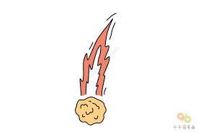
Predicted by gravitation:
The velocity of the stars
➔Inconsistent with the existing law
Missing mass in our universe!
Weakly Interacting Massive Particles(WIMPs)
WIMPs
Reach through region
(Low E region)
Avalanche region
(High E region)
E-h generated
Mechanism:
(1)Excitation
(2)Ionization
electron
Give out many electrons
Drifted in the crystal
G(T,E…)
+
-
hole
Purity: Ge
Impurity: Be, Al, Ga, (3A)-hole. “P-type detector”
Amplification

Slide 5
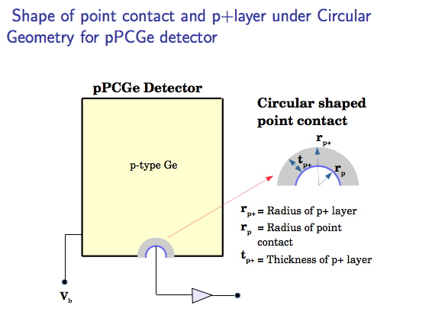
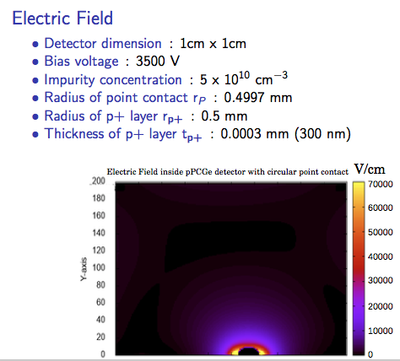
Examples from other people

Slide 6
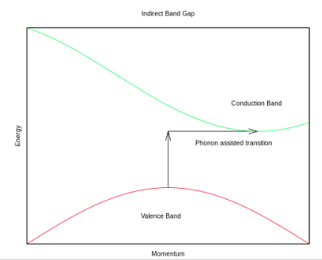
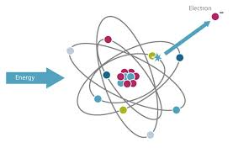
Clarification(Solid-State Physics)
The energy to produce E-h pair
 | Excitation (Ionization) -Ge | Ionization -Impurities
4K | 3.3eV | 0.01eV
77K | 3.0eV | 0.01eV
e-h pair
e-ion pair
(e-h pair)
*In our topic, we call them “Ionization” and “e-h pair” totally
➔ The one energy that can produce e-h pair

Slide 7

Issue?
I have the low background!
I’m easy to be achieved!
4K
Versus
77K
Liquid Helium
Winner or Loser?
$$\frac{Signal}{Noise}$$
Liquid Nitrogen
(Beijing Tsing-Hua University)

Slide 8
Non-trivial issues
Breakdown voltage
Leakage current
…….
Many issues at there!
At the beginning, we start at “Gain” without other noises!

Slide 9
Gain factor
How do we know about the gain?
➔ We need to know about the number of e-h pair we can produce!
*Ionization rate
➔ How many e-h pairs will be produced during the avalanche region?

Slide 10
Parameter(1): Mean free path
*Definition:
How far the electron(hole) can run without colliding with others
(Relaxation time) * (velocity)

Slide 11
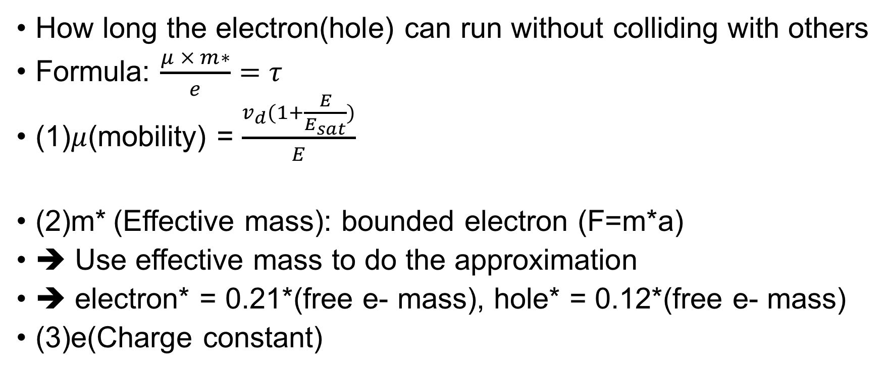
Parameter(2): Relaxation time
How long the electron(hole) can run without colliding with others
Formula: $\frac{μ × m∗}{e}=τ$
(1)$μ$(mobility) = $\frac{v_{d}(1+\frac{E}{E_{sat}})}{E}$
(2)m* (Effective mass): bounded electron (F=m*a)
➔ Use effective mass to do the approximation
➔ electron* = 0.21*(free e- mass), hole* = 0.12*(free e- mass)
(3)e(Charge constant)

Slide 12
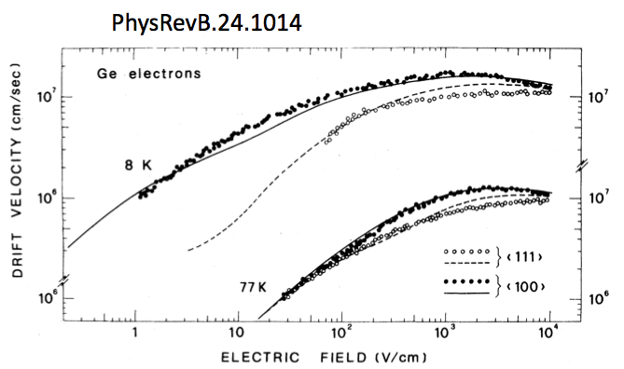

Parameter(3): Velocity
$$E_{sat}$$

Slide 13
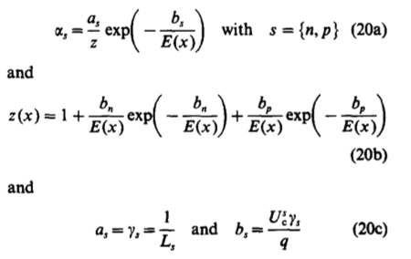
Parameter(4): Ionization rate
Important point: (1) Mean free path (2)Ionization energy

Slide 14
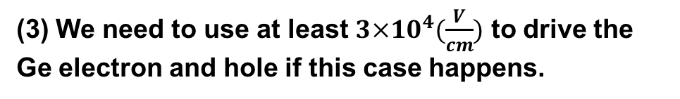
Results – Ionization rate(1/cm)
How many e-h can be produced per centimeter?
Hole’s rate is bigger than electron’s for both of the temperature
*P-type detector ( Benefit )
(2) At 4K, the rates of both electron and hole are bigger than 77K individually.
*4K is the winner in this case.
(3) We need to use at least $3×{10}^{4}(\frac{V}{cm})$ to drive the Ge electron and hole if this case happens.

Slide 15
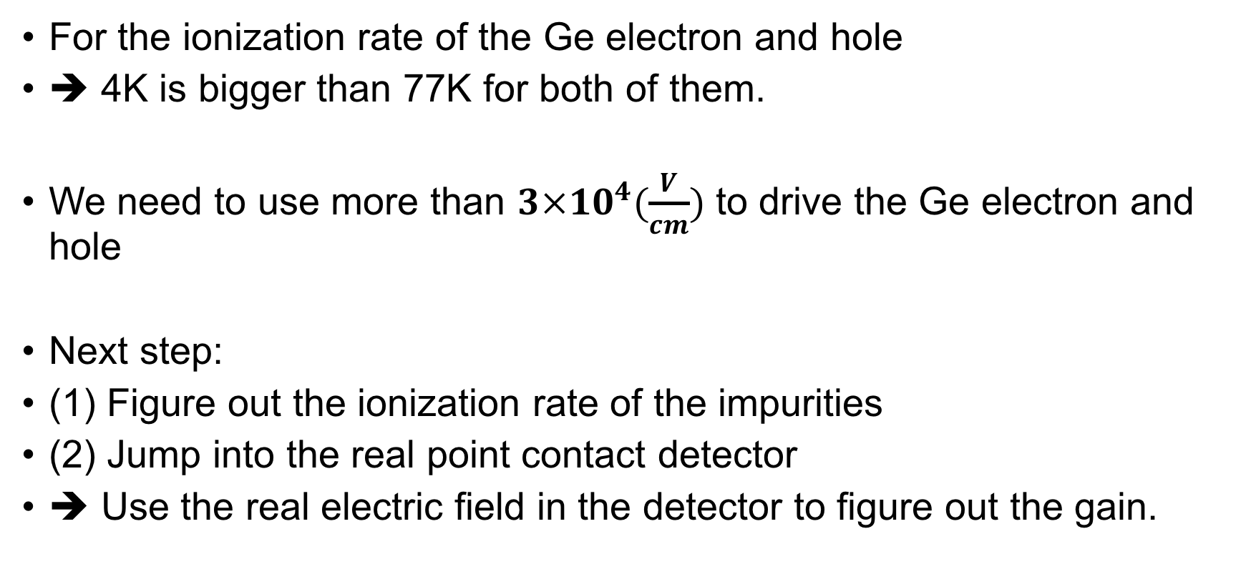
Conclusion and Prospect
For the ionization rate of the Ge electron and hole
➔ 4K is bigger than 77K for both of them.
We need to use more than $3×{10}^{4}(\frac{V}{cm})$ to drive the Ge electron and hole
Next step:
(1) Figure out the ionization rate of the impurities
(2) Jump into the real point contact detector
➔ Use the real electric field in the detector to figure out the gain.

Slide 16
BackUp

Slide 17

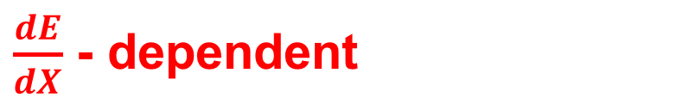
Nuclear recoil
t
Dark matter
After nuclear recoil
➔ It will collide with electrons and atoms
Dark matter
Focus!
Electrons ➔ e-h pairs
(Effective ionization energy)
Electronic stopping of heavy ion
Atoms➔ phonons
Nuclear stopping of heavy ion
Non-SM Weak interaction
${10}^{−4}\sim {10}^{2}$eV
Event rate dependent
Nuclear
Nuclear
Fake-Feynman diagram of DM-Nuclear scattering
Nuclear recoil (scattering off)
NR
$\frac{dE}{dX}$ - dependent

Slide 18

Electron recoil
t
After the electron recoil
➔ It will collide with electrons
Dark matter
Dark matter
Electrons ➔ e-h pairs
(Effective ionization energy)
Focus!
Non-SM Weak interaction
${10}^{−4}\sim {10}^{2}$eV
Event rate dependent
Electron
Electron
No phonon basically! Can’t give nuclear much energy
Fake-Feynman diagram of DM-electron scattering
Too big….
Come on!
Electron recoil (scattering off)
ER
e
Nuclear

Slide 19
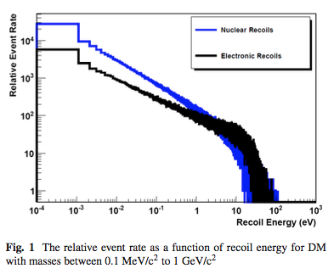
Different DM Mass
Different Recoil energy
Different Relative event rate!
GeV to MeV dark matters

