Slide 1
Direct Detection of the Dark Matter: Germanium detector Internal Amplification(GeIA)
*Chih-Hsiang Yeh, Tsz-King Henry Wong
Institute of Physics, Academic Sinica (IoPAS)
August 21, 2019

Slide 2
Parameter(1): Mean free path
*Definition:
How far the electron(hole) can run without colliding with others
(Relaxation time) * (velocity)

Slide 3
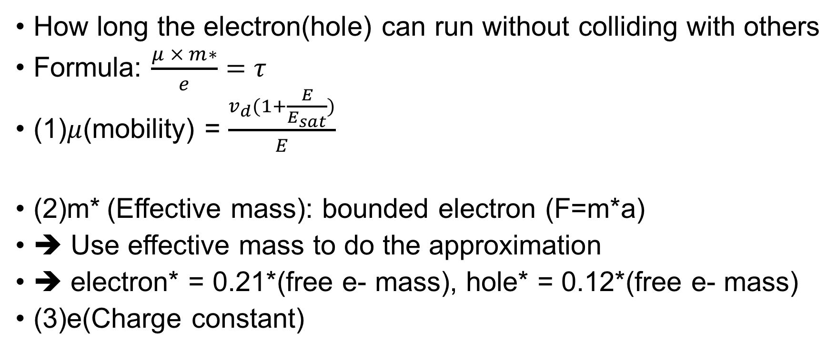
Parameter(2): Relaxation time
How long the electron(hole) can run without colliding with others
Formula: $\frac{μ × m∗}{e}=τ$
(1)$μ$(mobility) = $\frac{v_{d}(1+\frac{E}{E_{sat}})}{E}$
(2)m* (Effective mass): bounded electron (F=m*a)
➔ Use effective mass to do the approximation
➔ electron* = 0.21*(free e- mass), hole* = 0.12*(free e- mass)
(3)e(Charge constant)

Slide 4
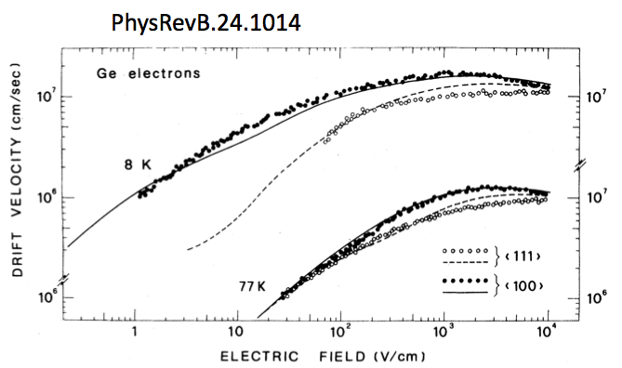

Parameter(3): Velocity
$$E_{sat}$$

Slide 5
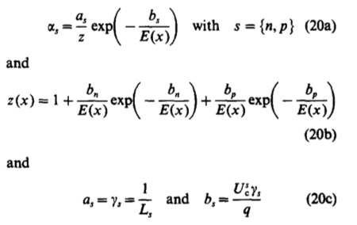
Parameter(4): Ionization rate
Important point: (1) Mean free path (2)Ionization energy

Slide 6
Results – Ionization rate(1/cm)

Slide 7
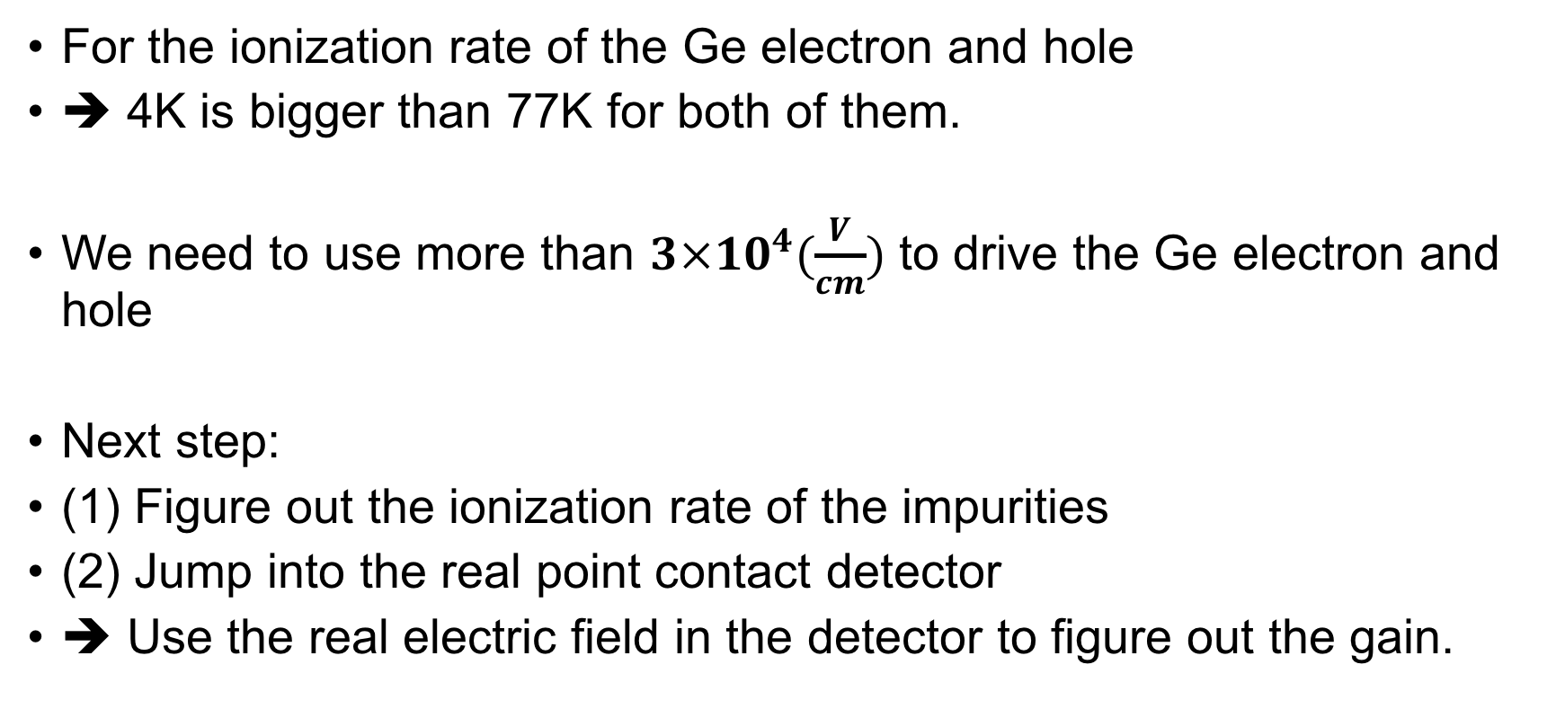
Conclusion and Prospect
For the ionization rate of the Ge electron and hole
➔ 4K is bigger than 77K for both of them.
We need to use more than $3×{10}^{4}(\frac{V}{cm})$ to drive the Ge electron and hole
Next step:
(1) Figure out the ionization rate of the impurities
(2) Jump into the real point contact detector
➔ Use the real electric field in the detector to figure out the gain.

