Slide 1
Internal Amplification Ge(GeIA) Theory of predicting the necessary gain
*Chih-Hsiang Yeh, Tze-Tzing Henry Wong

Slide 2
The reminder of the previous results
At the first place, the ionization rates of electron and hole were predicted by some of the formulae:
Signal(Ge)
Signal(Impurities)
Ionization rate
Give us the “Gain” in the end.
Great! But what‘s the next?
Debut of our “BKG”!!
Umm…It seems complicated!
Let me map out the blueprint first!

Slide 3
Three steps
Gain
SIG estimation
BKG estimation
Ionization rate
Gain(E,T)
Theory of BKG
Signal threshold
Type of the detector?
Temperature?
Electric field?
Know our predicted gain for signal
Under the certain T and E
Know the threshold of the signal
(Signal ➔ Gain)
Predicted by BKG (Theory)

Slide 4
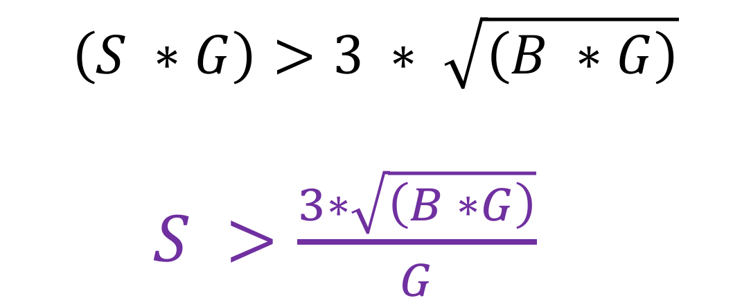
Raw/Observable
(SIG) > (3 * sigma of BKG)
No Amplification
Raw SIG/BKG
With Amplification
Obs SIG/BKG
$$\left(S ∗G\right)>3 ∗ \sqrt{\left(B ∗G\right)}$$
$S >\frac{3∗\sqrt{\left(B ∗G\right)}}{G}$
S
S*G
B
B*G
Various thresholds (Given the dark matter energy) ➔ All can be predicted.

Slide 5

Confirm the circumstance
 | G | S(GS) | B(GB) | Threshold
(1)USD | 1 | 1(1) | 1(1) | 3
(2)China-THU | 100 | 1(100) | 100(10000) | 3
(SIG) > (3 * sigma of BKG)
$$\left(S ∗G\right)>3 ∗ \sqrt{\left(B ∗G\right)}$$
$S >\frac{3∗\sqrt{\left(B ∗G\right)}}{G}$

Slide 6
Purpose of this study
*The important issue:
Can we predict “the necessary gain” by the signal we expect?
Next step:
Find out the right BKG and find out the right threshold plots.
➔ Then, we can apply it on our detector
➔ Even design the different type of the detector compared with other people.

