Slide 1
Right concept: Bulk leakage current
Chih-Hsiang Yeh

Slide 2
77K, 4K 1.Partially-depleted detector 2.Fully-depleted detector

Slide 3
77K, 4K 1.Partially-depleted detector

Slide 4
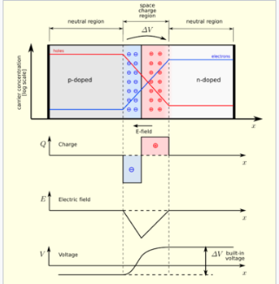
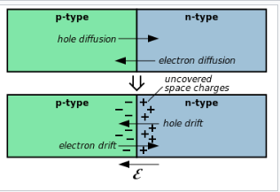
What’s “depletion”?
This is the basic phenomenon happening in the PN-junction.
The following picture is the simplest case:

Slide 5
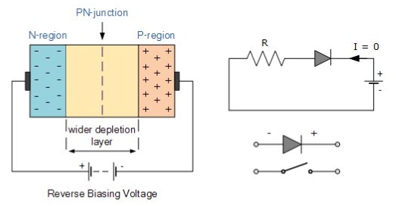
Why is “Bias voltage”?

Slide 6
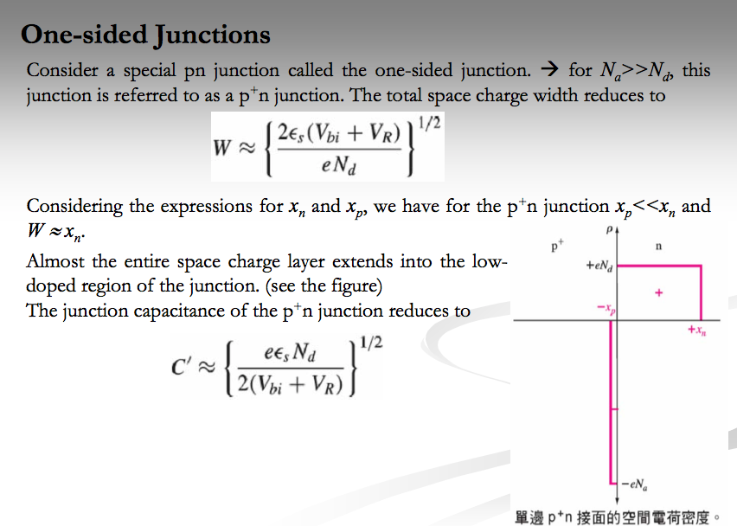
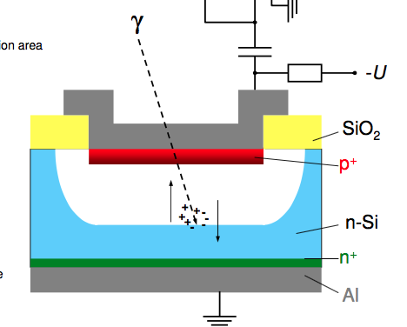
In our case
We can do the calculation of transforming between the Electric field and voltage by applying the conservation of the energy.
➔ Depend on the geometry of the detector as well.

Slide 7
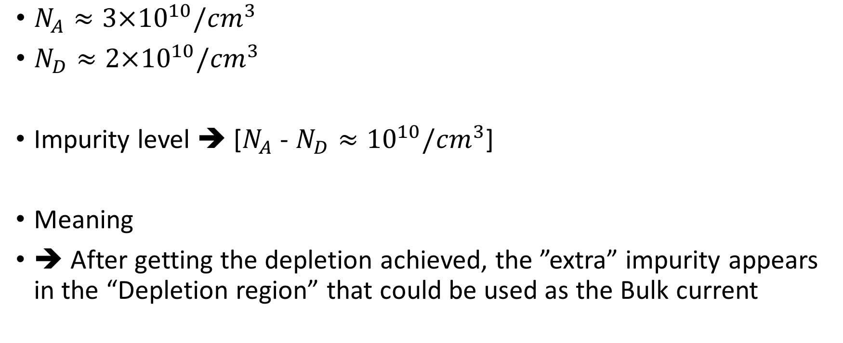
Let take some calculations – p-type
$N_{A}≈3×{10}^{10}/{cm}^{3}$
$N_{D}≈2×{10}^{10}/{cm}^{3}$
Impurity level ➔ [$N_{A}$ - $N_{D}≈{10}^{10}/{cm}^{3}$]
Meaning
➔ After getting the depletion achieved, the ”extra” impurity appears in the “Depletion region” that could be used as the Bulk current

Slide 8
Charged concentration density
No-electric-field-zone
Temperature-dependent
charged concentration density
Lower than “ionization energy”
120K
Density of the charged concentration will get smaller since the insufficient fluctuation.
$$∝\frac{1}{e^{\frac{E}{2k_{B}T}}}$$
Net impurity$({cm}^{3})$ : $\frac{1}{e^{\frac{0.0106}{2k_{B}∗120}}}$ = $x({cm}^{3}): \frac{1}{e^{\frac{0.0106}{{2k}_{B}T}}}$
We can get the charged concentration correlated with the temperature!

Slide 9
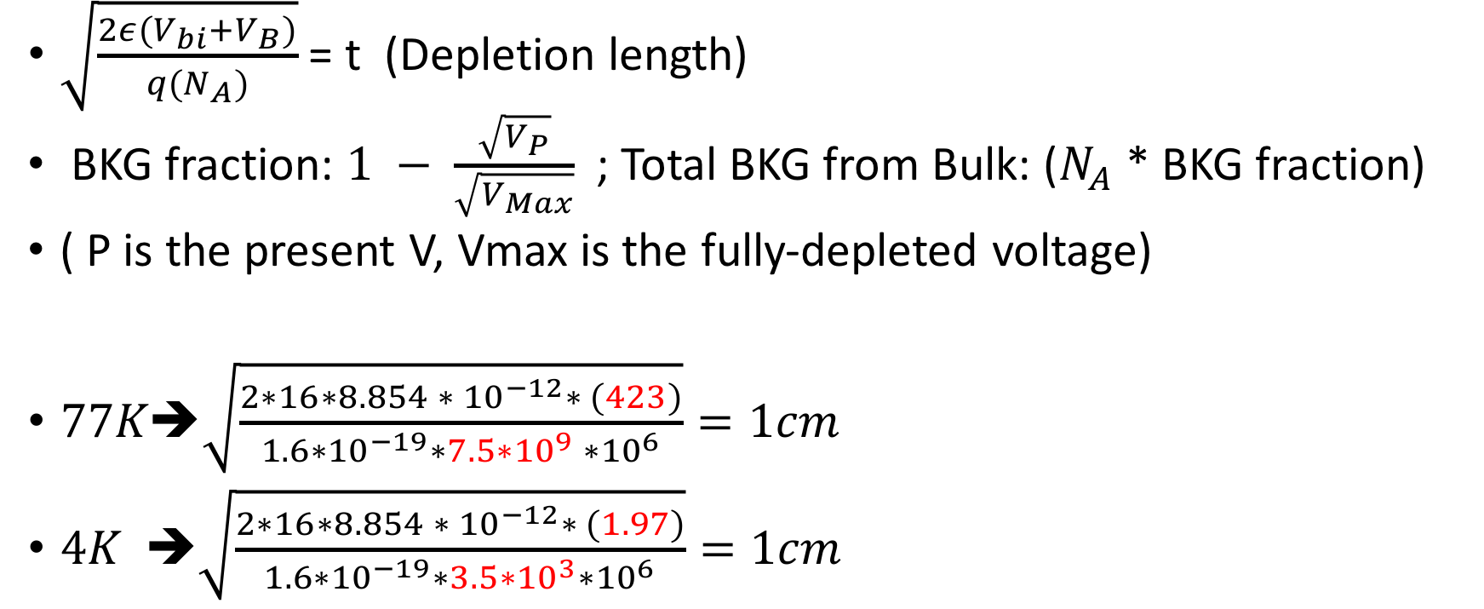
The voltage used to deplete the detector
$\sqrt{\frac{2ε(V_{bi}+V_{B})}{q{(N}_{A})}}$ = t (Depletion length)
BKG fraction: $1 − \frac{\sqrt{V_{P}}}{\sqrt{V_{Max}}}$ ; Total BKG from Bulk: ($N_{A}$ * BKG fraction)
( P is the present V, Vmax is the fully-depleted voltage)
$77K➔\sqrt{\frac{2∗16∗8.854 ∗ {10}^{−12}∗ (423)}{1.6∗{10}^{−19}∗7.5∗{10}^{9} ∗{10}^{6}}}=1cm$
$4K ➔\sqrt{\frac{2∗16∗8.854 ∗ {10}^{−12}∗ (1.97)}{1.6∗{10}^{−19}∗3.5∗{10}^{3}∗{10}^{6}}}=1cm$

Slide 10
77K, 4K 2.Fully-depleted detector

Slide 11
The right picture(fully-depleted case)
1. When the impurities pop-up with the excitation of the thermal generation
➔ They will go to their “Right” place to stand by, becoming the sources giving out the electric field
➔ There is no “impurity” used for giving the bulk leakage current
In this case, the intrinsic material will be the dominant term
➔ Since the intrinsic electron-hole pair given by the thermal fluctuation will become ubiquitously and uniformly
➔ It won’t be in the line of the depletion ( No potential problem )

Slide 12
In other words:
We don‘t have the sources of the impurities when the fully-depleted case happened!
In this case
➔ The only sources of the bulk leakage current could be
➔“intrinsic semiconductor”
➔ Let us do some calculations!

Slide 13
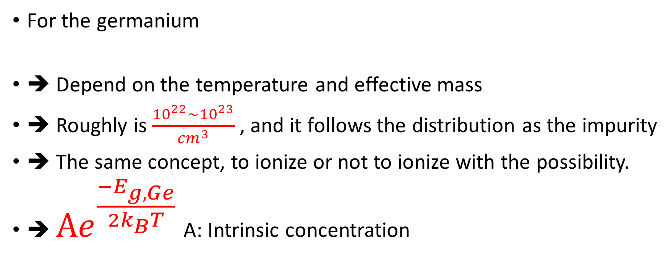
Intrinsic purity concentration
For the germanium
➔ Depend on the temperature and effective mass
➔ Roughly is $\frac{{10}^{22}\sim {10}^{23}}{{cm}^{3}}$, and it follows the distribution as the impurity
➔ The same concept, to ionize or not to ionize with the possibility.
➔ $Ae^{\frac{−E_{g, Ge}}{2k_{B}T}}$ A: Intrinsic concentration

Slide 14
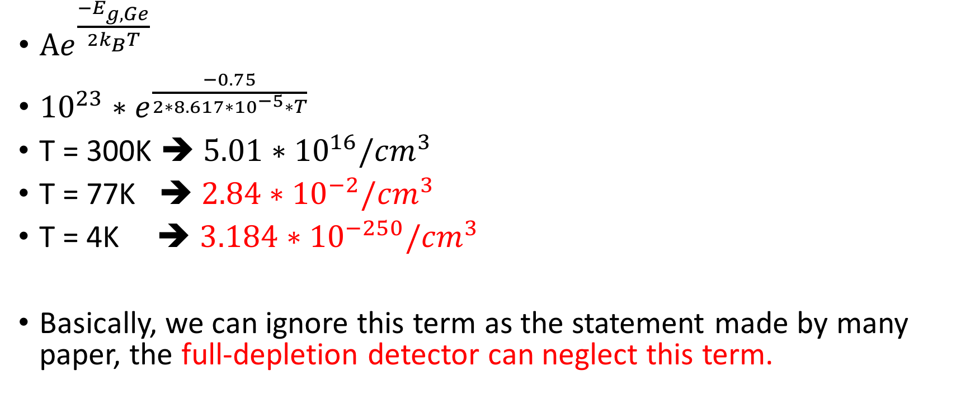
Calculations
$Ae^{\frac{−E_{g, Ge}}{2k_{B}T}}$
${10}^{23}∗e^{\frac{−0.75}{2∗8.617∗{10}^{−5}∗T}}$
T = 300K ➔ $5.01∗{10}^{16}/{cm}^{3}$
T = 77K ➔ $2.84∗{10}^{−2}/{cm}^{3}$
T = 4K ➔ $3.184∗{10}^{−250}/{cm}^{3}$
Basically, we can ignore this term as the statement made by many paper, the full-depletion detector can neglect this term.

Slide 15
Right concept: Contact leakage current
Chih-Hsiang Yeh

Slide 16
Resources
https://en.wikipedia.org/wiki/Thermionic_emission
➔ Basic rationale of the barrier formula
https://en.wikipedia.org/wiki/Schottky_barrier
➔ Basic theory (where phi e comes from)
https://ecee.colorado.edu/~bart/book/extrinsi.htm
➔ Fermi level will be alternated by the change of the impurity concentration
https://ecee.colorado.edu/~bart/book/extrinsi.htm#charge

Slide 17


Thermionic emission

Slide 18
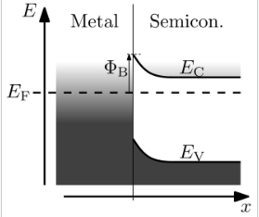


Shottky barrier

Slide 19
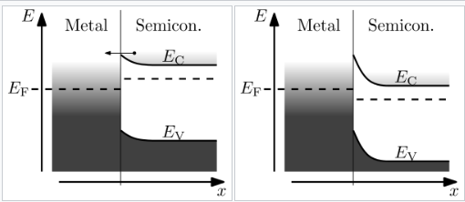
Mechanism

Slide 20
Bulk leakage current
Contact leakage current
Surface leakage current
Ignored below 77K
Dominant at
77K
Dominant at
4K
$${10}^{−16}A$$
〖10〗^(−16) 𝐴
$${10}^{−18}A$$
〖10〗^(−18) 𝐴
Thermal generation
Semi-metal-connection leakage
The qualification of the crystal
Background source
140eV at 77K
14eV at 4K

