Slide 1
Internal Amplification Ge(GeIA) Theory of predicting the necessary gain
*Chih-Hsiang Yeh, Tze-Tzing Henry Wong

Slide 2
The reminder of the previous results
At the first place, the ionization rates of electron and hole were predicted by some of the formulae:
Signal(Ge)
Signal(Impurities)
Ionization rate
Give us the “Gain” in the end.
Great! But what‘s the next?
Debut of our “BKG”!!
Umm…It seems complicated!
Let me map out the blueprint first!

Slide 3
Three steps
Gain
SIG estimation
BKG estimation
Ionization rate
Gain(E,T)
Theory of BKG
Signal threshold
Type of the detector?
Temperature?
Electric field?
Know our predicted gain for signal
Under the certain T and E
Know the threshold of the signal
(Signal ➔ Gain)
Predicted by BKG (Theory)

Slide 4
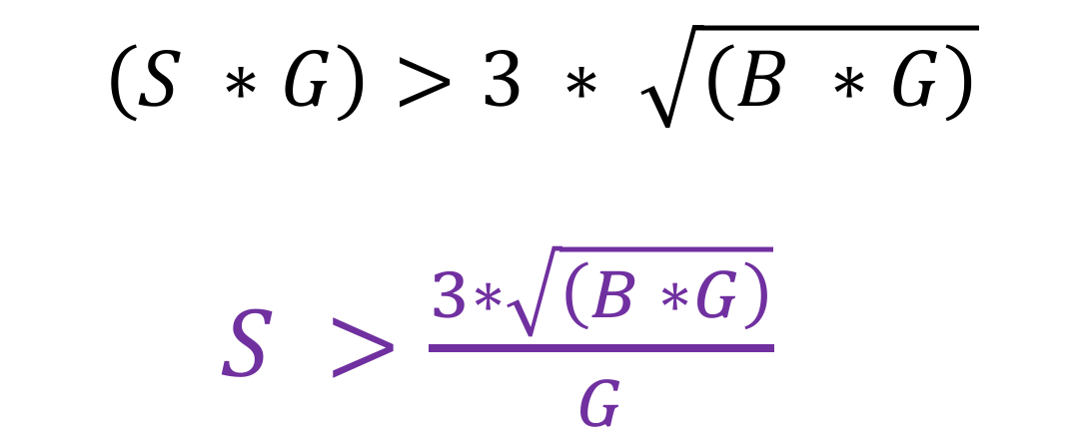
Raw/Observable
(SIG) > (3 * sigma of BKG)
No Amplification
Raw SIG/BKG
With Amplification
Obs SIG/BKG
$$\left(S ∗G\right)>3 ∗ \sqrt{\left(B ∗G\right)}$$
$S >\frac{3∗\sqrt{\left(B ∗G\right)}}{G}$
S
S*G
B
B*G
Various thresholds (Given the dark matter energy) ➔ All can be predicted.

Slide 5

Confirm the circumstance
 | G | S(GS) | B(GB) | Threshold
(1)USD | 1 | 1(1) | 1(1) | 3
(2)China-THU | 100 | 1(100) | 100(10000) | 3
(SIG) > (3 * sigma of BKG)
$$\left(S ∗G\right)>3 ∗ \sqrt{\left(B ∗G\right)}$$
$S >\frac{3∗\sqrt{\left(B ∗G\right)}}{G}$

Slide 6
Purpose of this study
*The important issue:
Can we predict “the necessary gain” by the signal we expect?
Next step:
Find out the right BKG and find out the right threshold plots.
➔ Then, we can apply it on our detector
➔ Even design the different type of the detector compared with other people.

Slide 7
Theory of BKG

Slide 8
Image….
Generate rate
(Evaporate)
Water
Recombination rate
(Condensate)
T equilibrium
G=R
Take off the cover
G>R
The same as our experiment!

Slide 9
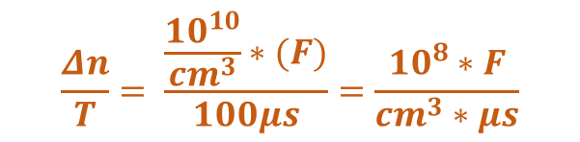
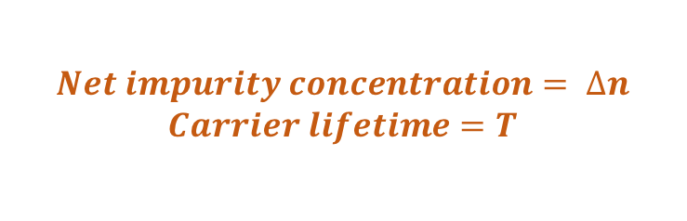
Image again….
$$Net impurity concentration= ∆n$$
$$Carrier lifetime=T$$
$$\frac{Δn}{T}= \frac{\frac{{10}^{10}}{{cm}^{3}}∗(F)}{100μs}=\frac{{10}^{8}∗F}{{cm}^{3}∗μs}$$
Generate rate (e pop up)
Electron sea
Recombination rate
(e absorbed)
T equilibrium
(Electric field off)
G=R
Take off the cover
(Electric field on)
G>R

Slide 10
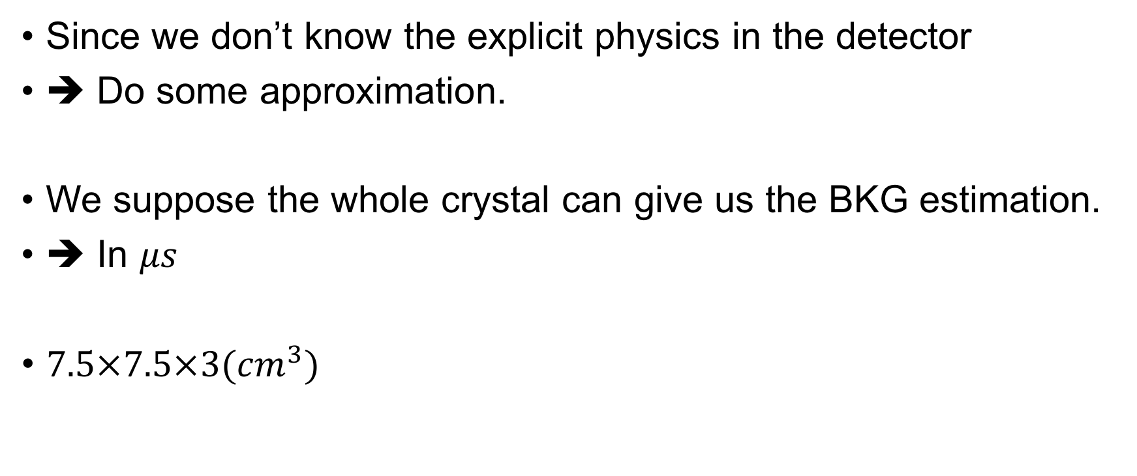

Give us the sense
$$\frac{Δn}{T}= \frac{\frac{{10}^{10}}{{cm}^{3}}∗(F)}{100μs}=\frac{{10}^{8}∗F}{{cm}^{3}∗μs}$$
Since we don’t know the explicit physics in the detector
➔ Do some approximation.
We suppose the whole crystal can give us the BKG estimation.
➔ In $μs$
$7.5×7.5×3({cm}^{3})$

Slide 11
How do we know we are right? The standard case as follows:

Slide 12
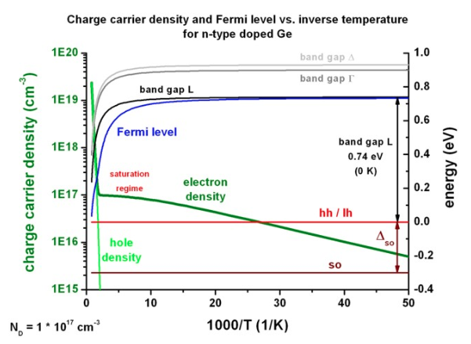
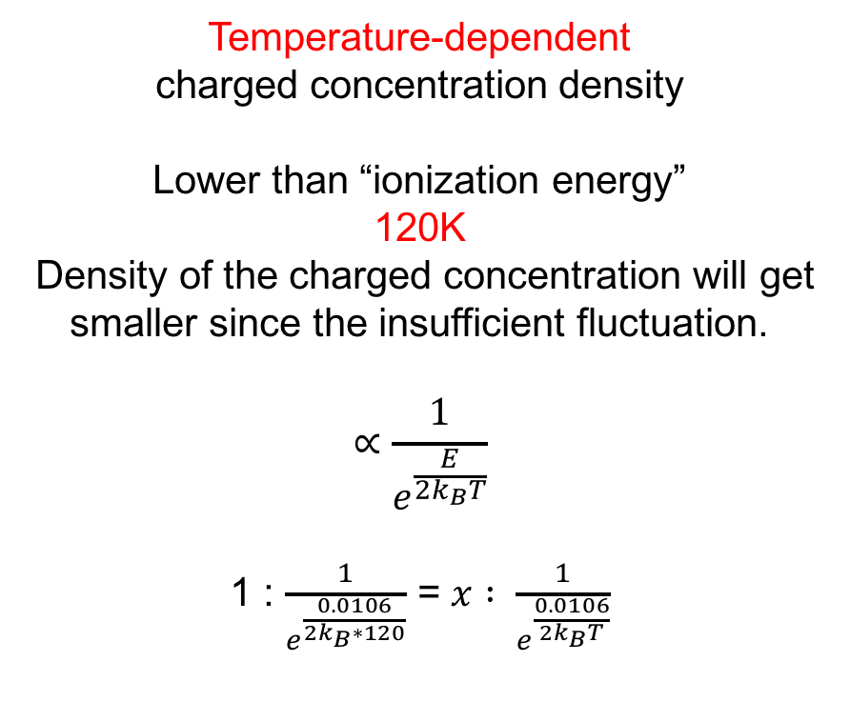
Charged concentration density
No-electric-field-zone
Temperature-dependent
charged concentration density
Lower than “ionization energy”
120K
Density of the charged concentration will get smaller since the insufficient fluctuation.
$$∝\frac{1}{e^{\frac{E}{2k_{B}T}}}$$
1 : $\frac{1}{e^{\frac{0.0106}{2k_{B}∗120}}}$ = $x : \frac{1}{e^{\frac{0.0106}{{2k}_{B}T}}}$
We can get the charged concentration correlated with the temperature!

Slide 13
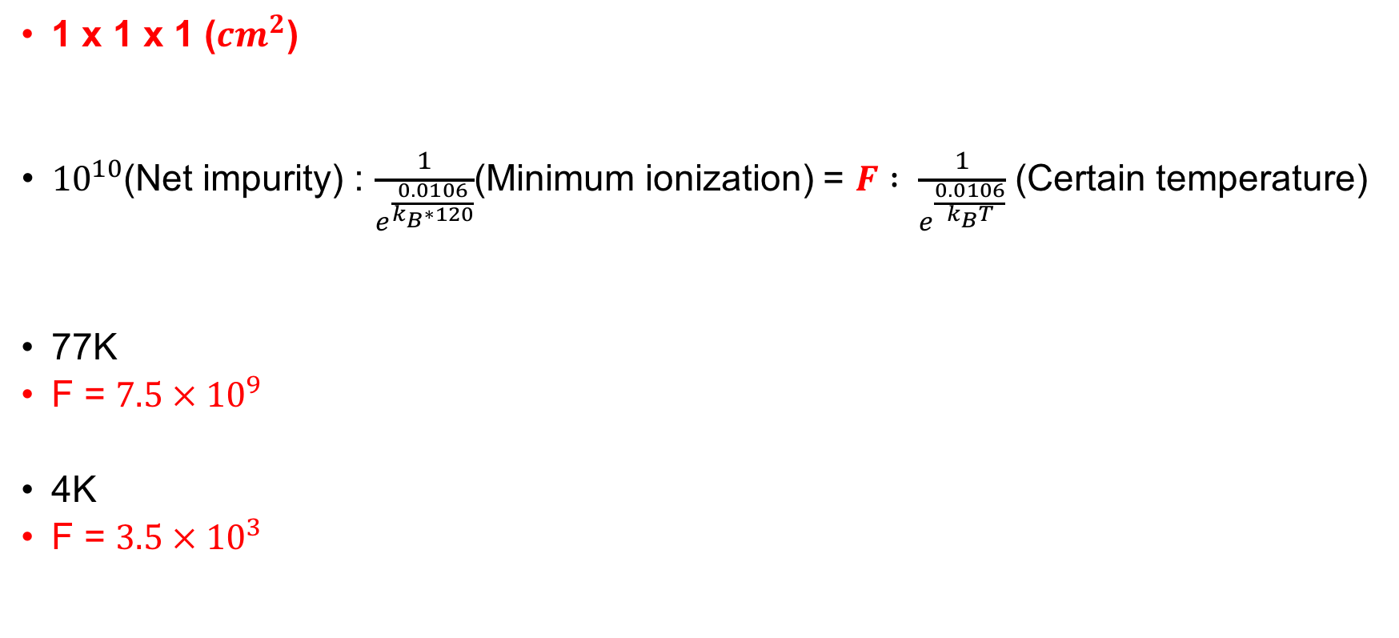
The standard Germanium
1 x 1 x 1 (${cm}^{2}$)
${10}^{10}$(Net impurity) : $\frac{1}{e^{\frac{0.0106}{k_{B}∗120}}}$(Minimum ionization) = $F : \frac{1}{e^{\frac{0.0106}{k_{B}T}}}$ (Certain temperature)
77K
F = $7.5 × {10}^{9}$
4K
F = $3.5 × {10}^{3}$
-
1 cm
+

Slide 14

The standard Germanium
1 x 1 x 1 (${cm}^{2}$)
“No Gain”➔ Apply the small field
$\frac{1 cm}{{10}^{7}\frac{cm}{s}}=0.1μs$
-
1 cm
+
$\frac{Δn}{T}= \frac{ (F)}{100μs}=\frac{0.01∗F}{{cm}^{3}∗μs}=\frac{{10}^{−3}∗F}{{cm}^{3}∗0.1μs}={10}^{−3}∗F$ (/${cm}^{3}∗0.1μs$)

Slide 15

Threshold
$$\left(S ∗G\right)>3 ∗ \sqrt{\left(B ∗G\right)}$$
$S >\frac{3∗\sqrt{\left(B ∗G\right)}}{G}$
8.221keV
5.64eV

