Slide 1
Network Protocol Visualizer & Error Detection Playground
Interactive OSI Model Simulation and Error Detection Techniques

Slide 2
Project Overview
• React + Vite frontend
• Zustand state management
• OSI layer visualization
• Error detection algorithms (Parity, Checksum, CRC)
• Live deployment on Vercel

Slide 3
Key Features
OSI Layer Stack with animated packet flow
Control panel for play/pause/step
Info panel showing packet details
Error Detection Playground – toggle parity, checksum, CRC-8
Inject bit errors and see detection results
Responsive design – works on desktop & mobile

Slide 4
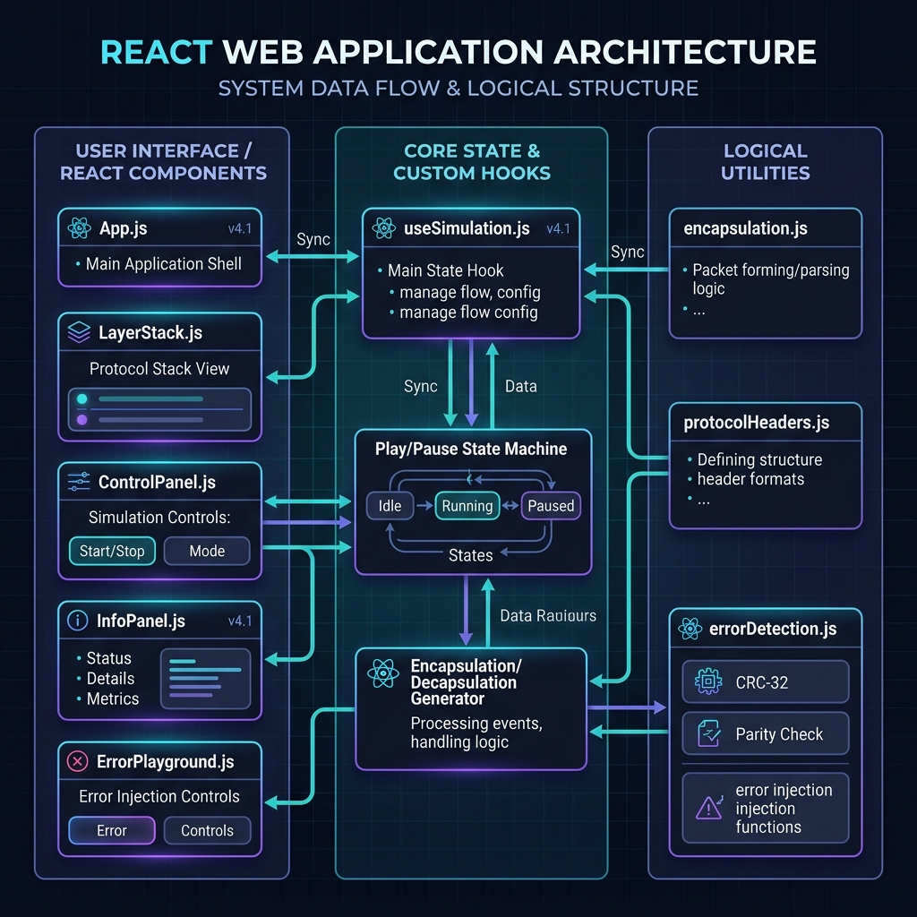
Architecture Overview

Slide 5
Error Detection Techniques
1‑D Parity (even/odd)
2‑D Parity (row & column)
Checksum (8‑bit sum)
CRC‑8 (generator polynomial 0x07)

Slide 6
Live Links
GitHub Repository: https://github.com/chiiinmay/network-protocol-visualizer
Vercel Deployment: https://network-protocol-visualizer.vercel.app

